Slide 1

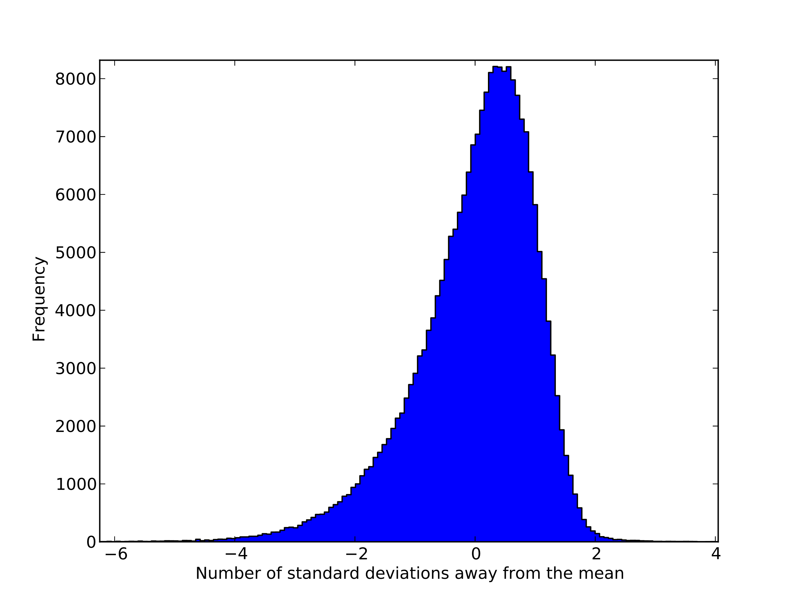
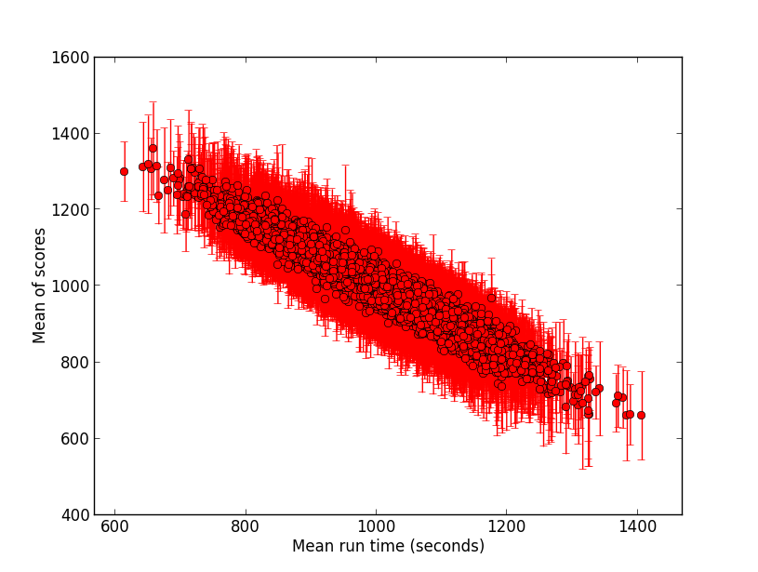
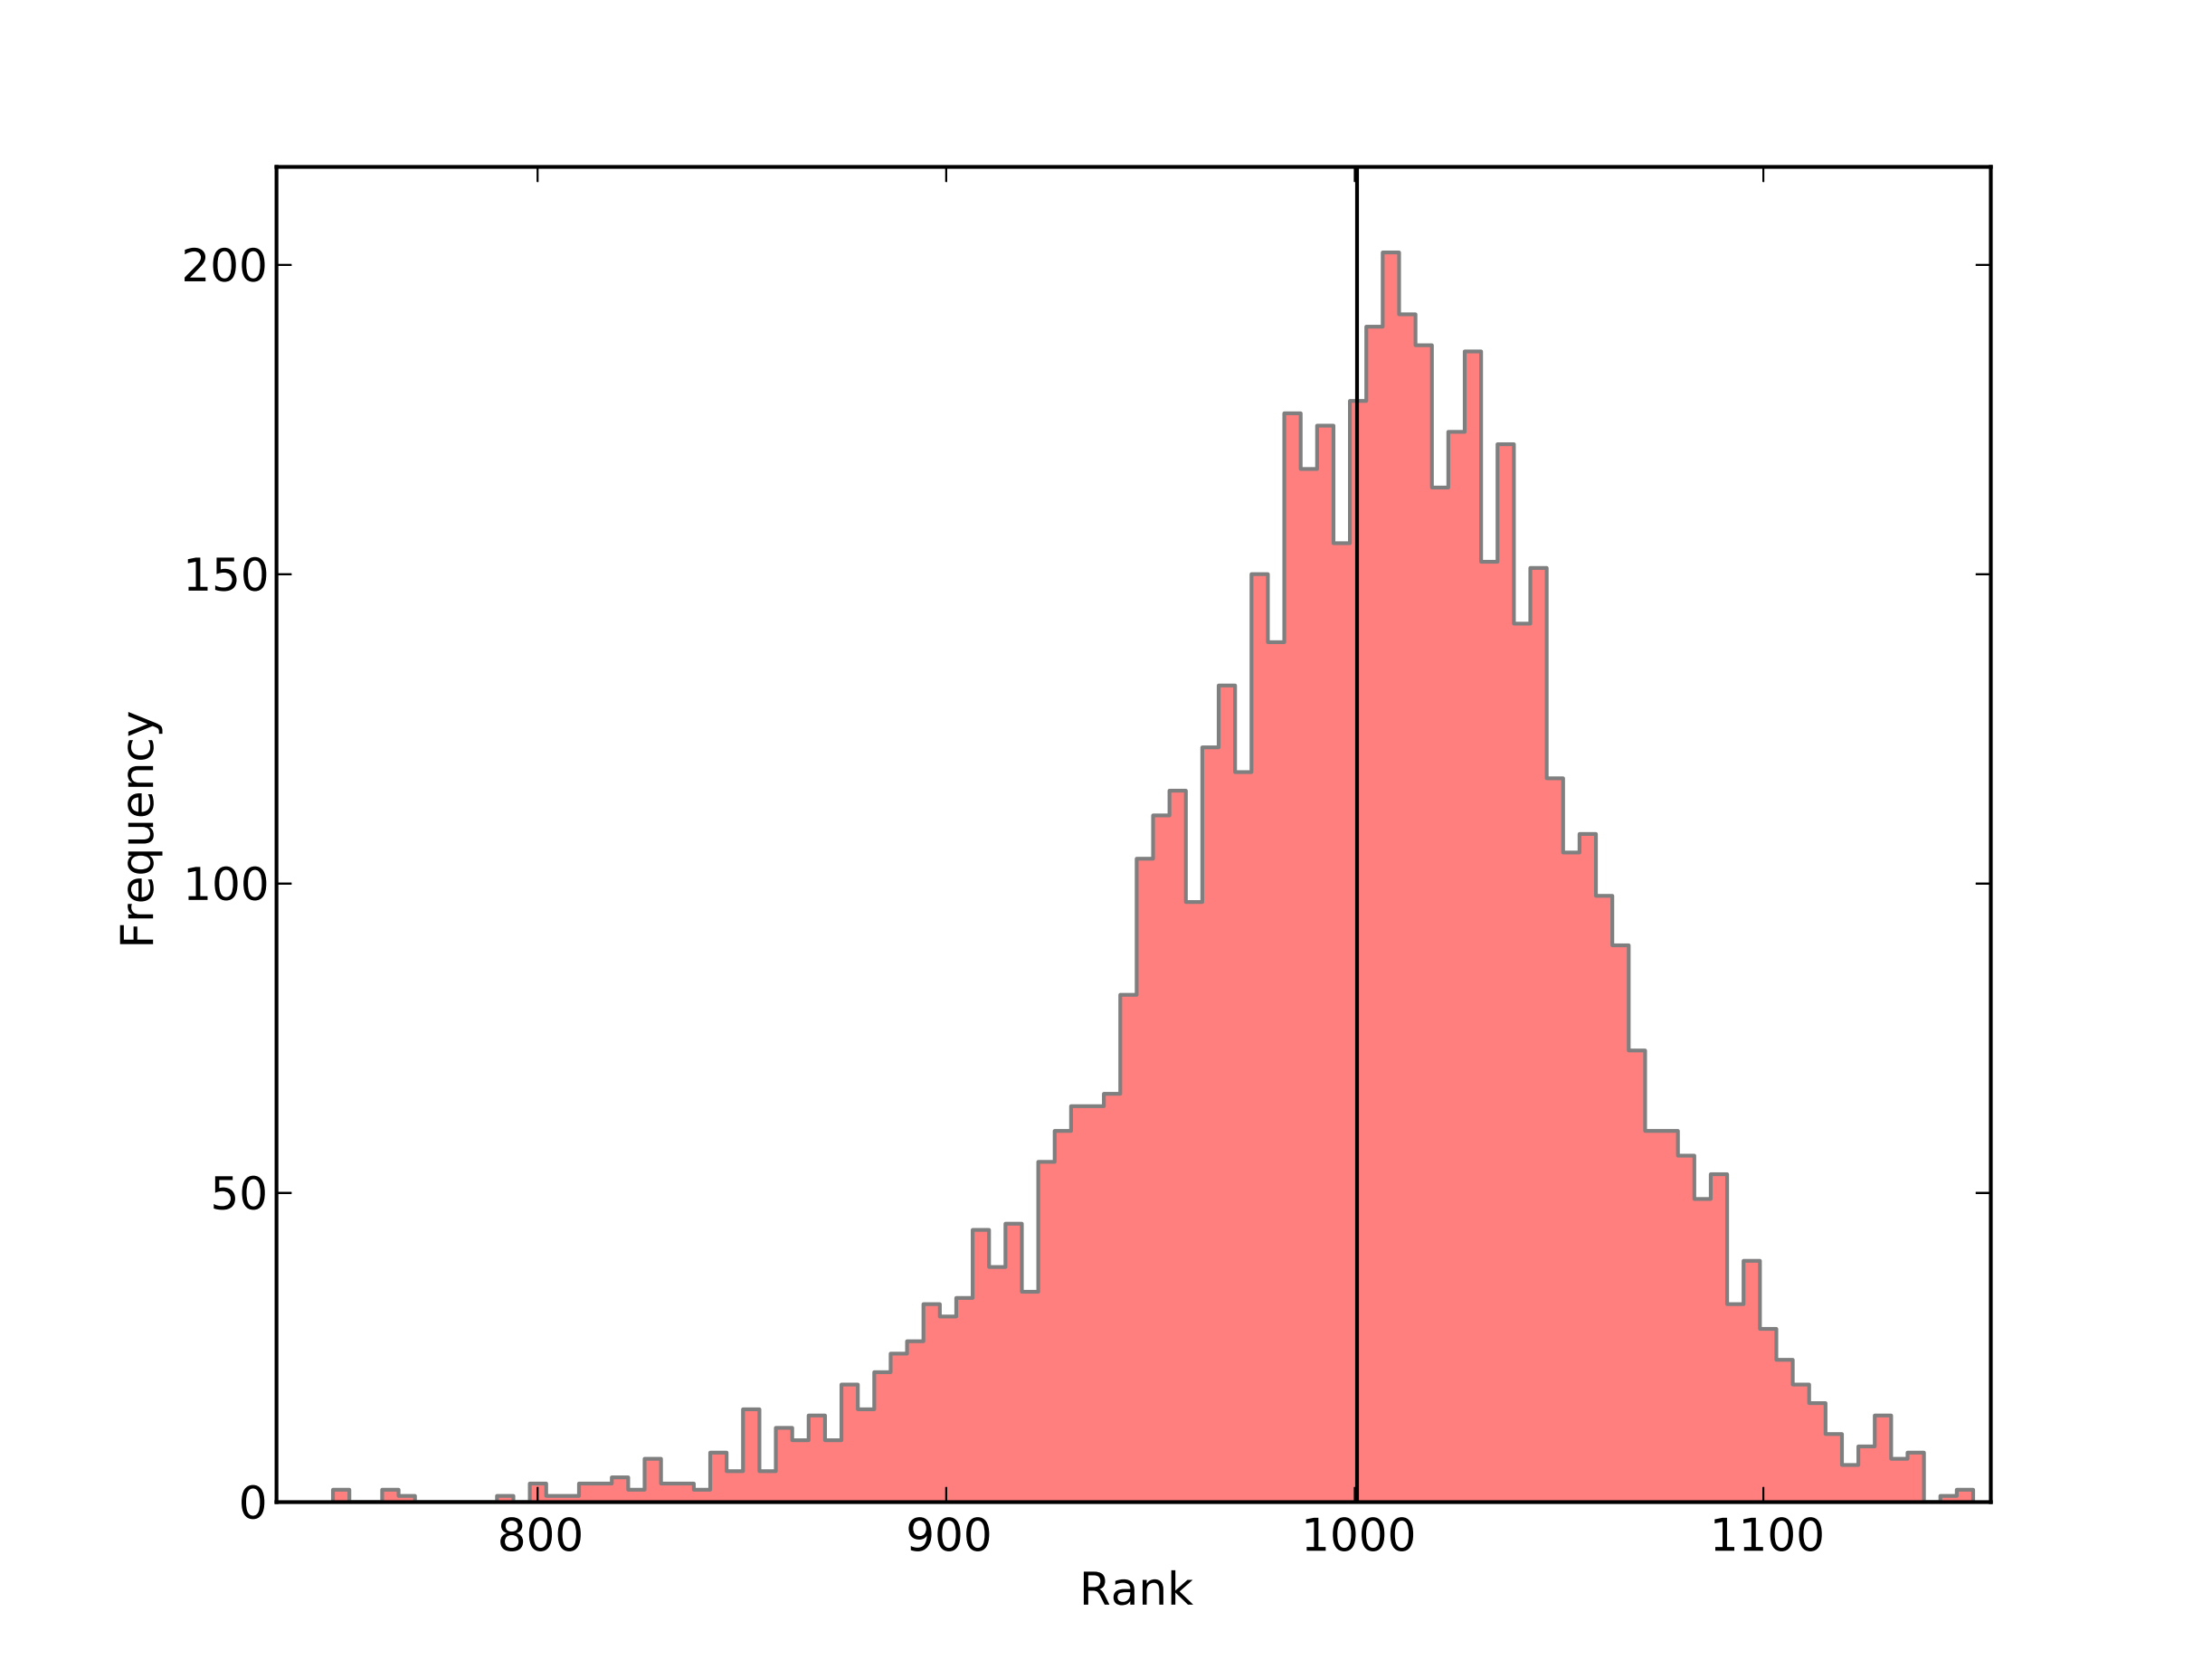
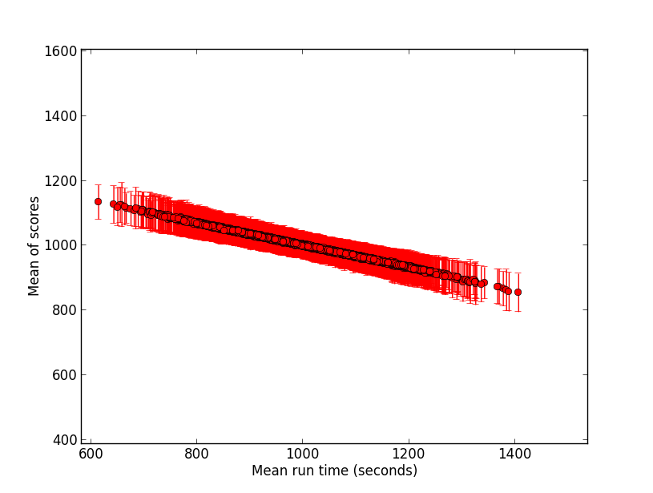
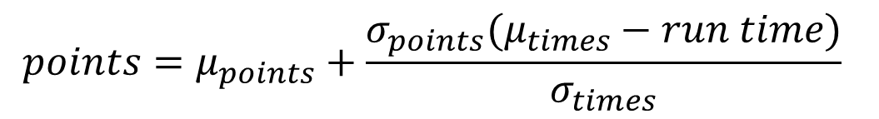
Analyzing a ranking scheme Justs Zarins, Supervisor Prof Graeme Ackland
Motivation and aim
Objectively comparing and ranking a set of entities is an important challenge. Consumers are daily tested to choose the right products, online search engines order query results by relevance and students compete in exams. If there are clear criteria for comparison, ranking is straightforward. This is not the case in many sports, so statistical schemes are employed. The aim of this project was to evaluate the ranking scheme used in British orienteering competitions through computer simulation and real data analysis.
Simulation results
The ranking scheme was generally able to deduce runners’ abilities only from their race results in all simulated cases. 1(a) shows how early on the ranks of runners are not clear at all and there is a lot of uncertainty. In 1(b), after many races with differnet subsets of all racers participating, awarded ranks align correctly with each person’s mean run time.
Real data results
In reality the underlying ability distribution is unknown. However, raw run time distances from the mean of each race were found to be distributed as shown in 2(a). Evidently, there are more ways to run a race poorly than to do well. The same shape was replicated in the scores assigned by the ranking scheme and can be seen in 2(b).
$$points=μ_{points}+\frac{σ_{points}(μ_{times}−run time)}{σ_{times}}$$
µ stands for mean and σ stands for standard deviation. These are calculated for each race separately.
Faithfully replicating
2(a)
Fighting through uncertainty
1(a)
2(b)
1(b)
Conclusion
Analysis of the British orienteering ranking system inspires confidence in its accuracy. It recovers the underlying ability distribution correctly for simulated data and produces a plausible rank distribution for real data.

