Slide 1
Final Project
g. t. h. wickramarathne
1132
Dibm - 03

Slide 2
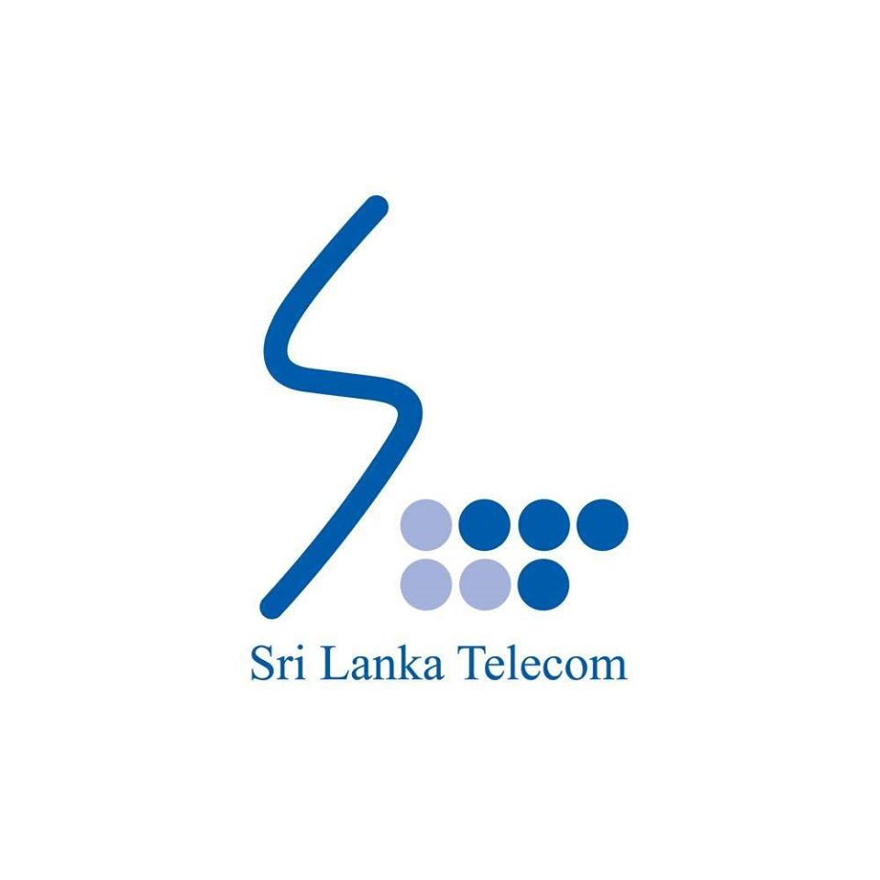
Sri Lanka Telecom

Slide 3
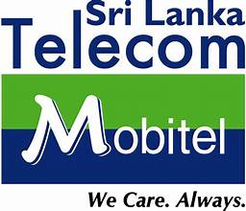
SLT - Mobitel

Slide 4
About SLT
Sri Lanka Telecom (SLT) is the National Information and Communications Technology (ICT) solutions provider and the leading broadband and backbone infrastructure services provider of Sri Lanka.
Established in 1858
For over 163 years, the Company has served the Nation’s need for connectivity, operating on fixed, mobile, and other operational segments

Slide 5
Our Mission
"Your trusted and proven partner for innovative and exciting communication experiences delivered with passion, quality and commitment"

Slide 6
Our Vision
"All Sri Lankans seamlessly connected with world-class information, communication and entertainment services."

Slide 7
Our Goal
“Covering the entire island, the SLT Group serves a customer base of over nine million customers across fixed and mobile ICT services. The wide range of customers include domestic users, small and medium enterprises (SMEs), retail customers, multinationals and enterprises, public sector institutions, and other operators and wholesale customers. The extensive fiber optic network, with broadband speeds of up to 1 Gbps, extends nearly 60,000 km across the Nation.”

Slide 8
Performance Overview
Over 65,000 km Fiber Network
9.3 million Subscribers
LKR 4.8 Bn. Group Profits
LKR 107.7 Bn. Group Revenue
LKR 240.6 Bn. Total Assets

Slide 9
Business Activities
Principal lines of business
Fixed ICT operations
Mobile ICT operations
Other segment operations
Secondary lines of business
IPTV services and content creation facilities
Human Resources solutions
ICT infrastructure and system integrator solutions
Directory services
Digital marketing solutions
Tertiary educational services
Healthcare channeling platform
Submarine cable maintenance
Software solutions

Slide 10
Our Values
1. Customer Caring
“We put our customers at the central of everything we do”
2. Trustworthy
“We are true to our promises”
3. Innovative
“We continuously invent new opportunities through creative thinking”
4. Responsive
“We are ready to listen and act promptly”
5. Teamwork
“We are one team with a common purpose to achieve common goals”
6. Excellence
“We are committed to exceptional performance”
7. Results Driven
“We are committed to enhancing shareholder value”

Slide 11

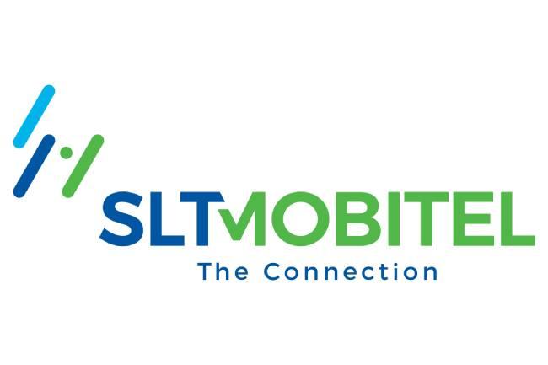
Unifying
SLT and SLT-Mobitel unveiled their unified brand identity on January 1, 2021.
But there was no integrated operational structure up till January 2023.

Slide 12
SLT – Mobitel (2023)

Slide 13
Competitors
Dialog
Hutch
Airtel
Etisalat

Slide 14
Thank You !

