Slide 1


Slide 2
Libraries & Images

Slide 3
Libraries

Slide 4
Libraries
At the simplest level, libraries are just code that is external to your program that you want to use
Code someone else wrote that does what you need
Code you wrote at another time that you want to reuse
Code you're writing now but it's too much to usably fit in a single file
By putting code into libraries, you only need to include the parts that you are going to use instead of having all the code in a single file.
In order to use the code in a library, we need to import it.
There are three different ways to import code from a library

Slide 5
Import the entire library
Import the entire library
To use functions and object that are imported like this, we reference them using the name of the library, a period, and the name of the thing we want to use:
You can bind the library name to something else if you want
This is often done if the library name is long to save on typing
Just be sure your short name makes sense and is easy to understand
import operator
sum = operator.add(3,7)
import operator as op
sum = op.add(3,7)

Slide 6
Import all the names from a library
The previous import method grabbed the entire library but kept the names separate from any names you defined in your program by requiring you to use the library name (or alias) when calling the functions
If you don't want to have to use the library name each time, you can import this way
This is only recommended for small libraries where you know all the names. If you import something this way, and it has the same name as something you created in your code, there will problems and the code might not do what you expect
from operator import *
sum = add(3,7)

Slide 7
Import specific items from a library
When you only need a few items from the library, you can just import the specific items you need
The items are listed in a comma separated list and are added to your code without the library name at the beginning
This is probably the most common way to import functions or objects into your code
from operator import add, mul, sub
sum = add(3, 7)
product = mul(2, 5)
difference = diff(15, 2)

Slide 8
Installing libraries
Python comes with a lot of useful libraries, but most libraries are not part of the standard Python distribution.
We'll be using several libraries this semester that you will need to install as you work through the labs, homeworks, and projects
When you want to install new libraries, you use the pip common in a terminal window
Sometimes this doesn't work, and you need to use the longer form:
This installs the library and then you can import it in your Python code
pip install byuimage
python –m pip install byuimage
import byuimage

Slide 10
Images

Slide 11
Project 1 – Image Processor
For your first project in this class, you'll be writing a small program that reads in images, manipulates them, and then writes out the resulting image.
Several of the next labs, along with Homework 2, focus on developing some of the functionality you will need to complete the project.
You will need the byuimage library for these assignments and will install it (if you haven't already) during your next lab session
Since you will be working with images, let's talk a bit about them, how they are represented, and how we work with them

Slide 12
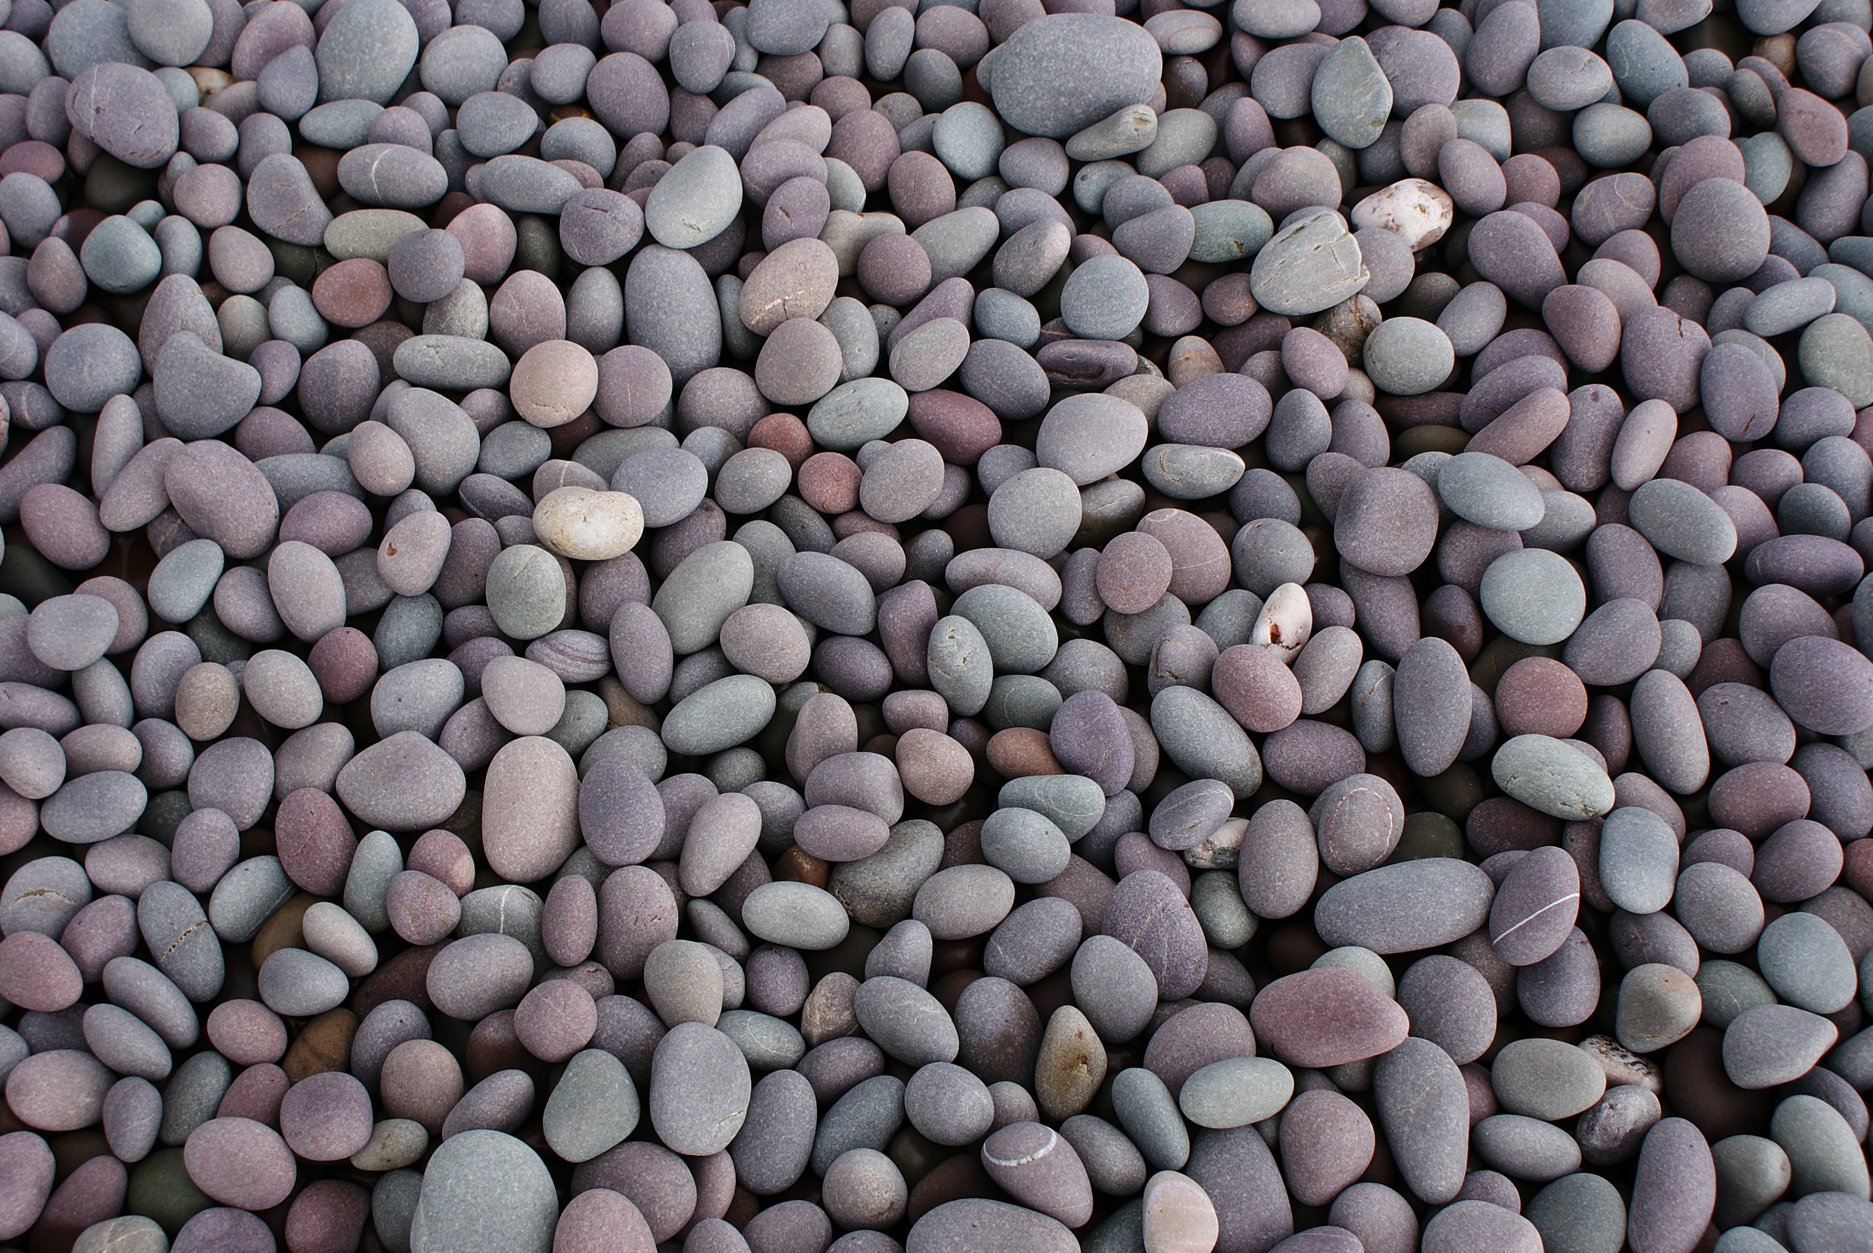
Understanding Images
Images consist of pixels
A pixel is just a tiny square showing a single color
They are arranged in a rectangular grid
Colors are represented by a number of different systems – RGB, HSV, LCH, CMYK, etc.
Each of these use different values to represent the colors
We'll be using the RGB system - RGB stands for Red-Green-Blue
The pixel color is controlled by varying the values in each of those three color channels
Values can range from 0-255
The colors mix to form the final color of the pixel
With 256 values in each color channel there are 16.7 million colors possible.

Slide 13
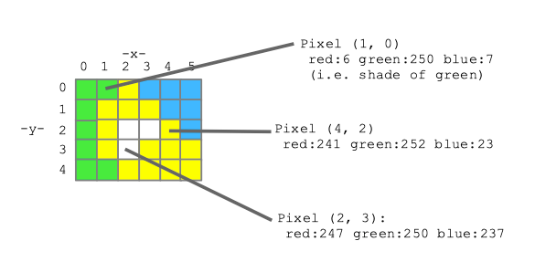
Reading in an image
Using the byuimage library, reading in an image is simple
The pixels in the image are a collection, sort of like a list
The collection is ordered
they go from left to right and top to bottom
(0,0) → (1,0) → (2,0) …
(0,1) → (1,1) → (2,1) …
The collection is iterable
from byuimage import Image
myImage = Image("pebbles.jpg")
myImage.show()

Slide 14
Looping over an image
Since the Image object is iterable, we can loop over all the pixels and manipulate them if we wanted to
To see only the red values in the image, we might do something like this
This processes each pixel in the image, one by one, setting the blue and green values to zero.
image = Image("pebbles.jpg")
for pixel in image:
pixel.green = 0
pixel.blue = 0
image.show()

Slide 15
Returning an Image from a function
The Images created by the byuimage library are just object like anything else (list, strings, numbers, etc.) and so can be passed to and returned from functions.
What does this function do?
def darken(image):
for pixel in image:
pixel.red = pixel.red * 0.5
pixel.green = pixel.green * 0.5
pixel.blue = pixel.blue * 0.5
return image

Slide 16
Accessing specific pixels
So far, we've been accessing every pixel in the image using the for loop.
What if we want to just access a specific pixel (or range of pixels) in the image?
Remember that our image is just a grid
The Image object has some additional functions and attributes that will be useful
.height = the height of the image in pixels
.width = the width of the image in pixels
.get_pixel() – A function that returns the pixel at the specified coordinates

Slide 17
Accessing specific pixels (cont.)
This gives us a different way to loop over all the pixels
Here's a slightly different version of the darken() function
What if we wanted to only darken the top half of the image?
Or the right half?
def darken(image):
""" Pass in an image, modify it """
for y in range(image.height):
for x in range(image.width):
pixel = image.get_pixel(x, y)
pixel.red = pixel.red * 0.5
pixel.green = pixel.green * 0.5
pixel.blue = pixel.blue * 0.5

Slide 18
Copying pixels
If we have two different pixels, how do we copy one into the other?
We just copy the color values
a = image.get_pixel(1,7)
b = image.get_pixel(3,10)
a.red = b.red
a.green = b.green
a.blue = b.blue

Slide 19
Copying images
What if we wanted to copy an entire image into a new one?
The Image object has a function called blank() that takes a width and height as parameters and returns an empty (white) image of that size.
Then we can just copy the pixel from the old image to the new one
def copy(image):
new_image = Image.blank(image.width, image.height)
for y in range(image.height):
for x in range(image.width):
pixel = image.get_pixel(x, y)
pixel_new = new_image.get_pixel(x, y)
pixel_new.red = pixel.red
pixel_new.green = pixel.green
pixel_new.blue = pixel.blue
return new_image

Slide 21
Manipulating Images

Slide 22
Manipulating the images
We can write functions to manipulate the image in any way we want.
This one makes a copy of the image and then darkens only the pixels in the top half that have an average color value greater than 220
def mute_top(image):
new_image = Image.blank(image.width, image.height)
for y in range(image.height):
for x in range(image.width):
pixel = image.get_pixel(x, y)
pixel_new = new_image.get_pixel(x, y)
factor = 1.0
if (pixel.red + pixel.blue + pixel.green)/3 > 220 and y < image.height//2:
factor = 0.5
pixel_new.red = pixel.red * factor
pixel_new.green = pixel.green * factor
pixel_new.blue = pixel.blue * factor
return new_image

Slide 23
Let's add a border
Let's write a function that takes an image and adds a 50-pixel wide, black border at the bottom.
def bottom_black_border(image):
"""
This function take an Image object and returns a new
Image that is 50 pixels larger with a black stripe at
the bottom
"""

Slide 24
Add a border (solution)
def bottom_black_border(image):
new_image = Image.blank(image.width, image.height+50) # Create the larger image.
for y in range(image.height): # Copy the original image
for x in range(image.width): # into the top of the new
pixel = image.get_pixel(x, y) # one.
pixel_new = new_image.get_pixel(x, y)
pixel_new.red = pixel.red
pixel_new.green = pixel.green
pixel_new.blue = pixel.blue
for y in range(image.height,image.height+50): # Make the pixels in the
for x in range(image.width): # bottom black. RGB for
pixel_new = new_image.get_pixel(x, y) # black is (0,0,0).
pixel_new.red = 0
pixel_new.green = 0
pixel_new.blue = 0
return new_image

Slide 26
Green Screen

Slide 27
Chroma key compositing (AKA green screening)
Let's try something a little more challenging – a simple green screen effect
For this we need two images
The background
The foreground image with the green screen
What do we need to do?
Create a copy of the background
Copy the pixels from the foreground image that aren't green into the new image
How do we determine that?

Slide 28
Determining Green
How do we tell if a pixel is green or not?
We could check the green pixels to see if it is above some threshold
Let's see what that does if we change everything detected as green to red:
def detect_green(pixel):
threshold = 100
if pixel.green > threshold:
return True
else:
return False
def change_to_red(image):
for y in range(image.height):
for x in range(image.width):
pixel = image.get_pixel(x, y)
if detect_green(pixel):
pixel.red = 255
pixel.green = 0
pixel.blue = 0

Slide 29
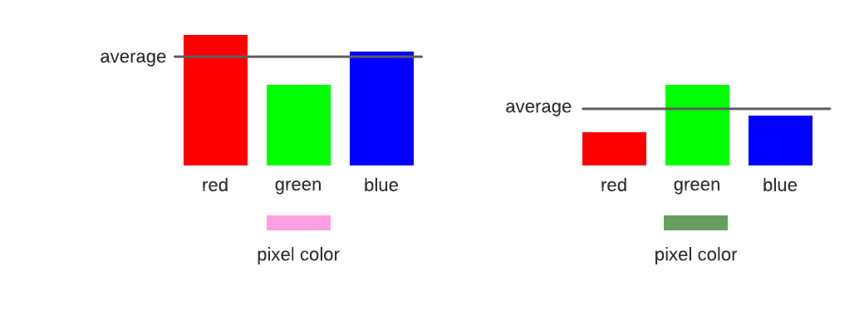
Determining green II
That didn't work
What about looking at the average color of the pixel
And then checking to see if the green value is higher than that by some factor?
We can play with the value of factor to get it to be a better fit
def detect_green(pixel):
factor = 1.7
average = (pixel.red + pixel.green + pixel.blue) / 3
if pixel.green >= factor * average:
return True
else:
return False

Slide 30
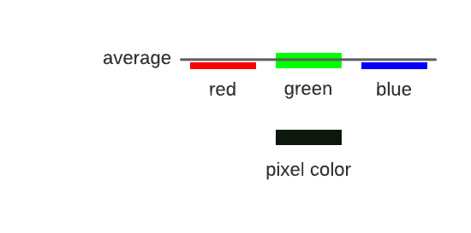
Determining green III
But there is still an issue
Look at his hair and his belt
These pixels are dark, almost black, but are still getting changed.
They have values something like this image
Let's combine the two techniques
def detect_green(pixel):
factor = 1.3
threshold = 100
average = (pixel.red + pixel.green + pixel.blue) / 3
if pixel.green >= factor * average and pixel.green > threshold:
return True
else:
return False

Slide 31
Putting it all together
def green_screen(foreground,background):
final = Image.blank(background.width,background.height)
for y in range(background.height):
for x in range(background.width):
fp = final.get_pixel(x,y)
bp = background.get_pixel(x,y)
fp.red = bp.red
fp.green = bp.green
fp.blue = bp.blue
for y in range(foreground.height):
for x in range(foreground.width):
fp = foreground.get_pixel(x, y)
if not detect_green(fp):
np = final.get_pixel(x,y)
np.red = fp.red
np.green = fp.green
np.blue =fp.blue
return final
What problems might we have with this code?

