Slide 1
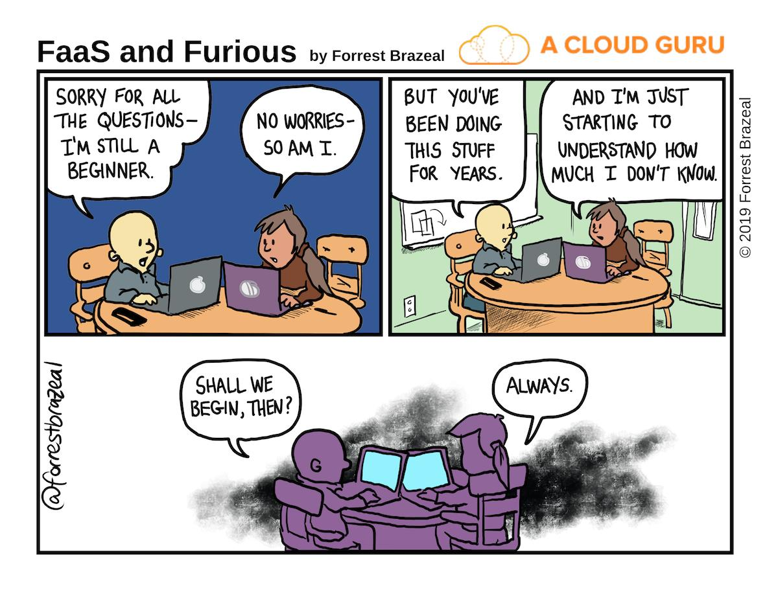

Slide 2
Basic Python Syntax

Slide 3
Values, Expressions, & Statements

Slide 4
What do programs do?
Programs work by manipulating values
Expressions in programs evaluate to values
Expression: 'a' + 'hoy'
Value: 'ahoy'
The Python interpreter evaluates expressions and displays their values
Statements give direction to the program
assigning values
defining things
determining program flow

Slide 5
Values
Programs manipulate values.
Each value has a certain data type.
Try these in a Python interpreter. What gets displayed?
Data Type | Example Values
Integers | 2 44 -3
Floats | 3.14 4.5 -2.0
Booleans | True False
Strings | '¡hola!' 'its python time!'

Slide 6
Expressions (with operators)
An expression describes a computation and evaluates to a value.
Some expressions use operators:
addition: 18 + 69
subtraction: 2024 - 1972
multiplication: 2 * 100
division
floating point: 23/6
integer: 23//6
modulus: 23 % 6
Try these in a Python interpreter. What gets displayed?

Slide 7
Call Expressions
Many expressions use function calls:
pow(2,100)
max(50, 300, -1600)
min(1, -300, -67)
Function calls are a type of expression, called a call expression, and like operator expressions evaluate to some value.

Slide 8
Anatomy of a Call Expression
add ( 18 , 69 )
Operator
Operand
Operand
How Python evaluates a call expression:
Evaluate the operator
Evaluate the operands
Apply the operator (a function) to the evaluated operands (arguments)
Operators and operands are also expressions, so they must be evaluated to discover their values.

Slide 9
Evaluating nested expressions
45
add(add(6, mul(4, 6)), mul(3, 5))
30
15
add
add(6, mul(4, 6))
mul(3, 5)
24
add
6
mul(4, 6)
mul
3
5
This is called an expression tree.
mul
4
6

Slide 11
Statements

Slide 12
Statements
A statement is executed by the interpreter to perform an action.
Some examples (details on these in future slides and lectures)
Statement type | Example
Assignment statement | name = 'sosuke' greeting = 'ahoy, ' + name
Def statement | def greet(name): return 'ahoy, ' + name
Return statement | return 'ahoy, ' + name

Slide 13
Compound statements
A compound statement contains groups of other statements.
<header>:
<statement>
<statement>
...
<separating header>:
<statement>
<statement>
...
# CLAUSE
# SUITE
# CLAUSE
# SUITE
The first header determines a statement's type, and the header of each clause controls the suite that follows.

Slide 14
Python and Whitespace
In Python, whitespace matters!
This is different than most other languages, especially the curly brace languages (C & C++ and their derivatives such as Java, C#, Javascript, etc.)
Python uses newlines to signify the end of statements
Python uses the indentation level to signify the contents of suites or blocks of code.
Everything in a block of code must be at the same indentation level.
It can be tabs or spaces but must be the same for any given suite – no mixing and matching.

Slide 15
Execution of suites
A suite is a sequence of statements.
Execution rule for a sequence of statements:
Execute the first statement
Unless directed otherwise, execute the rest
<header>:
<statement>
<statement>
...
<separating header>:
<statement>
<statement>
...
# SUITE
# SUITE

Slide 17
Names

Slide 18
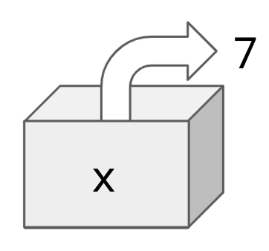
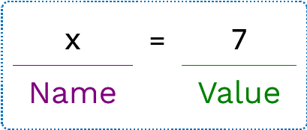
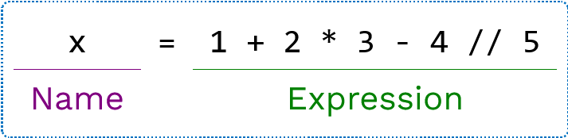
Names
A name can be bound to a value.
One way to bind a name is with an assignment statement.
The value can be any expression:

Slide 19
Using names
A name can be referenced multiple times:
A name that's bound to a data value is also known as a variable.
Be aware that in Python, you can also bind names to existing functions:
x = 10
y = 3
result1 = x * y
result2 = x + y
f = pow
f(10, 2) #=> 100

Slide 20
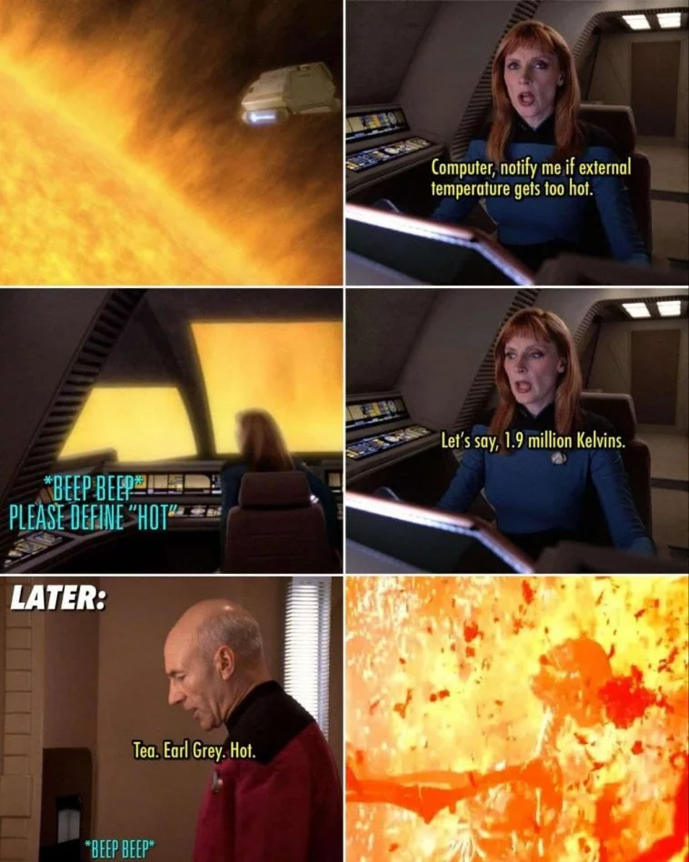
Name rebinding
A name can only be bound to a single value
💬 Will that code cause an error? If not, what will my_name store?
It will not error (similar code in other languages might, however). The name my_name is now bound to the value 'Pamelaella'.
my_name = 'Pamela'
my_name = my_name + 'ella'

Slide 22
Console I/O

Slide 23
Writing to the screen
To write something to the computer screen, we use the print() statement
We can print as many different things in a single print statement as we would like.
Just separate them by commas
A space is printed in between each one
print("Hello world!")
# Hello world!
n = 10
print("There are", n, "apples.")
# There are 10 apples.

Slide 24
Formatting decimal numbers
When you print floating point numbers, Python will print a number of decimal places that it thinks is appropriate, usually as many as possible.
Often you don't want that.
You can specify the number of decimal places by using an f-string:
We'll talk more about f-strings and their uses in a future lecture
e = 2.718281828459050
print("e = ", e)
# e = 2.71828182845905
e = 2.718281828459050
print(f"2 decimals: {e:.2f}")
print(f"10 decimals: {e:.10f}")
# 2 decimals: 2.72
# 10 decimals: 2.7182818285

Slide 27
Boolean Expressions

Slide 28
Boolean Expressions
A Boolean value is either True or False and is used frequently in computer programs.
An expression can evaluate to a Boolean. Most Boolean expressions use either comparison or logical operators.
An expression with a comparison operator:
An expression with a logical operator:
passed_class = grade > 65
wear_jacket = is_raining or is_windy

Slide 29
Comparison Operators
Operator | Meaning | True expressions
== | Equality (is equal to) | 32 == 32
!= | Inequality (is not equal to) | 30 != 32
> | Greater than | 60 > 32
>= | Greater than or equal | 60 >= 32, 32 >= 32
< | Less than | 20 < 32
<= | Less than or equal | 20 < 32, 32 <= 32
⚠️ Common mistake: Do not confuse = (the assignment operator) with == (the equality operator).

Slide 30
Logical Operators
Operator | True Expressions | Meaning
and | 4 > 0 and -2 < 0 | Evaluates to True if both conditions are true. If one is False evaluates to False.
or | 4 > 2 or -2 < 0 | Evaluates to True if either condition is true. Evaluates to False only if both are false.
not | not (5 == 0) | Evaluates to True if condition is false; evaluates to False if condition is true.

Slide 31
Compound Booleans
When combining multiple operators in a single expression, use parentheses to group:
There is an order of operations to the evaluation of the Boolean operators, but it is always safer to include the parentheses.
may_have_mobility_issues = (age >= 0 and age < 2) or age > 90

Slide 33
Conditional Statements

Slide 34
Conditional Statements
A conditional statement gives your code a way to execute a different suite of code statements based on whether certain conditions are true or false.
A simple conditional:
if <condition>:
<statement>
<statement>
...
clothing = "shirt"
if temperature < 32:
clothing = "jacket"

Slide 35
Compound conditionals
A conditional can include any number of elif statements to check other conditions.
if <condition>:
<statement>
...
elif <condition>:
<statement>
...
elif <condition>:
<statement>
...
clothing = "shirt"
if temperature < 0:
clothing = "snowsuit"
elif temperature < 32:
clothing = "jacket"

Slide 36
The else statement
A conditional can include an else clause to specify code to execute if no previous conditions are true.
if <condition>:
<statement>
...
elif <condition>:
<statement>
...
else:
<statement>
...
if temperature < 0:
clothing = "snowsuit"
elif temperature < 32:
clothing = "jacket"
else:
clothing = "shirt"

Slide 37
Conditional statements summary
if num < 0:
sign = "negative"
elif num > 0:
sign = "positive"
else:
sign = "neutral"
Syntax tips:
Always start with if clause.
Zero or more elif clauses.
Zero or one else clause, always at the end.

Slide 38
Execution of conditional statements
Each clause is considered in order.
Evaluate the header's expression.
If it's true, execute the suite of statements underneath and skip the remaining clauses.
Otherwise, continue to the next clause.
num = 5
if num < 0:
sign = "negative"
elif num > 0:
sign = "positive"
else:
sign = "neutral"

Slide 40
A note on program Structure

Slide 41
How Python reads a file
When Python opens a file, it starts reading the file and executing all the statements inside it in order.
But Python files can be opened in different ways:
As a program
As a module (more on modules later)
In either case, all the statements are executed
However, when opened as a program a special variable name, __name__ is assigned the value "__main__"
This allows us to specify code that should only be run when invoked as a program

Slide 42
An example
This is the starter code we give you for Homework 00
We'll talk more about how this can be helpful and useful, as well as the def statement syntax, later. For now, just remember to implement your code where the comment says to.
## CONSTANTS SHOULD GO BELOW THIS COMMENT ##
def main():
## YOUR CODE SHOULD GO IN THIS FUNCTION ##
pass
if __name__ == "__main__":
main()

