Slide 1
Network File System

Slide 2
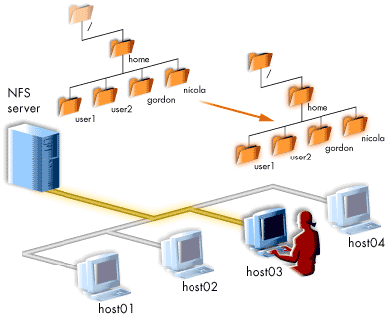

Slide 3
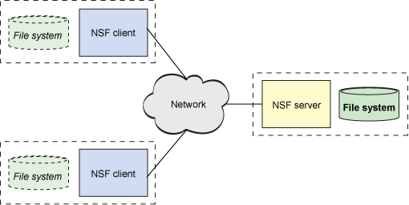

Slide 4
Network Services
A Linux system starts some services at boot time and allow other services to be started up when necessary. These services are controlled by processes called daemons.
A daemon is a process running in the background which performs some system-related task, whether a network service, or some other service.
If all services started up at boot time, even though they might or might not be used, this would take up a lot of system resources. To overcome this problem, the xinetd daemon was created, which listens on the ports of many network services and, upon receiving a connection, starts up the service's corresponding daemon, which runs only until its task is complete.

Slide 5
The Internet Daemon
xinetd starts at boot time and gets the list of services that it will manage from its configuration file ( /etc/xinetd.conf ).
The way it knows which port to listen for each services is from the /etc/services file.

Slide 6
xinetd
Changes to the xinetd.conf file do not take effect until you tell xinetd to re-read it. After sending a hangup signal, you should wait and check the log files for error messages related to your changes. xinetd logs errors to syslog under the ‘daemon’ facility.
xinetd plays an important role in securing your system. It is important to make sure that only services that you need, and trust are enabled in the xinetd.conf file. Typically you modify your xinetd.conf file to disable services that are unnecessary and turn on only those services that are absolutely necessary.

Slide 7
Remote Procedure Calls (RPC)
RPC is a collection of tools and library functions for client/server applications, upon which, applications such as NFS, the Network Filesystem are built.
An RPC server provides a group of procedures which a client can call by sending a request to the server. The server then invokes the procedure on behalf of the client, returning a value as necessary.
The collection of procedures that an RPC server provides is called a program and is identified by a program number. The file /etc/rpc maps service names to their program numbers. You will only need to edit this file if you bring up a new RPC server providing a new set of procedures.

Slide 8
RPC
The portmapper daemon solves this problem.
When an RPC server starts, it picks an available port, and then registers that port and what RPC program numbers it will serve with the portmapper daemon.
When a client program needs to access a service, it first queries the portmapper on the RPC server's host which reports the TCP and UDP port on which the server is listening, and then it contacts that port to request its service.

Slide 9
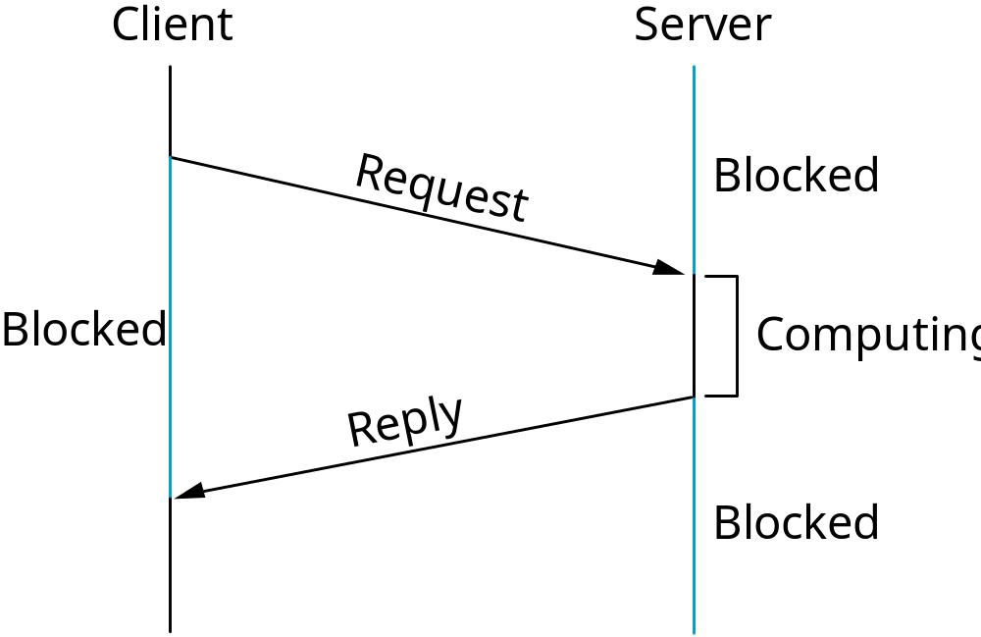
RPC Timeline

Slide 10
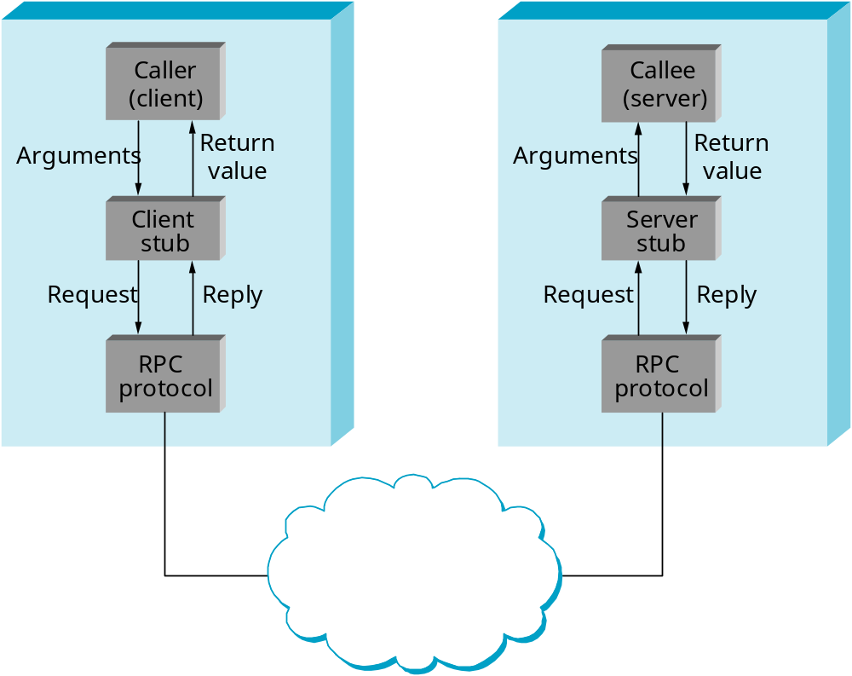
RPC Components
Complete RPC Mechanisms

Slide 11
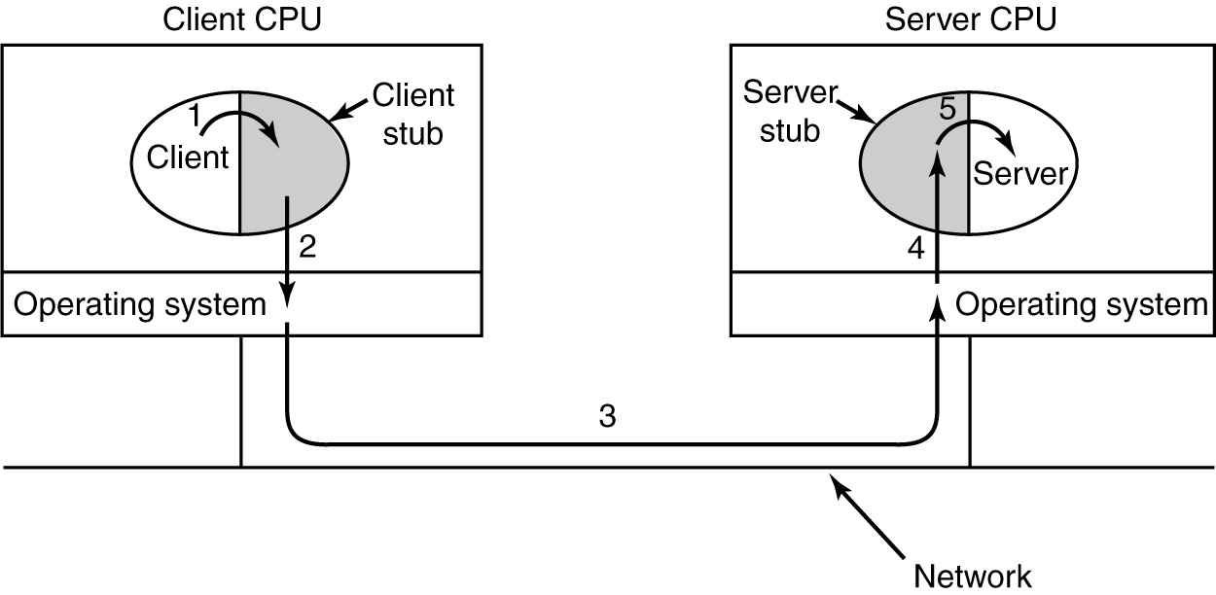
Steps in Making an RPC call

Slide 12
Network File System (NFS)
NFS, or the Network File System, was originally developed by Sun Microsystems in the 1980's as a way to create a file system on diskless clients. NFS provides remote access to shared file systems across networks.
NFS is almost transparent to the user and is stateless, meaning that information is lost when a NFS server crashes.
All UNIX vendors provide a version of NFS and many use code licensed from SUN.

Slide 13
NFS
NFS consists of several components.
  a mounting protocol and mount server
  daemons that coordinate basic file service
  several diagnostic utilities
NFS runs on top of Sun’s RPC protocol, which defines a system-independent way for processes to communicate over the network.

Slide 14
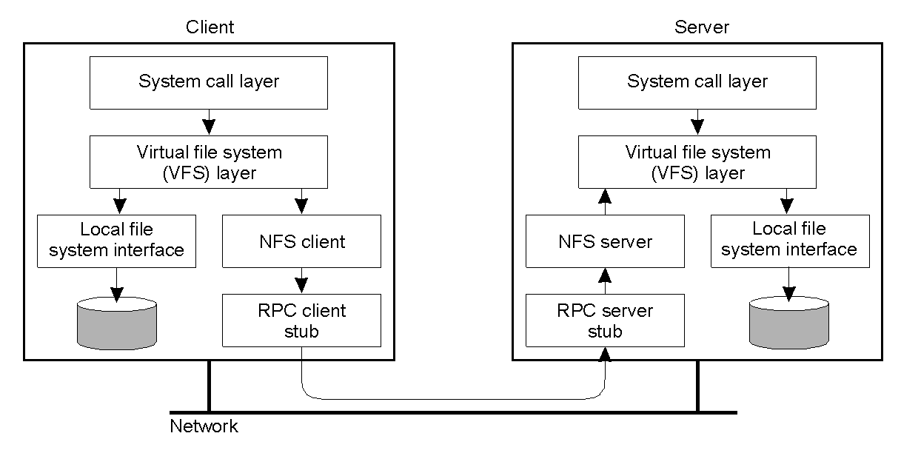
NFS Architecture
The basic NFS architecture for UNIX systems.
The basic NFS architecture for UNIX systems.

Slide 15
NFS
The server side of the NFS makes files available to other systems by a process called exporting. These file systems that are available to other systems are considered to be shared file systems.
In order to access these shared files, the clients have to mount these files systems onto their machines. Once this occurs, the file system is integrated into the directory structure.
Server-side NFS
  mountd
  nfsd

Slide 16
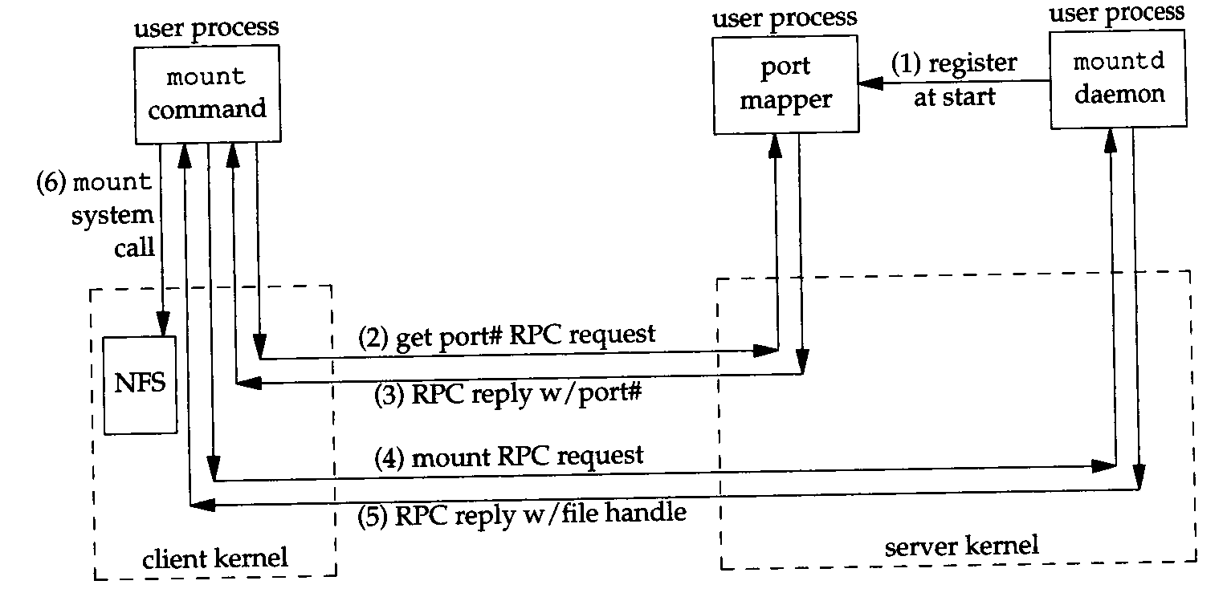
Mount Protocol used by Unix mount Command

Slide 17
Exporting File Systems
On systems, the /etc/exports file on the NFS server contains a list of directories that can be exported, and the restrictions and attributes that are imposed on these directories.
/etc/exports
  / master(rw) trusty(rw)
If the /etc/exports file is modified the export command must be run for the changes to take effect immediately.

Slide 18
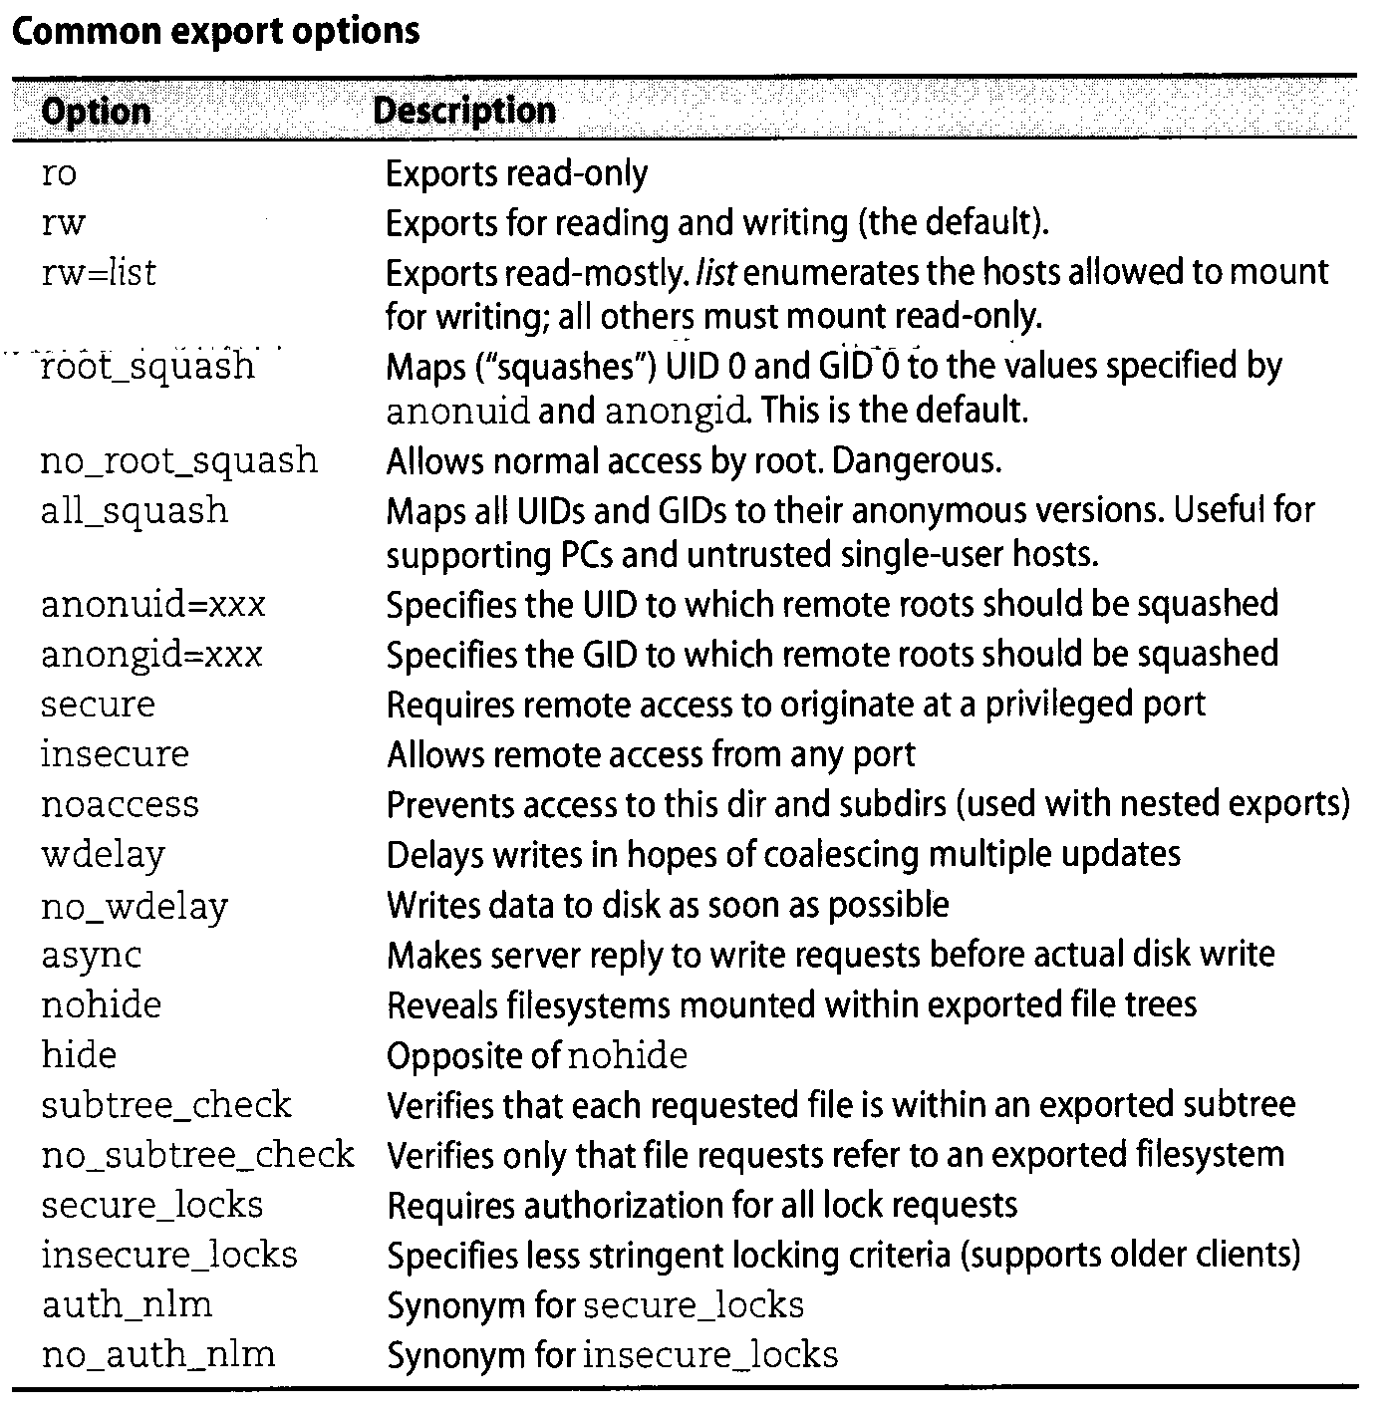
Common Export Options

Slide 19
Mounting Remote File Systems
NFS allows mounting any file system as long as the file system is not one that is already mounted from another server. These files can be mounted at boot time (read from the /etc/vfstab file) or can be mounted individually by the mount command. When mounting remote files, the remote machines’ name has to also be included in the command.
parrot.uh.edu:/users/staff /staff nfs rw,noquota 0 0

Slide 20
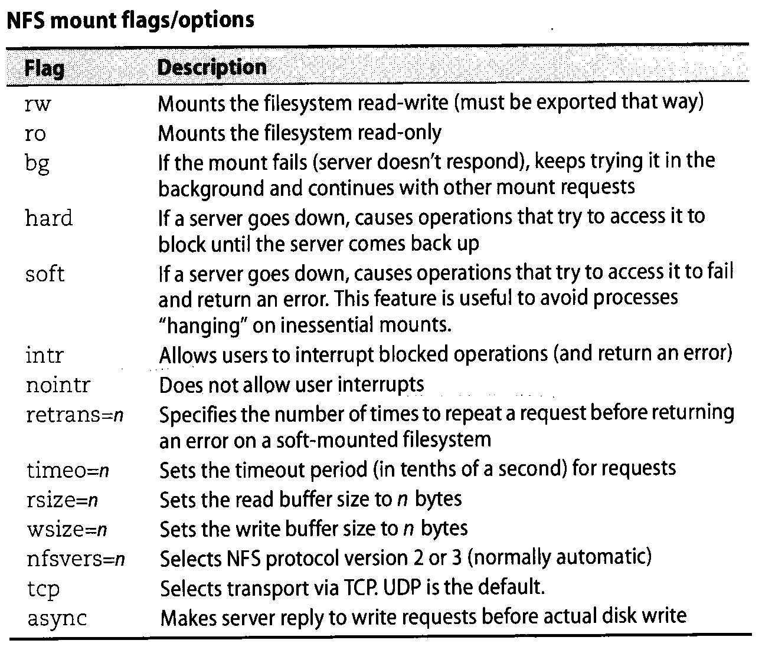
NFS Mount Flags/Options

Slide 21
NFS issues
Unix identifies users and groups by numbers. If machine X shares files with machine Y, then UID 288 had better refer to the same user on both systems.
When mounting file systems, users are generally given identical privileges, but root user ID’s are changed to that if ‘nobody’ so that they cannot become root on a mounted file system.

Slide 22
NFS Services
The NFS server package includes three facilities, included in the portmap and nfs-utils packages.
portmap : It maps calls made from other machines to the correct RPC service.
nfs: It translates remote file sharing requests into requests on the local file system.
rpc.mountd: This service is responsible for mounting and unmounting of file systems.

Slide 23
Setup and Configure NFS Mounts on Linux Server
To setup NFS mounts, we’ll be needing at least two Linux/Unix machines or two servers.
NFS Server: nfsserver.example.com with IP-192.168.0.100
NFS Client : nfsclient.example.com with IP-192.168.0.101

Slide 24
Installing NFS Server and NFS Client
We need to install NFS packages on our NFS Server as well as on NFS Client machine.
We can install it via “yum” (Red Hat Linux) and “apt-get” (Debian and Ubuntu) package installers.

Slide 25
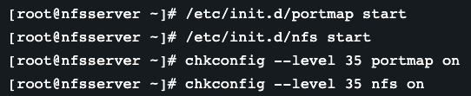
Now start the services on both machines.
After installing packages and starting services on both the machines, we need to configure both the machines for file sharing.

Slide 26

Setting Up the NFS Server
For sharing a directory with NFS, we need to make an entry in “/etc/exports” configuration file.
Here we are creating a new directory named “nfsshare” in “/” partition to share with client server.
you can also share an already existing directory with NFS.
Now we need to make an entry in “/etc/exports” and restart the services to make our directory shareable in the network.
In the above example, there is a directory in / partition named “nfsshare” is being shared with client IP “192.168.0.101” with read and write (rw) privilege.

Slide 27
Some other options we can use in “/etc/exports” file for file sharing is as follows.
ro: With the help of this option we can provide read only access to the shared files i.e client will only be able to read.
rw: This option allows the client server to both read and write access within the shared directory.
sync: Sync confirms requests to the shared directory only once the changes have been committed.
no_subtree_check: This option prevents the subtree checking. When a shared directory is the subdirectory of a larger file system, nfs performs scans of every directory above it, in order to verify its permissions and details. Disabling the subtree check may increase the reliability of NFS but reduce security.
no_root_squash: This phrase allows root to connect to the designated directory.

Slide 28
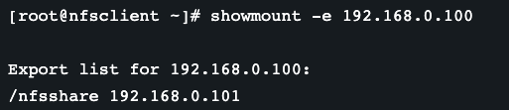
Setting Up the NFS Client
After configuring the NFS server, we need to mount that shared directory or partition in the client server.
Now at the NFS client end, we need to mount that directory in our server to access it locally. To do so, first we need to find out that shares available on the remote server or NFS Server.
Above command shows that a directory named “nfsshare” is available at “192.168.0.100” to share with your server.

Slide 29
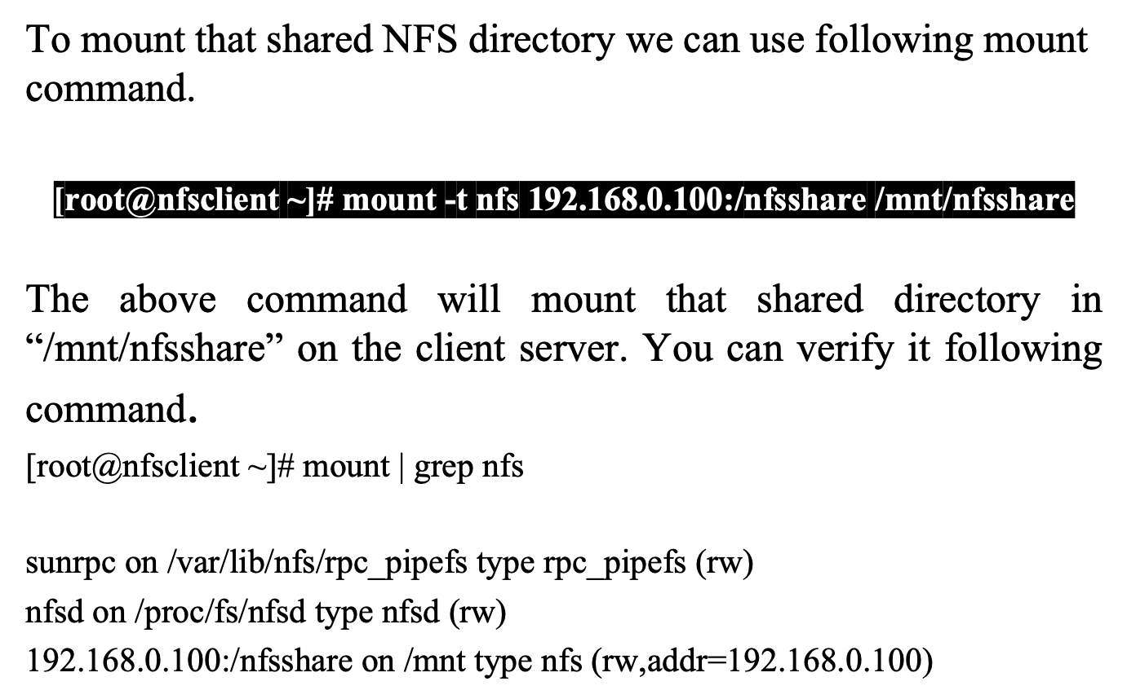
Mount Shared NFS Directory

Slide 30

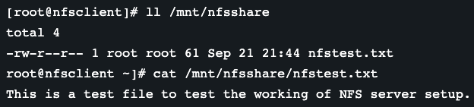
Test the Working of NFS Setup
We can test our NFS server setup by creating a test file on the server end and check its availability at nfs client side or vice-versa.
At the nfs client end

Slide 31
Thank You

