Slide 1
Object oriented programming - python Ch:1
Installing PyCharm in Laptops

Slide 2
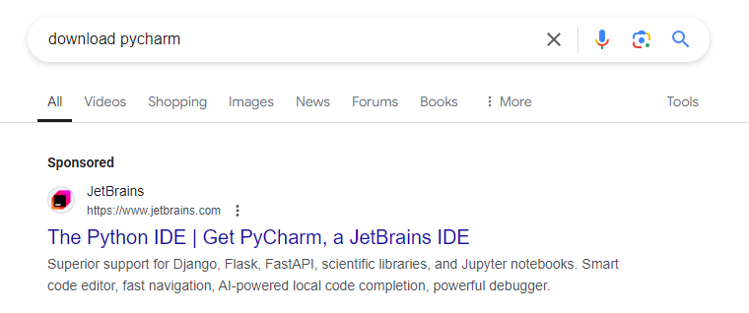
PyCharm installation

Slide 3
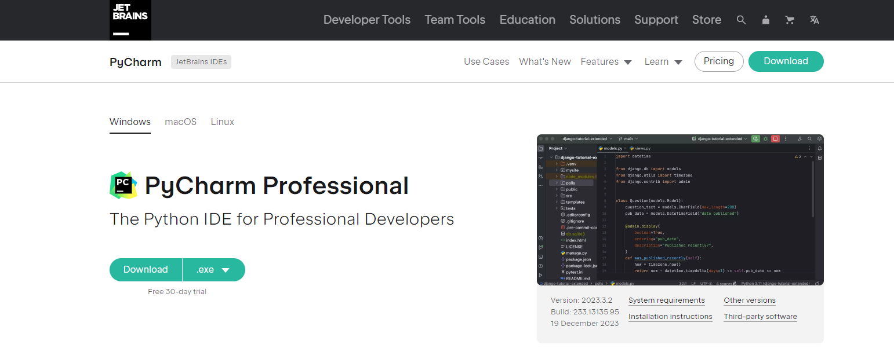
PyCharm installation

Slide 4
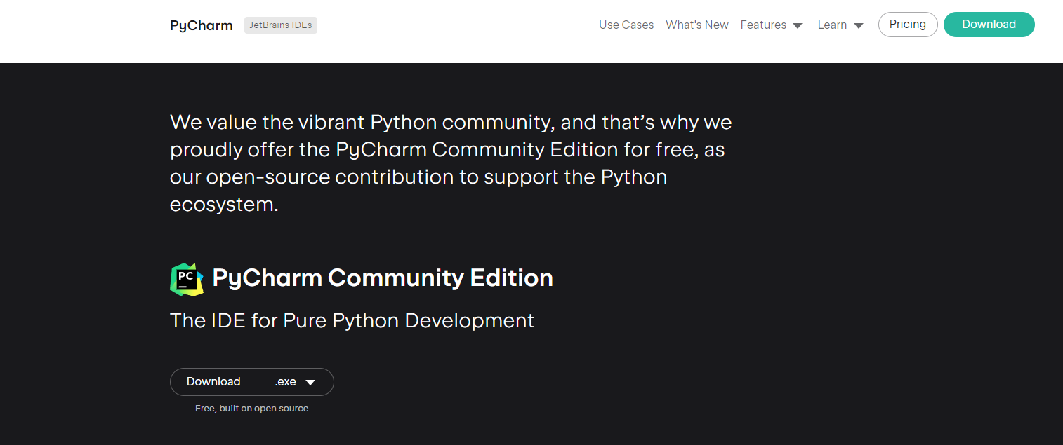
PyCharm installation

Slide 5
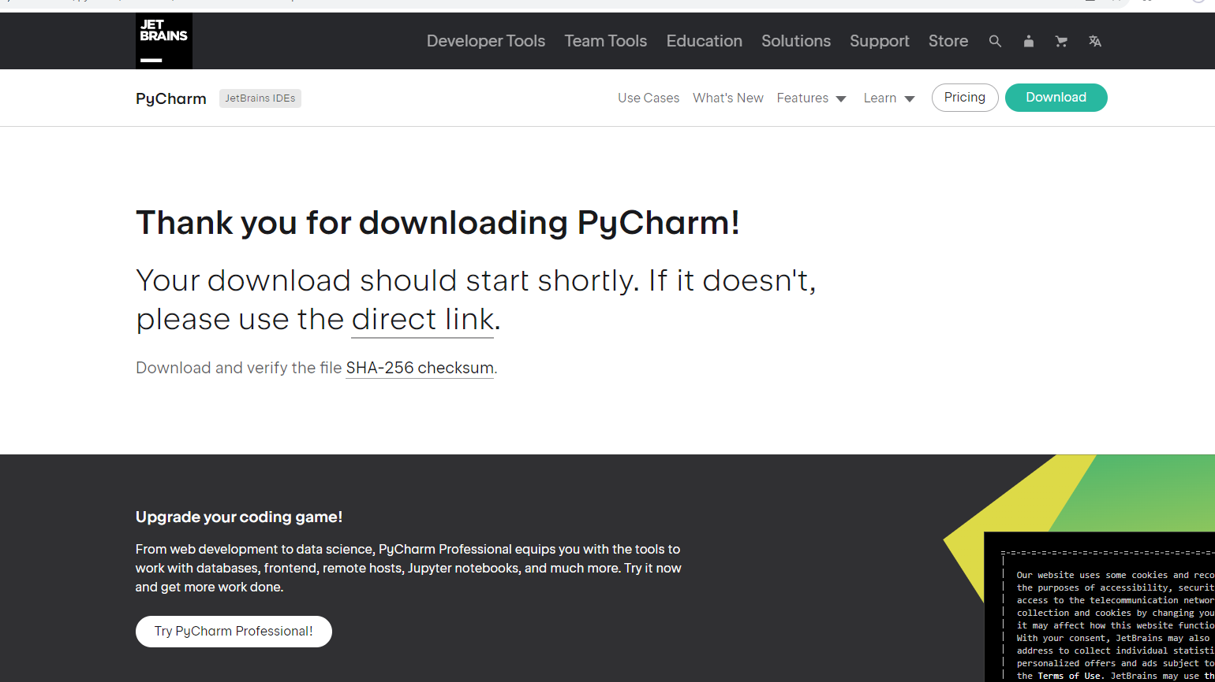
PyCharm installation

Slide 6
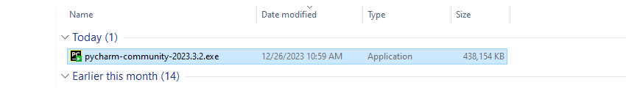
PyCharm installation

Slide 7
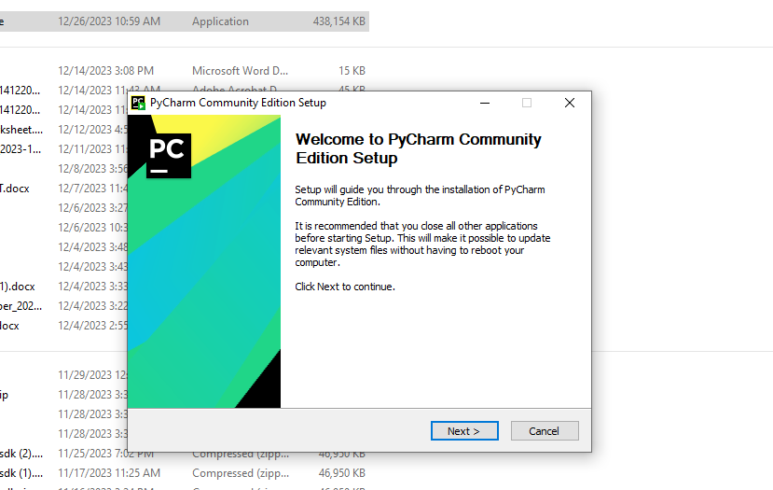
PyCharm installation

Slide 8
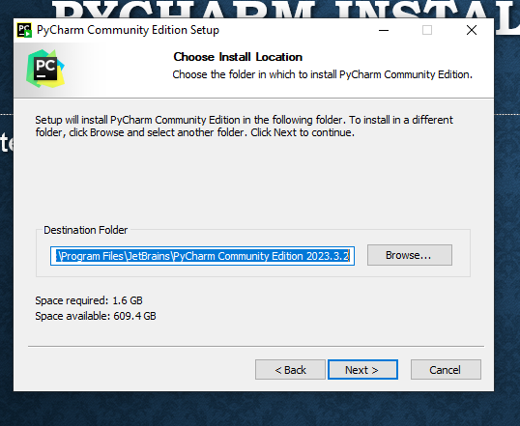
PyCharm installation

Slide 9
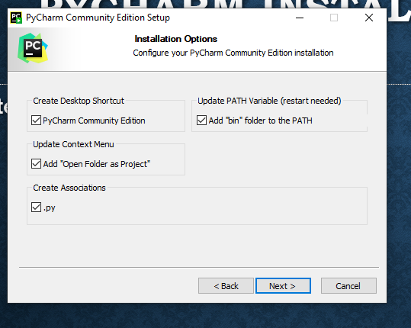
PyCharm installation

Slide 10
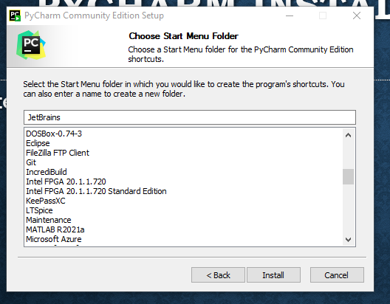
PyCharm installation

Slide 11
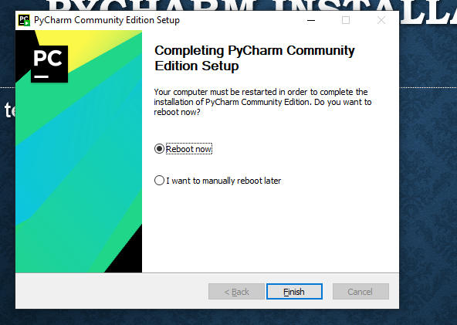
PyCharm installation

Slide 12
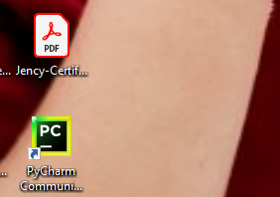
PyCharm installation

Slide 13
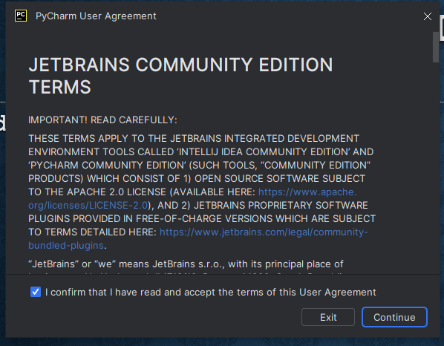
PyCharm installation

Slide 14
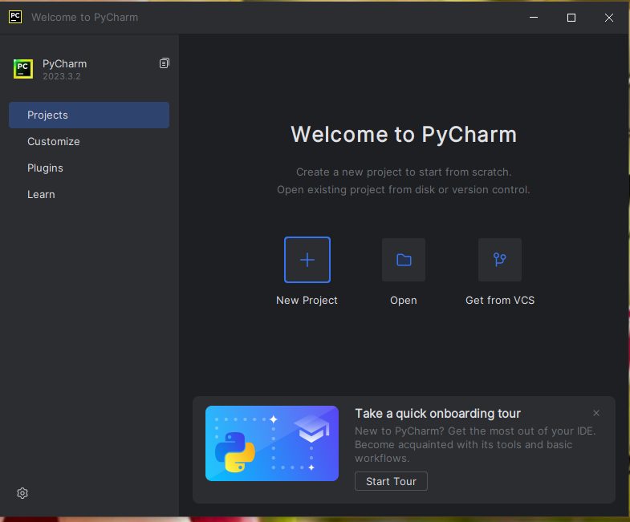
PyCharm installation

Slide 15
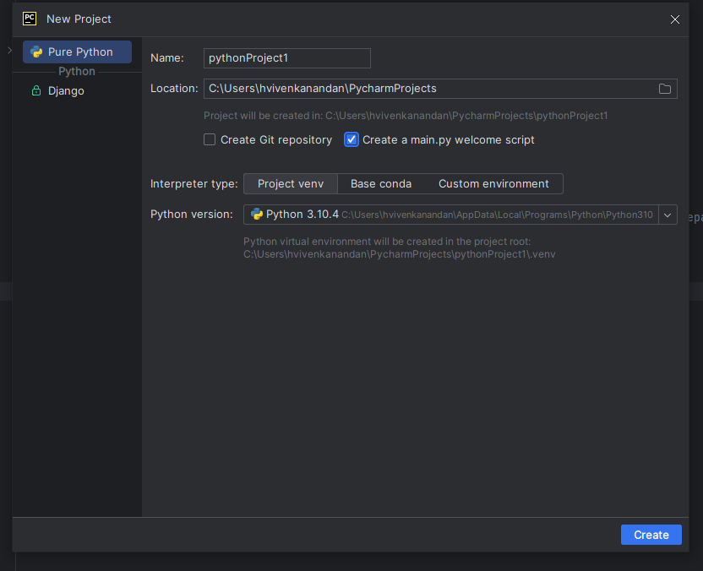
PyCharm installation

Slide 16
PyCharm installation

Slide 17
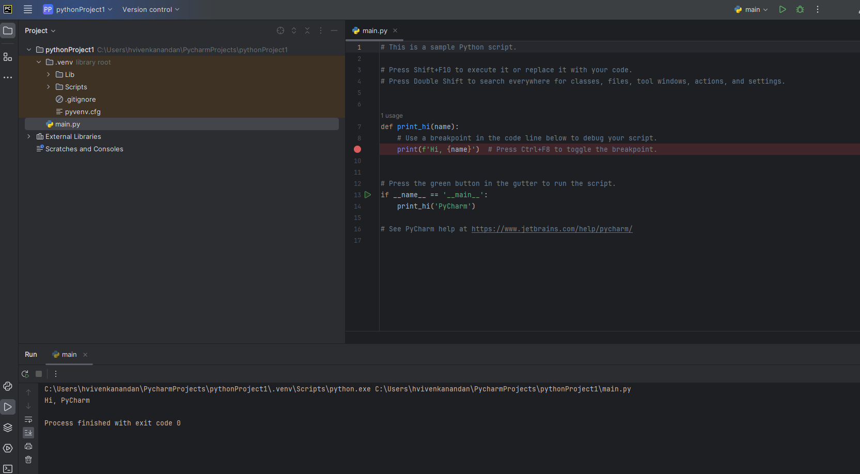
PyCharm installation

