Slide 1
Object oriented programming - python Ch:1
DR. HEPSIBA VIVENKANANDAN
JBU

Slide 2
Topics to be covered:
PyCharm installation
Programming Basics

Slide 3
Today’s Verse
But the one who stands firm to the end will be saved. Matthew 24 : 13

Slide 4
Program
A computer program consists of instructions executing one at a time.
Basic instruction types are:
Input: A program gets data, perhaps from a file, keyboard, touchscreen, network, etc.
Process: A program performs computations on that data, such as adding two values like x + y.
Output: A program puts that data somewhere, such as to a file, screen, network, etc.

Slide 5
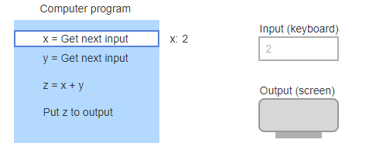
Program(contd..)
A basic computer program's instructions get input, process, and put output.
This program first assigns x with what is typed on the keyboard input, in this case 2.

Slide 6
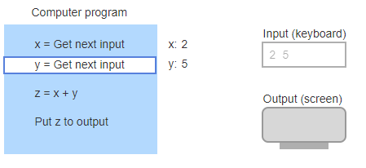
Program(contd..)
The program's next instruction gets the next input, in this case 5.

Slide 7
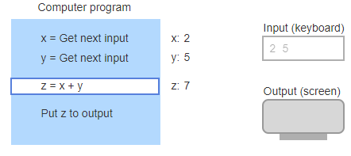
Program(contd..)
The program then does some processing, in this case assigning z with x + y (so 2 + 5 yields z of 7).

Slide 8
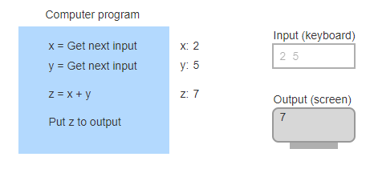
Program(contd..)
Finally, the program puts z (7) to output, in this case to a screen

Slide 9
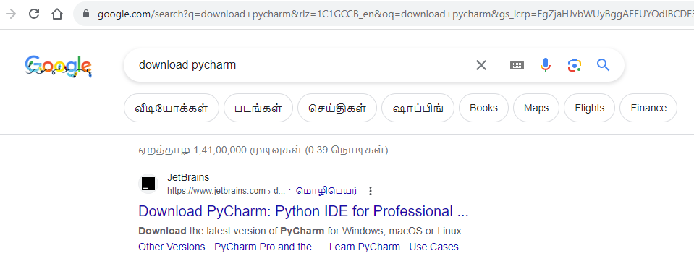
PyCharm installation

Slide 10
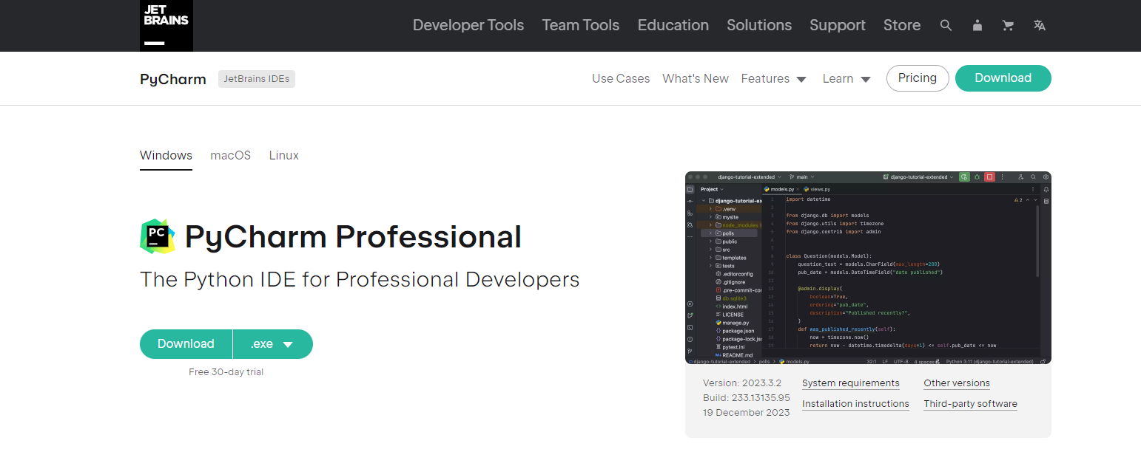
PyCharm installation

Slide 11
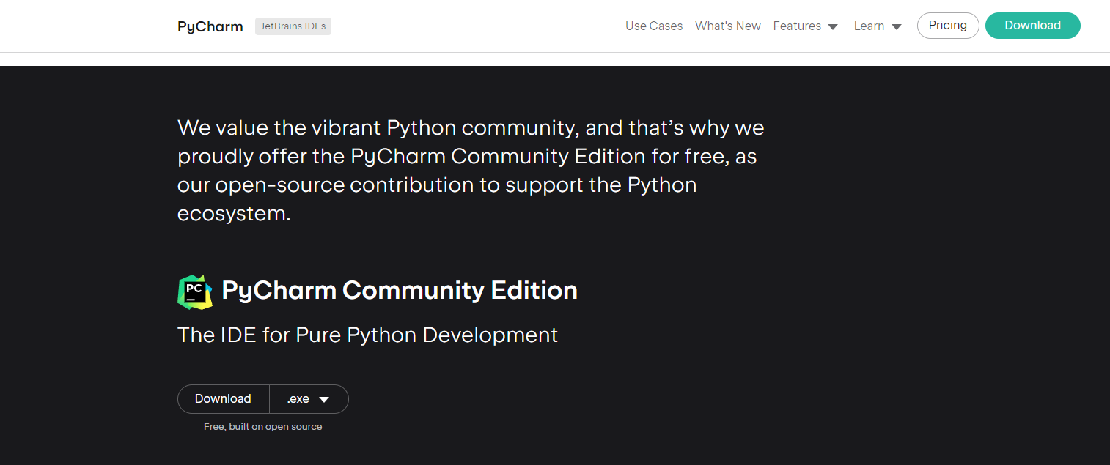
PyCharm installation

Slide 12
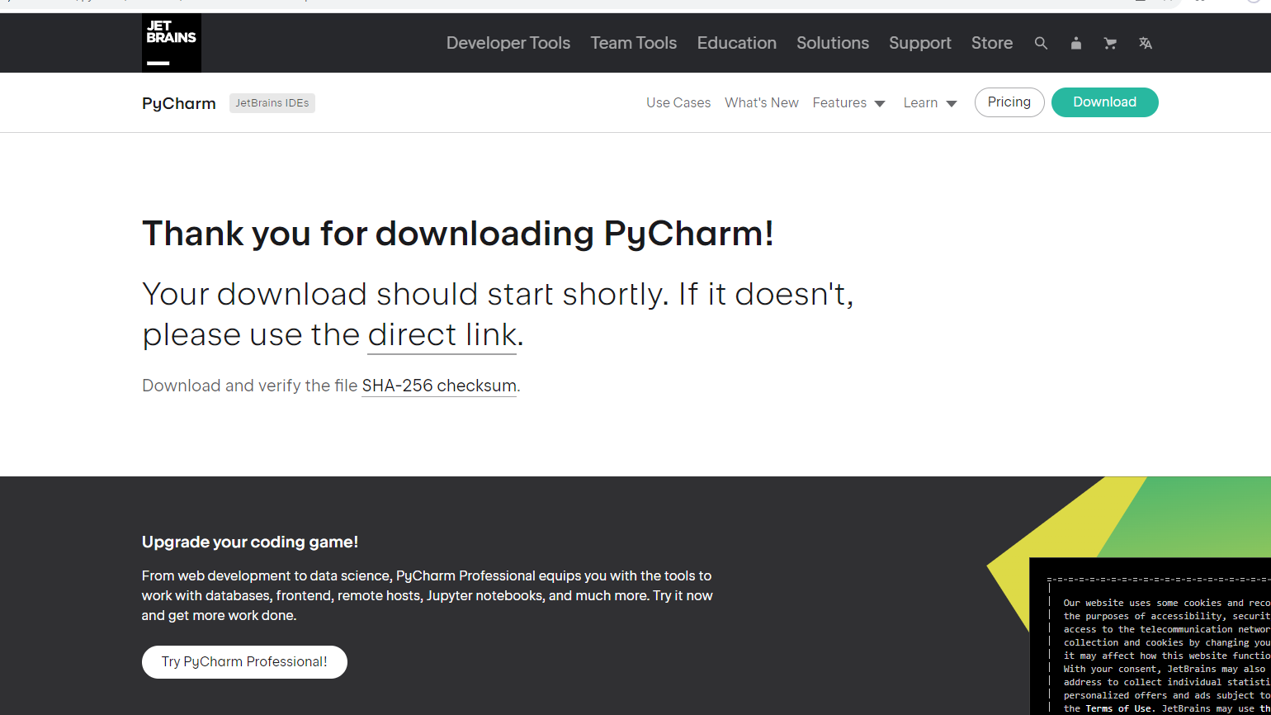
PyCharm installation

Slide 13
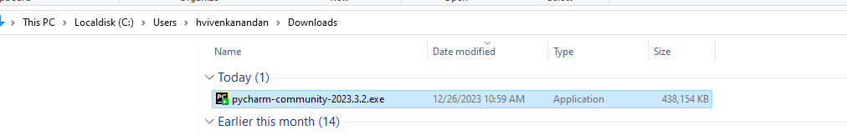
PyCharm installation

Slide 14
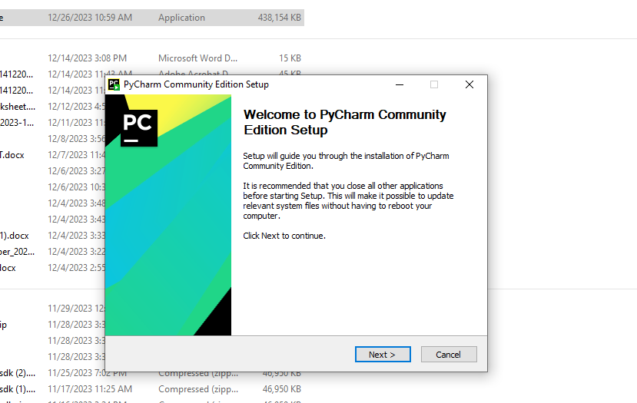
PyCharm installation

Slide 15
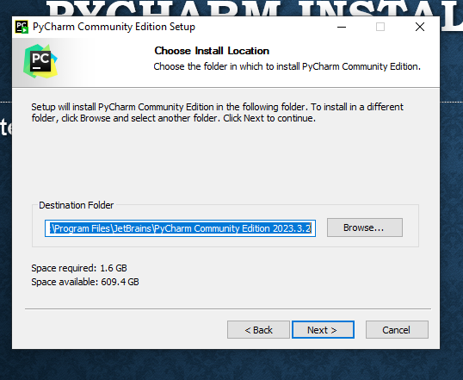
PyCharm installation

Slide 16
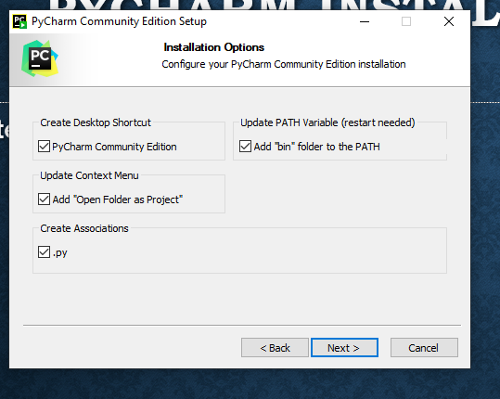
PyCharm installation

Slide 17
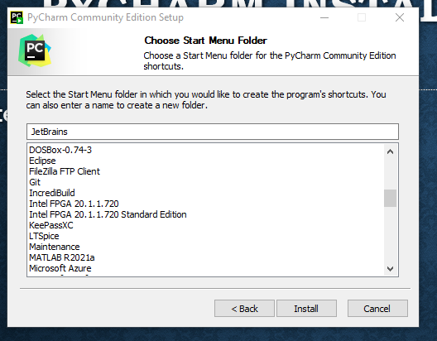
PyCharm installation

Slide 18
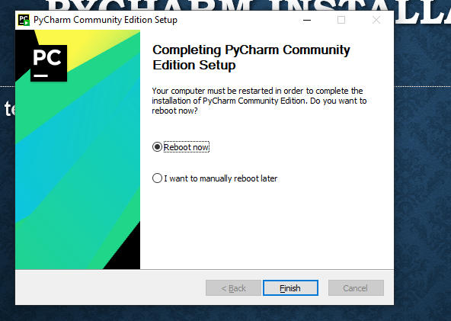
PyCharm installation

Slide 19
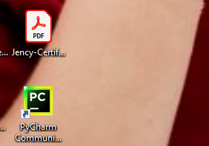
PyCharm installation

Slide 20
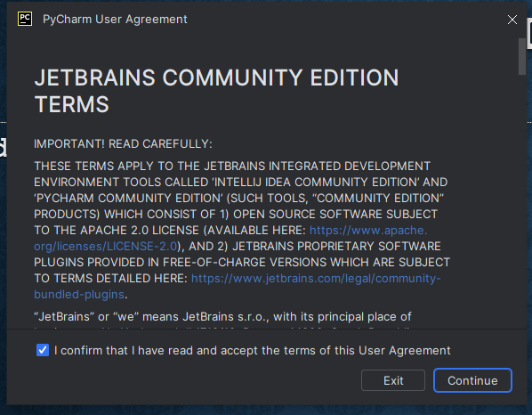
PyCharm installation

Slide 21
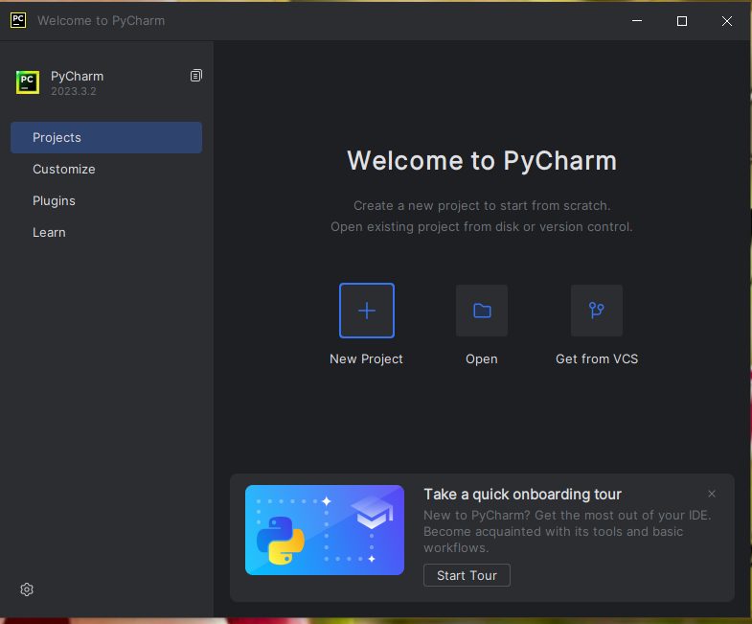
PyCharm installation

Slide 22
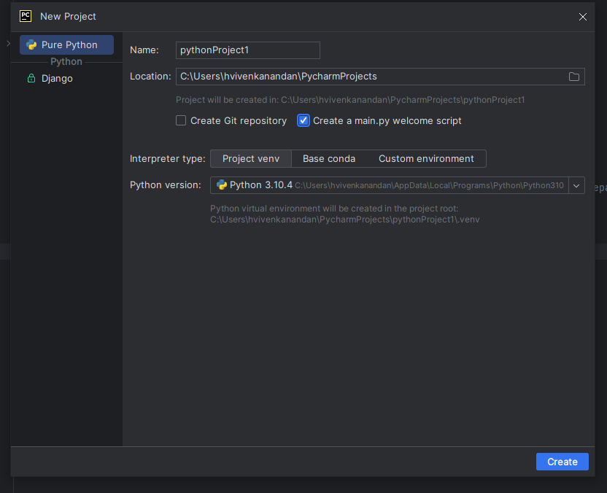
PyCharm installation

Slide 23
PyCharm installation

Slide 24
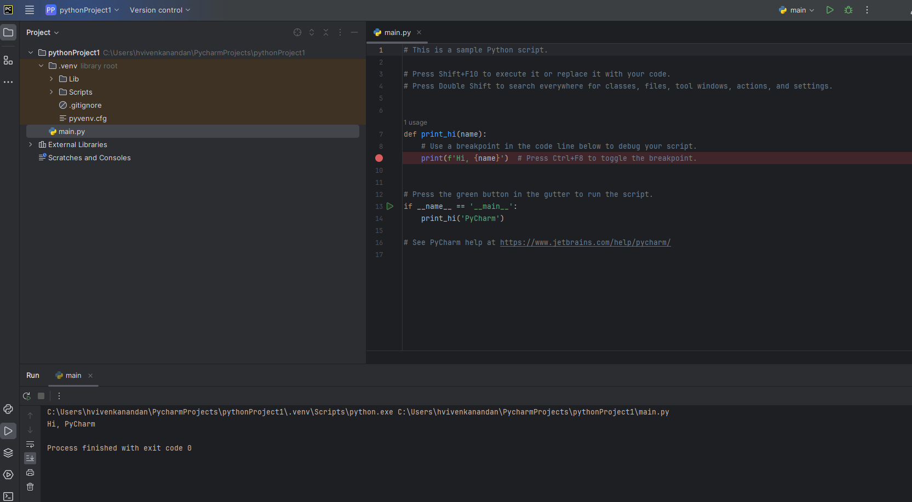
PyCharm installation

Slide 25
Programming using python
Python interpreter :
The Python interpreter is a computer program that executes code written in the Python programming language.
An interactive interpreter is a program that allows the user to execute one line of code at a time.
Code is a common word for the textual representation of a program (and hence programming is also called coding).
A line is a row of text.

Slide 26
Programming using python
The interactive interpreter displays a prompt (">>>") that indicates the interpreter is ready to accept code.
The user types a line of Python code and presses the enter key to execute the code. Initially, you may think of the interactive interpreter as a powerful calculator.
The example program below calculates a salary based on a given hourly wage, the number of hours worked per week, and the number of weeks per year.

Slide 27
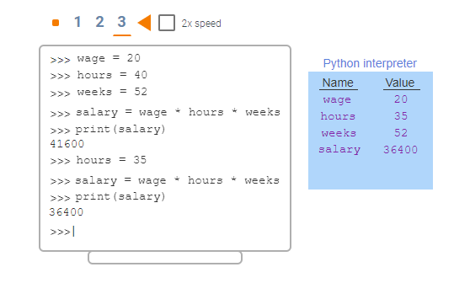
Python interpreter

Slide 28
Executing a Python program
The Python interactive interpreter is useful for simple operations or programs consisting of only a few lines.
However, entering code line-by-line into the interpreter quickly becomes unwieldy for any program spanning more than a few lines.
Instead, a programmer can write Python code in a file then provide that file to the interpreter.
The interpreter begins by executing the first line of code at the top of the file and continues until the interpreter reaches the end.

Slide 29
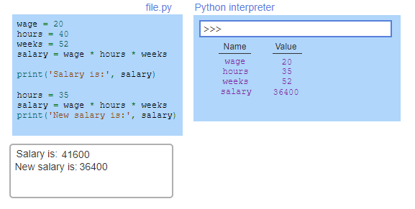
Executing a Python program

Slide 30
Executing a Python program
A statement is a program instruction.
A program mostly consists of a series of statements, and each statement usually appears on its own line.
Expressions are code that return a value when evaluated;
- for example, the code wage * hours * weeks is an expression that computes a number.
- The symbol * is used for multiplication.
-The names wage, hours, weeks, and salary are variables, which are named references to values stored by the interpreter.

Slide 31
Executing a Python program
A new variable is created by performing an assignment using the = symbol, such as salary = wage * hours * weeks, which creates a new variable called salary.
The print() function displays variables or expression values.
Characters such as "#" denote comments, which are optional but can be used to explain portions of code to a human reader.

Slide 32

Questions
What is the purpose of variables?
a. To store values for later use
b. To instruct the processor to execute an action
c. To automatically color text in the editor
The code 20 * 30 is an expression ?
a. True
b. False

Slide 33
Questions
3. How are most Python programs developed??
a. By writing code in the interactive interpreter
b. By writing code in files
4. Comments are required in programs?
a. True
b. False

Slide 34
Sample code
wage = 20
hours = 40
weeks = 52
salary = wage * hours * weeks
print('Salary is:', salary)
hours = 35
salary = wage * hours * weeks
print('New salary is:', salary)

