Slide 1
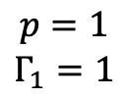










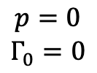
Target cells
$$0$$
$$1$$
$$2$$
$$3$$
$$4$$
$$5$$
$$α=0$$
$$α=1$$
$$n_{cells,0}=2$$
$$n_{cells,1}=3$$
$$p=0$$
$$Γ_{0}=0$$
$$p=1$$
$$Γ_{1}=1$$

