Slide 2
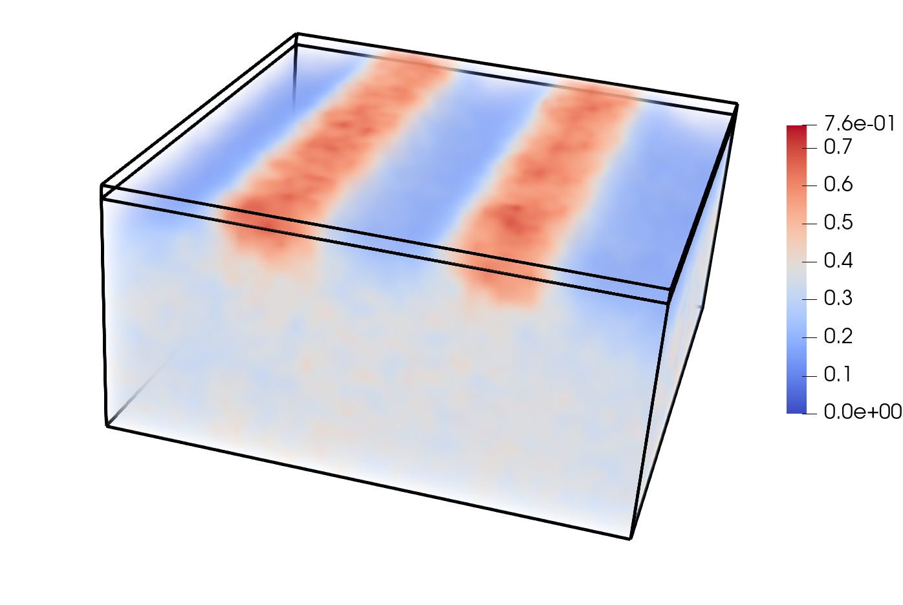


$$\tilde{φ}$$
$$A$$

