Slide 1

CVM MONTHLY DATA BUNDLES
ACQUISITION PROPENSITY MODEL
Benard Mbuthia
Justus Muchiri

Slide 2
Problem Statement
Mobile Data Tribe is focused on driving growth through various Customer Value Management (CVM) initiatives, key among them personalized value offers to customers.
Within the year the team has come up with personalized monthly bundles, with a medium term target to achieve 200K monthly subscriptions.
Sharp targeting of customers is essential in order to enhance :
Maximum utilization of resources e.g. messaging bandwidth
Enhance relevance and efficiency in offers communication
Grow conversion
The objective of this solution is to identify potential customers to focus-on in the acquisition drive, through a propensity model.

Slide 3

Current vs Proposed Solution
Customer are currently targeted based on monthly data ARPU.
This is susceptible to omitting hidden patterns that influence a customer’s likelihood of conversion and introducing communication inefficiency due to broad based targeting.
The proposed solution is to develop a model which considers all the available and relevant attributes, to predict the likelihood of a customer subscribing to their availed personalized monthly bundle.

Slide 4

Success Criteria
Ability to predict likelihood of a customer opting into monthly bundles with at least 70% accuracy rate.

Slide 5
Execution Plan
Requirements
Data
Model
Business Problem Definition
Model
Development
Data Mining
Solution Design
Model Performance
Analysis
Data Exploration
Datapoints
Identification
Feedback
&
Model Improvement

Slide 6
Data Mining
Features
Customer Category
Temporal Features
Acquisition Month
Customer Demographic
Age
Gender
Region
Data usage & charge metrics
Voice usage & charge metrics
Preferred data products
Preferred voice products
CVM Monthly Personalized offers
CVM Monthly Bundles Acquired Customers (Launch to Date)
Randomized sample data active
non-CVM monthly bundles customers

Slide 7
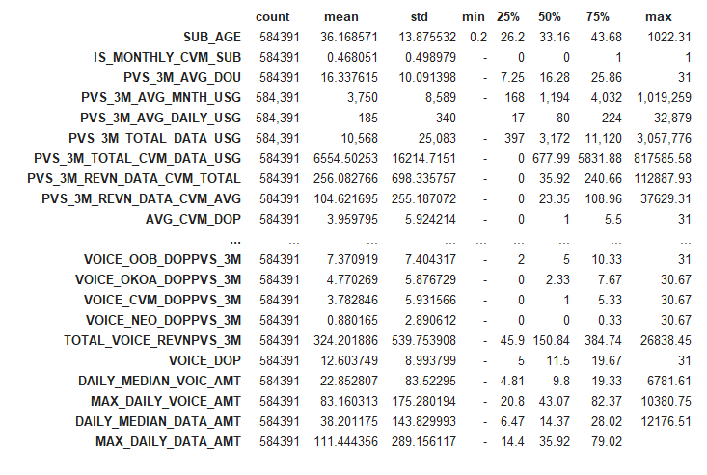
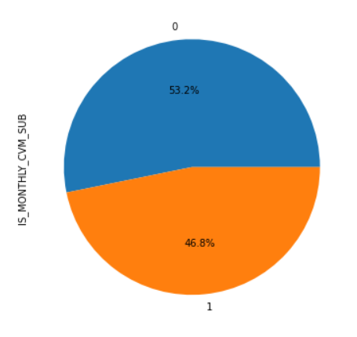

Data Preprocessing & Exploration
Exclusion of unnecessary data as informed by relevance / domain knowledge e.g. record id, acquisition month, second monthly offer
Exclusion of duplicate records
Exclusion of records with null values in key data fields e.g. age, sales region
Statistical Summary

Slide 8
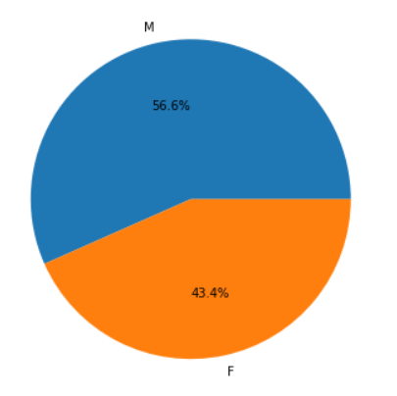
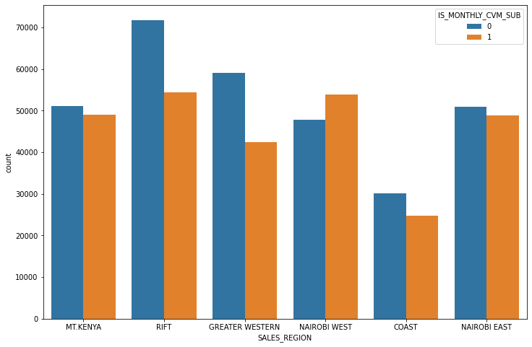
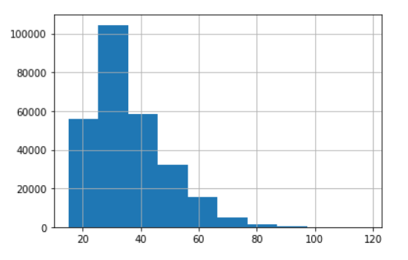
Dataset Gender Distribution
Distribution by Region
Age Histogram

Slide 9
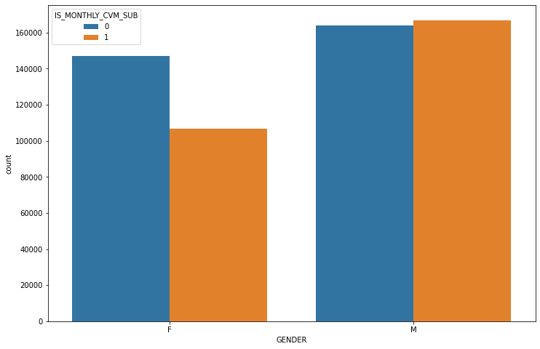
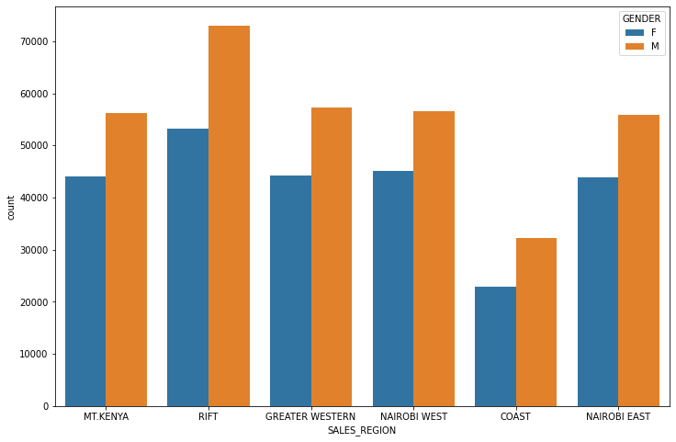
Subscription Status by Gender
Regional Gender Distribution
There is notable higher proportion of male on subscribed status than female
All regions have a higher proportion of male than female in the gender distribution. This should be correlated with overall gender distribution in the entire customer base.

Slide 10
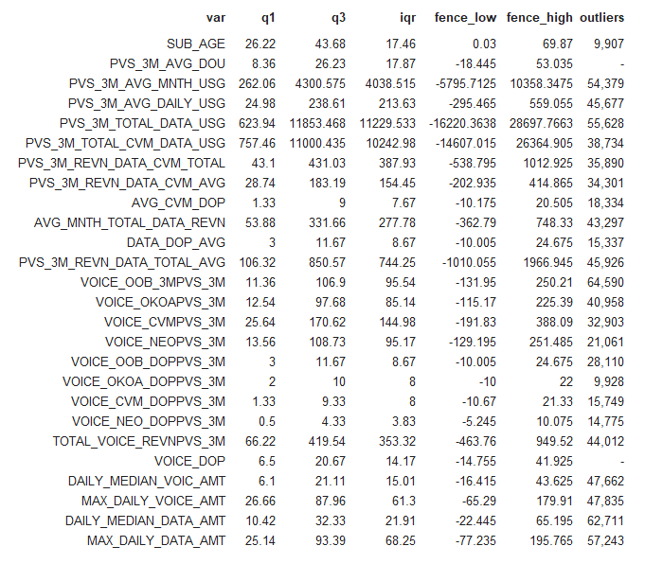
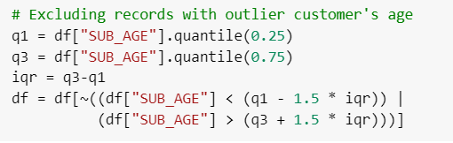
Handling Outliers
Outliers as determined using Interquartile range
Using the interquartile range, the outliers for each variable was examined.
Since the accuracy of each of the features is guaranteed from the data source, it is recommended to retain the outlier records as they are all valuable to the model.
This is in exception of customers age, whose accuracy is dependent on accuracy of KYC.

Slide 11
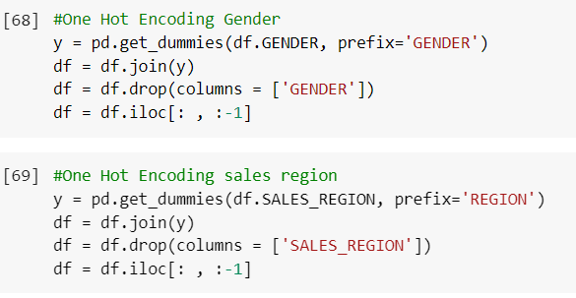
Feature Engineering
- The following features were one-hot encoded for the model’s purposes.
Gender
Region
Availed personalized offer
One-hot encoding was preferred over label encoding as the encoded value between different values in the features have no weighted relationship.
The final column of each encoded variable was also dropped to avoid collinearity in the encoded features.

Slide 12
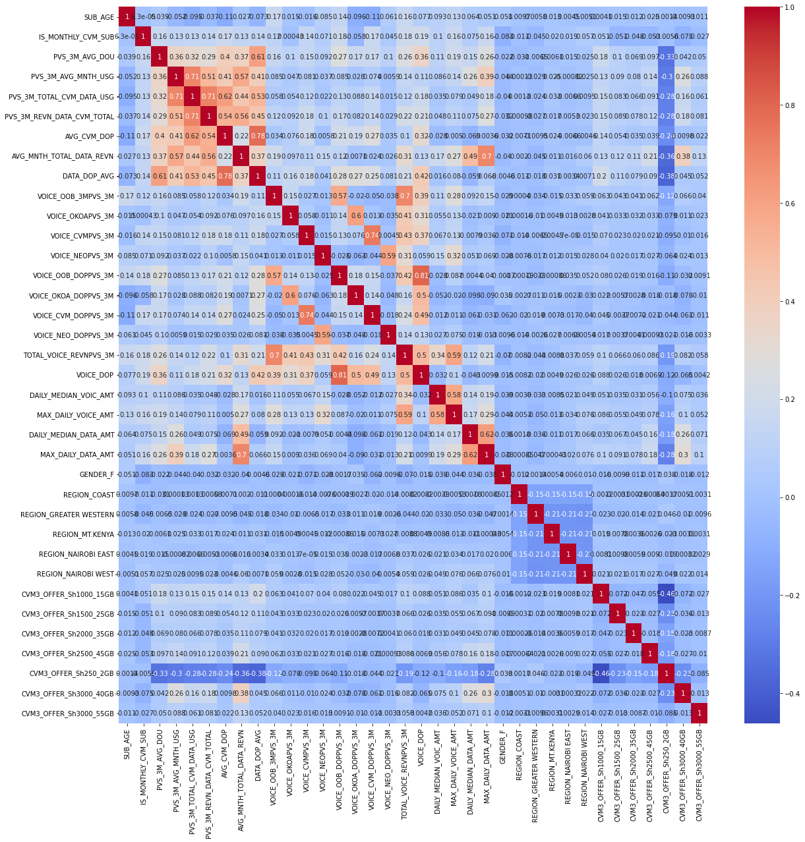
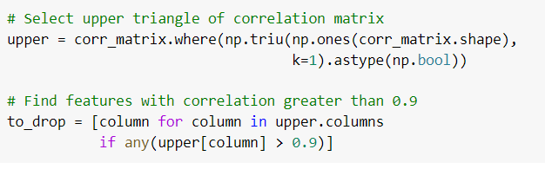
Handling Multi-Collinearity
A correlation test done on the variables showed high collinearity between some features.
Features with >0.9 collinearity were dropped.
PVS_3M_AVG_DAILY_USG PVS_3M_TOTAL_DATA_USG PVS_3M_REVN_DATA_CVM_AVG PVS_3M_REVN_DATA_TOTAL_AVG

Slide 13
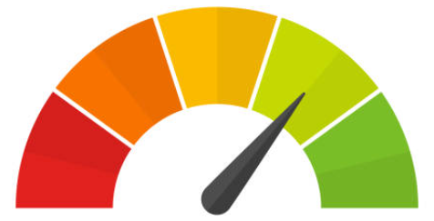
Model Training & Performance
Training Data Pre-Processing
Adopted Approach
Train-test splitting
Feature scaling
Each model was trained using Stratified cross validation with five iterations of the training data
SVM & KNN were noted to take extremely long period excluded from training.
Considered Models During Training
LogisticRegression
DecisionTreeClassifier
GaussianNB
BaggingClassifier
RandomForestClassifier
AdaBoostClassifier
GradientBoostingClassifier
XGBClassifier
MLPClassifier
Models Performance
Model | Accuracy
Decision Tree Classifier | 63.9%
Gaussian Naïve Bayes | 64.6%
Bagging Classifier | 70.2%
AdaBoost Classifier | 70.7%
Logistic Regression | 71.1%
XGB Classifier | 71.9%
Gradient Boosting Classifier | 71.9%
Random Forest Classifier | 72.9%
MLP Classifier | 75.1%

Slide 14
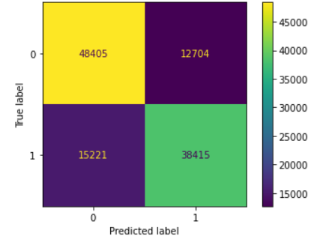
Conclusion
Performed Model Improvement
MLP Classifier produced the highest accuracy at 75%
Dimensionality Reduction using Principal Component Analysis (PCA) done. Features were reduced from 35 to 30 with fairly the same accuracy.
MLP Classifier Confusion Matrix
Further Model Improvement to be Considered
Hyperparameter Tuning using Grid Search to achieve optimum accuracy on the trained models.

Slide 15



