Slide 1

Work-it-Out
Likhitha Veganti, Kewal Deepak Tadas, Justus Ngunjiri, Alex Churchill
Gym Management System
Notes:
Alex
Introduce the team, project

Slide 2


Fitness Industry at a Glance
115,000 fitness business in the United States
86.6% of the fitness market is dominated by small gyms
Revenue expected to be 31.8 billion in 2023
Source: https://my.ibisworld.com/us/en/industry/71394/products-and-markets#supply-chain
Notes:
Alex
Fitness industry in the US is huge and growing
The majority of this market is made up by boutique gyms (often with under 1,00 sq ft)
Barriers to entry are low, we can expect this market to keep growing
A lot of small players will keep entering

Slide 3


Boutique Gym Ownership IT Needs
Owner Needs | Custom-Built Database Application | Generic Database Applications
Low Cost
Easy-to-Use
Meets Business Needs
Notes:
Alex
Gyms need applications to manage their business
Customers
Trainers
finances
Existing solutions fall short
Custom built solutions are expensive
Generic solutions may not have everything a gym needs (customer portal, but no integrated financial system)

Slide 4




Enter Work-it-Out
One stop-shop for a boutique gym owner’s IT needs
Simple to use
Affordable
Meets Every Business Need
Members
Owner
Financial Information
Trainers
Notes:
Justus
Our product meets all the needs of a boutique gym owner,members, trainers
Simple and cheap
Fully functional
Connects customers with trainers
Trainers with customers
Owners with everything they need to manage their business (including finances)

Slide 5
Frontend Design
Application Views
Admin View Trainer View Member View
Access to admin profile, gym equipment inventory, financial reports, member and trainer lists
Add or remove gym equipment inventory
Create and modify financial reports
add or remove members and trainers
modify member and trainer profile information
Access to trainer profile, workout plans, member list, schedule
Create and modify workout and diet plans offerings
View member attendance
View Salary
View upcoming schedule
Access to member profile, workout plans, attendance record, payment history
Schedule sessions with trainers and sign up for workout programs
Update profile and payment details
View upcoming schedule
Notes:
Justus

Slide 6
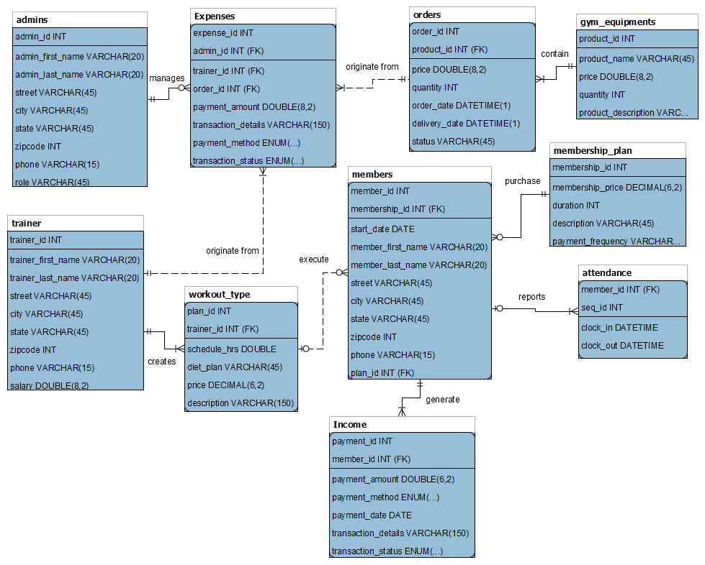
Backend Design
.
Notes:
Justus
Simple: Key tables Expenses, Members, train
Has any information that an owner may be interested in

Slide 7
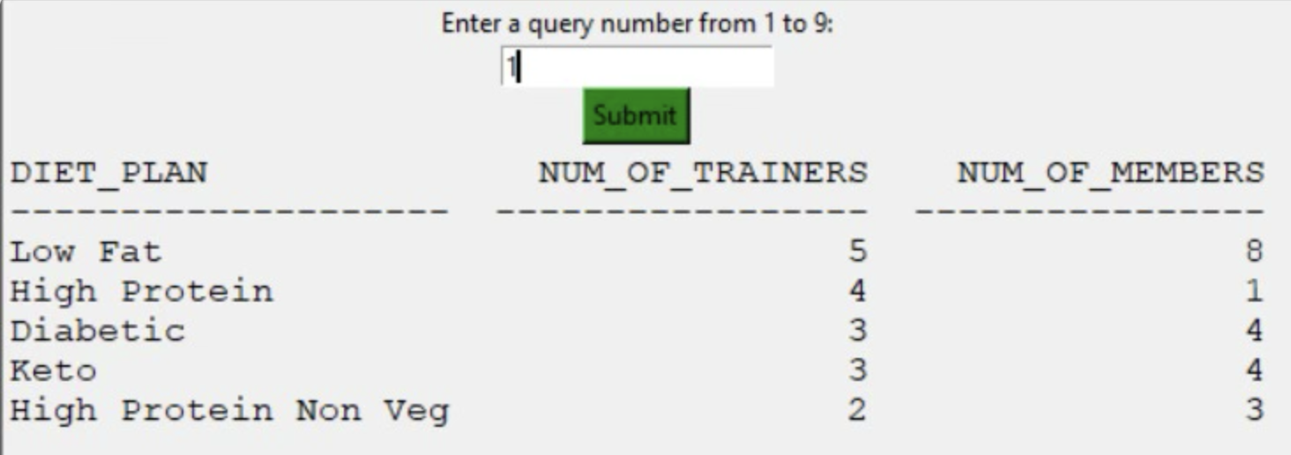
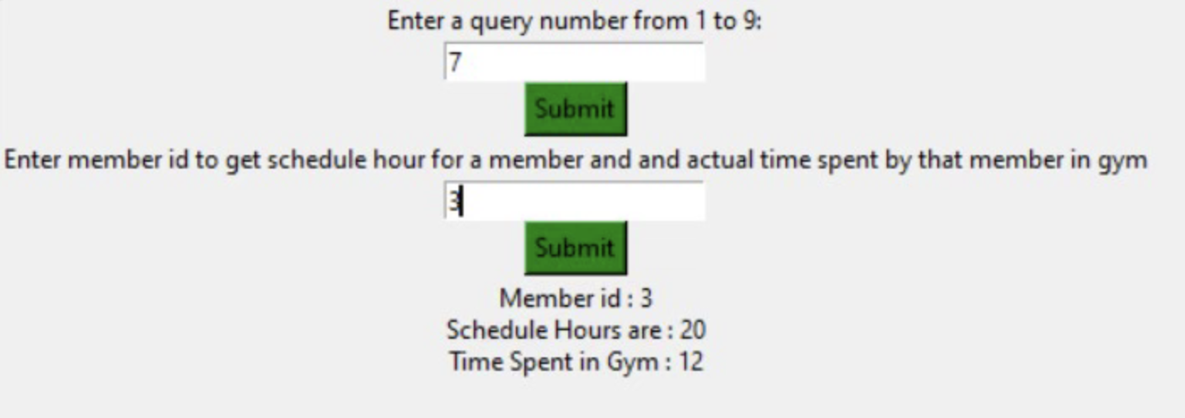
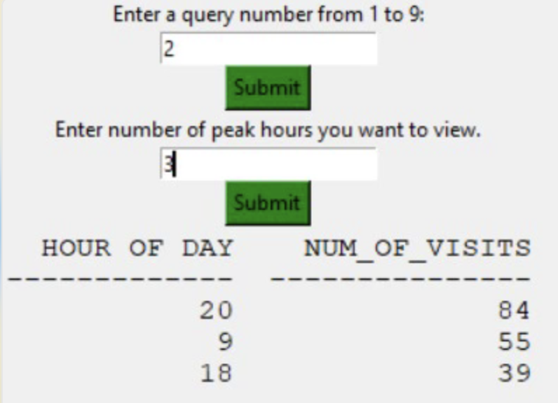
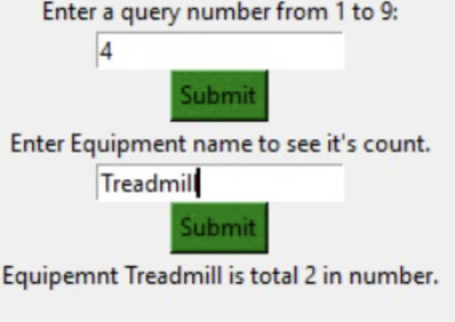
GUI Demonstration
Scheduled vs Attended Hours
Trainers offering diet plans and the number of members following each one
Peak Attendance Hours
Equipment totals for inventory management
Notes:
Kewal and Likhitha

Slide 8
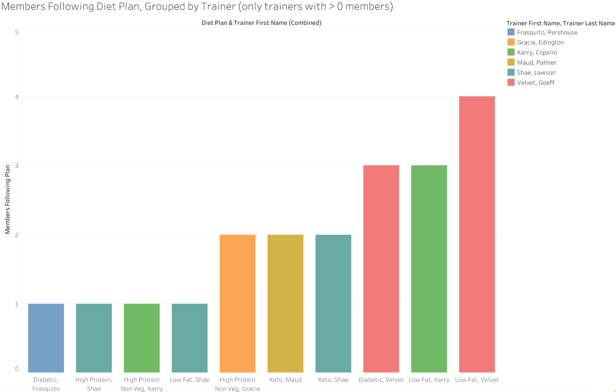
Further Development: Popular Plans and Trainers
Notes:
Kewal
Gym owners Can make future marketing decisions based on this kind of analysis
We can see a low fat diet plan suggested by velvet n karry is like the most popular out there also we can see high protein plan from shae is not so popular among members so we make some relevant change in that.

Slide 9
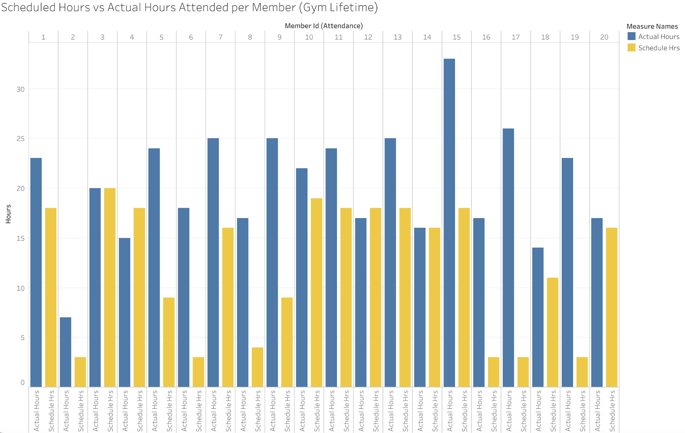
Further Development: Performance Metrics
Notes:
Kewal
Trainers can look at this and decide if a member s spending more time in the gym than he’s schedules hours they can analyze this and make them buy different membership plan or assign more schedule hours in the future.
This are types of the visualization that’s gonna be available in our app once it’s available

Slide 10
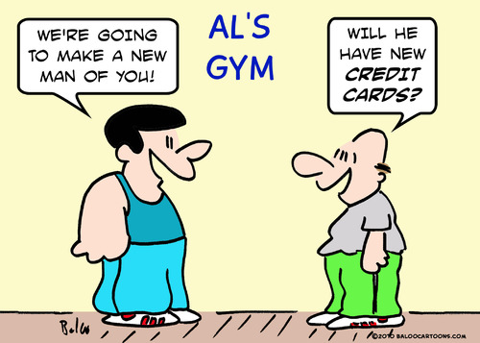
Investors? Possibly You!
Work-It-Out | Owner Needs
Low Cost
Easy-to-Use
Meets Business Needs
Business KPIS
Large, underserved Market
Exceptional Product-Market Fit
Application already under development
Simple app = low startup costs
Notes:
Checks all the requirements alex talked earlier n more
Huge huge market for application like this
It fits the market needs exceptionally
Application is already under development
Business owners don’t really have to spend much to get all this services n our app.

Slide 11
Questions?

