Slide 1

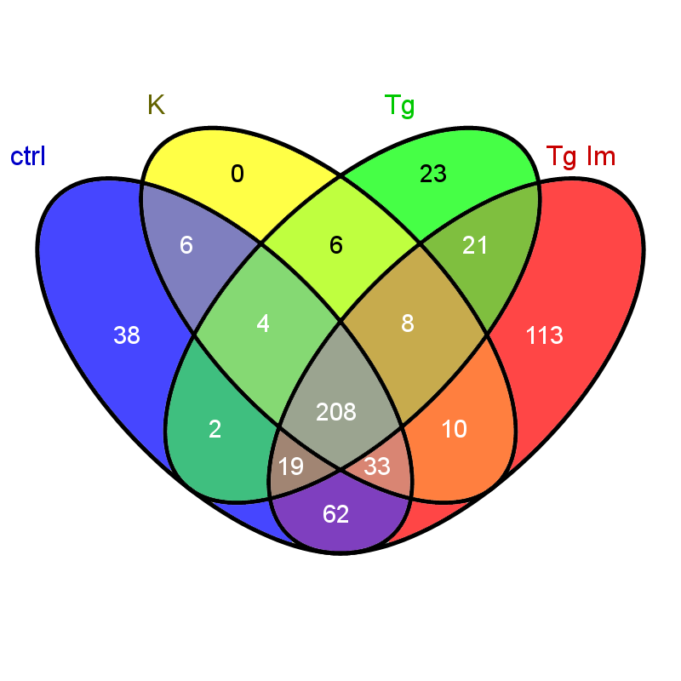
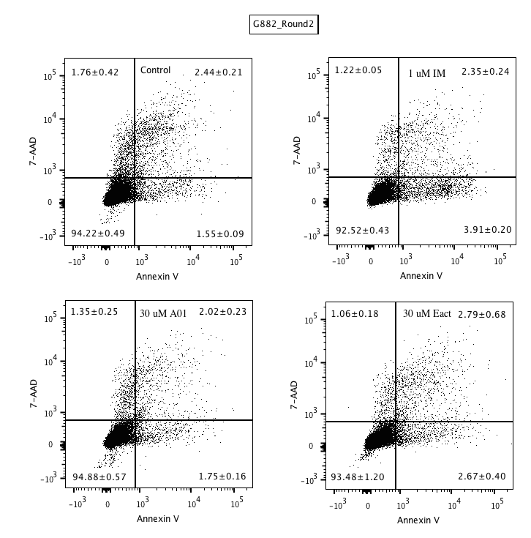

Deadwood prediction using Autogluon
Justus Noegel, Andrea Ingrosso
This is an example of a poster. Please use the template, but feel free to adjust areas, image and image size, etc. Your poster will be presented electronically on 50” screens.
The conclusion first (headlines: 44 pt bold)
The purpose of a poster is to reach out with your message! Capture the reader's interest by starting with the most important thing! (You only have seconds).
Present what has been done, by whom and the results and conclusions. Keep it short. Too much text causes the message to be lost. Try to make sure the poster gives an airy impression. (Body text: 34 pt regular)
Introduction
Many posters are hard to read. Important results are often hidden in too many words. Do not try to bring in everything! Be logical - it's easier to follow the message.
The goal of the poster
Reach your audience! Grow interest, curiosity and attention. The poster should act as an ad and not as a report.
Use images
Illustrative images allow you to remove unnecessary text. Photos capture the interest! If you do not have pictures, it's definitely worth taking a little extra effort to get it.
Layout, Photography and Printing
Do not underestimate the layout! If you're inexperienced, get help from a professional media agency.
Use charts to illustrate results. If you’re wondering, the image above is a four-dimensional Venn diagram.
Tip:
If a poster is to be read vertically and at a distance, the letters should be centimeter high and use a sans-serif font. Left aligned text is most easily read. Max 45 keystrokes per line and 4-6 lines per parapgraph.
Finish with a hint of what's going on in your future research. Please do add a photo of yourself.
Photo
Always write explanatory captions. 28pt regular (the image above shows flow cytometry).
Hospital/University (24 pt bold)
Name Surname
Title • Department
Visitor address • Postal address
E-mail: name@domain.com
Phone: xxx-xxx xx xx, Fax: xxx-xxx xx xx
Web: www.domain.com

