Slide 1
Memory Key Characteristics

Slide 2

Introduction to Memory
Charles Babbage started Difference engine in1821 but failed its test in 1833, Why?
Due to unavailability of Memory
What is Memory?
A single separate storage structure that holds information in the form of bits called as Memory
The binary information may be instructions and data
Stored program concept was introduced with the advent of vacuum tubes by John Von Neumann 1940

Slide 3
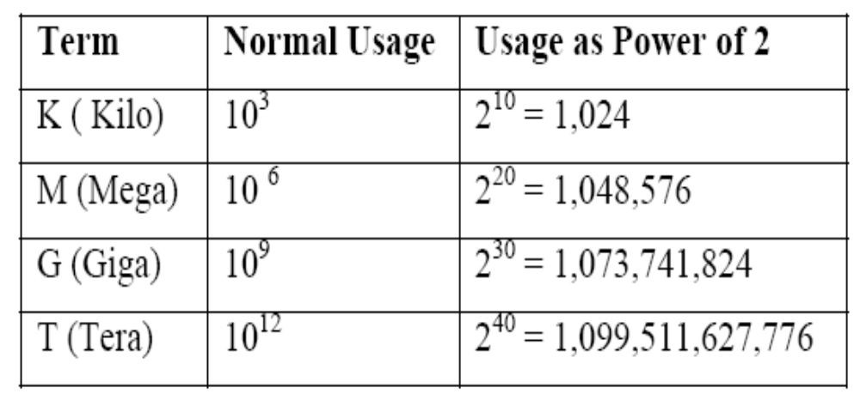
Memory Capacity
Number of bytes that can be stored

Slide 4

Key Characteristics
Location
  CPU
  Internal (main)
  External (secondary)
Capacity
  Word size
  Number of words
Unit of transfer
  Word
  Block
Access methods
  Sequential access
  Direct access
  Random access
  Associative access
Performance
  Access time
  Cycle time
  Transfer rate

Slide 5
Key Characteristics contd.,
Physical Type
  Semiconductor
  Magnetic surface
  Optical
Physical Characteristics
  Volatile / Non-Volatile
  Erasable / Non-erasable
Organization

Slide 6
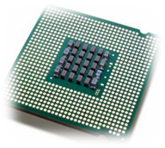
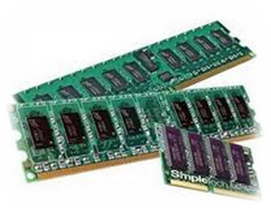
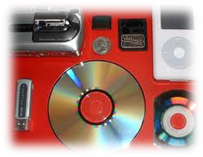
Location
Three locations of memories
  CPU
    Registers – used by CPU as its local memory
  Internal memory
    Main memory
    Cache memory
  External memory
    Peripheral devices – disk, tape – accessible to CPU via I/O controllers

Slide 7
Capacity
Internal memory capacity is expressed in terms of bytes or words.
External memory capacity is expressed in terms of blocks (depends on words in memory)
Total memory = number of words × word length
Number of words = 2^{address bus width}
Word length = Data bus width

Slide 8
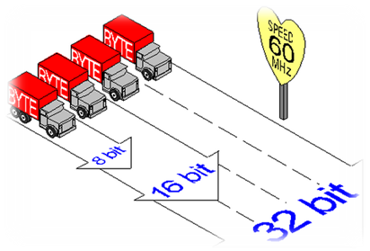
Unit of transfer
Internal memory – number of data lines into and out of the main memory module
External memory – blocks – longer units than a word

Slide 9
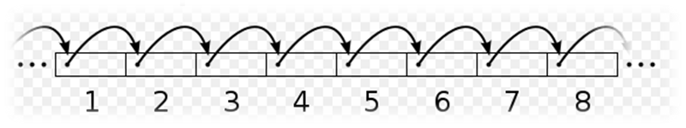
Access Methods
Four types
  Sequential Access
    Accesses the memory in predetermined sequence
    Shared read/write head is used, and this must be moved its current location to the desired location, passing and rejecting each intermediate record.
    So, the time to access an arbitrary record is highly variable
    Slower than random access memory
    Ex: Magnetic Tapes, data in memory array
Motion
Read – write head

Slide 10
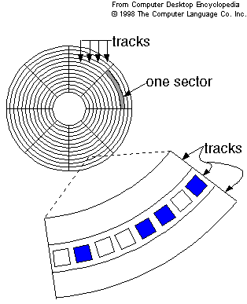
Access Methods contd.,
Direct access
  Also referred as semi random access memory
  Access time is variable
  The track is accessed randomly but access within each track is serial
  Access is accomplished by general access to reach a general vicinity plus sequential searching, counting, waiting to reach the final location.
  Ex: Magnetic Disk

Slide 11
Access methods contd.,
Random Access
  Each addressable location in memory has unique, physically wired – in addressing mechanism
  Time to access a location is independent of the sequences of prior access and is constant
  Main memory systems are a random access
  Storage locations can be accessed in any order
  Semi conductor memories
Read write head selector
Read write heads
Storage locations

Slide 12
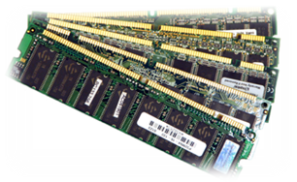
Access Methods contd.,
Associate Access
  Word is retrieved based on portion of its contents rather than its address
  This enables one to make a comparison of desired bit locations within a word for specific match
  Has own addressing mechanism
  Retrieval time is constant
  Access time is independent of location or prior access patterns
  Cache memories

Slide 13
Performance
Access time
  The time required to read / write the data from / into desired record
  Depends on the amount of data to be read / write
  If the amount data is uniform for all records then the access time is same for all records.
  Time from the instant that an address is presented to the memory to the instant that data have been stored or made available for use.
Memory Cycle time
  Access time + time required before a second access can commence
  For Random access method ,this memory cycle time is same for all records
  The sequential access and direct access ,the memory cycle time is different

Slide 14
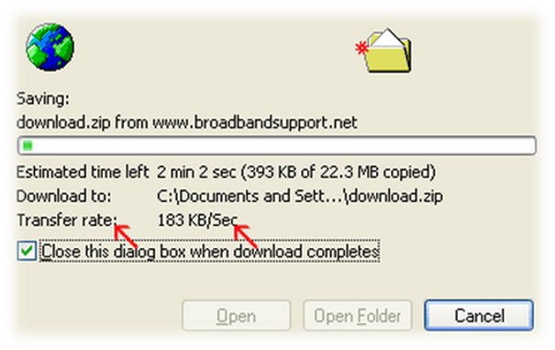
Performance contd.,
Transfer rate / Throughput
  Rate at which the data can be transferred into or out of a memory unit
  Random access memory
    1/cycle time
  Non-Random access memory
    T_{n} = T_{a} + (N/R), where
      T_{n} – average time to read
      or write N bits
      T_{a} – average access time
      N – Number of bits
      R – Transfer rate,
      in bits per second (BPS)

Slide 15
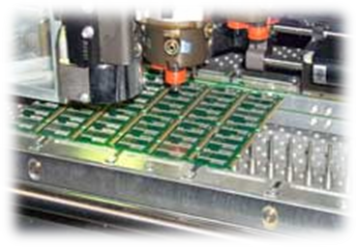
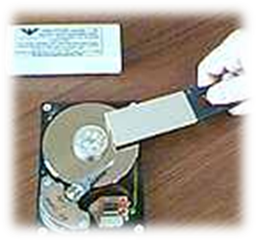
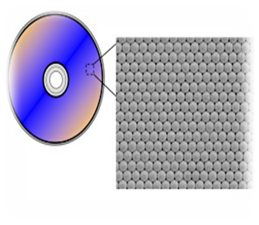
Physical type
Semiconductor
Semiconductor memory uses semiconductor-based integrated circuits to store information.
Magnetic surface
Magnetic storage uses different patterns of magnetization on a magnetically coated surface to store information.
Example:
Magnetic disk, Floppy disk, Hard disk drive
Optical
The typical optical disc, stores information in deformities on the surface of a circular disc
and reads this information by illuminating the surface with a laser diode and observing the reflection.
Notes:
magnetic storage was also used for primary storage in a form of magnetic drum, or core memory, core rope memory, thin-film memory, twistor memory or bubble memory.

Slide 16
Physical characteristics
Volatile memory
  Information decays naturally or lost when electrical power is switched off
Non-volatile memory
  Once recorded is retained until deliberately changed
  No electrical power is needed to retain information
  Magnetic surface memories
Semiconductor memories may be either volatile or non-volatile
  A type of non-volatile semiconductor memory known as flash memory
  A type of volatile semiconductor memory is random access memory
Non-erasable memory
  Cannot be altered, except by destroying the storage unit (ROM)
  A practical non-erasable memory must also be non-volatile
  Ex: CD-R, Flash Memories
Erasable memory
  Erase the stored information by writing new information
  Ex: Magnetic storage is erasable

Slide 17
Organization
Physical arrangement of bits to form words
2 types
  1 dimensional
  2 dimensional

Slide 18
Memory Organization
Basic element = memory cell
Properties of Memory cell:
- They exhibit two stable states, which can be used to represent binary 1 and 0.
- They are capable of being written into (atleast once) to set the state.
- They are capable of being read to sense the state.

Slide 19
1 – dimensional organization
Internal
Control
signals
W bits
● ● ●
a₀
Timing
And
control
a₁
●
●
●
●
Storage cell
unit
Address
decoder
Control lines
a₂^{m}₋ ₁
Address
drivers
Read / write drivers
(sense amplifiers)
Address buffer
m
Data buffer
Address bus
W
Data bus

Slide 20
2 – dimensional organization
Storage Cell Array
Row
Address
decoder
●
●
●
●
●
●
●
●
X
Y
Address
buffer
m_{X}
m_{Y}
Column
Address
decoder
m
Address bus

Slide 21
Byte Storage Methods
Big-Endian
  Assigns MSB to least address and LSB to highest address
  Ex: 0 × DEADBEEF
Memory Location | Value
Base Address + 0 | DE
Base Address + 1 | AD
Base Address + 2 | BE
Base Address + 3 | EF

Slide 22
Byte Storage Methods contd.,
Little Endian
  Assigns MSB to highest address and LSB to least address
  Ex: 0 × DEADBEEF
Memory Location | Value
Base Address + 0 | EF
Base Address + 1 | BE
Base Address + 2 | AD
Base Address + 3 | DE

Slide 23
Byte Storage Methods contd.,
Little Endian
  Intel × 86 family
  Digital equipment corporation architectures (PDP – 11, VAX, Alpha)
Big Endian
  Sun SPARC
  IBM 360 / 370
  Motorola 68000
  Motorola 88000
Bi-Endian
  Power PC
  MIPS
  Intel’s 64 IA - 64

Slide 24
Example
Example: Show the contents of memory at word address 24 if that word holds the number given by 122E 5F01H in both the big-endian and the little-endian schemes?

Slide 25
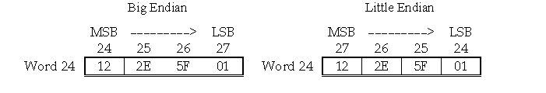

Slide 26
References
William Stallings “Computer Organization and architecture” Prentice Hall, 7th edition, 2006

