Slide 1
Focra
Ming Sheng 2110022T

Slide 2
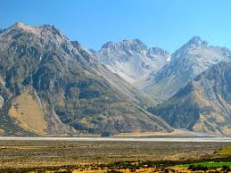


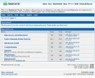

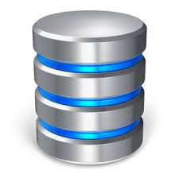

Overall Architecture
HTML Pre-processing
Generating Tempalate
Unprocessed Forum Data
Django Server
Focra DB
Crawler DB
Focras (Focra Spider)

Slide 3
Front – End
Step 1
Step 2
Step 3
Fetch URL
Creating Template
Crawler Name Pagination
1. Get Response
1. Key in Fields Columns
1. Crawler Name
2. Process Response
(Remove unwanted link, effects, blocking scripts etc.)
2. Select Field Data (Aided by Algorithms)
(Previewing of Data)
2. Pagination
(Finding the ‘Next’)

Slide 4
Back-End
Focras (Focra Spider)
Crawler DB
Load Crawler
Template
And Settings
Statistics
Focra DB

Slide 5
Chain Crawlers
c
c
Level 1
Chain
Topics (e.g general, money, relationship
c
c
c
c
c
c
c
Level 2
Chain
Threads (my money not enf!! etc.)
…
n level
Chain

