Slide 1
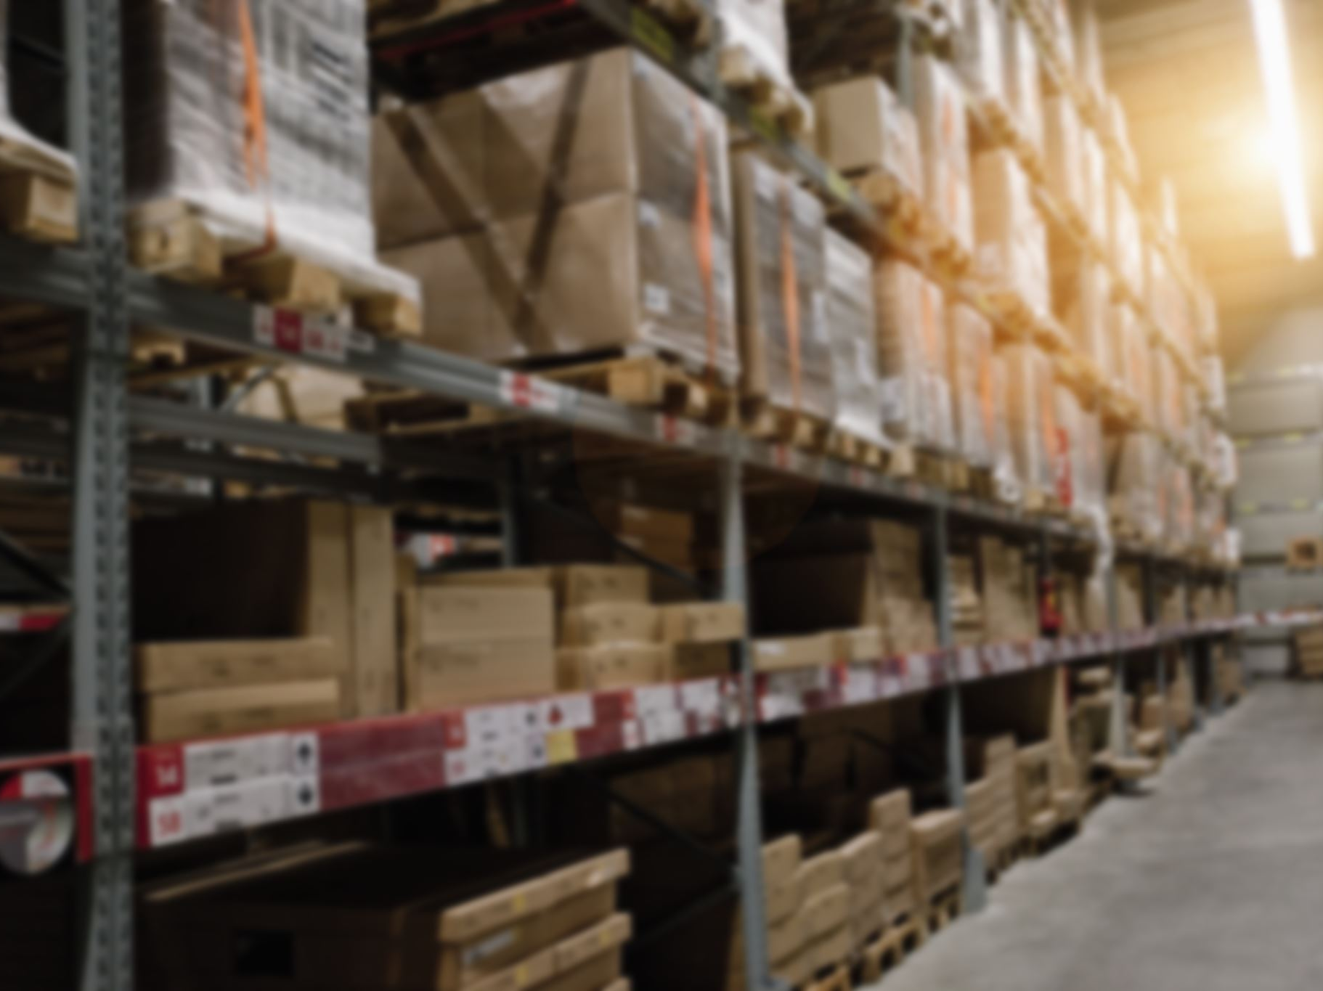
Inventory Management System
Team Members:
Aditya Varma(CB.EN.U4CCE23004)
Suraj Rajeev M(CB.EN.U4CCE23057)
Tarun Sri Vathsan(CB.EN.U4CCE23058)

Slide 2

Table of Contents
Motivation
Objective
Schema
ER Diagram
Progress
UI Design

Slide 3
Motivation
Efficient Inventory Management:
Businesses need streamlined solutions to improve productivity and reduce costs.
Traditional methods often cause errors and inefficiencies.
Digital Solution:
Rising demand for an online platform to order products easily from devices.
Project Goal:
Bridge the gap between businesses and customers with an automated inventory management system.
Benefits:
Saves time by eliminating in-person shopping.
Ensures accuracy, reduces overhead, and enhances efficiency for both businesses and customers.
Key Features:
Real-time tracking, automated stock management, and secure transactions.

Slide 4
Key Objectives
Objective: Develop an automated, user-friendly system to optimize inventory management, reduce manual effort, and improve decision-making.
Key Objectives:
Efficient Stock Management:
Real-time tracking and automated alerts to optimize stock levels and prevent wastage.
Automation & Error Reduction:
Automates data entry, stock updates, and order processing to reduce errors and save time.
User-Friendly Interface:
Intuitive design for easy navigation in stock monitoring, order processing, and supplier management.
Secure Transactions & Payment Integration:
Secure payment gateway for safe transactions and data protection.
Comprehensive Database Management:
Organized storage for product details, sales, and order history for efficient data retrieval.
Data-Driven Decision Making:
Reports and analytics to help businesses forecast demand, manage stock, and support growth.
By achieving these objectives, the system enhances efficiency, accuracy, security, and scalability in inventory operations.

Slide 5
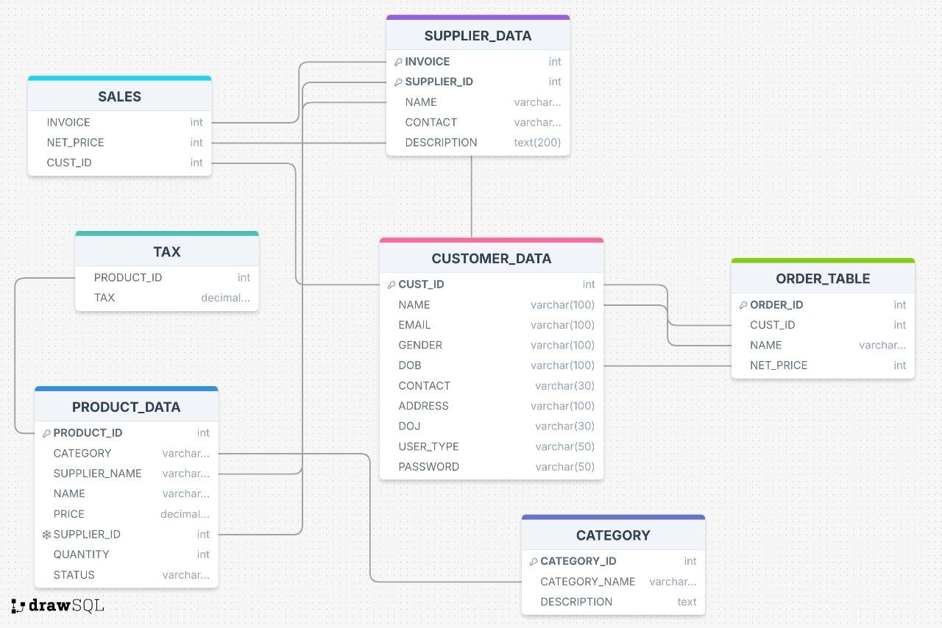
Schema and Database Design

Slide 6
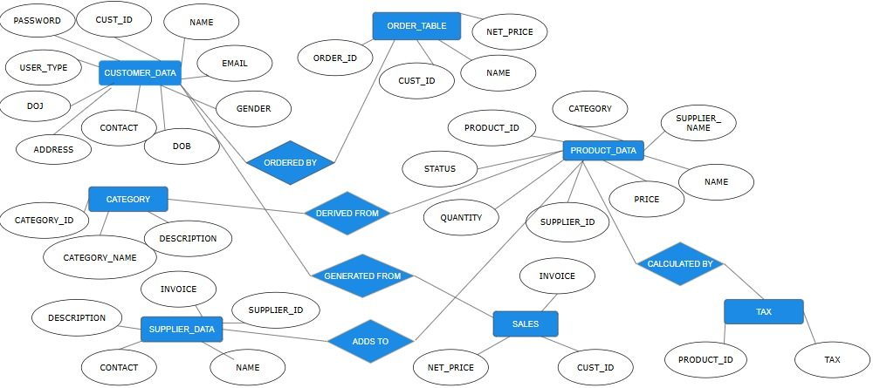
ER Diagram

Slide 7
Key Entities and Relationship
Customer Data:
Stores details (name, contact, login).
Linked to orders via ORDERED BY.
Product Data:
Contains product details (name, category, price, quantity).
Linked to categories via DERIVED FROM and sales via ADDS TO.
Tax applied via CALCULATED BY.
Category:
Organizes products with ID, name, and description.
Linked to products via DERIVED FROM.
Supplier Data:
Stores supplier info (ID, name, contact).
Linked to sales via GENERATED FROM.
Order Table:
Tracks orders (ID, customer ID, net price).
Linked to customers via ORDERED BY.
Sales:
Records transactions, linked to products via ADDS TO and suppliers via GENERATED FROM.
Tax:
Manages tax details applied to products.
Linked to products via CALCULATED BY.

Slide 8
Progress Achieved
Database Development:
Successfully created the database and structured tables based on the schema.
Sample data populated for testing and development.
Frontend Design:
Developed homepage and user registration page.
Focus on intuitive, user-friendly interface for seamless navigation.
Ongoing Work:
Developing Supplier Management Module to add, update, and manage supplier details.
Ongoing testing and development to enhance functionality and streamline inventory operations.

Slide 9
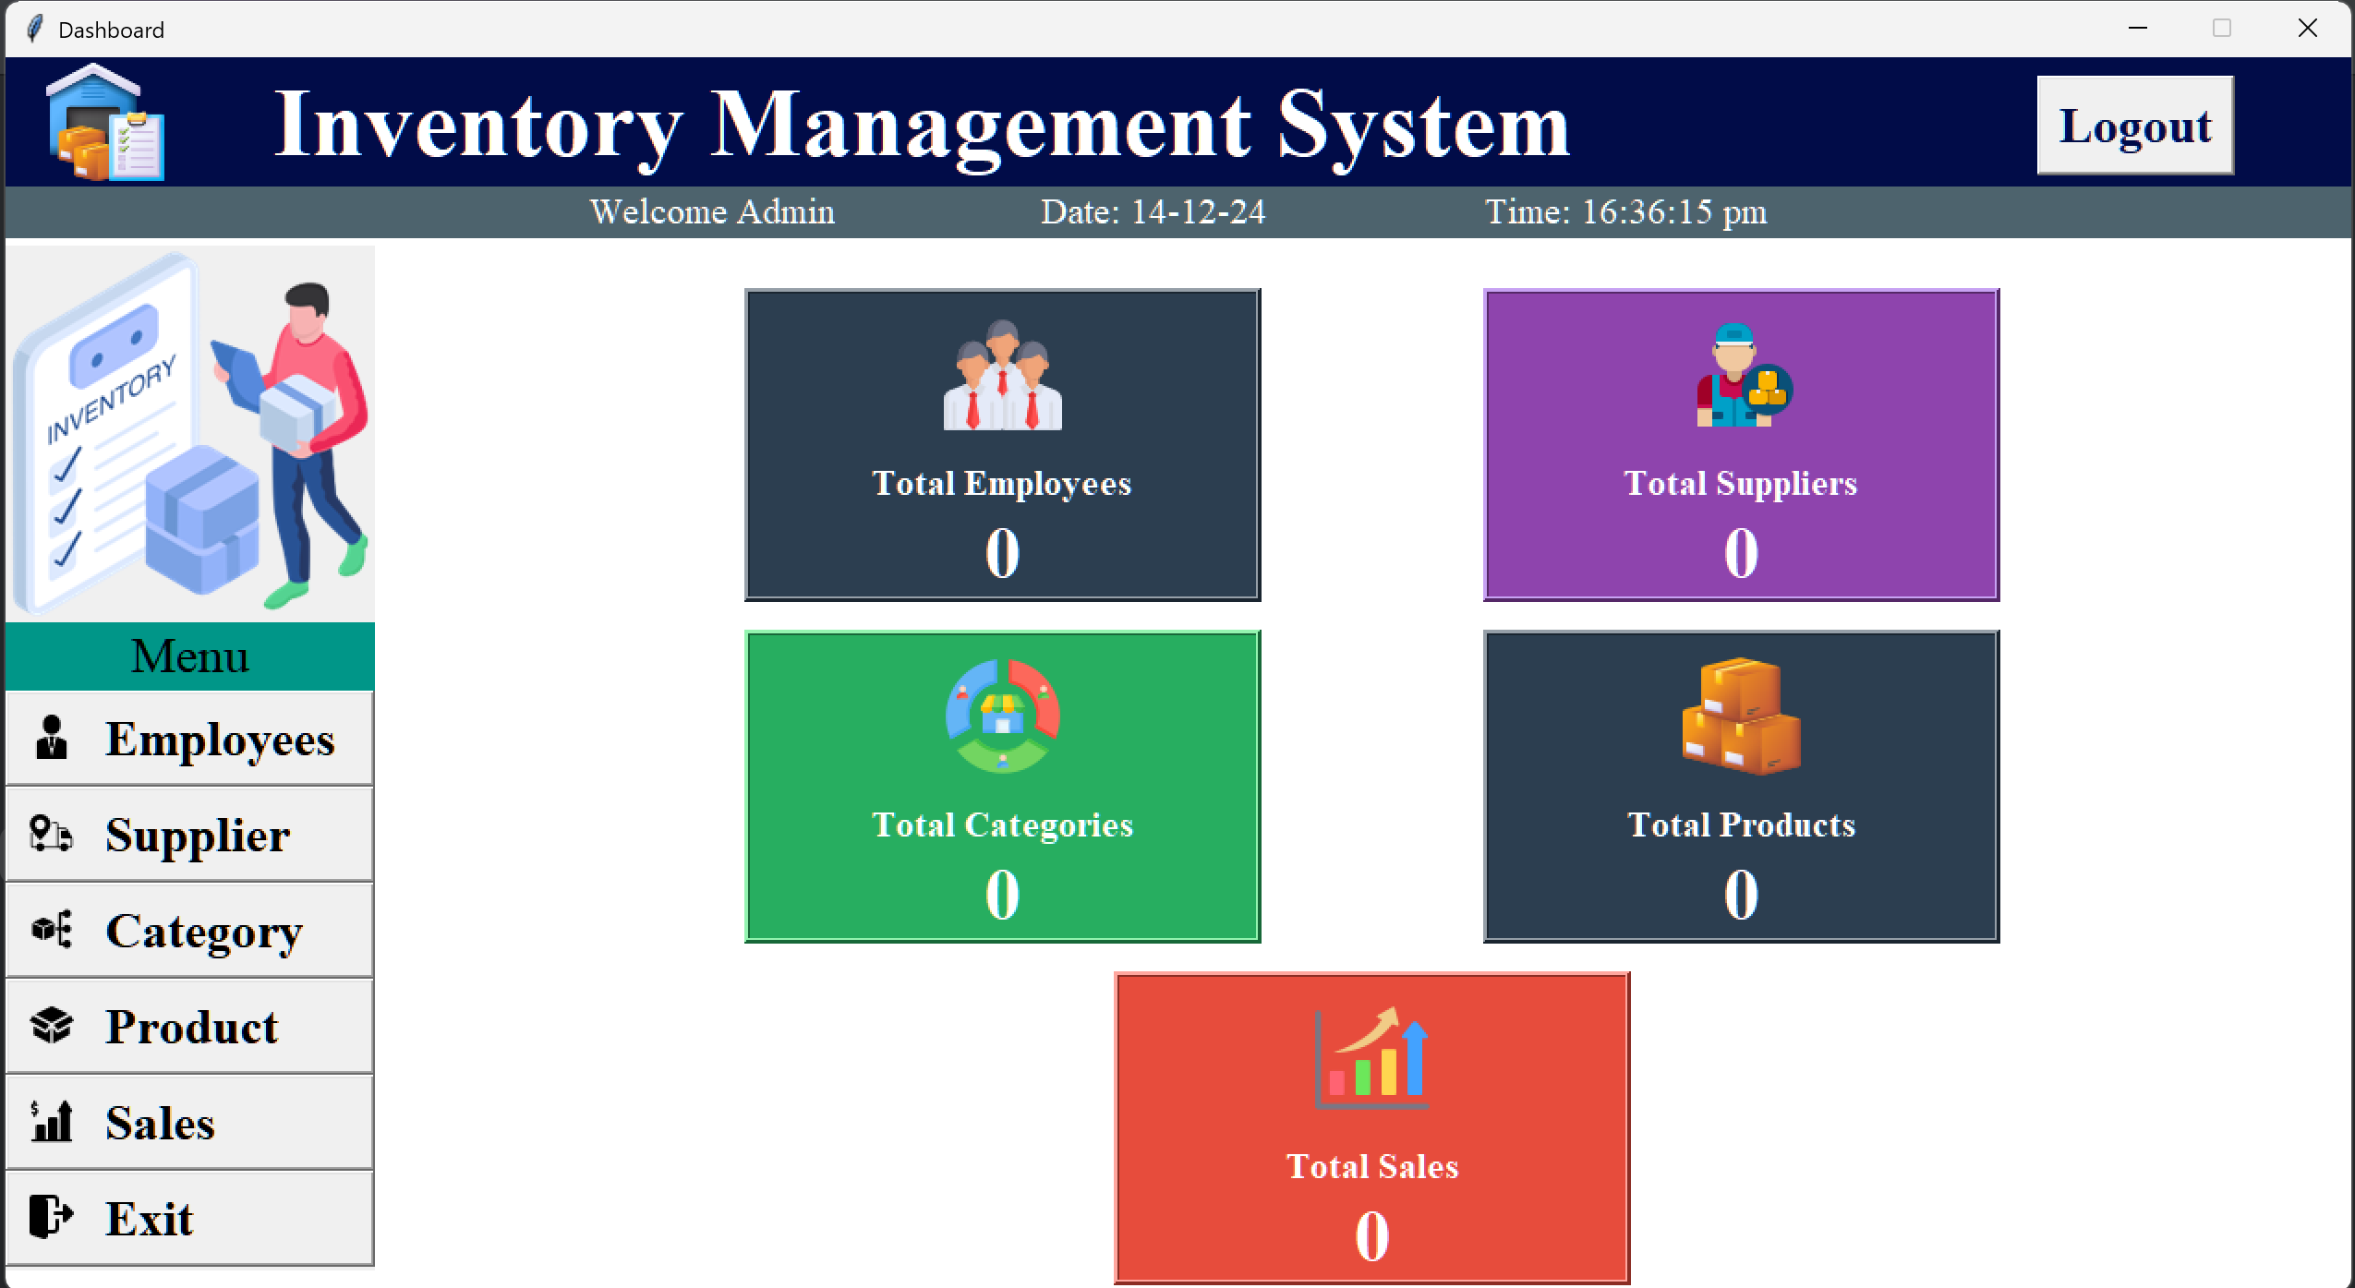
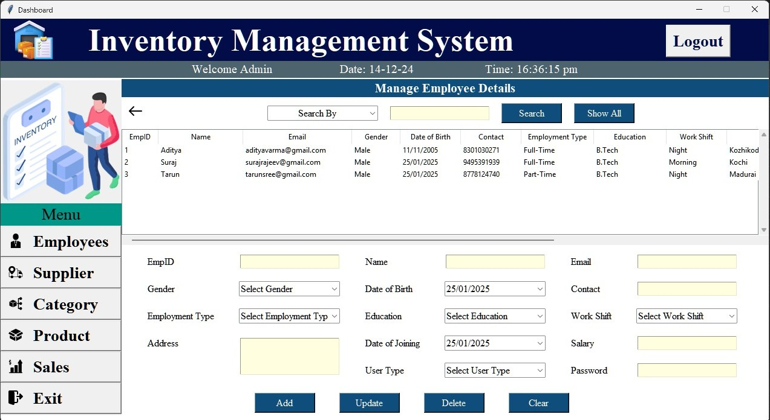
User Interface

Slide 10

Thank You

