Slide 1

Inventory Management System
Team Members:
Aditya Varma(CB.EN.U4CCE23004)
Suraj Rajeev M(CB.EN.U4CCE23057)
Tarun Sri Vathsan(CB.EN.U4CCE23058)

Slide 2

Table of Contents
Motivation
Objective
Schema
ER Diagram
UI Flowchart
UI Design

Slide 3
Motivation
Efficient Inventory Management:
Businesses need streamlined solutions to improve productivity and reduce costs.
Traditional methods often cause errors and inefficiencies.
Digital Solution:
Rising demand for an online platform to order products easily from devices.
Project Goal:
Bridge the gap between businesses and customers with an automated inventory management system.
Benefits:
Saves time by eliminating in-person shopping.
Ensures accuracy, reduces overhead, and enhances efficiency for both businesses and customers.
Key Features:
Real-time tracking, automated stock management, and secure transactions.

Slide 4
Key Objectives
Objective: Develop an automated, user-friendly system to optimize inventory management, reduce manual effort, and improve decision-making.
Key Objectives:
Efficient Stock Management:
Real-time tracking and automated alerts to optimize stock levels and prevent wastage.
Automation & Error Reduction:
Automates data entry, stock updates, and order processing to reduce errors and save time.
User-Friendly Interface:
Intuitive design for easy navigation in stock monitoring, order processing, and supplier management.
Secure Transactions & Payment Integration:
Secure payment gateway for safe transactions and data protection.
Comprehensive Database Management:
Organized storage for product details, sales, and order history for efficient data retrieval.
Data-Driven Decision Making:
Reports and analytics to help businesses forecast demand, manage stock, and support growth.
By achieving these objectives, the system enhances efficiency, accuracy, security, and scalability in inventory operations.

Slide 5
Database Structures and Features
The inventory_systems database efficiently manages products, suppliers, categories, employees, and tax details. It consists of five key tables: category_data, employee_data, product_data, supplier_data, and tax_table, ensuring structured data storage for seamless inventory tracking, supplier management, employee records, and tax calculations.
product_data (Stores product details)
Manages product information with an auto-incremented id as the primary key. Fields include category, supplier, name, price, discount, discounted_price, quantity, and status for efficient inventory tracking and pricing management.
supplier_data (Stores supplier details)
Manages supplier information with invoice as the primary key. Fields include name, contact, and description to track suppliers, manage procurement, and ensure smooth product supply.
category_data (Stores product categories)
Organizes products into categories for efficient inventory management. Fields include id (primary key), name, and description to streamline product filtering and stock organization.
employee_data (Stores employee details)
Manages employee records with id as the primary key. Fields include name, role, contact, and salary for tracking roles, communication, and payroll management.
tax_table (Stores tax details)
Maintains tax rates for products and transactions with id as the primary key. The tax field stores applicable tax percentages for accurate billing and compliance.
The inventory_systems database ensures seamless inventory, supplier, employee, and tax management. Its structured design enhances data consistency and operational efficiency for supply chain businesses.

Slide 6
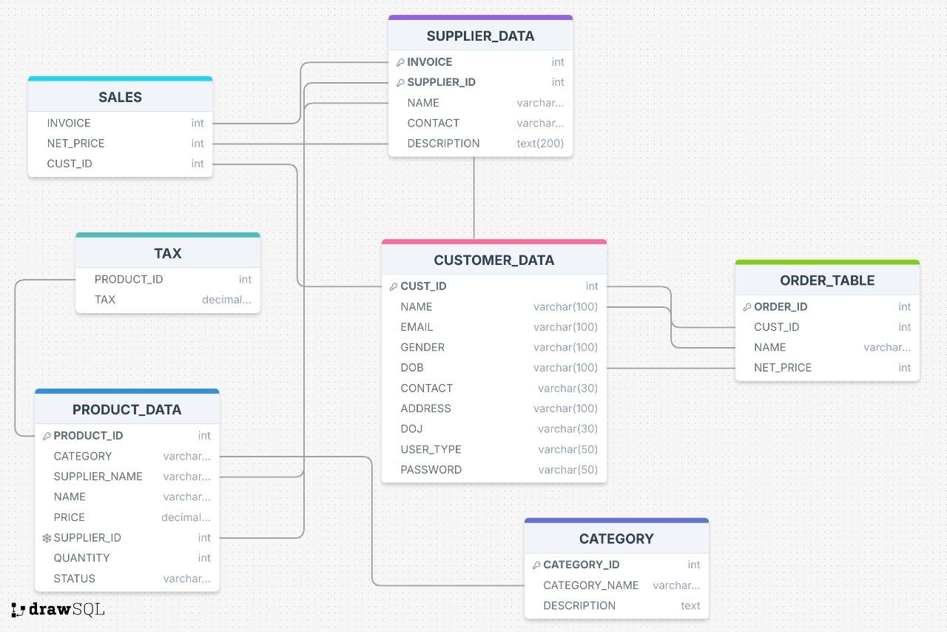
Schema and Database Design

Slide 7
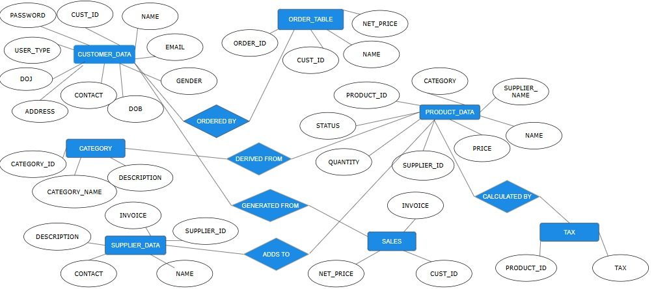
ER Diagram

Slide 8
Key Entities and Relationship
Customer Data:
Stores details (name, contact, login).
Linked to orders via ORDERED BY.
Product Data:
Contains product details (name, category, price, quantity).
Linked to categories via DERIVED FROM and sales via ADDS TO.
Tax applied via CALCULATED BY.
Category:
Organizes products with ID, name, and description.
Linked to products via DERIVED FROM.
Supplier Data:
Stores supplier info (ID, name, contact).
Linked to sales via GENERATED FROM.
Order Table:
Tracks orders (ID, customer ID, net price).
Linked to customers via ORDERED BY.
Sales:
Records transactions, linked to products via ADDS TO and suppliers via GENERATED FROM.
Tax:
Manages tax details applied to products.
Linked to products via CALCULATED BY.

Slide 9
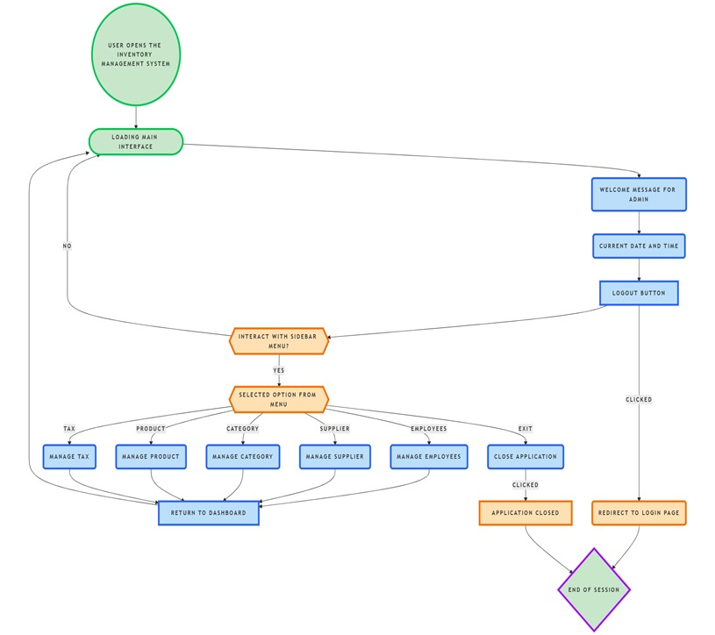
UI Flowchart

Slide 10
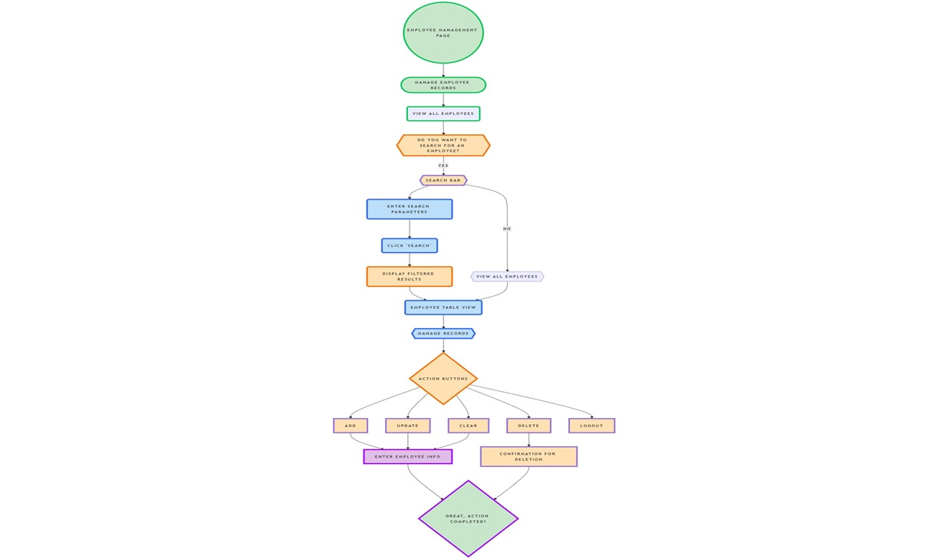
UI Flowchart

Slide 11
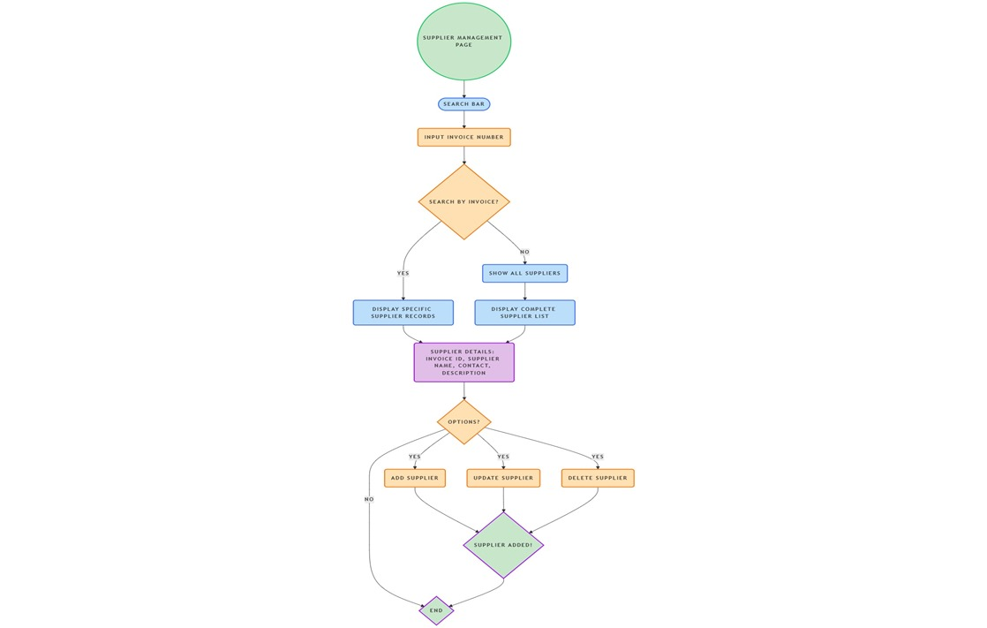
UI Flowchart

Slide 12
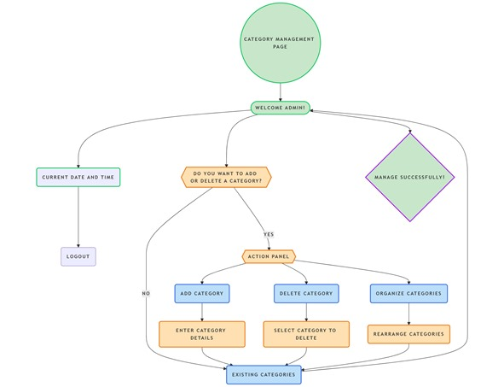
UI Flowchart

Slide 13
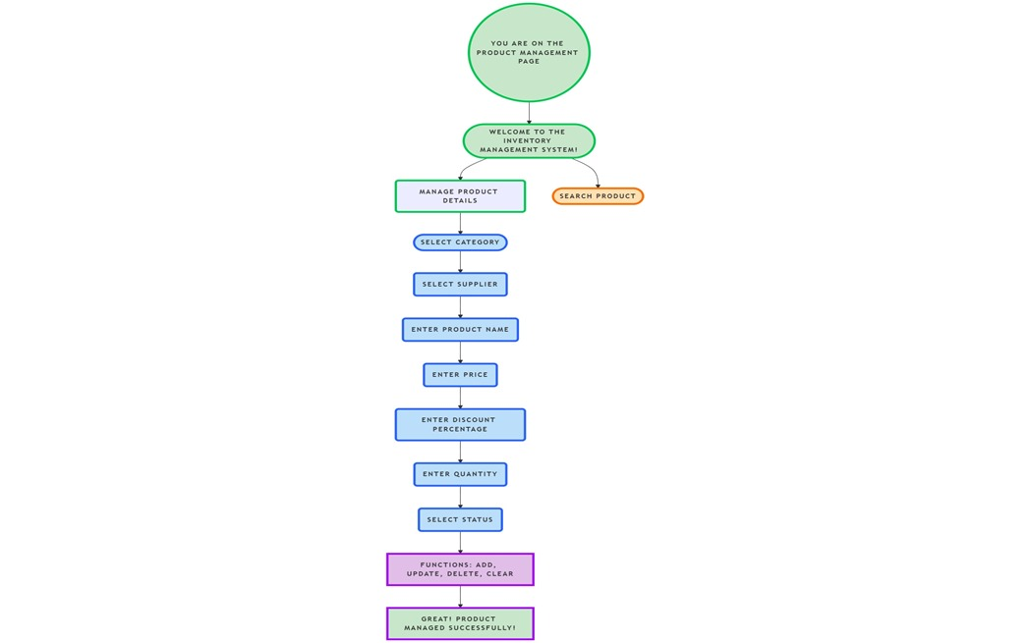
UI Flowchart

Slide 14
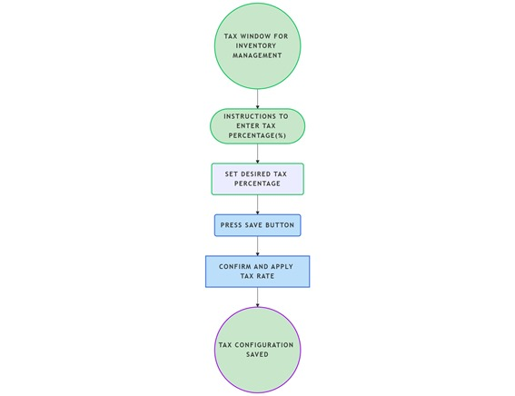
UI Flowchart

Slide 15
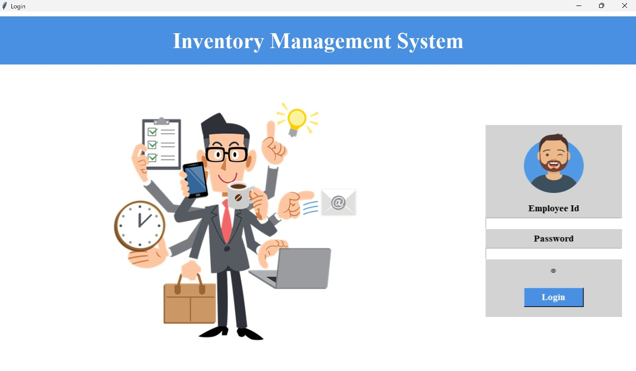
User Interface

Slide 16
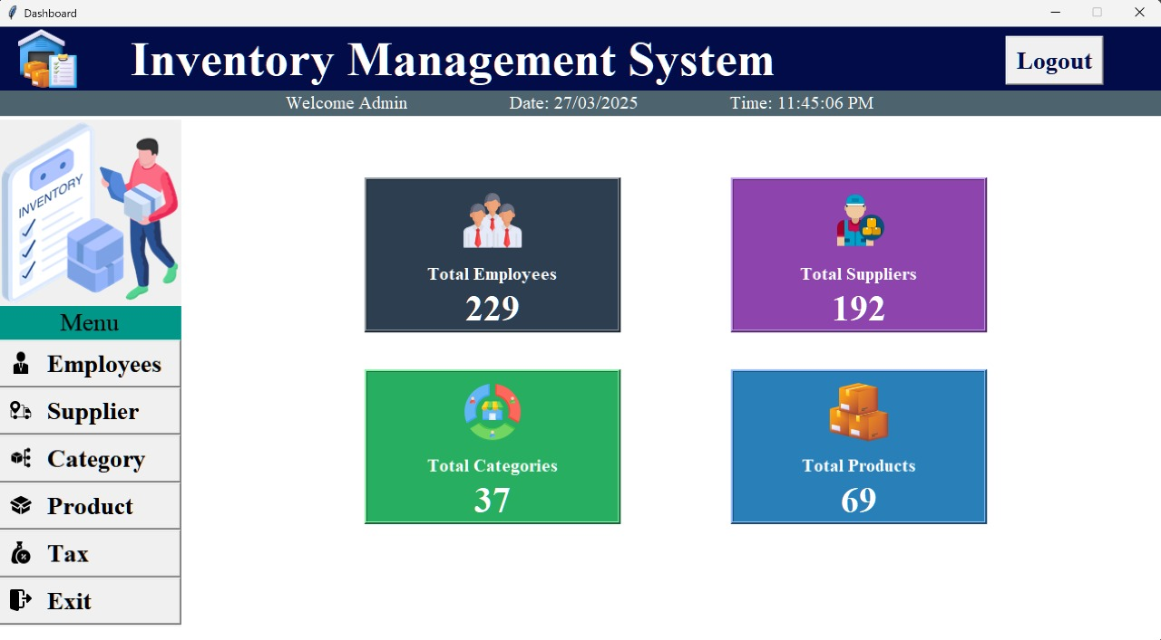
User Interface

Slide 17
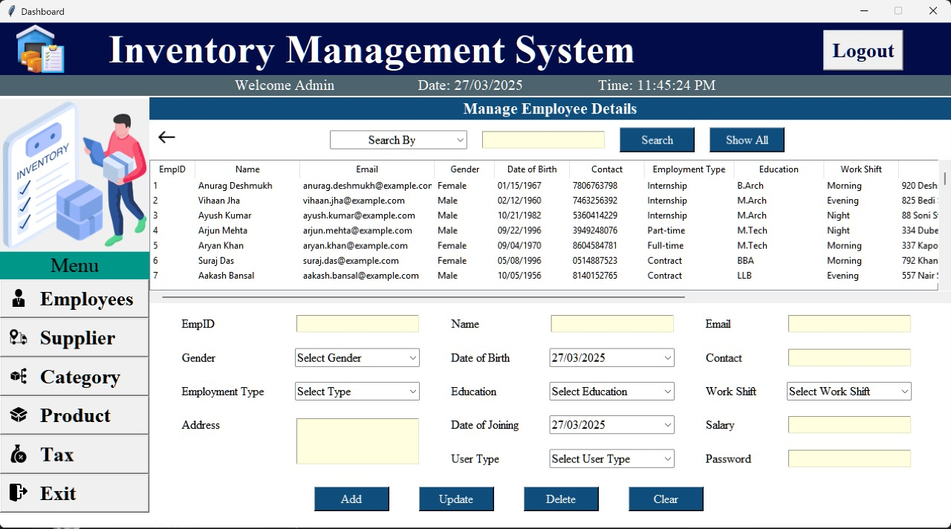
User Interface

Slide 18
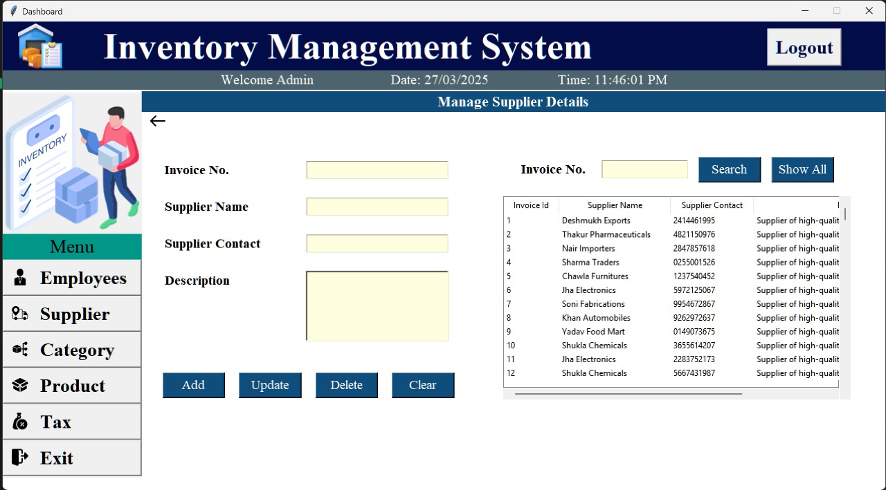
User Interface

Slide 19
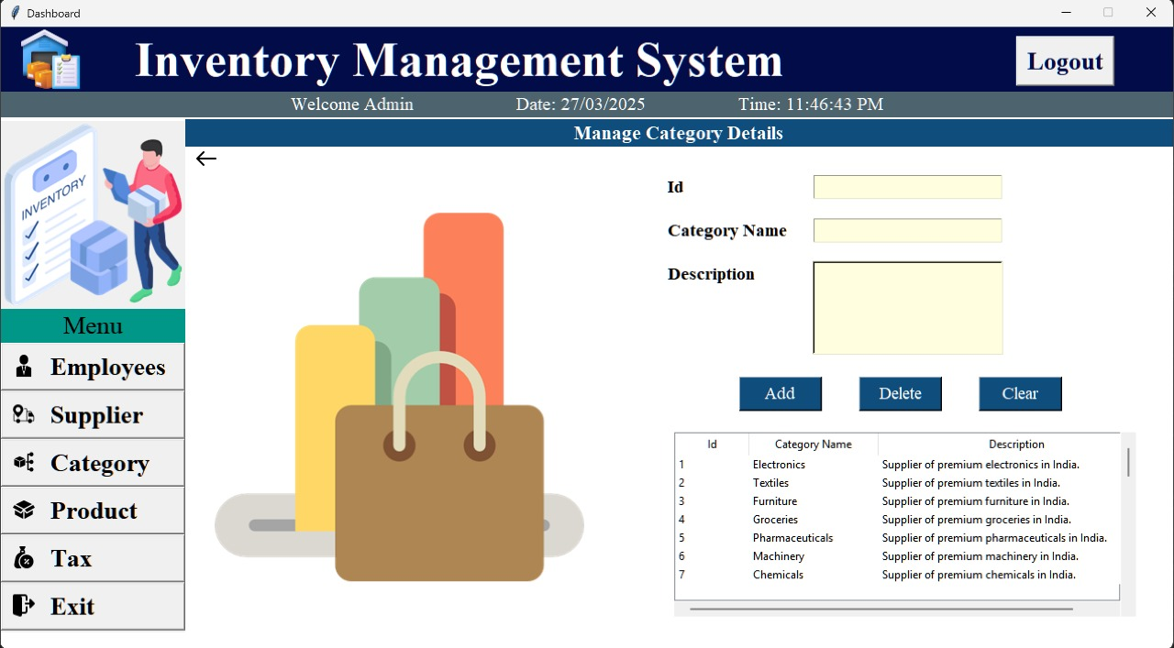
User Interface

Slide 20
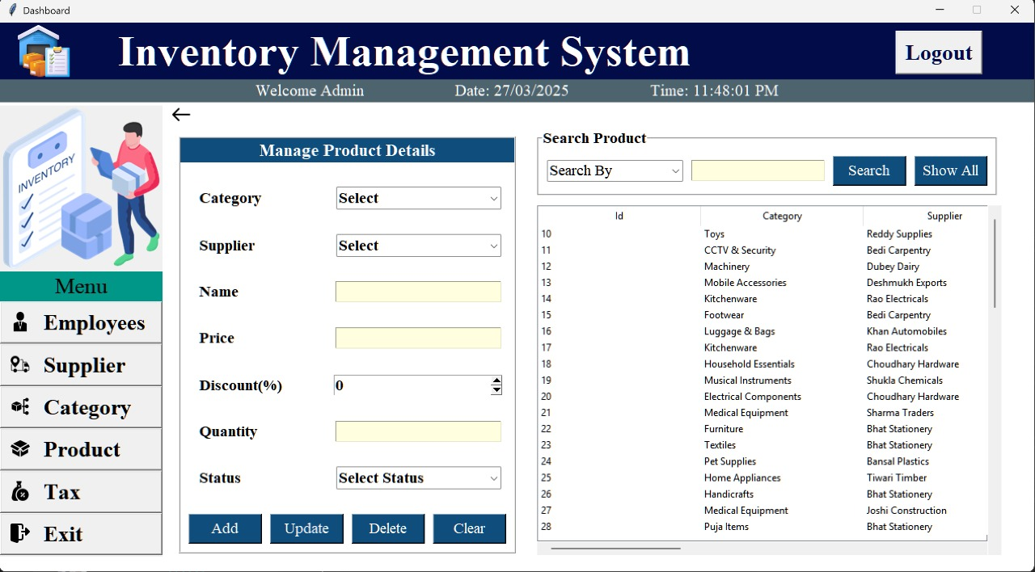
User Interface

Slide 21
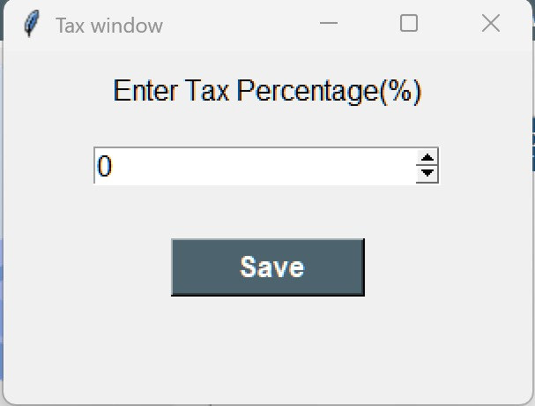
User Interface

Slide 22
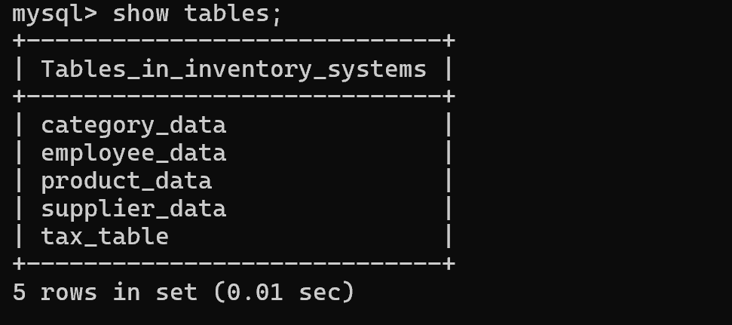
User Interface

Slide 23
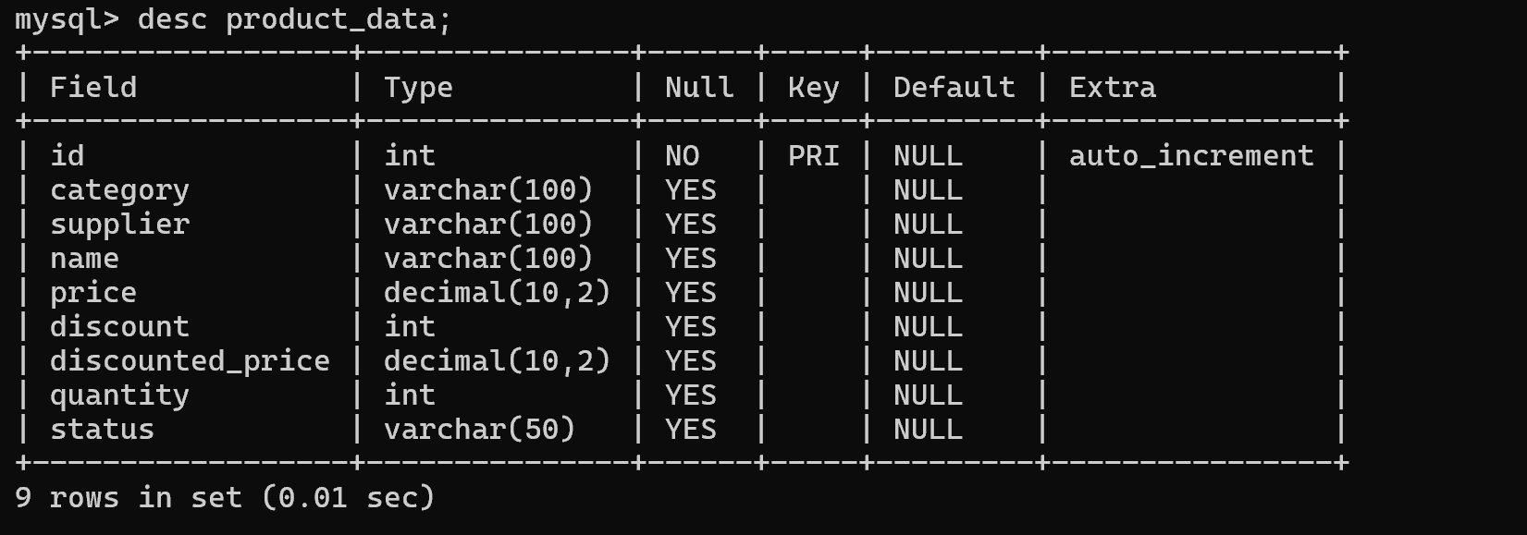
User Interface

Slide 24
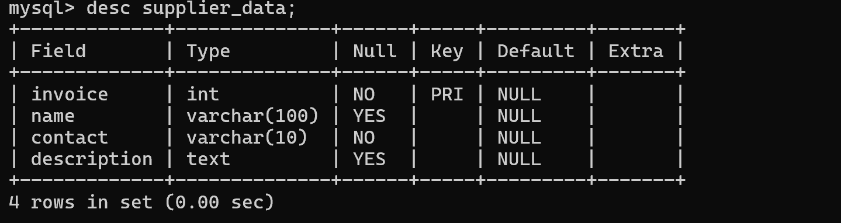
User Interface

Slide 25
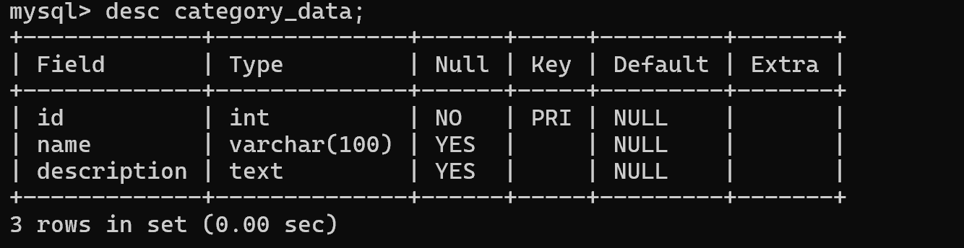
User Interface

Slide 26
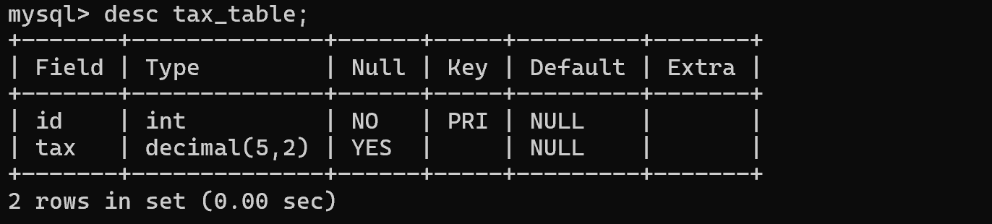
User Interface

Slide 27

Thank You

