Slide 1
XENIUM / HANDS-ON
575K
From decoded transcripts
to tissue niches
segmented cells
86.8M
A reproducible QC-to-application portfolio built around transcript assignment, segmentation, and spatial context.
decoded transcripts
2026 · full biological run
Notes:
[Sources]
10x Genomics Xenium example data: https://www.10xgenomics.com/support/software/xenium-onboard-analysis/latest/resources/xenium-example-data

Slide 2
XENIUM QC ATLAS
Xenium quality is a chain, not a count cutoff
01
02
03
04
05
Decode
Assign
Segment
Profile
Interpret
QV + controls
cell_id + locality
cell / nucleus geometry
panel-aware identity
spatial null models
A failure upstream can masquerade as biology downstream.
The workflow keeps each evidence layer visible and versioned so a reviewer can audit how a cell entered a neighborhood claim.
02
Notes:
[Sources]
Goods et al., Nature Methods (2025): https://doi.org/10.1038/s41592-025-02617-2
Janesick et al., Nature Communications (2023): https://doi.org/10.1038/s41467-023-43458-x

Slide 3
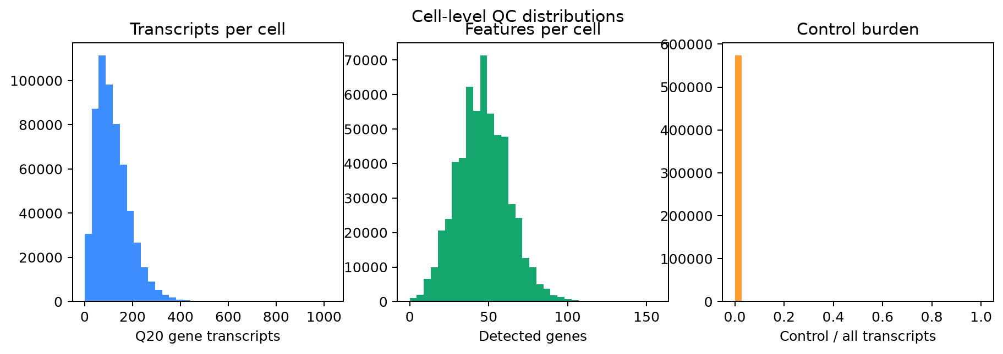
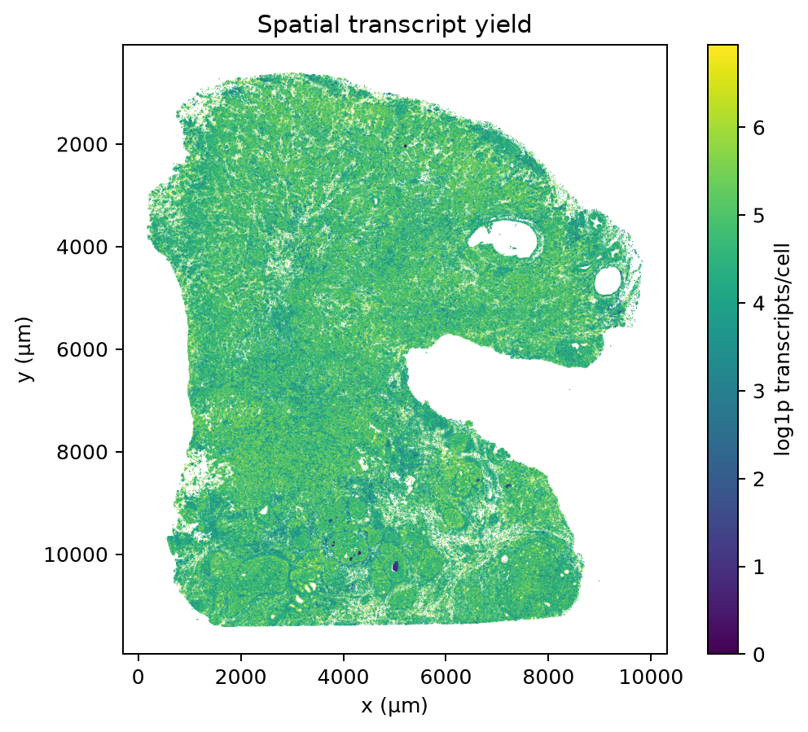
XENIUM QC ATLAS
The full breast section passed the complete QC-to-niche workflow
574,852
segmented cells
97.7%
cells passing configured QC
105
median transcripts per cell
46
median detected genes per cell
FULL BIOLOGICAL SAMPLE · XOA 1.0.2
03
Notes:
[Sources]
10x Genomics full FFPE human breast IDC dataset, CC BY 4.0: https://www.10xgenomics.com/products/xenium-in-situ/human-breast-dataset-explorer
Metrics and plots generated locally from the complete official output bundle.

Slide 4
XENIUM QC ATLAS
QC separates assay failure from segmentation failure
LAYER
MEASURE
FAILURE MODE
DECISION
Specificity
QV tails · negative probes · codewords
background or decoding artifact
spatial hotspot review
Assignment
assigned fraction · unassigned density
boundary / cytoplasm mismatch
compare by morphology
Geometry
nucleus:cell area · density · nuclei/cell
over/under-segmentation
flag extremes, inspect image
Identity
marker score · annotation margin
panel dropout or mixed lineage
retain unresolved cells
Spatial
local yield · Moran’s I · adjacency z
technical stripe or real niche
replicate + pathology support
Thresholds are hypotheses. Test them by sample and cell class.
04
Notes:
[Sources]
Moses et al., Nature Methods (2024): https://doi.org/10.1038/s41592-024-02325-3
Goods et al., Nature Methods (2025): https://doi.org/10.1038/s41592-025-02617-2

Slide 5
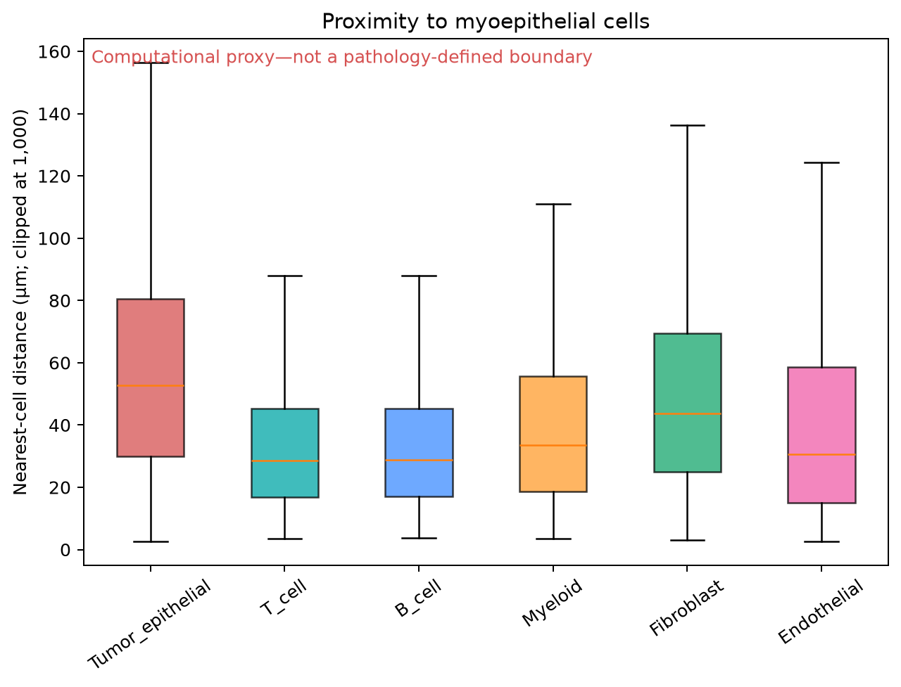
XENIUM QC ATLAS
The application asks what changes at the invasive boundary
Primary analyses
1
distance-to-boundary gradients
2
tumor–myeloid / fibroblast adjacency
3
B–T neighborhood enrichment
4
region-aware pseudobulk testing
5
segmentation sensitivity analysis
05
Notes:
[Sources]
Janesick et al., Nature Communications (2023): https://doi.org/10.1038/s41467-023-43458-x
Distance plot generated locally from the complete 10x breast section. It is a computational proximity proxy, not a pathology-defined boundary.

Slide 6
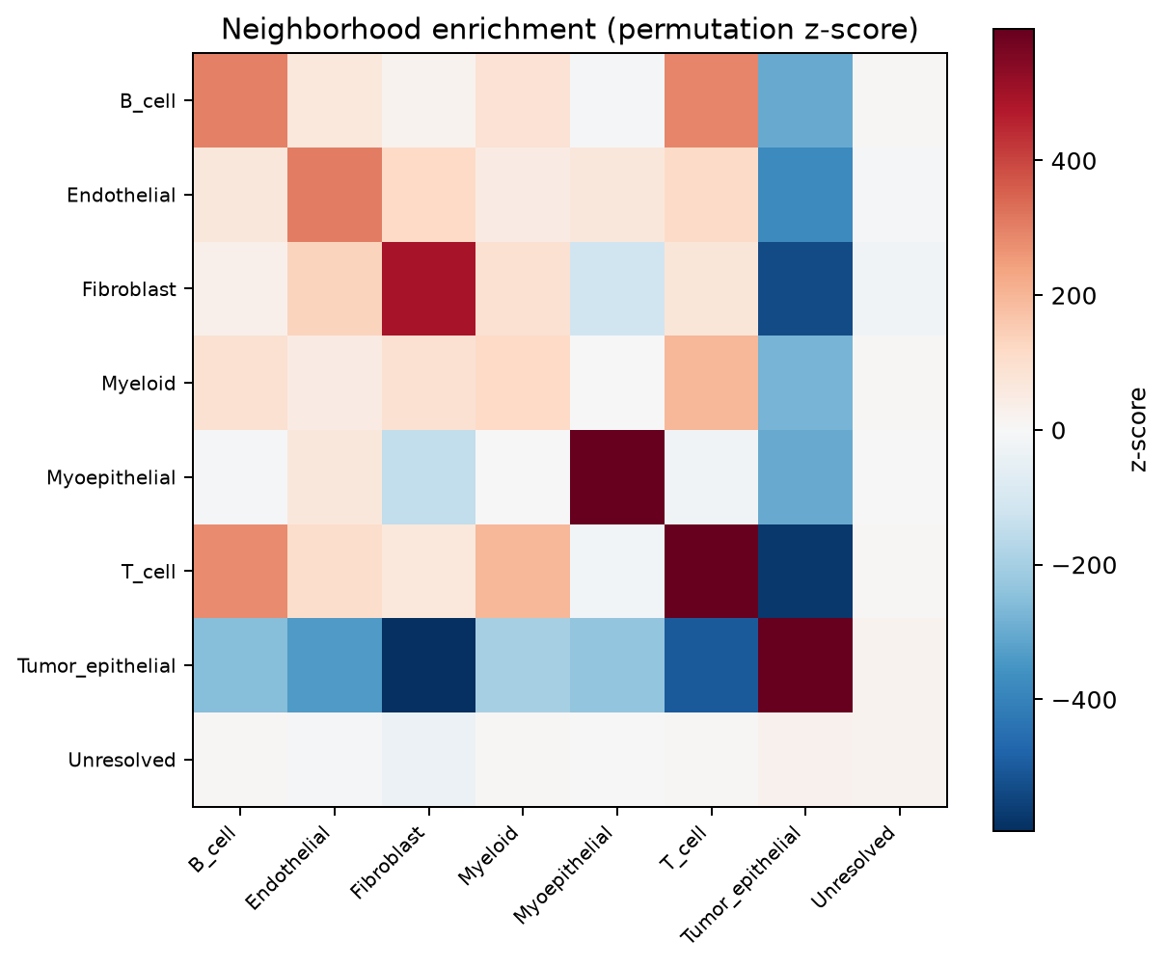
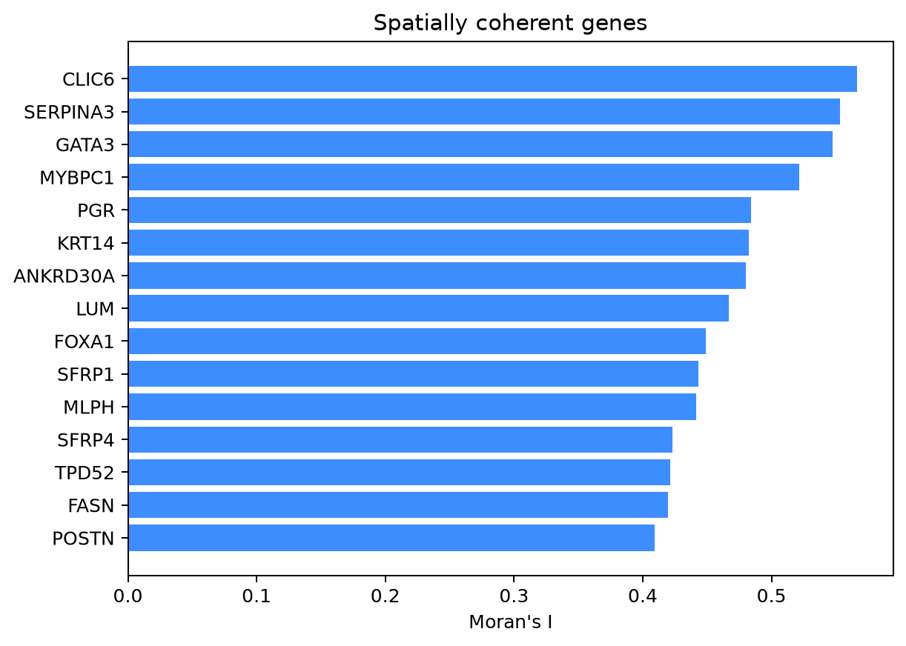
XENIUM QC ATLAS
Spatial claims are tested against explicit null models
kNN
↓
shuffle
labels
↓
z-score
GATA3, PGR, KRT14, LUM and POSTN recover coherent tumor–stroma structure.
06
Notes:
[Sources]
Figures generated locally from the complete 10x human breast IDC output bundle.
Permutation logic and Moran's I implementation are documented in src/xenium_showcase/analysis.py.

Slide 7
XENIUM QC ATLAS
The release makes every handoff reproducible
RUNNABLE
REVIEWABLE
✓
MD5-verified public download
✓
editable PPTX summary
✓
XOA-format-aware loader
✓
threshold sensitivity hooks
✓
deterministic configuration
✓
full-data breast profile
✓
CSV / JSON evidence trail
✓
clear demo-vs-biology guardrail
Scale-up path: patient-level pseudobulk · pathology registration · container digest · workflow engine
07
Notes:
[Sources]
Repository release assets generated locally: README.md, RELEASE_NOTES.md, environment.yml, configs/, scripts/, src/, results/.

Slide 8
THE TAKEAWAY
I can trace a spatial claim
back to the transcript.
READY
to run locally
This release demonstrates more than clustering: it connects platform-aware QC, segmentation diagnostics, spatial statistics, and a biologically motivated boundary question in one reproducible package.
full dataset
figures
PPTX
release notes
github.com / full-data release
Notes:
[Sources]
Summary of locally generated repository artifacts and executed results.

