Slide 1
Abnormal RACH in JX CMCC
Xu YangChun
9-12-2016
Confidential

Slide 2
问题描述
客户发现某小区接入困难，检查kpi 后发现该小区，Preamble 数量》rrc request 数量，然后客户开始关注该指标。
经过排查，1400+个站问题较严重，200个站问题十分严重，除了20个站外重启问题都能恢复 msg1/msg3 指标
正常 <1.2
较严重 >5
严重 >100
十分严重 >1000
<Change information classification in footer>

Slide 3
Parameter optimization
发现cell 178 的PRACH Offset配置为85导致本小区PUCCH和PRACH重叠导致的。
nCqiRb=11，PUCCH PRB(分散在上行prb 的两侧) =2（SR）+9(Ack Nak)+11(nCQI)=22 PRB, prachFreqOff=85，占用PRB 85~90，这和PUCCH 造成了重叠。请按照要求将prachFreqOff配置为<=83。
Reserve resources for PRACH preambles
•Frequency: 6 Resource Blocks x 180 KHz = 1,08 MHz
so that PRACH is located next to PUCCH.
1) roundup(MaxPucchResourceSize/2) if it is located at the lower edge, or 2) ulChBw-6-roundup(MaxPucchResourceSize/2 if it is located at the upper edge of the PUSCH area
需要现场check下这个站相邻小区的rootseqindex配置情况, 是否按照每个cell大于等于6个rootseqindex的隔开
<Change information classification in footer>

Slide 4
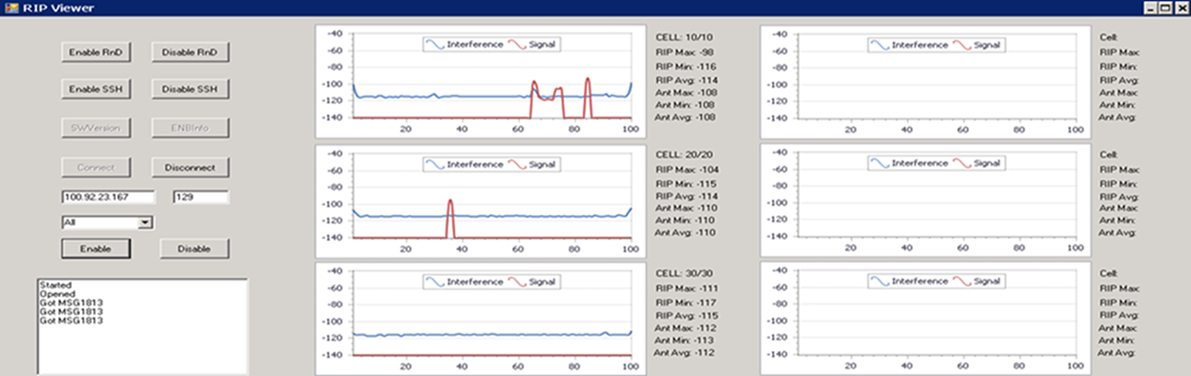
OCT 14反馈无干扰的情况下问题依旧
RIP viewer 显示的干扰状况
<Change information classification in footer>

Slide 5
软件包分析
选一问题站,fallback RL55 问题依旧
说明问题不是TL15A 才引入的。
<Change information classification in footer>

Slide 6
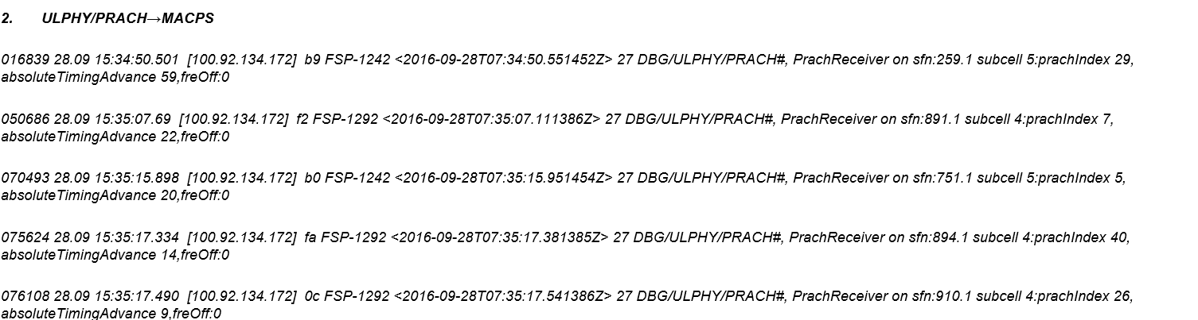
研发分析
要求提供：
Bts log（prach debug print），emil log（包含PHY_PRACH_RECEIVE_IND_MSG 这条消息），TTI trace。
Emil log 表明基站对所有RACH 都给了Msg 2应答，怀疑远方的的UE有接入，但是基站回复msg2后它收不到或无法解析
<Change information classification in footer>

Slide 7
分析了TTI trace，发现TA大的UE MSG3都解成DTX和NACK,出knife当TA大于50 Ts（log 中的 absoluteTimingadvance单位是 Ts）时触发去抓取天线数据。
建议将PrachCS 从缺省的10 改为6后，限制过远的UE接入
*log 中的 absoluteTimingadvance 的单位是 Ts
*. Ts : 抽样频率：15K frequency 的载波，要FFT抽样 2048次，所以= 1/(15000*2048)s
Ts* 光速 约等于 5米
* 但 网络中 TA command 的调整单位是 16 Ts
<Change information classification in footer>

Slide 8
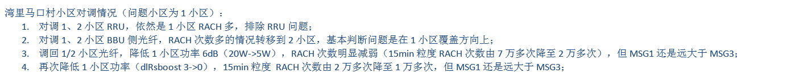
现场反馈
OCT 27 将 prachCS 设置成6， 问题没有改善
问题最严重并且重启不能恢复的马口村站，换上新rru/天线,然后做如下测试
<Change information classification in footer>

Slide 9
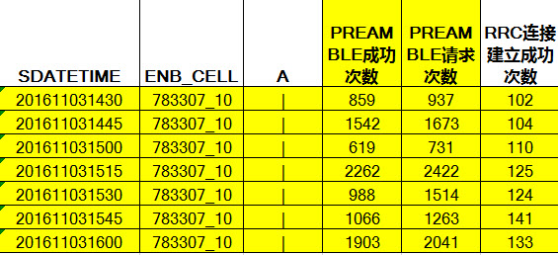
On site
Nov 2 发现ulphy 做的debug knife 对IQDUMP 工具的config操作没反应,所以以前抓的IQDUMP老是旧的数据。
Nov 3 反对研发要求将Prachcs继续缩小的建议，提议 prachCS 6->12 , 允许更多UE接入，这样才能对数据进行分析，同时也可以防止失败的rach 重发。
结果情况大大改善
<Change information classification in footer>

Slide 10
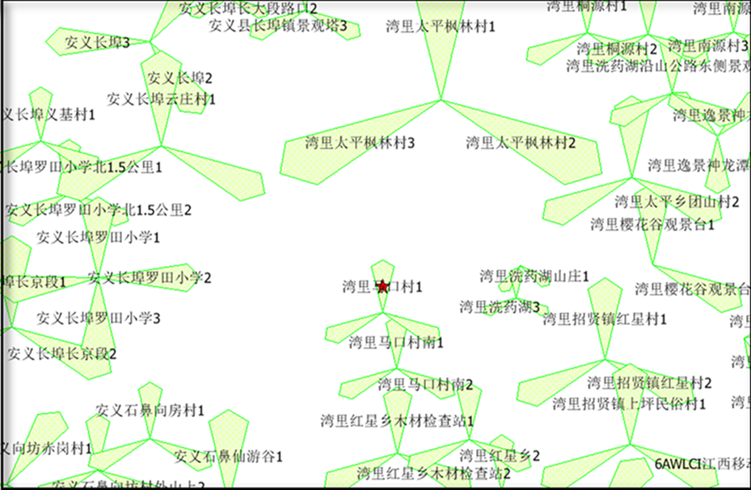
马口村实地勘察
山顶站，塔到平地的尽头也不过300米
<Change information classification in footer>

Slide 11
现场troubleshooting
现场用路测软件选距离基站100m, 200m,300m的位置打call, 后台抓取emil log ，获得TA 值。
开车到山脚，一路路测软件即使锁定pci也很难接入。要求NPO enable 该区域的parodical measurement report, 获知ue距离信息。
<Change information classification in footer>

Slide 12
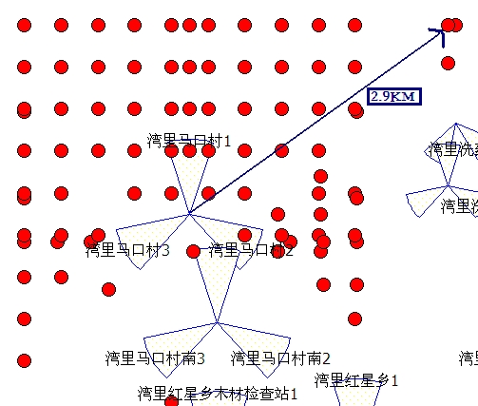
TA-距离对比统计
通过emil log发现马口村Cell 10上报的TA 达到10km以外，而是实际根据MR 要求ue 上报的经纬度可以发现UE的覆盖不超过3KM
<Change information classification in footer>

Slide 13
On site 总结
MR 弱覆盖报告=>问题站收到很多RACH 其TA值远大于可能覆盖范围。
但现场用测试ue做定点测试,TA值与ue 距离一致
需要查找是基站解析问题还是UE 问题？
Confidential

Slide 14
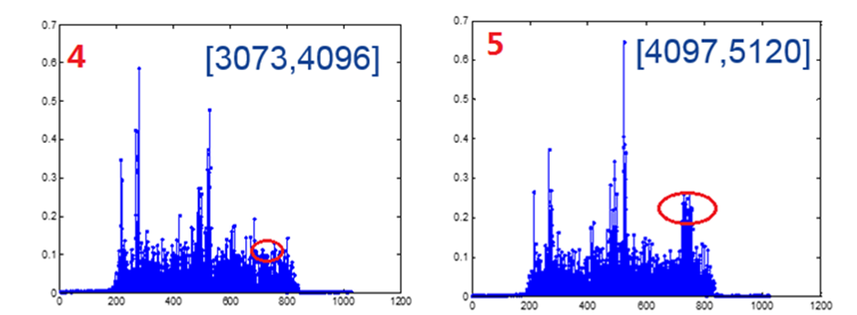
研发解释:RACH的 TA 实际已经溢出
对某一无响应prach信号做一下分解，每隔1024Ts观察一下ULPHY接收到的频谱图。下图红色标记的为PRACH 信号，前4幅图基本看不到明显的PRACH信号，第5幅图才能看到PRACH信号。说明实际上PRACH信号的延迟应该在4*1024=4096Ts左右。
一 RACH, 软件记录 preambleID是14, TA是1850Ts。而IQ data 分析结果是TA在4096Ts左右。 解释是： UE实际发送的PreambleID为15，1850Ts+2226Ts=4076Ts， 由于该值大于检测窗口（ 当PrachCS=10时 为2226Ts ），所以落入了相邻的的检测窗口。(代码中各个检测窗口有重叠)
UE 由于收到的msg2中 preambleID不匹配，会继续发起RACH
PrachCS 扩大为12后，由于检测窗口扩大问题能够得到改善。
<Change information classification in footer>

Slide 15
问题UE 查找
筛选出所有TA过大的s-tmsi，再找出对应IMSI/IMEI，统计表明问题ue 中oppo/vivo ue 占比较高
<YGF +正常站的TA 统计 >
Confidential

Slide 16


Slide 17
Copyright and confidentiality
The contents of this document are proprietary and confidential property of Nokia. This document is provided subject to confidentiality obligations of the applicable agreement(s).
This document is intended for use of Nokia’s customers and collaborators only for the purpose for which this document is submitted by Nokia. No part of this document may be reproduced or made available to the public or to any third party in any form or means without the prior written permission of Nokia. This document is to be used by properly trained professional personnel. Any use of the contents in this document is limited strictly to the use(s) specifically created in the applicable agreement(s) under which the document is submitted. The user of this document may voluntarily provide suggestions, comments or other feedback to Nokia in respect of the contents of this document ("Feedback"). Such Feedback may be used in Nokia products and related specifications or other documentation. Accordingly, if the user of this document gives Nokia Feedback on the contents of this document, Nokia may freely use, disclose, reproduce, license, distribute and otherwise commercialize the feedback in any Nokia product, technology, service, specification or other documentation.
Nokia operates a policy of ongoing development. Nokia reserves the right to make changes and improvements to any of the products and/or services described in this document or withdraw this document at any time without prior notice.
The contents of this document are provided "as is". Except as required by applicable law, no warranties of any kind, either express or implied, including, but not limited to, the implied warranties of merchantability and fitness for a particular purpose, are made in relation to the accuracy, reliability or contents of this document. NOKIA SHALL NOT BE RESPONSIBLE IN ANY EVENT FOR ERRORS IN THIS DOCUMENT or for any loss of data or income or any special, incidental, consequential, indirect or direct damages howsoever caused, that might arise from the use of this document or any contents of this document.
This document and the product(s) it describes are protected by copyright according to the applicable laws.
Nokia is a registered trademark of Nokia Corporation. Other product and company names mentioned herein may be trademarks or trade names of their respective owners.
<Change information classification in footer>

Slide 18

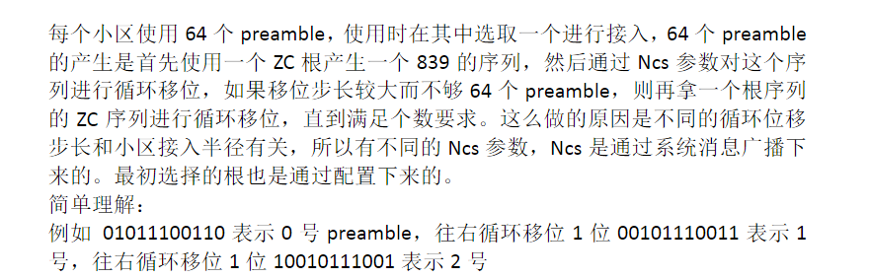
<Change information classification in footer>

Slide 19
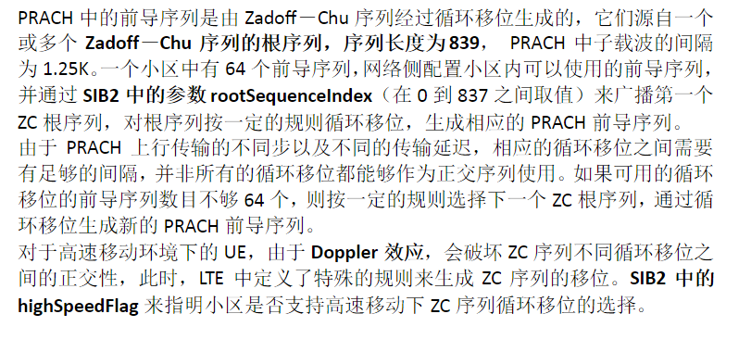
1 root--→ 一个839位的序列，可以用来循环移位
rootSequenceIndex字段配置,范围是0-837,它跟序列长度两回事
<Change information classification in footer>

Slide 20
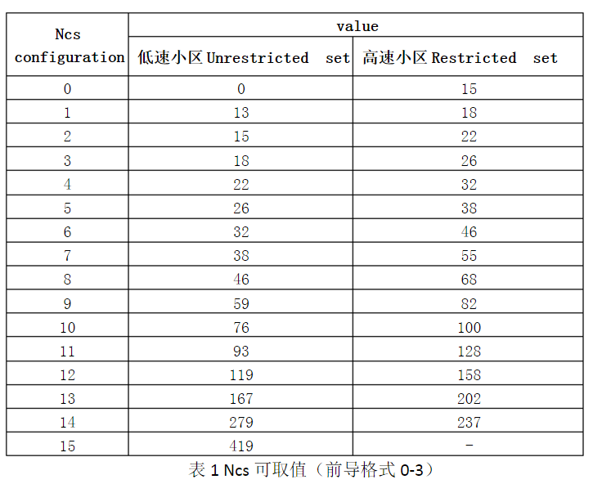
Ncs 决定循环移位的步长
<Change information classification in footer>

Slide 21
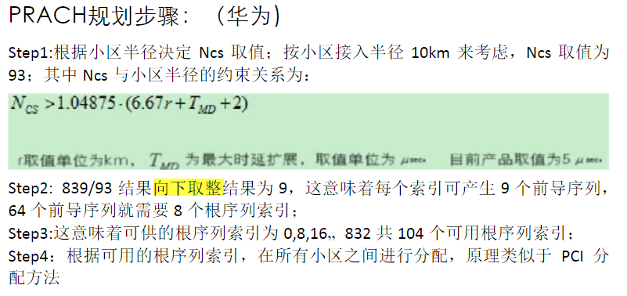
循环移位步长---〉每个839位的序列可以支持多少个preamble-→
多少个连续rootseqindex 才可以支持64个preamble➔即间隔
<Change information classification in footer>

Slide 22
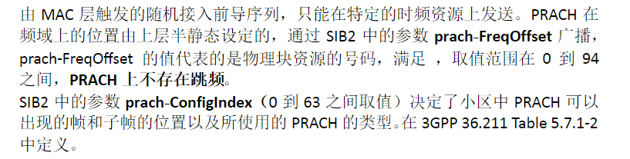
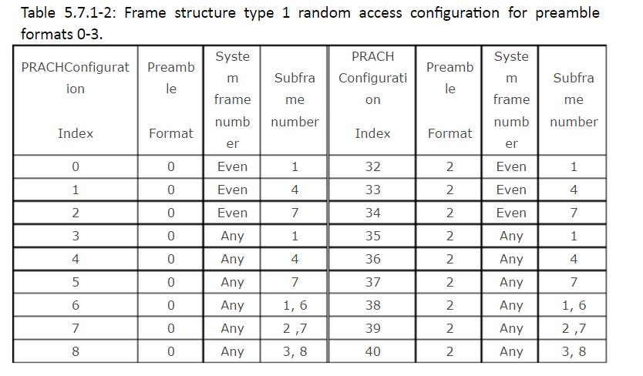
<Change information classification in footer>

Slide 23
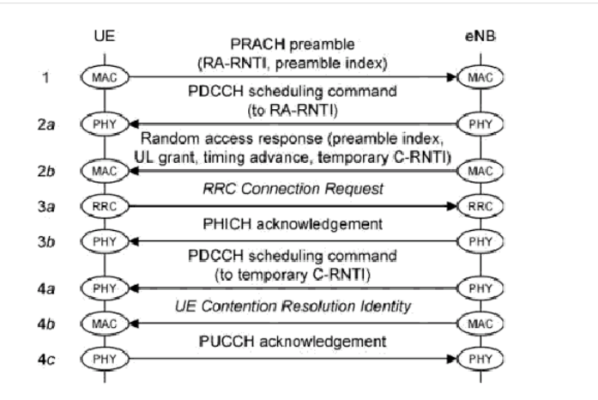
flowchart
<Change information classification in footer>

Slide 24
Original Nokia scf in 1 site
<p name="prachFreqOff">85</p>
<p name="prachCS">10</p>
<p name="prachConfIndex">3</p>
<p name="prachHsFlag">false</p
<p name="rootSeqIndex">798</p>
<Change information classification in footer>

Slide 25
eNodeB通过测量UE的上行传输来确定每个UE的timingadvance值。因此，只要UE有上行传输， eNodeB就可以用来估计timing advance值。理论上，UE发送的任何信号（SRS/DMRS/CQI/ACK/NACK/PUSCH等）都可用于测量timingadvance。 在随机接入过程中，eNodeB通过测量接收到的preamble，根据接收到的ZC序列，与本地序列进行比较，计算出接收到的ZC序列移了多少位，从而算出TA。来确定timing advance值
<Change information classification in footer>

Slide 26
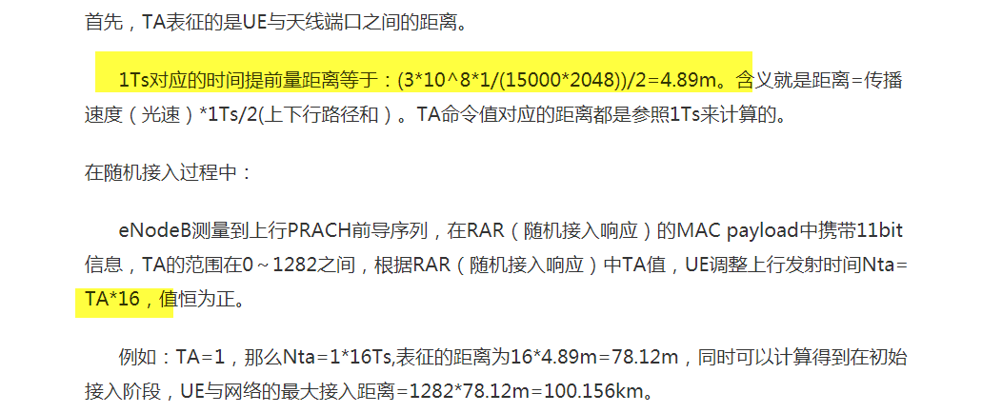
TA
<Change information classification in footer>

