Slide 1
CAS-62051-S4H6 vip站点上网困难
<Document ID: change ID in footer or remove> <Change information classification in footer>

Slide 2
问题描述
客户反馈9月15日15：30分左右开始出现上网困难情况，流量指标也可以反映出来当时1小区确认存在问题。远程重启无法恢复
<Document ID: change ID in footer or remove> <Change information classification in footer>

Slide 3
初步分析
下行 TTI Trace 显示data buffer 基本为空，表明核心侧没有提供足够下行ip数据，其他KPI正常
ＰＭ counter 显示上行PDCP率丢包过高，但上行各个研发组排查没发现问题。
<Document ID: change ID in footer or remove> <Change information classification in footer>

Slide 4
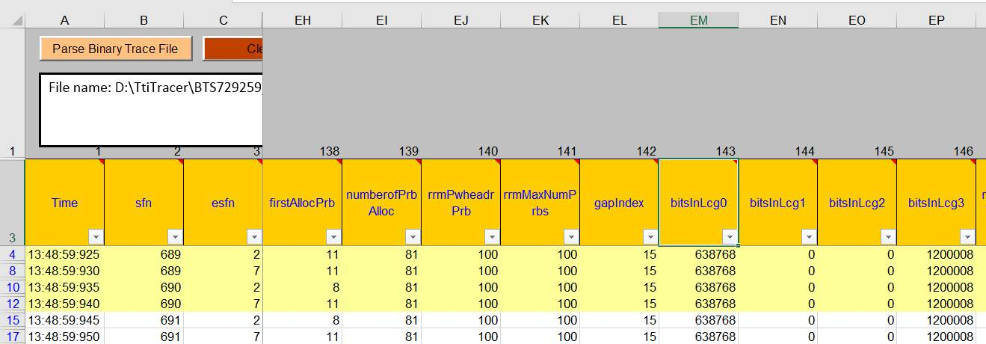
根据上行prb利用率过高的线索分析
有问题UE 不断在LCG 0 发起请求，由于正常的internet 数据在LCG 3调度，优先级比LCG 0低，得不到调度机会。由于上行tcp包受阻，下行tcp包也因为没收达ａｃｋ不再发送后续ｉｐ包。
<Document ID: change ID in footer or remove> <Change information classification in footer>

Slide 5
问题ＵＥ排查
由于问题ＵＥ的呼叫持续时间很长，可以持续一个上午或下午，从现场提供的log中没法找到呼叫建立过程中的LOG,没法得到IMSI/TMSI定位问题ＵＥ．
后经过现场努力（根据FGI？，还是其他规律）定位一款问题ＵＥ是美版iPhone 7,但通过IOT组联系苹果，苹果公司反馈该款手机使用的firmware/iOS都没有该故障
推测有ＵＥ运行了问题APP，在LCG 0上发起大量数据请求，由于LCG 0上按设置可以发SRB或
QCI 5数据，而后者与VoLTE业务相关。现场在问题站试验关闭VoLTE业务，问题没有再现。
<Document ID: change ID in footer or remove> <Change information classification in footer>

Slide 6
综合分析
根本的解决方法是定位UE／ＩＭＳＩ，限制其使用VoLTE业务。
如基站限制LCG0的上行速率/流量，可以改善问题，但问题UE发起的上行调度依然消耗上行空口资源，影响相关KPI
临时方案：将QCI 5的LCG改为３，与tcp/ip数据同一优先级调度，这样可以保证internet 访问，但没法改善上行prb占用率。
<Document ID: change ID in footer or remove> <Change information classification in footer>

Slide 7
临时方案的执行效果
请ＮＰＯ在此补充
<Document ID: change ID in footer or remove> <Change information classification in footer>

Slide 9
Copyright and confidentiality
The contents of this document are proprietary and confidential property of Nokia. This document is provided subject to confidentiality obligations of the applicable agreement(s).
This document is intended for use of Nokia’s customers and collaborators only for the purpose for which this document is submitted by Nokia. No part of this document may be reproduced or made available to the public or to any third party in any form or means without the prior written permission of Nokia. This document is to be used by properly trained professional personnel. Any use of the contents in this document is limited strictly to the use(s) specifically created in the applicable agreement(s) under which the document is submitted. The user of this document may voluntarily provide suggestions, comments or other feedback to Nokia in respect of the contents of this document ("Feedback"). Such Feedback may be used in Nokia products and related specifications or other documentation. Accordingly, if the user of this document gives Nokia Feedback on the contents of this document, Nokia may freely use, disclose, reproduce, license, distribute and otherwise commercialize the feedback in any Nokia product, technology, service, specification or other documentation.
Nokia operates a policy of ongoing development. Nokia reserves the right to make changes and improvements to any of the products and/or services described in this document or withdraw this document at any time without prior notice.
The contents of this document are provided "as is". Except as required by applicable law, no warranties of any kind, either express or implied, including, but not limited to, the implied warranties of merchantability and fitness for a particular purpose, are made in relation to the accuracy, reliability or contents of this document. NOKIA SHALL NOT BE RESPONSIBLE IN ANY EVENT FOR ERRORS IN THIS DOCUMENT or for any loss of data or income or any special, incidental, consequential, indirect or direct damages howsoever caused, that might arise from the use of this document or any contents of this document.
This document and the product(s) it describes are protected by copyright according to the applicable laws.
Nokia is a registered trademark of Nokia Corporation. Other product and company names mentioned herein may be trademarks or trade names of their respective owners.
<Document ID: change ID in footer or remove> <Change information classification in footer>

