Slide 1
NA05747389 Afrimax
Xu YangChun

Slide 2
缩写或简称说明：
FZHA/FZHJ：NSN RRU
RET/RCU：遵循AISG标准的电调控制产品或技术
BT(Bias-Tee)/SBT(Small Bias-Tee)：遵循AISG标准的调制解调产品或技术
OOK：遵循AISG标准的调制信号(2.176MHz)
RS485：遵循AISG标准的差分信号(AISG线缆传输的即为RS485+DC)
AISG：天线接口标准组织及其发布标准

Slide 3
现场抱怨
FZHJ 无法检测到 tonyu 天线上集成的RET

Slide 4
Tonyu：波特率问题，RRU改软件
Kampala及周边改建40余站点，采用我司的TD FAD宽频天线TYDA-202616DE4-BT 135PCS，RRU应为FZHA(内置BT，即校准口支持RF校准信号+DC+控制信号OOK)；(后面为何又使用FZHJ(无内置BT，校准口只支持RF校准信号，另有AISG接口)，我无从得知)。
上述情况，基本排除物理(硬件)兼容性问题，可能原因还是在逻辑(软件)兼容性上。由于我司RCU只支持固定9600bps波特率，而AISG定义了3种波特率(9600bps为默认，38400bps和115200bps为可选)，因此需要确认波特率的问题。另外也请确认下扫描算法是否一样(我个人发现贵司RRU扫描过程和设备管理方式在不同RRU上略有差异)，并尽快在我司常规外置RCU产品上验证(我司RCU产品是成熟产品，且一直未发现过兼容性，内置RCU都延用了外置RCU的软硬件设计)。

Slide 5
以前的FZHJ的测试情况
FZHJ was tested with other vendor’s RET (Katherine, Andrew)

Slide 6
Nokia RF R&D task force
Can’t find hw issue
Try the sw tuning suggested via TONYU, no effect

Slide 7
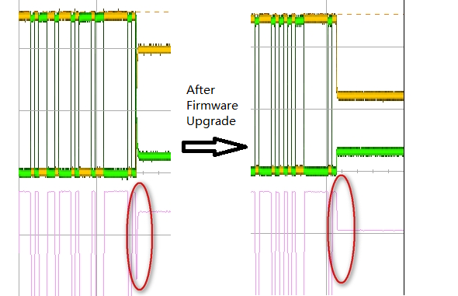
Jointly with tonyu
At the end of message sent from TONGYU RET, there is a spike downward, it will be judged as an additional bit by the FZHJ hardware and the message would be treated as incorrect. After upgrading the RET firmware the spike could be eliminated and RET is detected by FZHJ successfully.
Root cause: TONGYU RET design issue.

Slide 8
TONGYU RET not detected by FZHJ
Answer: The connection between FZHA and RET is different with connection between FZHJ and RET. FZHA combine the AISG signal (OOK modulation) with the RF signal on the “Cal” port and transmit/receive through the RF cable, and an equipment called “Smart Bias-T” is between FZHA and RET which transport to/from RS485 with the RET.
FZHJ has a dedicated RS485 port which connect to the RET directly, so signal not need to translate from OOK modulation to RS485, and vice versa.
During the translation from TONGYU RS485 to OOK modulation, most probability the downward spike is ignored by the smart Bias-T that the message could reach RRU successfully.

Slide 9
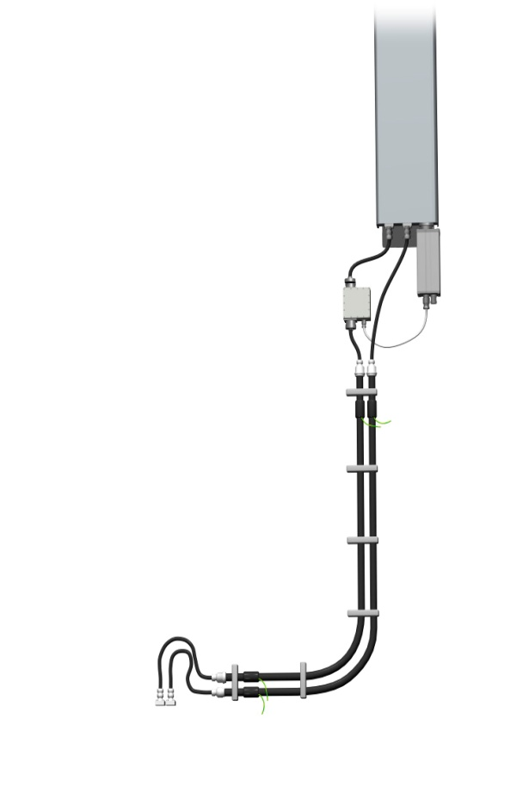
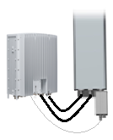
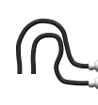

TONGYU RET not detected by FZHJ
Antenna with
adjustable tilt
RRH with an AISG interface (RET power and AISG signal fed with a separate RET cable)
RET actuator
Smart Bias-T
RET control cable
FZHJ and RET Connection
FZHA and RET Connection

Slide 10
实际？Follow myself
FZNC与FZHJ一致，校准口与RET 口分开，但它没有问题
比较硬件设计，发现FZNC内部还是有一个类似功放，所以接上RET 电压不会突然拉低出了一个spur

