Slide 1

TCP Theory And Advanced Diagnosis
Part 1
Mobile Broadband Workshop
Bilal Shahid
Munich
August 2010
TCP Theory & Advance Diagnosis 1 / Bilal Shahid / Munich / August 2010
Notes:
Based on material prepared by Carsten Langer Version 3, November 2009
(This slideset is available at https://sharenet-ims.inside.nokiasiemensnetworks.com/Open/410716248.)

Slide 2
Agenda
We are here
  Overview, motivation
  Recap on TCP basics
  Intro to tcptrace/jplot analysis tools
  Recap on TCP basics continued
  TCP throughput limitations
  Usefulness of certain TCP options
  Tweaking TCP parameters
  Outlook/references
TCP Theory & Advance Diagnosis 1 / Bilal Shahid / Munich / August 2010

Slide 3
Overview, Expectation Setting
  This slideset shall introduce you to the basic parts of the TCP theory which are important for Mobile Broadband (MBB).
  It will however not explain details of TCP which are not relevant for MBB.
  The expectation is that you know already the TCP basics.
  Also expected is that you are interested to challenge your understanding of TCP while you learn more details about it.
TCP Theory & Advance Diagnosis 1 / Bilal Shahid / Munich / August 2010

Slide 4
Overview, Expectation Setting
  This slideset is part 1 of 2 parts.
    This first part is designed for the common (beginner) part of the MBB workshop.
    The second part is designed for SOA expert part of the MBB workshop.
    The main differences are that in this beginners part we’ll present theory and demonstrations, and on the SOA expert part the participants will have practical exercises using the provided tools and some more theory.
  This slideset will demonstrate showcases using the tool tcptrace/jplot, as most of the analysis is done with this tool. If you are interested in using the tool yourself, please refer to the 2nd part of this slideset mentioned above.
  There are a lot of showcases, part of which will be shown during the workshop. For offline reading, you find a short summary of the findings for each showcase in this slideset.
TCP Theory & Advance Diagnosis 1 / Bilal Shahid / Munich / August 2010

Slide 5
Motivation For Analyzing MBB TCP Traces
In a typical Mobile Broadband project, there are two phases.
Phase 1:
  Directly after deploying HS(D)PA technology, some measurements are done in testbed or live network under controlled and optimal conditions and still the promised throughput is not achieved.
  This is where this workshop comes handy: With this knowledge you should be able to find and fix the throughput problems for an optimal environment.
  By fixing the throughput in an optimal, controlled environment, you set the baseline for the real life performance.
  If the promised performance can’t already be reached in this phase 1, all effort for phase 2 is a waste of time and money.
This phase 1 is equivalent to stage 1, End User Services Assessment, from the Delivery Guideline for MBB Assessment and Analysis service.
TCP Theory & Advance Diagnosis 1 / Bilal Shahid / Munich / August 2010

Slide 6
Motivation For Analyzing MBB TCP Traces
Phase 2:
  The real life performance will usually be less than the optimal baseline performance.
  Typical reasons are
    concurrent traffic requests more resources than are available
    packet loss and retransmission due to buffer overflow before smallest link (expected)
    packet loss and retransmission in other network parts (unexpected)
  For most of these effects, it is important that we explain to the operator where they are coming from, and if they are expected or not according to the traffic pattern. This workshop gives you the theory background.
  For expected effects there will be no optimization available, as they are inherent to the TCP protocol’s behavior in overload situations.
  For unexpected effects there may be optimizations possible, but it lies under the sope of NOA.
This phase 2 is equivalent to stage 2, E2E Mobile Broadband analysis, Analysis of bearer capabilities, from the Delivery Guideline for MBB Assessment and Analysis service.
TCP Theory & Advance Diagnosis 1 / Bilal Shahid / Munich / August 2010

Slide 7
Agenda
  Overview, motivation
  Recap on TCP basics
  Intro to tcptrace/jplot analysis tools
  Recap on TCP basics continued
  TCP throughput limitations
  Usefulness of certain TCP options
  Tweaking TCP parameters
  Outlook/references
We are here
TCP Theory & Advance Diagnosis 1 / Bilal Shahid / Munich / August 2010

Slide 8
Agenda
We are here
  Recap on TCP basics Part 1
    Focus on the heart of TCP:
    the sliding window, clocked by ACKs
  Recap on TCP basics Part 2
    Slow Start
    Congestion Avoidance
    Fast Retransmit
    Fast Recovery
    Delayed ACK
    Selective ACK
TCP Theory & Advance Diagnosis 1 / Bilal Shahid / Munich / August 2010

Slide 9
Transmission Control Protocol (TCP)
It is expected that you know already some basics on TCP
  TCP is a connection-oriented, end-to-end reliable protocol.
    3-way-SYN handshake to start the connection, FIN to stop.
  TCP has mechanisms to reliably work on top of unreliable network layer protocols, e.g. IP.
    Received data is acknowledged, lost data is retransmitted.
  TCP automatically adopts the transmission speed to any available bandwidth and delay of the underlying network.
    Slow-start, congestion avoidance, dynamic speed change.
  So TCP will always work, but it may not always perform optimally in mobile networks!
  We will see in this slideset some details, why this is so.
TCP Theory & Advance Diagnosis 1 / Bilal Shahid / Munich / August 2010

Slide 10
TCP – Standards
  RFC 793: original TCP specification (= TCP Tahoe)
  RFC 813: Silly Window Syndrome and Delayed ACKs
  RFC 1122: mandatory corrections and updates
  RFC 1323: TCP Extensions for High Performance
  RFC 2001: TCP Slow Start, Congestion Avoidance etc.
  RFC 2018: TCP Selective Acknowledgment Options
  RFC 2581: TCP Congestion Control (= TCP Reno)
  … and others, check out the list and discussion in:
  RFC 3841: TCP over 2.5G and 3G networks
The standards above are delivered with this slideset.
TCP Theory & Advance Diagnosis 1 / Bilal Shahid / Munich / August 2010

Slide 11
Important Points About TCP
  TCP is adaptive.
  It is constantly trying to go faster.
  It always slows down when it detects a loss.
  How much it sends is controlled by windows.
  When it sends is controlled by received ACKs (or timeouts).
TCP Theory & Advance Diagnosis 1 / Bilal Shahid / Munich / August 2010

Slide 12
How Does TCP Work Internally?
To understand what drives TCP internally, we need to understand:
  TCP data: segments in a sequence number space.
  The heart of TCP: the sliding window, clocked by ACKs.
  Equilibrium state: stable situation with maximum throughput.
  How to speed up: Slow Start and Congestion Avoidance.
  How to slow down: Reactions to packet loss.
TCP Theory & Advance Diagnosis 1 / Bilal Shahid / Munich / August 2010

Slide 13
TCP Data = Segmented Sequence of Data
Application
100 Byte
4,000 Byte
more data
SEND(100)
SEND(4000)
SEND(more)
TCP Buffer
10,000 Byte
Sequence of bytes, application data boundaries got lost
100,001 (sequence number of first byte)
110,000
TCP Seg-
mentation
1,460 Byte
1,460 Byte
1,460 Byte
…
100,001
101,461
102,921 (sequence number of first byte)
100,001 to
101,460
  Application sends data to buffer.
  In buffer the data is a sequence of bytes in a sequence number space.
  Application data boundaries are lost.
  Data gets segmented before sending over IP.
TCP/IP Headers
40 Byte
101,461 to
102,920
102,921 to
104,380
send out on network interface card
TCP Theory & Advance Diagnosis 1 / Bilal Shahid / Munich / August 2010

Slide 14
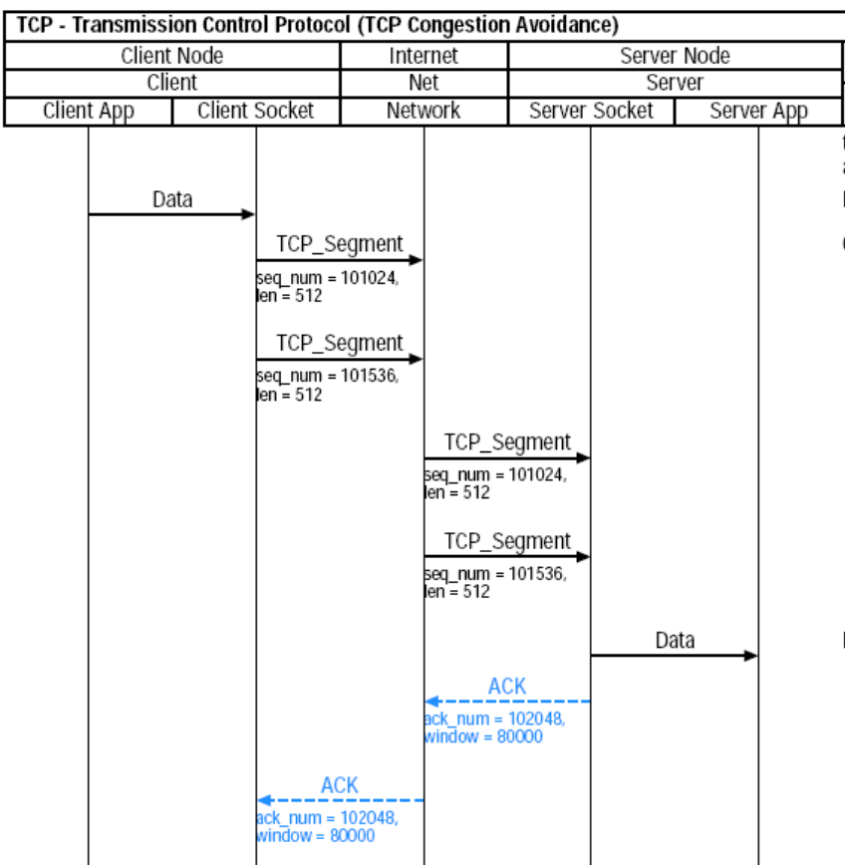
TCP Acknowledgements
  Receiver ACK’s the received segments of data.
  Every or latest every second segment is ACK’ed
  (see delayed ACK).
  The ACK sequence number is actually the next expected sequence number, i.e. the ACK covers all sequence numbers up to but excluding the mentioned sequence number → cumulative ACK.
  The receiver window size is delivered with each ACK.
TCP Theory & Advance Diagnosis 1 / Bilal Shahid / Munich / August 2010

Slide 15
What Drives TCP – The Sliding Window
  The data that the sender sends into the bit pipe is considered flowing between the sender and the receiver until it is ACK’ed by the receiver and the ACK reaches the sender.
  The amount of data that the sender can send into the bit pipe before waiting for the data to be ACK’ed is controlled by a window.
  This window is sliding through the sequence number space.
  The size of the sliding window is controlled by:
    CWND: Congestion Window controlled by
    Slow Start and Congestion Avoidance algorithms.
    RWIN: Receiver window announced in ACKs:
    how much data the receiver is willing to receive
    Sliding Window size = min(CWND, RWIN).
The Sliding Window is also often just called Congestion Window, which is effectively true if RWIN is big enough.
TCP Theory & Advance Diagnosis 1 / Bilal Shahid / Munich / August 2010

Slide 16
What Drives TCP – The Sliding Window
  CWND: Congestion Window (e.g. 2,920 Byte)
  RWIN: Receiver window (e.g. 6,000 Byte).
101,461
104,381
107,461
TCP buffer
and sequence space
some data
2,920 Byte
more data
already
acknowledged
data
CWND: 2,920 Byte
data not yet allowed to send
RWIN: 6,000 Byte
Window to send: min(CWND, RWIN) = 2,920 Byte, starting at SEQ=101,461
Data segmented
101,461 to
102,920
102,921 to
104,380
TCP Theory & Advance Diagnosis 1 / Bilal Shahid / Munich / August 2010

Slide 17
What Drives TCP – The Sliding Window
  Upon receiving the ACK with next sequence number 102,921:
    move left edge of CWND and RWIN to next sequence number:
    Sliding Window.
    CWND and RWIN may change the size (see later).
    move right edge of CWND and RWIN accordingly.
102,921
105,841
108,921
TCP buffer
and sequence space
ACK’ed data
2,920 Byte
more data
ACK up to but excluding 102,921 arrives
CWND: 2,920 Byte
data not yet sent
RWIN: 6,000 Byte
Window to send: min(CWND, RWIN) = 2,920 Byte, starting at SEQ=102,921,
wherefrom first 1,460 Byte already sent.
Data segmented
104,381 to
105,840
TCP Theory & Advance Diagnosis 1 / Bilal Shahid / Munich / August 2010

Slide 18
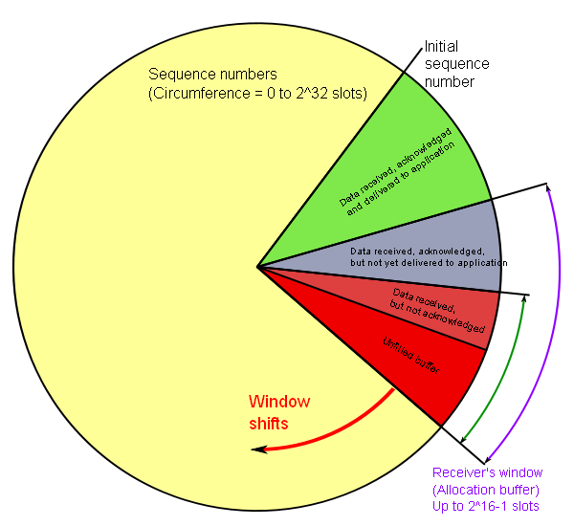
TCP Sequence Number Space
Receiver Point of View
TCP sequence
numbers cycle
through the
2^32
number
space.
The ACKs are
clocking TCP
to drive the sliding
window through the
sequence number
space.
TCP Theory & Advance Diagnosis 1 / Bilal Shahid / Munich / August 2010

Slide 19
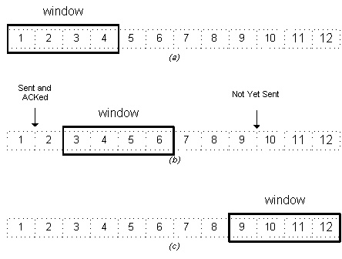
TCP Transmission As State Machine
As a simplified summary, TCP transmission is a
simple state machine, clocked by received ACKs.
  Receive ACK.
  Shift CWIN and RWIN to right.
    If needed, change CWIN and RWIN window sizes.
    Calculate new sliding window = min(CWIN, RWIN).
  Send out the new data segments which are now within the shifted sliding window (if any).
  Wait for next ACK.
TCP Theory & Advance Diagnosis 1 / Bilal Shahid / Munich / August 2010

Slide 20
TCP Equilibrium State
  A TCP connection ‘in equilibrium’ means that it is running stably with a full window of data in transit.
  The packet flow is what a physicist would call ‘conservative’: A new packet isn’t put into the network until an old packet leaves.
  Another way to look at the conservation property is to say that the sender uses ACKs as a ‘clock’ to strobe new packets into the network.
  Since the receiver can generate ACKs no faster than data packets can get through the network, the protocol is
  ‘self clocking’.
  Self clocking systems automatically adjust to bandwidth and delay variations, have a wide dynamic range and are robust to congestion.
TCP Theory & Advance Diagnosis 1 / Bilal Shahid / Munich / August 2010

Slide 21
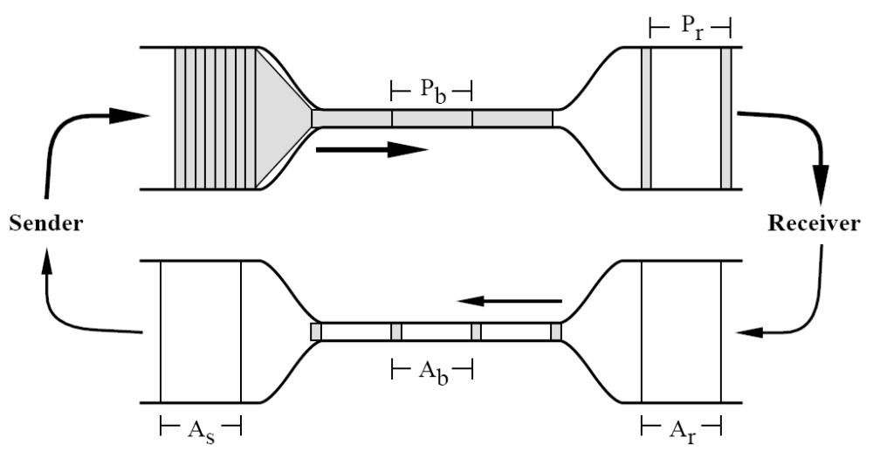
TCP Equilibrium State With Maximum Throughput
max. throughput
at bottleneck
ACKs have same inter-packet
timing as data packets
  TCP is “self-clocked” - for each packet received a new packet is sent.
  Vertical = bandwidth; horizontal = time; area (bandwidth * time) = bits
  See notes pages for detailed explanations.
  Also: http://www.osischool.com/protocol/Tcp/selfclocking/index.php.
TCP Theory & Advance Diagnosis 1 / Bilal Shahid / Munich / August 2010
Notes:
This is a schematic representation of a sender and receiver on high bandwidth networks
connected by a slower, long-haul net. The sender is just starting and has shipped a window’s
worth of packets, back-to-back. The ack for the first of those packets is about to
arrive back at the sender (the vertical line at the mouth of the lower left funnel).
The vertical dimension is bandwidth, the horizontal dimension is time. Each of the shaded
boxes is a packet. Bandwidth Time = Bits so the area of each box is the packet size. The
number of bits doesn’t change as a packet goes through the network so a packet squeezed
into the smaller long-haul bandwidth must spread out in time. The time Pb represents the
minimum packet spacing on the slowest link in the path (the bottleneck). As the packets
leave the bottleneck for the destination net, nothing changes the inter-packet interval so on
the receiver’s net packet spacing Pr = Pb. If the receiver processing time is the same for
all packets, the spacing between acks on the receiver’s net Ar = Pr = Pb. If the time slot
Pb was big enough for a packet, it’s big enough for an ack so the ack spacing is preserved
along the return path. Thus the ack spacing on the sender’s net As = Pb.
So, if packets after the first burst are sent only in response to an ack, the sender’s packet
spacing will exactly match the packet time on the slowest link in the path.

Slide 22
ACK Clocking
987
3
2
1
6 5 4
  A queue forms in front of a slower speed link.
  The slower link causes packets to spread.
  The spread packets result in spread ACKs.
  The spread ACKs end up clocking the source packets at the slowest link rate.
TCP Theory & Advance Diagnosis 1 / Bilal Shahid / Munich / August 2010

Slide 23
Agenda
  Overview, motivation
  Recap on TCP basics
  Intro to tcptrace/jplot analysis tools
  Recap on TCP basics continued
  TCP throughput limitations
  Usefulness of certain TCP options
  Tweaking TCP parameters
  Outlook/references
We are here
TCP Theory & Advance Diagnosis 1 / Bilal Shahid / Munich / August 2010

Slide 24
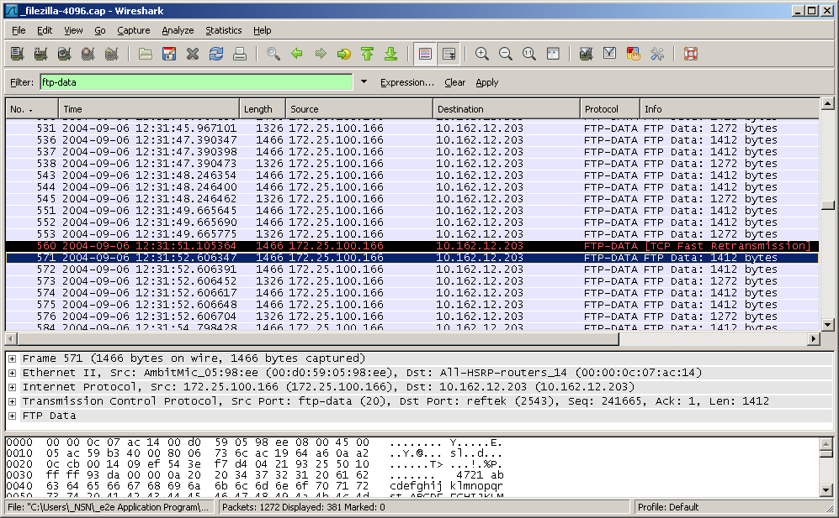
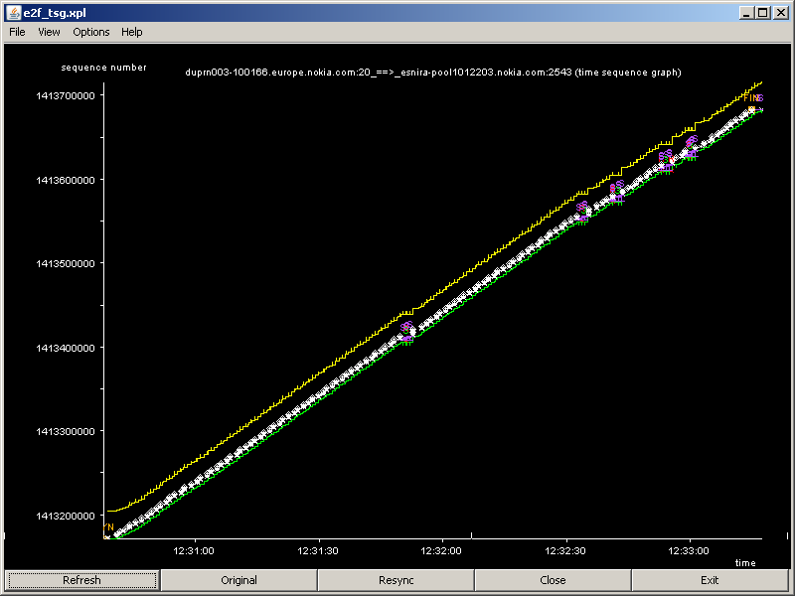
Analysis Tools
  For mass data analysis to get an overview and general statistics, we use e.g.
    Theta Networks xxxMAX tools, e.g. Bro@dMAX
    or Empirix (Mutina) IPXPlorer tool
  For individual troubleshooting of a single TCP connection we use
    Wireshark and analyze the trace packet by packet
    or better tcptrace/jplot to analyze the whole connection graphically
TCP Theory & Advance Diagnosis 1 / Bilal Shahid / Munich / August 2010

Slide 25
Intro to tcptrace/jplot Tools
  tcptrace is a tool for analysis of TCP dump files
  For each TCP connection, tcptrace produces:
    various statistics in text format,
    various graphs for further analysis.
  jplot is the tool to display the graphs generated by tcptrace.
  Home page: www.tcptrace.org
  User manual: www.tcptrace.org/manual.html
  jplot home page: tcptrace.org/jPlot/
  During the 2nd part (SOA expert) of this presentation during the MBB workshop, we’ll deal with issues and tricks to use the tool and also use it during exercises.
  So if you need more info, please refer to the 2nd part
  (see slide 4).
TCP Theory & Advance Diagnosis 1 / Bilal Shahid / Munich / August 2010

Slide 26
tcptrace Batch File Output
.log File
1 arg remaining, starting with 'example_trace.cap'
Ostermann's tcptrace -- version 6.6.0 -- Tue Nov 4, 2003
782 packets seen, 782 TCP packets traced
elapsed wallclock time: 0:00:00.006000, 130333 pkts/sec analyzed
trace file elapsed time: 0:02:59.531470
TCP connection info:
2 TCP connections traced:
================================
TCP connection 2:
host c: 172.25.100.166:20
host d: 10.162.12.203:2543
complete conn: yes
first packet: Mon Sep 6 12:30:37.800456 2004
last packet: Mon Sep 6 12:33:17.262094 2004
elapsed time: 0:02:39.461638
total packets: 760
filename: example_trace.cap
c->d: d->c:
total packets: 385 total packets: 375
ack pkts sent: 384 ack pkts sent: 375
pure acks sent: 2 pure acks sent: 373
sack pkts sent: 0 sack pkts sent: 25
dsack pkts sent: 0 dsack pkts sent: 0
max sack blks/ack: 0 max sack blks/ack: 1
unique bytes sent: 512000 unique bytes sent: 0
actual data pkts: 381 actual data pkts: 0
actual data bytes: 520472 actual data bytes: 0
rexmt data pkts: 6 rexmt data pkts: 0
rexmt data bytes: 8472 rexmt data bytes: 0
zwnd probe pkts: 0 zwnd probe pkts: 0
zwnd probe bytes: 0 zwnd probe bytes: 0
outoforder pkts: 0 outoforder pkts: 0
pushed data pkts: 125 pushed data pkts: 0
SYN/FIN pkts sent: 1/1 SYN/FIN pkts sent: 1/1
req sack: Y req sack: Y
sacks sent: 0 sacks sent: 25
urgent data pkts: 0 pkts urgent data pkts: 0 pkts
urgent data bytes: 0 bytes urgent data bytes: 0 bytes
mss requested: 1460 bytes mss requested: 1412 bytes
max segm size: 1412 bytes max segm size: 0 bytes
min segm size: 1132 bytes min segm size: 0 bytes
avg segm size: 1366 bytes avg segm size: 0 bytes
max win adv: 65535 bytes max win adv: 32768 bytes
min win adv: 65535 bytes min win adv: 31496 bytes
zero win adv: 0 times zero win adv: 0 times
avg win adv: 65535 bytes avg win adv: 32337 bytes
initial window: 2824 bytes initial window: 0 bytes
initial window: 2 pkts initial window: 0 pkts
ttl stream length: 512000 bytes ttl stream length: 0 bytes
missed data: 0 bytes missed data: 0 bytes
truncated data: 0 bytes truncated data: 0 bytes
truncated packets: 0 pkts truncated packets: 0 pkts
data xmit time: 155.982 secs data xmit time: 0.000 secs
idletime max: 2481.7 ms idletime max: 2040.1 ms
throughput: 3211 Bps throughput: 0 Bps
RTT samples: 345 RTT samples: 2
RTT min: 975.5 ms RTT min: 0.0 ms
RTT max: 3534.8 ms RTT max: 0.0 ms
RTT avg: 2019.2 ms RTT avg: 0.0 ms
RTT stdev: 407.0 ms RTT stdev: 0.0 ms
RTT from 3WHS: 975.5 ms RTT from 3WHS: 0.0 ms
RTT full_sz smpls: 230 RTT full_sz smpls: 1
RTT full_sz min: 1280.5 ms RTT full_sz min: 0.0 ms
RTT full_sz max: 3159.8 ms RTT full_sz max: 0.0 ms
RTT full_sz avg: 1865.2 ms RTT full_sz avg: 0.0 ms
RTT full_sz stdev: 358.6 ms RTT full_sz stdev: 0.0 ms
post-loss acks: 5 post-loss acks: 0
segs cum acked: 27 segs cum acked: 0
duplicate acks: 25 duplicate acks: 1
triple dupacks: 5 triple dupacks: 0
max # retrans: 2 max # retrans: 0
min retr time: 1497.3 ms min retr time: 0.0 ms
max retr time: 2859.0 ms max retr time: 0.0 ms
avg retr time: 2095.0 ms avg retr time: 0.0 ms
sdv retr time: 620.5 ms sdv retr time: 0.0 ms
average throughput in Byte/s!
for each connection detailed info in text format
TCP Theory & Advance Diagnosis 1 / Bilal Shahid / Munich / August 2010

Slide 27
tcptrace/jplot All Graphs
tcptrace produces and jplot displays various graphs for a TCP connection a2b. For details, please refer to the manual.
  a2b_owin.xpl: Outstanding Data
  a2b_rtt.xpl: TCP Round Trip Time
  a2b_ssize.xpl: Segment Sizes
  a2b_tput.xpl: Throughput
  a2b_tsg.xpl: Time Sequence Graph
  a_b_tline.xpl: Time Line (different name a_b instead of a2b!)
jplot a2b* opens all graphs but the Time Line graph
jplot a?b* opens all graphs including the Time Line graph
TCP Theory & Advance Diagnosis 1 / Bilal Shahid / Munich / August 2010

Slide 28
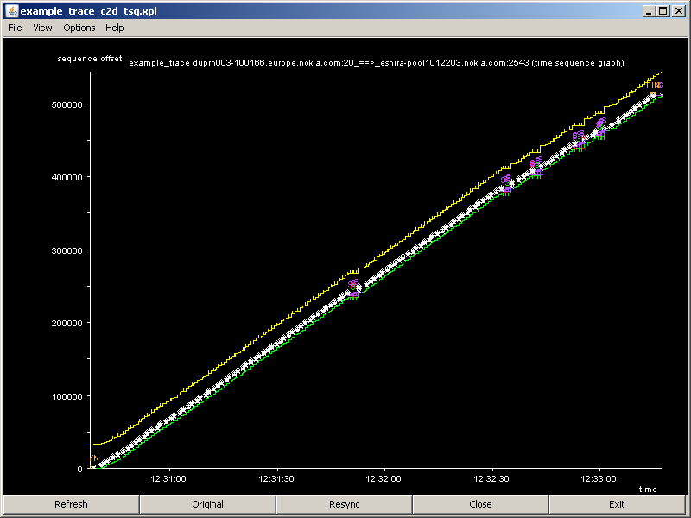
tcptrace/jplot Time Sequence Graph Explained
Time Sequence Graph shows, how the connection moves through the sequence number space over time.
FIN: end
Sequence Number Space
SYN: start
Issues to look at in detail.
Time
TCP Theory & Advance Diagnosis 1 / Bilal Shahid / Munich / August 2010

Slide 29
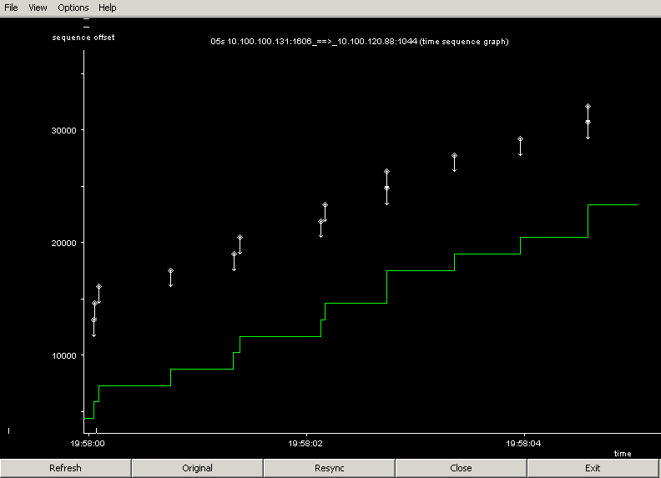
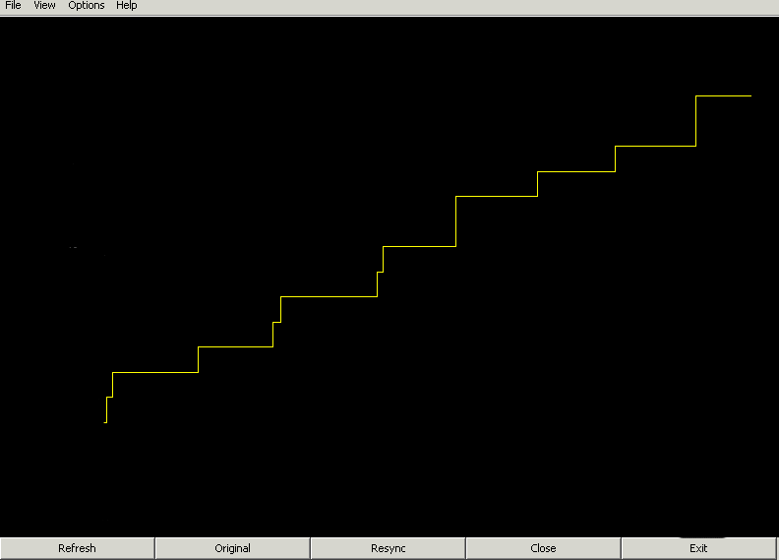
tcptrace/jplot Time Sequence Graph Zoomed In
05s_b2a_faked
General overview:
RWIN
CWND
Sent segments indicating size.
Each received ACK shifts sliding window.
Left edge of sliding window.
TCP Theory & Advance Diagnosis 1 / Bilal Shahid / Munich / August 2010

Slide 30
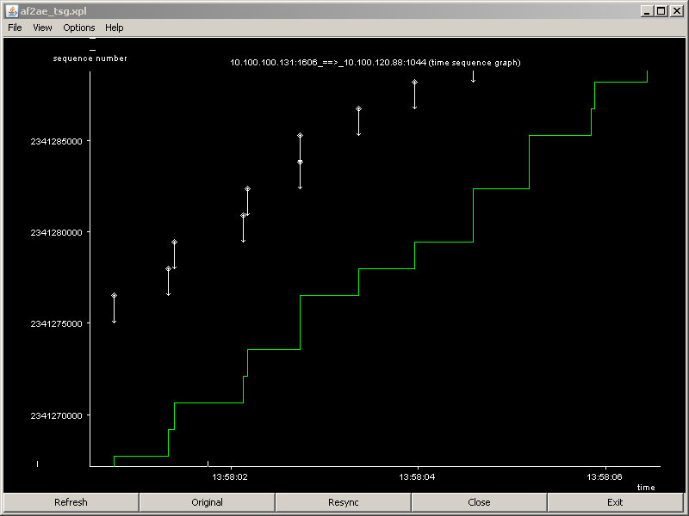
tcptrace/jplot Time Sequence Graph Zoomed In
TCP in equilibrium state:
1 packet out, 1 packet in!
RWIN too big
for graph
CWND
RTT
Sometimes more segments are ACK’ed together.
Sometimes each segment is ACK’ed separately.
TCP Theory & Advance Diagnosis 1 / Bilal Shahid / Munich / August 2010

Slide 31
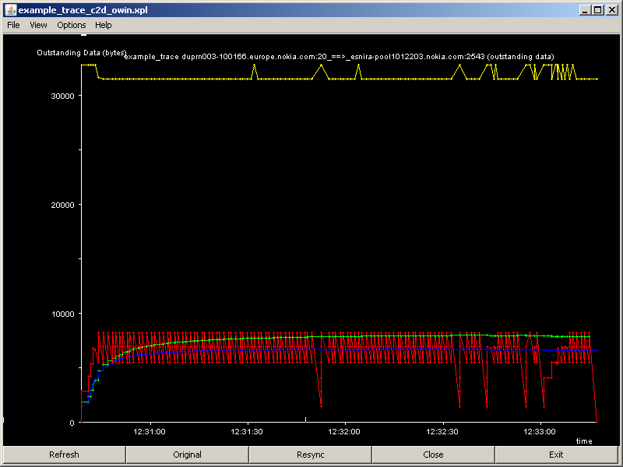
tcptrace/jplot Outstanding Data Graph Explained
RWIN
Outstanding data is data which is sent and not yet ACK’ed.
red: instantaneous value
blue: average
green: weighted average
TCP Theory & Advance Diagnosis 1 / Bilal Shahid / Munich / August 2010

Slide 32
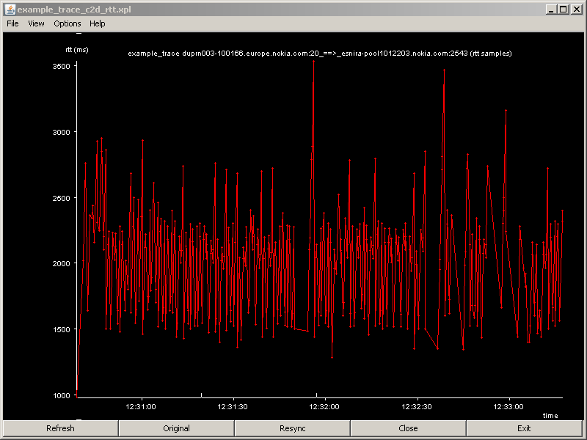
tcptrace/jplot Round Trip Time Graph Explained
Graph shows TCP RTT samples calculated
from non-retransmitted segments.
TCP Theory & Advance Diagnosis 1 / Bilal Shahid / Munich / August 2010

Slide 33
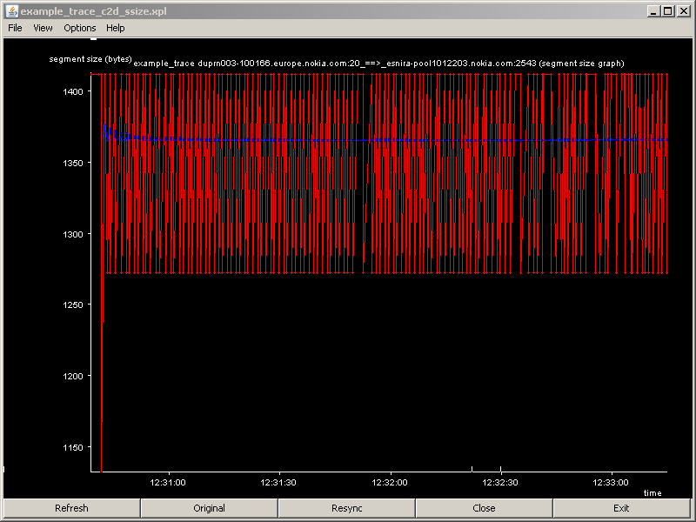
tcptrace/jplot Segment Size Graph Explained
red: instantaneous value
blue: average
Graph shows the size of each TCP segment.
Here it oscillates between 1412 Byte and 1272 Byte.
TCP Theory & Advance Diagnosis 1 / Bilal Shahid / Munich / August 2010

Slide 34
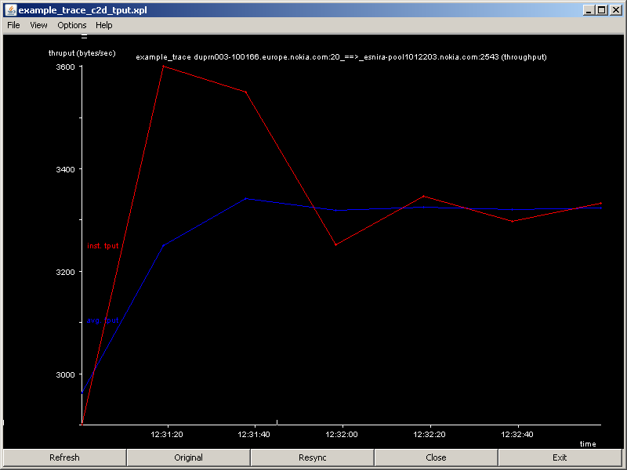
tcptrace/jplot Throughput Graph Explained
Graph shows the throughput in Byte/s.
blue: total average
red: sliding average of
the last 30 samples
(configurable in batch file)
TCP Theory & Advance Diagnosis 1 / Bilal Shahid / Munich / August 2010

Slide 35
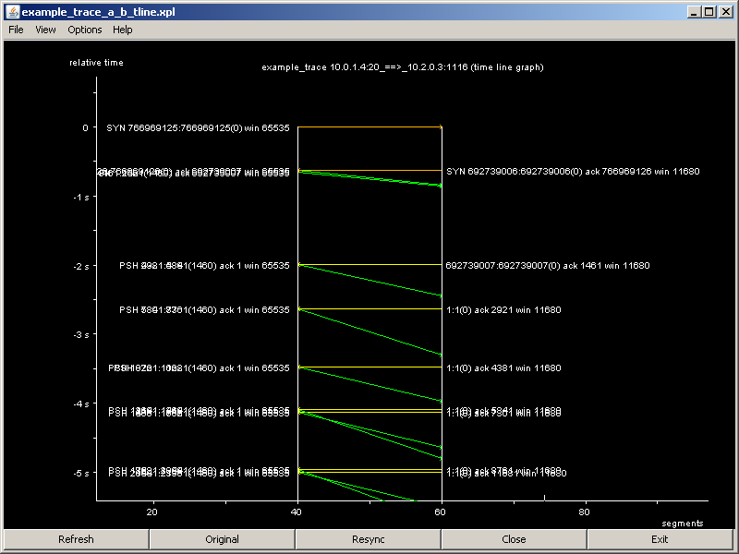
tcptrace/jplot Time Line Graph Explained
Graph shows the packets between
sender and receiver on a time line.
Graph is experimental.
Often hard to read due to overlapping labels.
TCP Theory & Advance Diagnosis 1 / Bilal Shahid / Munich / August 2010

Slide 36
Agenda
  Overview, motivation
  Recap on TCP basics
  Intro to tcptrace/jplot analysis tools
  Recap on TCP basics continued
  TCP throughput limitations
  Usefulness of certain TCP options
  Tweaking TCP parameters
  Outlook/references
We are here
TCP Theory & Advance Diagnosis 1 / Bilal Shahid / Munich / August 2010

Slide 37
Agenda
  Recap on TCP basics Part 1
    Focus on the heart of TCP:
    the sliding window, clocked by ACKs
  Recap on TCP basics Part 2
    Slow Start
    Congestion Avoidance
    Fast Retransmit
    Fast Recovery
    Delayed ACK
    Selective ACK
We are here
TCP Theory & Advance Diagnosis 1 / Bilal Shahid / Munich / August 2010

Slide 38
Get To And Keep The Equilibrium
  The same thing that makes a self-clocked system stable when it’s running makes it hard to start — to get data flowing there must be ACKs to clock out packets but to get ACKs there must be data flowing.
  To start the ‘clock’, TCP uses the Slow Start algorithm.
  Once started, to keep the equilibrium, a good RTT estimation is needed in order to estimate a proper value for TCP timeout. Lots of algorithms here.
  TCP uses Congestion Avoidance to adopt to changing network bandwidth.
  After packet loss, Fast Retransmit tries to avoid TCP timeouts.
  During Fast Retransmit, Fast Recovery avoids falling back to Slow Start.
  In practice, all four algorithms work closely together.
Interestingly, the original TCP specification (RFC 793, TCP Tahoe) works differently from how we know it today. The still valid RFC 793 does not contain either of the four mentioned algorithms. They were only added later (RFC 1122, 2001) and are known as TCP Reno.
TCP Theory & Advance Diagnosis 1 / Bilal Shahid / Munich / August 2010

Slide 39
TCP Congestion Window
  The heart of the TCP modifications by RFC 1122 and 2001 is the Congestion Window CWND.
  CWND is counted in Byte.
  CWND controls startup and limits throughput in the face of loss.
  CWND gets larger after every new ACK.
  CWND get smaller when loss is detected.
  Usable sliding window = min(RWIN, CWND).
So in practice, TCP will not be in perfect equilibrium, as it always tries to adopt to changing bandwidth by changing the CWND.
TCP Theory & Advance Diagnosis 1 / Bilal Shahid / Munich / August 2010

Slide 40
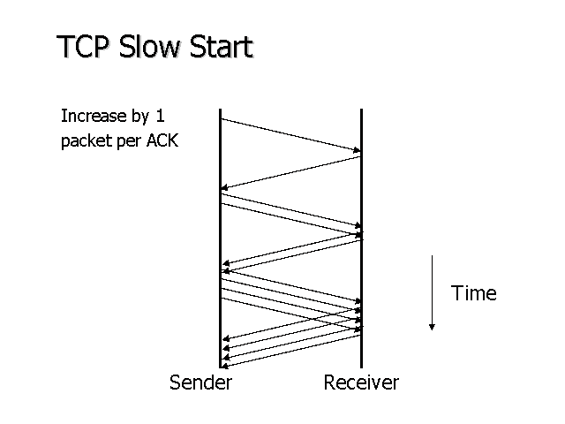
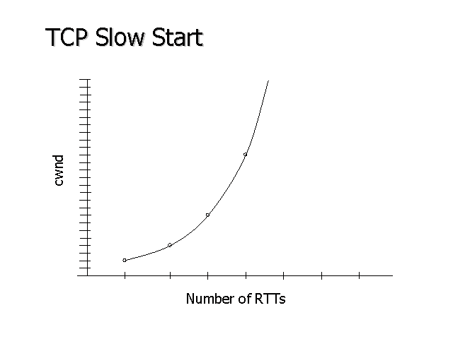
TCP Slow Start (RFC 1122, RFC 2001)
  Set CWND to 1, i.e. start with sending 1 segment.
  For each ACK received, increase CWND by 1.
  In the graph this yields: send 2 segments, then 4, 8, 16, …
  Exponential growth per RTT.
  In practice Slow Start often grows less than exponential.
  See also:
    http://www.osischool.com/protocol/Tcp/slowstart/index.php
    http://www.osischool.com/protocol/Tcp/slidingWindow/index.php
TCP Theory & Advance Diagnosis 1 / Bilal Shahid / Munich / August 2010

Slide 41
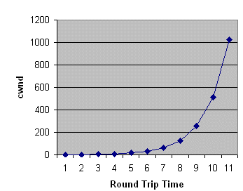
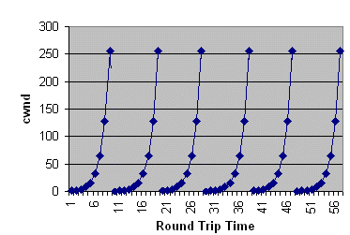
CWND During Slow Start
  CWND increased by one for every new ACK.
  CWND in theory doubles every round trip time (slower in practice)
  Without Fast Recovery, CWND is reset after each TCP loss.
  Fast Recovery, CWND is only reset after each TCP timeout.
pure Slow Start algorithm
with packet loss,
no Congestion Avoidance,
no Fast Recovery
TCP Theory & Advance Diagnosis 1 / Bilal Shahid / Munich / August 2010

Slide 42
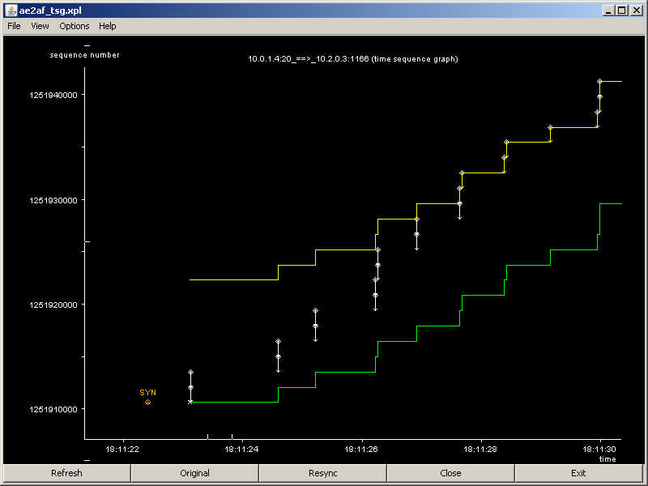
Slow Start in tcptrace/jplot Time Sequence Graph
CWND = 4 segments
RWIN = 8 segments
Each received ACK increases CWND by 1.
TCP Theory & Advance Diagnosis 1 / Bilal Shahid / Munich / August 2010

Slide 43
Congestion Avoidance (RFC 1122, RFC 2001)
  TCP stack keeps a variable Slow Start Threshold SSTHRESH, in Byte.
    If CWND ≤ SSTHRESH, TCP is in Slow Start.
    If CWND > SSTHRESH, TCP is in Congestion Avoidance.
  During Congestion Avoidance
    For each ACK increment CWND := CWND + SegmentSize² / CWND.
  That is a linear growth of CWND, compared to Slow Start's exponential growth.
    The increase in CWND should be at most one segment each round-trip time, regardless of the number of ACKs received in a round-trip time.
    Whereas Slow Start increments CWND by the number of ACKs received in a round-trip time.
    The typical increase in Congestion Avoidance is even slower:
    If e.g. CWND = 5 MSS, it takes 5 ACKs to increase it to 6 MSS.
  At each packet loss, set SSTHRESH := ½ current window.
  So after each packet loss TCP becomes more conservative.
TCP Theory & Advance Diagnosis 1 / Bilal Shahid / Munich / August 2010

Slide 44
TCP Congestion Window, Slow Start Threshold
(Simplified View, TCP Tahoe)
Slow Start Threshold
Congestion window [in Max segment size]
Transmission [in Round trip time]
TCP Theory & Advance Diagnosis 1 / Bilal Shahid / Munich / August 2010
Notes:
MSS = Maximum Segment Size (TCP payload) , default 576 bytes

Slide 45
TCP Timeout (RTO)
The TCP timeout is needed to detect packet loss.
When a TCP packet is sent out
a timer is started.
The timer is originally specified as:
Only once per RTT the RTO is updated!
Threshold
RTO = A + 4D
Congestion window [in Max segment size]
A = filtered RTT
D = filtered std RTT
Transmission [in Round trip time]
TCP Theory & Advance Diagnosis 1 / Bilal Shahid / Munich / August 2010

Slide 46
RTO With Network Impairments (Mobility)
GPRS example
TCP uses a timer to decide when a packet needs to be retransmitted.
The duration of this timer is referred to as RTO.
When RTT variance is close to zero, RTO converges towards RTT
If (RTT>RTO) then rtx occurs
80
RTT
70
RTO
60
Long transmission gap due to several cell reselections
50
Seconds
40
30
30
20
25
10
20
0
15
0
50
100
150
200
250
300
Packet number
10
In WCDMA (rel.99) soft handover allows mobility without break in transmission
Lower probability to have large delay variations in 3G rel.99
5
0
80
90
100
110
120
130
140
150
TCP Theory & Advance Diagnosis 1 / Bilal Shahid / Munich / August 2010

Slide 47
Fast Retransmit (RFC 2001)
  In original TCP (Tahoe), a segment loss would lead to a TCP timeout.
  But if only 1 or few segments are lost, the next segments still arrive at the receiver.
  The receiver ACK’s them, and the ACKs always indicate that the next awaited sequence number is the one of the first lost segment.
  Therefore all ACKs bear the same info, they are duplicates: DUPACKs.
  As the sender receives DUPACKs, it knows that at least 1 segment was not received, so it doesn’t need to wait for the TCP timeout to start retransmission. This saves time → Fast Retransmit.
  To avoid sending retransmission just because there was a packet reordering instead of a loss, the sender waits to receive 3 DUPACKs before considering the segment lost and start the retransmission.
  Today TCP stacks often consider the packet lost after 2 DUPACKs.
We see examples of Fast Retransmission during the Show Cases.
TCP Theory & Advance Diagnosis 1 / Bilal Shahid / Munich / August 2010

Slide 48
Fast Recovery (RFC 2001)
  Without Fast Recovery, each retransmission (time-out and Fast Retransmission) would
    set the SSTHRESH := ½ current sliding window size
    reset the CWND and restart Slow Start
  But if the retransmission is caused by Fast Retransmission instead of time-out, the DUPACKs prove that the transmission is still working.
  So instead of going back to Slow Start, TCP only goes to (or stays at) Congestion Avoidance with
    set the SSTHRESH := ½ current sliding window
    As CWND > SSTHRESH, we are now in Congestion Avoidance
    for each DUPACK received, send out a new segment
    when the first new ACK is received, reset CWND := SSTHRESH
Fast Recovery is an improvement that allows high throughput under moderate congestion, especially for large windows.
We see examples of Fast Recovery during the Show Cases.
TCP Theory & Advance Diagnosis 1 / Bilal Shahid / Munich / August 2010

Slide 49
TCP Reno In Action
Time out
Congestion Avoidance
Backoff
Fast Recovery
Congestion
Window
Slow Start
Slow Start
Threshold half the value before
Time
Here we see
  Slow Start
  Retransmission Timeout (RTO) followed by another Slow Start.
  Switch to Congestion Avoidance at half the window size where RTO occurred.
  2 times Fast Recovery, with decreasing steepness (backoff) of the CWND increase.
  Another RTO followed by another Slow Start etc.
TCP Theory & Advance Diagnosis 1 / Bilal Shahid / Munich / August 2010

Slide 50
Advanced Congestion Avoidance Algorithms
  Today there are more subtle algorithms to control the growth on CWND not only linearly, depending on the loss pattern.
  We have seen in recent traces behaviors, which are not explicable alone with the standard (TCP Reno) Congestion Avoidance theory and may come from implementations as:
    TCP New Reno
    TCP BIC and CUBIC (Linux)
    Compound TCP (Windows)
  However at the moment these algorithms are beyond this workshop. For more info see http://en.wikipedia.org/wiki/
  TCP_congestion_avoidance_algorithm.
  We hope to have time in STP1/10 to investigate further into this direction.
TCP Theory & Advance Diagnosis 1 / Bilal Shahid / Munich / August 2010

Slide 51
Delayed ACKs (RFC 813)
  TCP receiver sends an ACK:
    after every second segment.
    after a delayed ACK timeout.
  On every segment after a loss (missing segment).
  A new segment sets the ACK timer (typically 200 ms).
  A second segment (or timeout) triggers an ACK and zeros the delayed ACK timer.
Delayed ACKs slow down the exponential growth of Slow Start a bit. Nothing to worry about, it’s an accepted side-effect.
We see examples of slow start without and with the effect of delayed ACKs during the Show Cases.
TCP Theory & Advance Diagnosis 1 / Bilal Shahid / Munich / August 2010

Slide 52
Selective ACKs (SACK, RFC 2018)
Selective ACK prevents situations like the following:
We see later examples of Selective ACKs.
client
1° packet (SN = 1000)
server
2° packet (SN = 2460)
Cumulative ACK
3° packet (SN = 3920)
(all three packets are resent)
ACK (SN = 1000)
Only first packet is dropped; second and third are correctly received.
With the cumulative approach, the client only have the mechanism provided by the acknowledgement number to tell to the server that is still waiting for the SN = 1000. The server cannot know about second and third packets, so is retransmit everything.
SACKs allow the receiver to acknowledge discontinuous blocks of packets that were received correctly in addition to the cumulative acknowledgement.
With each SACK, the Left Edge and Right Edge of the each block is given.
client
1° packet (SN = 1000)
server
Selective ACK
2° packet (SN = 2460)
(only 1 packet is resent)
3° packet (SN = 3920)
ACK (SN = 1000, LE = 2460, RE = 5380)
TCP Theory & Advance Diagnosis 1 / Bilal Shahid / Munich / August 2010

Slide 53
Agenda
  Overview, motivation
  Recap on TCP basics
  Intro to tcptrace/jplot analysis tools
  Recap on TCP basics continued
  TCP throughput limitations
  Usefulness of certain TCP options
  Tweaking TCP parameters
  Outlook/references
We are here
TCP Theory & Advance Diagnosis 1 / Bilal Shahid / Munich / August 2010

Slide 54
TCP Throughput Limitation #1
throughput ≤ available bandwidth, i.e.
throughput ≤ unused bandwidth on slowest speed link
  in 2G/3G/HSPA, the slowest speed link should be the radio interface, but may also be an underdimensioned Iub.
  The unused bandwidth depends on how many other subscribers are sharing the same resources.
TCP Theory & Advance Diagnosis 1 / Bilal Shahid / Munich / August 2010

Slide 55
Bandwidth And RTT In Mobile Networks
Bandwidth and round trip time depend on a lot of different factors, that may change even inside the same call:
  The access network (UTRAN / GERAN: intersystem handovers may occur);
  The selected radio bearer inside UTRAN (3GPP release 99 or HSPA, different bit rates in case of 3GPP release 99);
  The QoS profile;
  The traffic load;
  The transmission bandwidth – the section of Iub close to the node-B is typically the most common bottleneck of transport network;
  Mobility:
    Rel. 99 bearers support soft / softer handover, thus there is seamless transition between cells, but Rel.5 (HSDPA) and rel.6 (HSUPA+HSDPA) bearers support soft handover only in the uplink;
    In the downlink, HS-DSCH channel is switched between the old serving cell and the new serving cell with the MAC-hs reset procedure;
    Even if very fast, MAC-hs reset procedure may generate some packet losses and an outage in the user plane;
TCP Theory & Advance Diagnosis 1 / Bilal Shahid / Munich / August 2010

Slide 56
Bandwidth * Delay Product (BDP)
  Bandwidth (Byte/s) * Delay (s) = Bytes in flight to fill path.
  TCP needs a receive window RWIN equal to or greater than the BW * Delay Product (BDP) to achieve maximum throughput.
  TCP often needs sender side socket buffers of 2 * BDP to recover from errors.
  “You need to send about 3 * BDP bytes for TCP to achieve maximum speed.” (citation Phil Dykstra)
  As the effective sliding window =
  min(CWND, RWIN, sender side socket buffer),
  RWIN and sender side socket buffer must be big enough to allow the sliding window to raise while CWND raises.
TCP Theory & Advance Diagnosis 1 / Bilal Shahid / Munich / August 2010

Slide 57
TCP Throughput Limitation #2
throughput ≤ RWIN / RTT
TCP has no concept of sending with a certain throughput.
  Instead, how much it sends is controlled by windows.
  When it sends is controlled by received ACKs (or timeouts).
  The TCP throughput is indirectly determined by
  the amount of data in flight and the RTT for this data.
  In today’s TCP stacks, usually the sender buffer size is adaptive, reasonably big and does not limit the throughput
  (but needs to be cross-checked during a project).
  So usually RWIN determines the max. sliding window size.
  Normal TCP limits RWIN to 64 KiB, but using Window Scaling, RWIN can be increased (see later for RFC 3841).
TCP Theory & Advance Diagnosis 1 / Bilal Shahid / Munich / August 2010

Slide 58
Packets In Flight vs. TCP Round Trip Time vs. Throughput
There is a fundamental relationship between the TCP data in flight determined by the CWND, the TCP RTT and the TCP throughput.
We will use this relationship throughout the whole workshop, so it’s important to understand it well.
  The main component of a RTT are
    Packet serialization and de-serialization on each individual link:
    e.g. 1,500 Byte * 8 Bit/Byte / 10 Mbit/s = 1.2 ms
    Time spent in protocols, e.g. scheduling and MAC (media access control) for each individual link -> usually independent from throughput.
    Propagation delay – negligible if serialization and protocol delays are big.
    Additional time spent in the buffer before each bottleneck.
    And all of the above for both directions, TX and RX.
TCP Theory & Advance Diagnosis 1 / Bilal Shahid / Munich / August 2010

Slide 59
CWND vs. TCP RTT vs. TCP Throughput
Seriali-zation Buffer
Sender
Receiver
10 Mbit/s
5 Mbit/s
10 Mbit/s
ACKs
Let’s analyze an example network.
  The sender (e.g. server in Internet) sends into a bit pipe of 10 Mbit/s width (in real networks a series of links with rather 100 Mbit/s or more).
  Next is a radio link with 5 Mbit/s, which is the bottleneck in the system.
  The link between the radio modem (the mobile/data card) and the receiver’s TCP stack is wider again, as it is e.g. a laptop PCMCIA or similar interface.
  Before each link, there is a serialization buffer.
  The ACKs flowing from the receiver back to the sender are clocking the sender’s sending speed.
TCP Theory & Advance Diagnosis 1 / Bilal Shahid / Munich / August 2010

Slide 60
CWND Below BDP
1.2
ms
2.4
ms
next to be serialized
1.2
ms
2.4
ms
Sender
1.2
ms
2.4
ms
Buffer
8
7
6
2
1
Receiver
5
4
3
ACKs
  Currently the total data in flow (CWND) is 8 * 1,500 Byte = 12,000 Byte.
  Currently the receiver receives 1 packet of 1,500 Byte every 3.6 ms, so the throughput is 3.33 Mbit/s.
  The ACKs clock the sender to send 1 packet of 1,500 Byte every 3.6 ms.
  One packet takes 1.2 ms to serialize on the big 10 Mbit/s links.
  So there is 2.4 ms time between two packets on the big links.
  One packet takes 2.4 ms to serialize on the small 5 Mbit/s link.
  So there is 1.2 ms time between two packets on the small link.
  The small link is not full, so there is no additional time spent for buffering.
  At 3.33 Mbit/s, the 12,000 Byte take 28.8 ms to be sent → TCP RTT = 28.8 ms.
  The total TCP RTT is 1.2 ms + 2.4 ms + 1.2 ms + MAC times + propagation time + ACK time = 28.8 ms. This is the idle RTT time.
TCP Theory & Advance Diagnosis 1 / Bilal Shahid / Munich / August 2010

Slide 61
CWND Just At BDP
1.2
ms
1.2
ms
just being serialized
1.2
ms
1.2
ms
Sender
1.2
ms
2.4
ms
Buffer
12
11
10
9
3
2
1
Receiver
8
7
6
5
4
ACKs
  Currently the total data in flow (CWND) is 12 * 1,500 Byte = 18,000 Byte.
  Currently the receiver receives 1 packet of 1,500 Byte every 2.4 ms, so the throughput is 5.0 Mbit/s.
  The ACKs clock the sender to send 1 packet of 1,500 Byte every 2.4 ms.
  One packet takes 1.2 ms to serialize on the big 10 Mbit/s links.
  So there is 1.2 ms time between two packets on the big links.
  One packet takes 2.4 ms to serialize on the small 5 Mbit/s link.
  So there is no time between two packets on the small link.
  The small link is full, but the sender is not sending more data than the whole bit pipe can hold, so there is not yet any additional buffering. CWND = BDP!
  At 5.0 Mbit/s, the 18,000 Byte take 28.8 ms to be sent → TCP RTT = 28.8 ms.
  The total TCP RTT remains the same idle time with 1.2 ms + 2.4 ms + 1.2 ms + MAC time + propagation time + ACK time = 28.8 ms.
TCP Theory & Advance Diagnosis 1 / Bilal Shahid / Munich / August 2010

Slide 62
CWND Increased Beyond BDP
1.2
ms
1.2
ms
waiting to be serialized
1.2
ms
1.2
ms
Sender
1.2
ms
2.4
ms
Buffer
14
13
12
11
10
9
3
2
1
Receiver
8
7
6
5
4
ACKs
  The sender increases CWND and puts 2 more packets into the bit pipe.
  So the total data in flow (CWND) is 14 * 1,500 Byte = 21,000 Byte.
  As the slowest link was already full, CWND is now > BPD and data has to be buffered before being serialized to the slowest link.
  The receiver still receives 1 packet of 1,500 Byte every 2.4 ms, so the
  throughput is still 5.0 Mbit/s.
  The ACKs still clock the sender to send 1 packet of 1,500 Byte every 2.4 ms.
  All packet serialization and packet inter-spacing remains the same as before.
  But for each extra packet in the serialization buffer, the packets have to wait for additional 2.4 ms.
  The total TCP RTT increases to 28.8 ms + 2 * 2.4 ms = 33.6 ms.
  Throughput remains at 21,000 Byte each 33.6 ms = 5.0 Mbit/s.
TCP Theory & Advance Diagnosis 1 / Bilal Shahid / Munich / August 2010

Slide 63
CWND Increased Beyond Buffer Capacity
1.2
ms
1.2
ms
1.2
ms
1.2
ms
Sender
1.2
ms
2.4
ms
Buffer
16
15
14
13
11
10
9
3
2
1
Receiver
8
7
6
5
4
ACKs
12
buffer overflow
→ tail drop
  The sender increases CWND and puts 2 more packets into the bit pipe.
  So the total data in flow (CWND) is 16 * 1,500 Byte = 24,000 Byte.
  The buffer before the bottleneck can take one more packet.
  But the next packet arriving from the big link will be discarded as the buffer is full.
  The receiver will notice a packet loss and report it back to the sender.
TCP Theory & Advance Diagnosis 1 / Bilal Shahid / Munich / August 2010

Slide 64
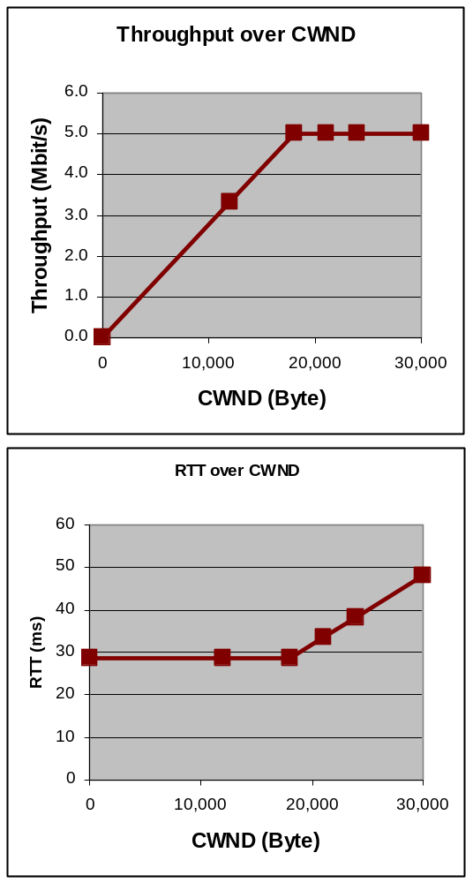
CWND vs. TCP RTT vs. TCP Throughput
loss
Summary:
  CWND < BDP:
    TCP RTT remains stable on idle level.
    Throughput increases with CWND,
    as throughput = CWND / RTT.
  CWND > BDP:
    TCP RTT increases if CWND increases.
    Throughput remains stable,
    as throughput = CWND / RTT.
  CWND >> BDP:
    Packet loss occurs due to buffer overflow.
→ So the optimal working zone for TCP is to have CWND fixed in the stable queuing zone between BDP and the point of packet loss.
BDP
Opti-mum
TCP Theory & Advance Diagnosis 1 / Bilal Shahid / Munich / August 2010

Slide 65
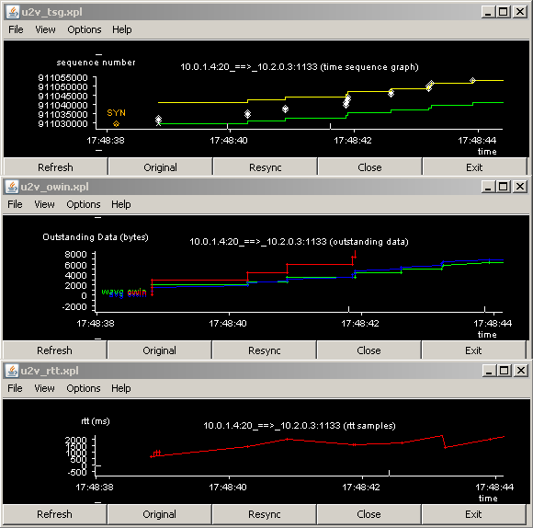
Correlation Between tcptrace/jplot Graphs
  The most important correlation is between the TSG, the OWIN and the RTT graph.
  Here we see e.g. how during Slow Start the OWIN increases every RTT, as more data is “on-the-fly”
  We also see RTT increase so we know that the pipe gets full.
TCP Theory & Advance Diagnosis 1 / Bilal Shahid / Munich / August 2010

Slide 66
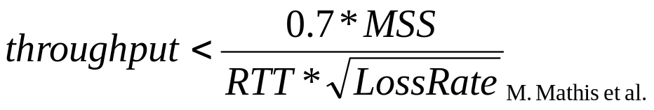
TCP Throughput Limitation #3
Formula only valid if
SACK option is not used!
  Once window size and available bandwidth aren’t the limit, TCP will speed up until it gets packet loss.
  After each loss, TCP will slow down and then recover speed.
  The loss rate (0 < LossRate < 1) determines, how often TCP will slow down, and how far it will have recovered before the next loss.
  Thus the loss rate limits the maximum average throughput according to above formula.
  Example:
    LossRate = 1%, MSS = 1460 Byte, RTT = 100 ms
    → throughput < 0.8 Mbit/s
TCP Theory & Advance Diagnosis 1 / Bilal Shahid / Munich / August 2010

Slide 67
Agenda
  Overview, motivation
  Recap on TCP basics
  Intro to tcptrace/jplot analysis tools
  Recap on TCP basics continued
  TCP throughput limitations
  Usefulness of certain TCP options
  Tweaking TCP parameters
  Outlook/references
We are here
TCP Theory & Advance Diagnosis 1 / Bilal Shahid / Munich / August 2010

Slide 68
RFC 3481: TCP over 2.5G and 3G Wireless Networks, Best Current Practice
  RFC 3481 describes the best current practice regarding TCP over 2.5G and 3G wireless networks.
  Contents:
    Description of the specific 2.5G and 3G link characteristics.
    Discussion of a lot of standard TCP options, which make sense to use in 2.5G and 3G networks.
    Discussion of open issues, which can be addressed by non-standard TCP options.
The following slides are only mentioning those options which have a high relevance for TCP over wireless networks.
For a full overview on the background theory and all discussed options of this RFC, please see the 2nd presentation (see slide 4).
TCP Theory & Advance Diagnosis 1 / Bilal Shahid / Munich / August 2010

Slide 69
RFC 3481: Appropriate Window Size
(Sender & Receiver)
  TCP over 2.5G/3G should support appropriate window sizes based on the Bandwidth Delay Product (BDP) of the end-to-end path.
  Normal TCP limits the receiver window size to 64 KB.
  If the end-to-end BDP is expected to be larger than 64 KB, the Window Scale Option [RFC 1323] can be used to overcome that limitation.
  Many operating systems by default use small TCP receive and send buffers around 16KB. Therefore, even for a BDP below 64 KB, the default buffer size setting should be increased at the sender and at the receiver to allow a large enough window.
TCP Theory & Advance Diagnosis 1 / Bilal Shahid / Munich / August 2010

Slide 70
RFC 3481: Selective Acknowledgments
(Sender & Receiver)
  The selective acknowledgment option (SACK, RFC 2018) is effective when multiple TCP segments are lost in a single TCP window.
  In particular, if the end-to-end path has a large BDP and a high packet loss rate, the probability of multiple segment losses in a single window of data increases.
  In such cases, SACK provides robustness beyond TCP-Tahoe and TCP-Reno.
  TCP over 2.5G/3G SHOULD support SACK.
  In the absence of SACK feature, the TCP should use NewReno RFC 2582.
TCP Theory & Advance Diagnosis 1 / Bilal Shahid / Munich / August 2010

Slide 71
RFC 3481: TCP Timestamps Option
(Sender & Receiver)
  Traditionally, TCP collects one RTT sample per window of data.
  This can lead to an underestimation of the RTT, and spurious timeouts on paths in which the packet transmission delay dominates the RTT.
  TCP connections with large windows may benefit from more frequent RTT samples provided with timestamps by adapting quicker to changing network conditions.
  Using the TCP Timestamps option has the advantage that retransmitted segments can be used for RTT measurement, which is otherwise forbidden by Karn's algorithm.
  Furthermore, the TCP Timestamps option is the basis for detecting spurious retransmits using the Eifel algorithm.
TCP Theory & Advance Diagnosis 1 / Bilal Shahid / Munich / August 2010

Slide 72
RFC 3481: TCP Timestamps Option
(Sender & Receiver)
  In 2.5/3G we have
    low degree of statistical multiplexing between different flows on the link.
    packet transmission and queuing delays dominate the path's RTT.
  This already results in large RTT variations as packets fill the queue while a TCP sender probes for more bandwidth, or as packets drain from the queue while a TCP sender reduces its load in response to a packet loss.
  In addition, the delay spikes across a 2.5/3G link may often exceed the end-to-end RTT.
  The thus resulting large variations in the path's RTT may often cause spurious timeouts.
TCP Theory & Advance Diagnosis 1 / Bilal Shahid / Munich / August 2010

Slide 73
RFC 3481: TCP Timestamps Option
(Sender & Receiver)
  It is advantageous to sample the path's RTT more often than only once per RTT.
  TCP can then track changes in the RTT more closely, especially react more quickly to sudden increases of the RTT by sooner updating the RTO to a more conservative value.
  The TCP Timestamps option provides this capability, allowing the TCP sender to sample the RTT from every segment that is acknowledged.
  Using timestamps in the mentioned scenario leads to a more conservative TCP retransmission timer and reduces the risk of triggering spurious timeouts.
TCP Theory & Advance Diagnosis 1 / Bilal Shahid / Munich / August 2010

Slide 74
RFC 3481: TCP Timestamps Option
(Sender & Receiver)
  There are two problematic issues with using timestamps:
    12 bytes of overhead are introduced by carrying the TCP Timestamps option and padding in the TCP header. This is a overhead of 0.8% for an MTU of 1500 Byte.
    Current TCP header compression schemes are limited in their handling of the TCP options field.
  Recommendation: TCP SHOULD use the TCP Timestamps option. It allows for better RTT estimation and reduces the risk of spurious timeouts.
TCP Theory & Advance Diagnosis 1 / Bilal Shahid / Munich / August 2010

Slide 75
RFC 3481: Summary 1 of 2
Item | Comment | Relevance (++, O, --)
Appropriate Window Size | (sender & receiver) based on end-to-end BDP | ++
Window Scale Option | (sender & receiver) Window size > 64KB | ++: for HSPA --: for 2.5G and 3G
Increased Initial Window | (sender) CWND = min(4 * MSS, max(2 * MSS, 4380 Byte)) | O: Typical sender already start with CWND=2, Only PEP or DMZ.
Limited Transmit | (sender) | O: as only for small amount of data
IP MTU larger than Default | more applicable to 3G | O: typically 1500 Byte already used.
The items not discussed in this slideset are discussed in the 2nd presentation.
TCP Theory & Advance Diagnosis 1 / Bilal Shahid / Munich / August 2010

Slide 76
RFC 3481: Summary 2 of 2
Item | Comment | Relevance (++, O, --)
Path MTU Discovery | (sender & intermediate routers) | O: usually already implemented
Selective Acknowledgment option (SACK) | (sender & receiver) | ++
Explicit Congestion Notification (ECN) | (sender & intermediate routers) | ???: too few experience.
Timestamps Option | (sender & receiver) | ++ for 3G and HSPA O: for 2.5 G due to overhead
Disabling RFC1144 TCP/IP Header Compression | (wireless host) | O: typically not used anyway.
The items not discussed in this slideset are discussed in the 2nd presentation.
TCP Theory & Advance Diagnosis 1 / Bilal Shahid / Munich / August 2010

Slide 77
RFC 3481: Open Issues
  There are additional mechanisms and parameter settings that may increase end-to-end performance when running TCP across 2.5G/3G networks.
  But as those mechanisms and parameter settings are not part of any standards track RFC at the time of this writing, they cannot be recommended for the Internet in general.
  This includes:
    Enhanced TCP/IP header compression schemes.
    Active queue management.
    Link layer retransmission schemes and local packet caching/retransmitting packets during transient link outages.
    Appropriate reaction to spurious timeouts, packet re-ordering, and packet duplication, e.g. by reverting congestion control state after such event has been detected and adapting the retransmission timer and duplicate acknowledgement threshold.
    Initial and subsequent RTO selection.
TCP Theory & Advance Diagnosis 1 / Bilal Shahid / Munich / August 2010

Slide 78
Agenda
  Overview, motivation
  Recap on TCP basics
  Intro to tcptrace/jplot analysis tools
  Recap on TCP basics continued
  TCP throughput limitations
  Usefulness of certain TCP options
  Tweaking TCP parameters
  Outlook/references
We are here
TCP Theory & Advance Diagnosis 1 / Bilal Shahid / Munich / August 2010

Slide 79
TCP Parameter Tweaking
We’ve seen that the most important parameters are:
  Receiver buffer size
  Sender buffer size
  Usage of SACK
  Window scaling option
  Timestamp option
The other TCP optimizations of RFC 3481 are usually already built-in into modern Windows and Linux TCP stacks.
TCP Theory & Advance Diagnosis 1 / Bilal Shahid / Munich / August 2010

Slide 80
TCP Parameter Tweaking On Windows
  See tcpip2000.doc delivered with this slideset for a full explanation of all registry values.
  See TCP_stack_tweaks_GPRS_windows.doc delivered with this slideset for an explanation of the important registry values with recommendations for GPRS.
  Or use one of the many “TCP optimizer” tools from the internet, which usually allow you to change the registry values via a GUI.
TCP Theory & Advance Diagnosis 1 / Bilal Shahid / Munich / August 2010

Slide 81
TCP Parameter Tweaking On Linux
  See all current parameters (as root) with
    # sysctl –a | fgrep tcp
    net.ipv4.tcp_timestamps = 1
    net.ipv4.tcp_window_scaling = 1
    net.ipv4.tcp_sack = 1
    net.ipv4.tcp_fack = 1
    net.ipv4.tcp_reordering = 3
    net.ipv4.tcp_mem = 96288 128384 192576
    net.ipv4.tcp_wmem = 4096 655360 6553600
    net.ipv4.tcp_rmem = 8192 873800 8738000
    net.ipv4.tcp_congestion_control = cubic
    net.ipv4.tcp_max_ssthresh = 0
    …
TCP Theory & Advance Diagnosis 1 / Bilal Shahid / Munich / August 2010

Slide 82
TCP Parameter Tweaking On Linux
  Alternatively, see values from /proc filesystem.
  Example: for the value net.ipv4.tcp_rmem the command is
    # cat /proc/sys/net/ipv4/tcp_rmem
    8192 873800 8738000
  To change the parameters, write new values to the proc filesystem.
  Example: for the value net.ipv4.tcp_rmem the command is
    # echo 10000 50000 100000 > /proc/sys/net/ipv4/tcp_rmem
TCP Theory & Advance Diagnosis 1 / Bilal Shahid / Munich / August 2010

Slide 83
TCP Parameter Tweaking
General comments:
  During an optimization project we can control client and server, but in real life this is more difficult.
  Subscriber side (clients)
    Too many subscribers to train them to optimize their settings themselves.
    The driver software of the HSPA card could optimize the TCP settings.
  Internet side (servers)
    Too many servers which are optimized for the average Internet user, but not for access through mobile networks.
    Connecting through a Proxy would help, but MBB subscribers usually connect directly to the Internet server without using a Proxy.
    Operator could use a transparent Proxy to control the server side.
TCP Theory & Advance Diagnosis 1 / Bilal Shahid / Munich / August 2010

Slide 84
Agenda
  Overview, motivation
  Recap on TCP basics
  Intro to tcptrace/jplot analysis tools
  Recap on TCP basics continued
  TCP throughput limitations
  Usefulness of certain TCP options
  Tweaking TCP parameters
  Outlook/references
We are here
TCP Theory & Advance Diagnosis 1 / Bilal Shahid / Munich / August 2010

Slide 85
Outlook
  We’ve learned a lot about how a typical TCP stack (TCP Reno) works.
  You’ll learn even more if you check out the 2nd presentation (see slide 4).
  Today more and more other variants of TCP stacks emerge and each behaves differently.
  Therefore in practice we’ll see effects that we can’t explain from the classical TCP Reno behavior.
  More work could be done to understand the effects of modern non-Reno TCP stacks on the TCP connection performance.
  Also the correlation of TCP traces with Nemo traces have just begun. Probably there is much more to examine to get a better understanding where the bottleneck is.
  Finally, the whole MBB/TCP optimization is within SOA a topic to be investigated further in STP1/2010.
TCP Theory & Advance Diagnosis 1 / Bilal Shahid / Munich / August 2010

Slide 86
References
  http://sd.wareonearth.com/woe/current_projects_information.htm
  http://www.wareonearth.com/whitepapers/ThroughputTests&PathDiagnostics.pdf
  http://www.eventhelix.com/EventStudio/tcp_ip_sequence_diagrams/
  http://www.caida.org/tools/taxonomy/measurement/
  http://www.nlanr.net/NATimes/NAT.1.2/phil.htm
  http://www.osischool.com
  http://www.cs.berkeley.edu/~kfall/EE122/lec22/index.htm
  http://www.slideshare.net/LoveMyTool/ostu-wireshark-tcp-stream-graphs-by-ray-tompkins-presentation
TCP Theory & Advance Diagnosis 1 / Bilal Shahid / Munich / August 2010

Slide 87
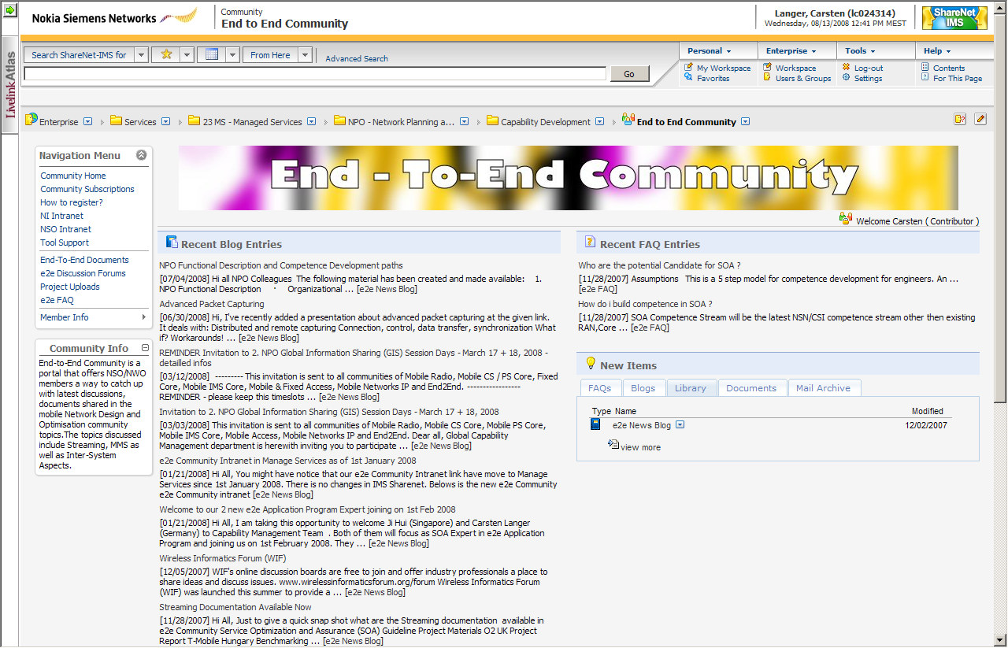
E2E Application Performance Program
Please refer to the E2E community for further info, blogs, forums and documents at https://sharenet-ims.inside.nokiasiemensnetworks.com/Open/cop_NSO_e2e.
TCP Theory & Advance Diagnosis 1 / Bilal Shahid / Munich / August 2010

