Slide 1
BOOTSTRAP 4
Containers, Grids, Typography, Colors, Tables

Slide 2
BOOTSTRAP CONTAINERS

Slide 3


Containers
Containers are used to pad the content inside of them, and there are two container classes available:
The .container class provides a responsive fixed width container
The .container-fluid class provides a full width container, spanning the entire width of the viewport

Slide 4
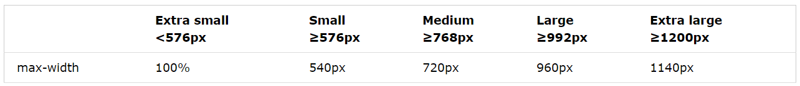
Fixed Container
Use the .container class to create a responsive, fixed-width container.
<div class="container"> <h1>My First Bootstrap Page</h1> <p>This is some text.</p> </div>

Slide 5
Fluid Container
Use the .container-fluid class to create a full width container, that will always span the entire width of the screen (width is always 100%).
<div class="container-fluid"> <h1>My First Bootstrap Page</h1> <p>This is some text.</p> </div>

Slide 6
Container Padding
By default, containers have 15px left and right padding, with no top or bottom padding. Therefore, we often use space utilities, such as extra padding and margins to make them look even better.
For example, .pt-3 means “add a top padding of 16px”.
<div class="container pt-3"></div>

Slide 7
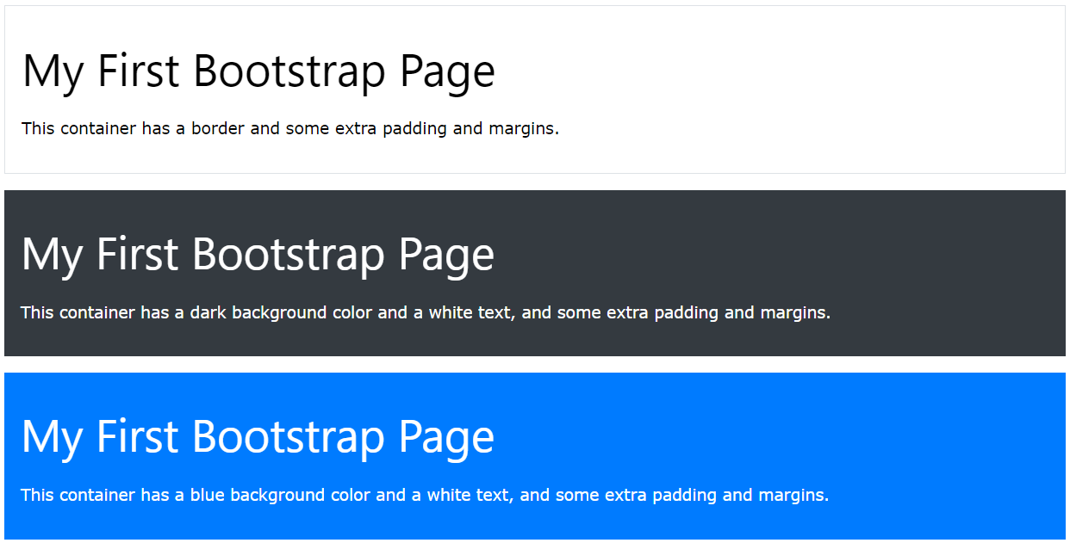
Container Border and Color
Other utilities, such as borders and colors, are also often used together with containers:
<div class="container p-3 my-3 border"></div> <div class="container p-3 my-3 bg-dark text-white"></div> <div class="container p-3 my-3 bg-primary text-white"></div>

Slide 8
BOOTSTRAP GRIDS BASICS

Slide 9
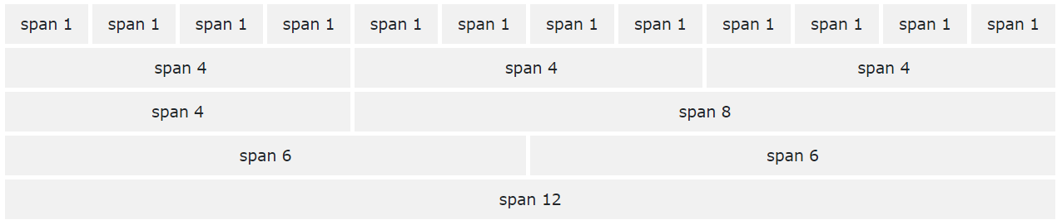
Grids
Bootstrap’s grid system is built with flexbox and allows up to 12 columns across the page.
If you do not want to use all 12 columns individually, you can group the columns together to create wider columns:

Slide 10
Grid Classes
The Bootstrap 4 grid system has five classes:
.col- (extra small devices – screen width less than 576px)
.col-sm (small devices – screen width equal to or greater than 576px)
.col-md (medium devices – screen width equal to or greater than 768px)
.col-lg (large devices – screen width equal to or greater than 992px)
.col-xl (extra large devices – screen width equal to or greater than 1200px)

Slide 11
Basic Structure of a Bootstrap Grid
The following is a basic structure of a Bootstrap grid:
<!-- Control the column width, and how they should appear on different devices --> <div class="row"> <div class="col-*-*"></div> <div class="col-*-*"></div> </div> <div class="row"> <div class="col-*-*"></div> <div class="col-*-*"></div> <div class="col-*-*"></div> </div> <!-- Or let Bootstrap automatically handle the layout --> <div class="row"> <div class="col"></div> <div class="col"></div> <div class="col"></div> </div>

Slide 12
Three Equal Columns
The following example shows how to create three equal-width columns, on all devices and screen widths:
<div class="row"> <div class="col">.col</div> <div class="col">.col</div> <div class="col">.col</div> </div>

Slide 13
Responsive Columns
The following example shows how to create four equal-width columns starting at tablets and scaling to extra large desktops.
On mobile phones or screens that are less than 576px wide, the columns will automatically stack on top of each other.
<div class="row"> <div class="col-sm-3">.col-sm-3</div> <div class="col-sm-3">.col-sm-3</div> <div class="col-sm-3">.col-sm-3</div> <div class="col-sm-3">.col-sm-3</div> </div>

Slide 14
Two Unequal Responsive Columns
The following example shows how to get two various-width columns starting at tablets and scaling to extra large desktops:
<div class="row"> <div class="col-sm-4">.col-sm-4</div> <div class="col-sm-8">.col-sm-8</div> </div>

Slide 15
BOOTSTRAP TYPOGRAPHY CLASSES

Slide 16
Typography Classes
The Bootstrap 4 classes below can be added to style HTML elements further:
Class | Description
.fw-bold | Bold text
.fw-bolder | Bolder text
.fst-italic | Italic text
.fw-light | Light weight text
.fw-lighter | Lighter weight text
.fw-normal | Normal text
.lead | Makes a paragraph stand out
.small | Indicates smaller text (set to 80% of the size of the parent)
.text-start | Indicates left-aligned text
.text-center | Indicates center-aligned text
.text-decoration-none | Removes the underline from a link
.text-end | Indicates right-aligned text

Slide 17
BOOTSTRAP COLORS

Slide 18
Bootstrap Colors
Bootstrap has some contextual classes that can be used to provide “meaning through colors”.
The classes for text colors are: .text-muted, .text-primary, .text-success, .text-info, .text-warning, .text-danger, .text-secondary, .text-white, .text-dark, .text-light
This text is muted.
This text is important.
This text indicates success.
This text represents some information.
This text represents a warning.
This text represents danger.
Secondary text.
Dark grey text.
Body text.
Contextual text classes can also be used on links, which will add a darker hover color.

Slide 19
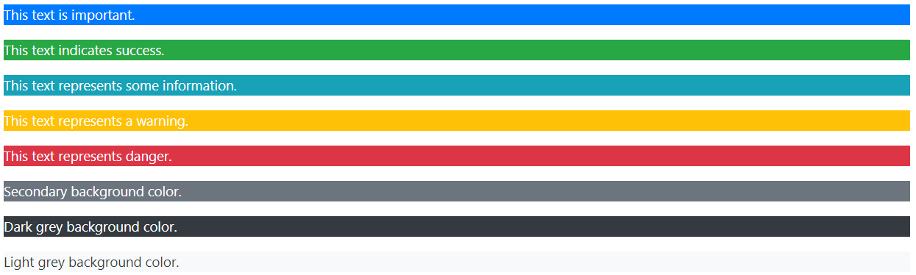
Background Colors
The classes for background colors are: .bg-primary, .bg-success, .bg-info, .bg-warning, .bg-danger, .bg-secondary, .bg-dark and .bg-light
Note that background colors do not set text color, so in some cases you will want to use them together with a .text-* class.

Slide 20
BOOTSTRAP TABLES

Slide 21
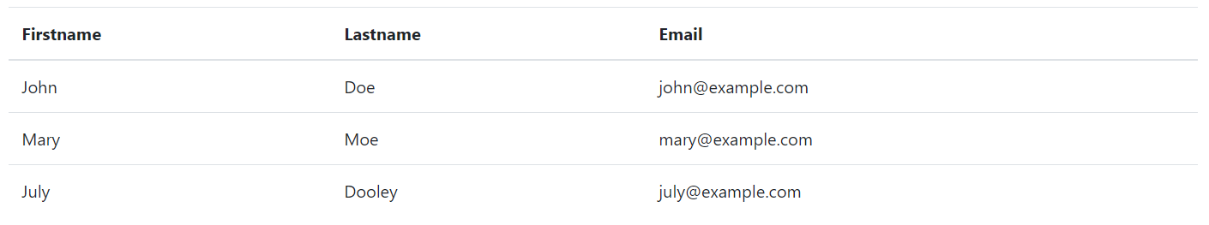
Bootstrap Tables
A basic Bootstrap table has a light padding and horizontal dividers.
The .table class adds basic styling to a table.
<table class="table">
<thead>
<tr>
<th>Firstname</th>
<th>Lastname</th>
<th>Email</th>
</tr>
</thead>
<tbody>
<tr>
<td>John</td>
<td>Doe</td>
<td>john@example.com</td>
</tr>
<tr>
<td>Mary</td>
<td>Moe</td>
<td>mary@example.com</td>
</tr>
<tr>
<td>July</td>
<td>Dooley</td>
<td>july@example.com</td>
</tr>
</tbody>
</table>

Slide 22
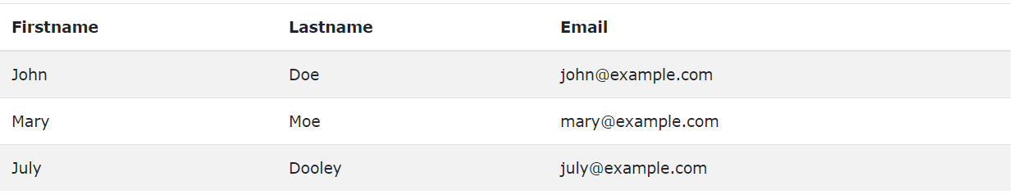
Striped Rows
The .table-striped class add zebra-stripes to a table.
<table class="table table-striped"> … </table>

Slide 23
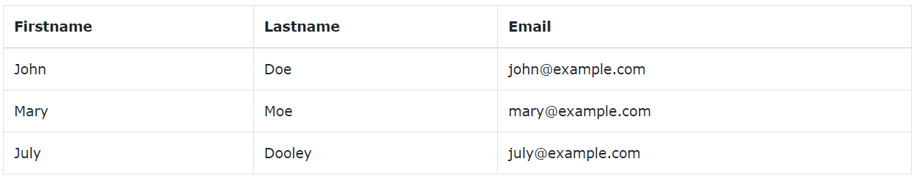
Bordered Table
The .table-bordered class adds borders on all slides of the table and cells.
<table class="table table-bordered"> … </table>

Slide 24
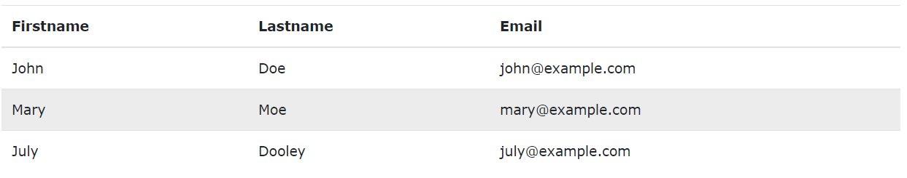
Hover Rows
The .table-hover class adds a hover effect (grey background color) on table rows.

Slide 25
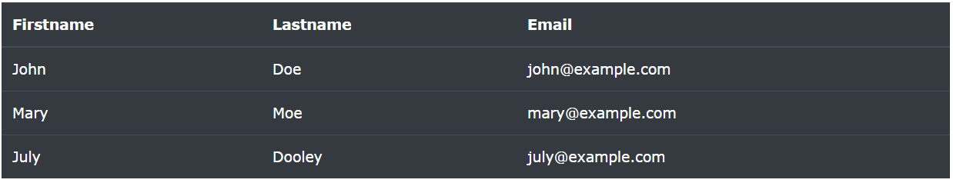
Black/Dark Table
The .table-dark class adds a black background to the table.

Slide 26
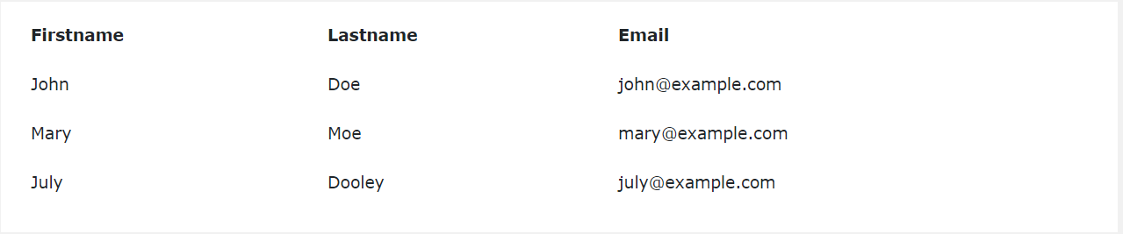
Borderless Table
The .table-borderless class removes borders from the table.

Slide 27
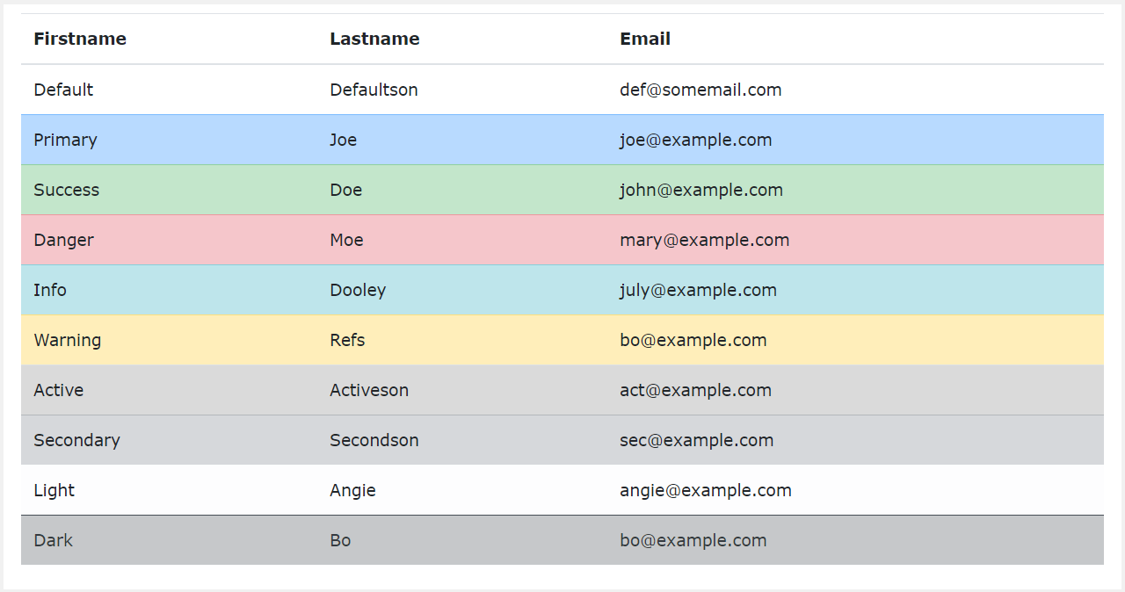
Contextual Classes
Contextual classes can be used to color the whole table (<table>), the table rows (<tr>), or table cells (<td>).

Slide 28
The contextual classes that can be used are:
Class | Description
.table-primary | Blue: Indicates an important action
.table-success | Green: Indicates a successful or positive action
.table-danger | Red: Indicates a dangerous or potentially negative action
.table-info | Light blue: Indicates a neutral informative change or action
.table-warning | Orange: Indicates a warning that might need attention
.table-active | Grey: Applies the hover color to the table row or table cell
.table-secondary | Grey: Indicates a slightly less important action
.table-light | Light grey table or table row background
.table-dark | Dark grey table or table row background

Slide 29
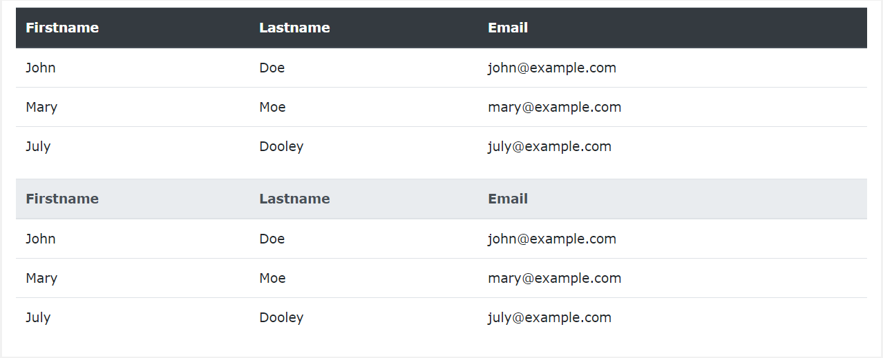
Table Head Colors
The .thead-dark class adds a black background to tabe headers, and the .thead-light class adds a grey background to table headers.
<table class="table">
<thead class="table-dark"> </thead>
</table>
<table class="table">
<thead class="table-light"> </thead>
</table>

Slide 30
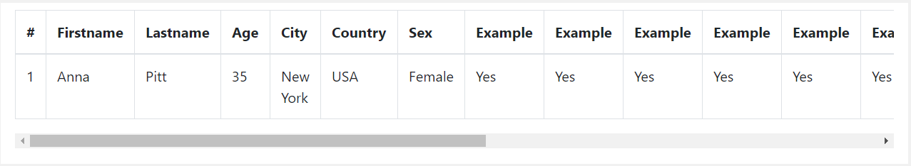
Responsive Tables
The .table-responsive class adds a scrollbar to the table when needed (when it is too big horizontally)
<div class="table-responsive"> <table class="table"> ... </table> </div>

