Slide 1
Time series data River Bosna stages
Introduction
Problem 1
MNIST data
Model
Results
Problem 2
River data
Model
Results
What have I learned?
Problem?
River stages from 2001 – 2011
Gauging station “Maglaj- Poljice”
4015 days
Supervised (Regression)
Forecast/predict t+1 river stage

Slide 2
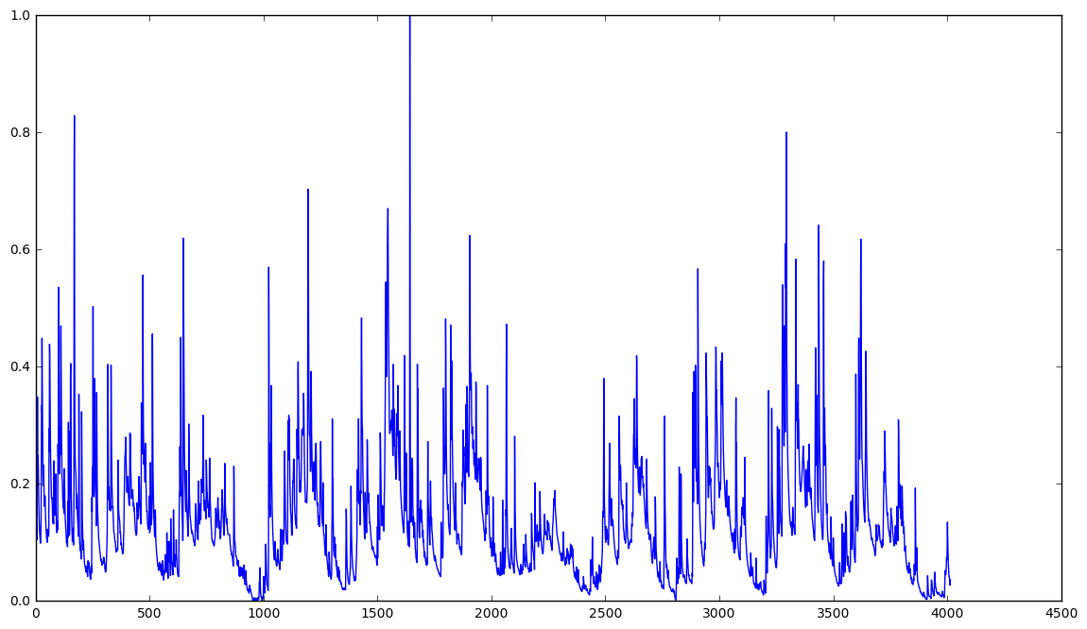
River Bosna stages Visualization
Introduction
Problem 1
MNIST data
Model
Results
Problem 2
River data
Model
Results
What have I learned?

Slide 3
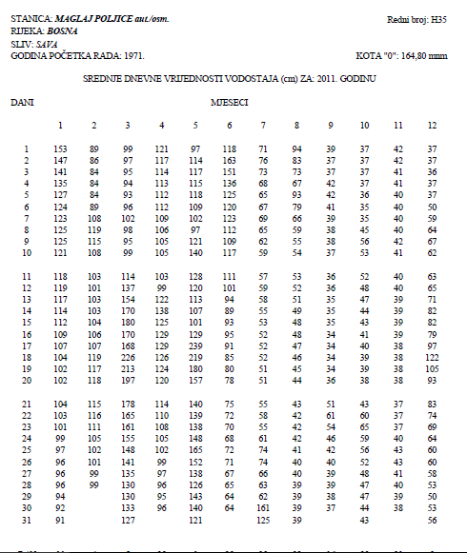
River Bosna stages Data
Introduction
Problem 1
MNIST data
Model
Results
Problem 2
River data
Model
Results
What have I learned?

Slide 4
Model
Introduction
Problem 1
MNIST data
Model
Results
Problem 2
River data
Model
Results
What have I learned?
80 % training data
20 % testing data
Different sequences:
3 days
5 days
8 days
30 days

Slide 5
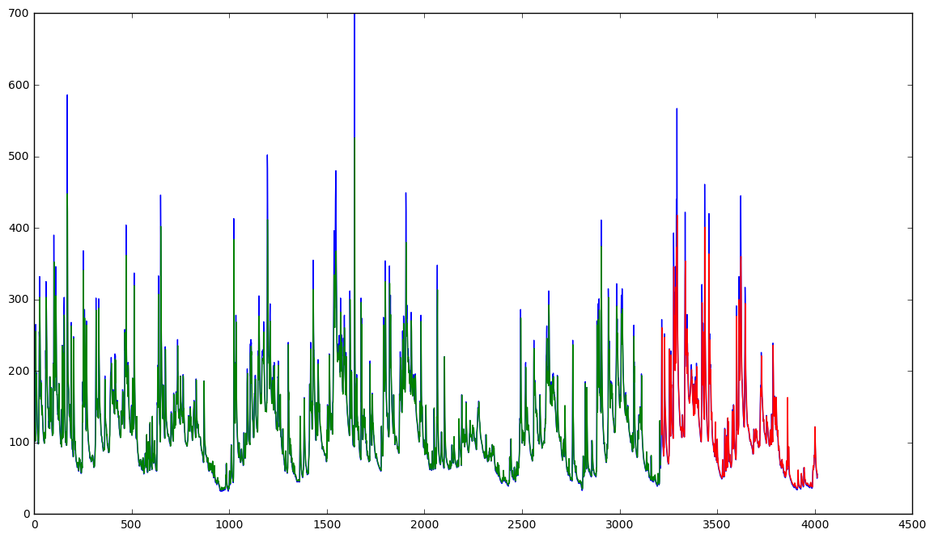
River Bosna stages Visualization
Introduction
Problem 1
MNIST data
Model
Results
Problem 2
River data
Model
Results
What have I learned?

Slide 6
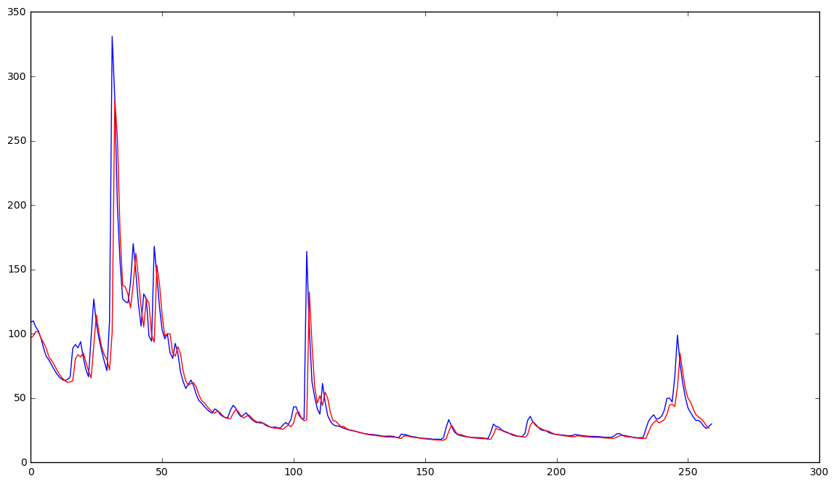
Results 8 days
Introduction
Problem 1
MNIST data
Model
Results
Problem 2
River data
Model
Results
What have I learned?

Slide 7
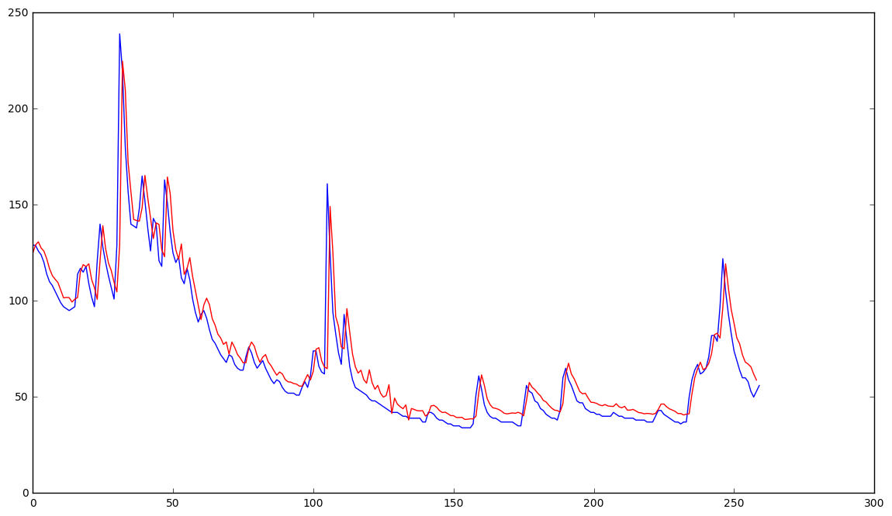
Results 30 days
Introduction
Problem 1
MNIST data
Model
Results
Problem 2
River data
Model
Results
What have I learned?

Slide 8
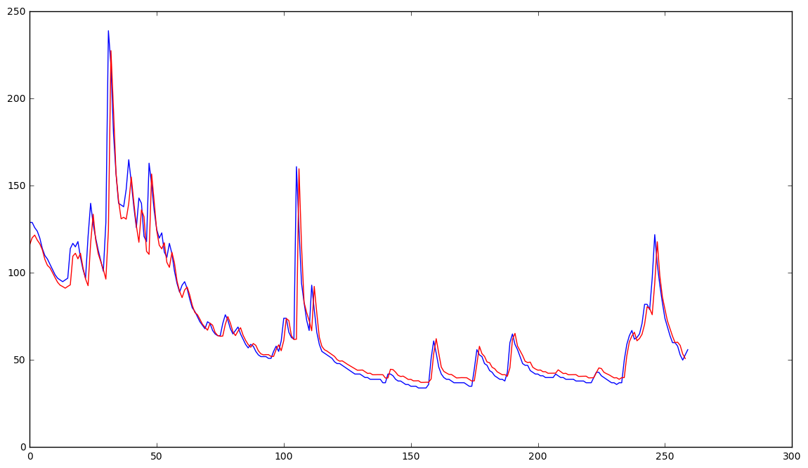
Results 5 days
Introduction
Problem 1
MNIST data
Model
Results
Problem 2
River data
Model
Results
What have I learned?

Slide 9
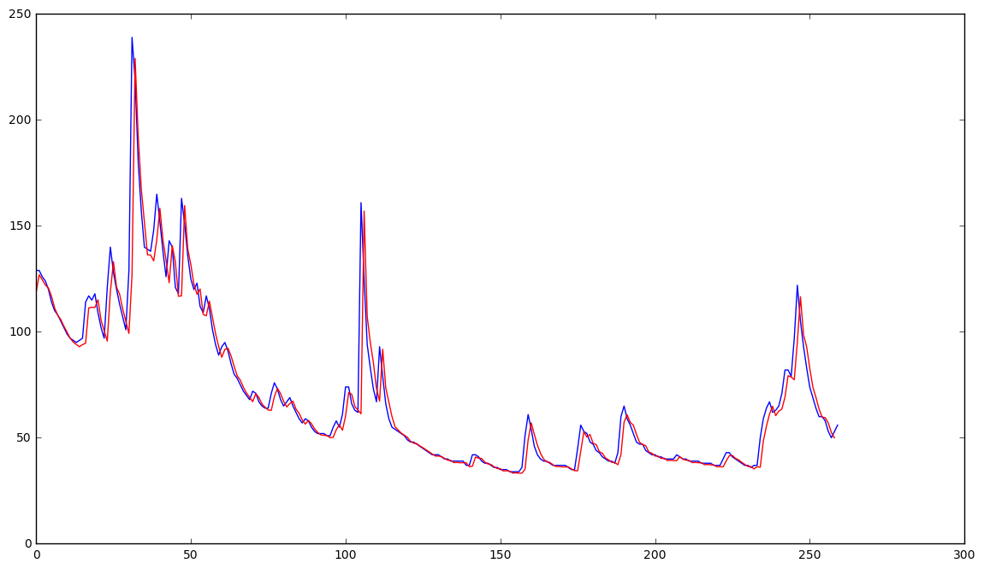
Results 3 days
Introduction
Problem 1
MNIST data
Model
Results
Problem 2
River data
Model
Results
What have I learned?

Slide 10
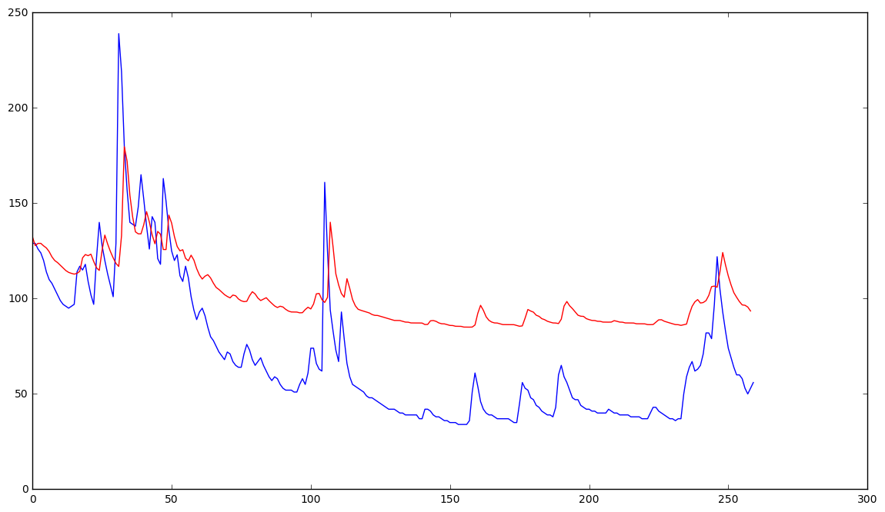
Results SGD optimizer
Introduction
Problem 1
MNIST data
Model
Results
Problem 2
River data
Model
Results
What have I learned?

Slide 11
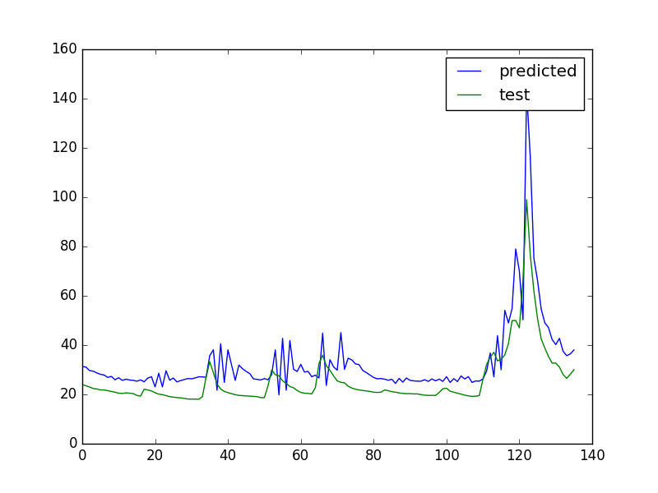
First try ☺
Introduction
Problem 1
MNIST data
Model
Results
Problem 2
River data
Model
Results
What have I learned?

Slide 12
How?
Introduction
Problem 1
MNIST data
Model
Results
Problem 2
River data
Model
Results
What have I learned?
Recurrent Neural Network
LSTM -> Long Short Term Memory
Good with time series data
Tensorflow
Keras library

Slide 13

How?
Introduction
Problem 1
MNIST data
Model
Results
Problem 2
River data
Model
Results
What have I learned?
“The clouds are in the … sky”
“I grew up in England… I speak fluent English”
2 4 8 16 32 ?

Slide 14
What have I learned?
Introduction
Problem 1
MNIST data
Model
Results
Problem 2
River data
Model
Results
What have I learned?
Convolutional Neural Network
Recurrent Neural Network

