Slide 1
Introduction
NLP
Word2Vec
Task 1
Task 2

Slide 2
Introduction
NLP – Natural language processing
Spam detection
Information extraction
Machine translation
Summarization
Sentiment analysis

Slide 3
Sentiment analysis
79 % typically human rate agrees
Prediction of 70 % accuracy is considered good
“Bag of words”
tf–idf → term frequency–inverse document frequency

Slide 4
“Bag of words”
Frequency of words is used as feature
“John likes to watch movies. Marry likes movies too”
“John also likes to watch football games”
[“John”, “likes”, “to”, “watch”, “movies”, “also”, “football”, “games”, “Marry”, “too”]
(1)[1, 2, 1, 1, 2, 0, 0, 0, 1, 1]
(2)[1, 1, 1, 1, 0, 1, 1, 1, 0, 0]

Slide 5
Word2Vec
Produces word embeddings
Google news word2vec model
Trained on 100 billion words
Contains 3 million words (1.5 GB)
Vector length: 300

Slide 6
King – man + women = ?

Slide 7
King – man + women = ?
King – man + women = queen
Gender is biggest difference

Slide 8

“Item_3469” with “pregnant”

Slide 9

“item_1379” “item_11275” “item_11868”

Slide 10
Dataset / movie reviews
8000 positive
8000 negative
60682 words

Slide 11
Positive example
this spectacular film is one of the most amazing movies i have ever seen it shows a china i had never seen or imagined and i believe it shows s china in the most real light ever seen in a movie it is absolutely heart breaking in so many situations seeing how hard life was for the characters and yet the story and the ending are incredibly joyful you truly see the depths and heigths of human existence in this film the actors are all perfect such that you feel like you have really entered a different world i simply can not recommend this movie highly enough it may just change you forever once you have seen it

Slide 12
Negative eaxmle
plot is not worth discussion even if it hints at corruption murder power and the rest of thriller related topics characters are interesting though sometimes not realistic but interesting nevertheless development is slow like tea drinking ceremony visuals not stunning but good enough to ease the eye strain good movie to watch after dinner before going to bed nothing shocking too much nothing overexciting movie sitcom style i liked woody excellent performance had to fight the plot inadequacy and did the job pretty good the rest are bearable though very predictable the whole is watchable and better than most tv shows

Slide 13
How?
Using word2vec vectors with CNN
Training accuracy: 98.3 %
Testing accuracy: 94.2 %

Slide 14
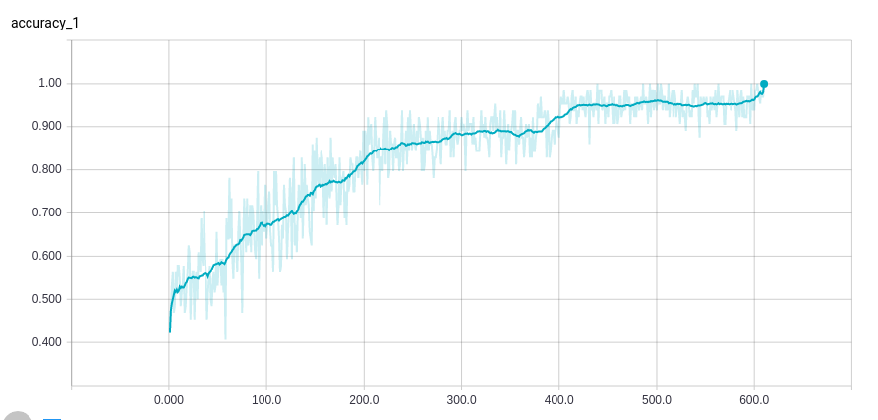

Slide 15
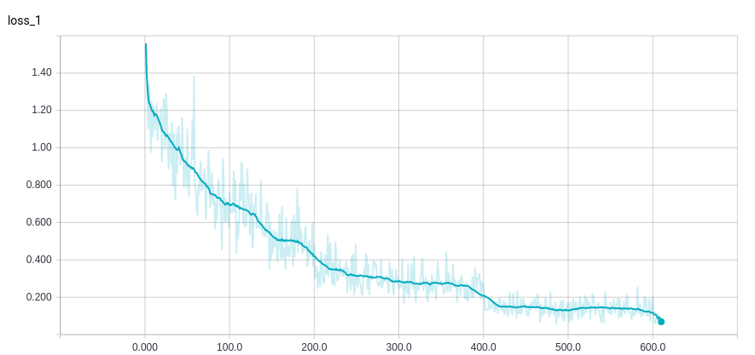

Slide 16
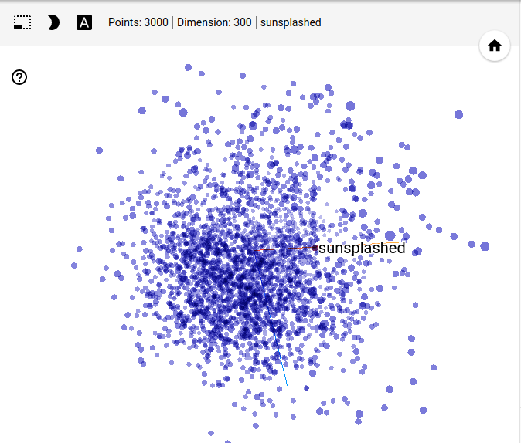

Slide 17
Another method
Averaging vectors
Logistic regression
8000 positive reviews
8000 negative reviews
Training accuracy: 83.7 %
Testing accuracy: 83.1 %

Slide 18
Thank you!

