Slide 1

Demo 3 Mentors: Faruk Pasalic, Samra Tanovic Atlantbh April, 12., 2017
Jusuf Koric

Slide 2
Idea → House price prediction of Sarajevo
Why?
Data
Olx.ba

Slide 3
Preprocessing data
7226 samples
50 features
2800 samples chosen
13 features chosen

Slide 4
Problems?
Squares
Missing values
Renting
Prices
Clusters / location
Data Normalization

Slide 5
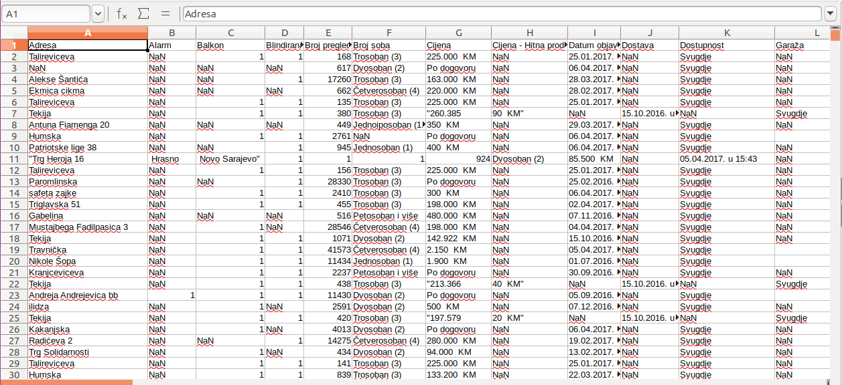

Slide 6
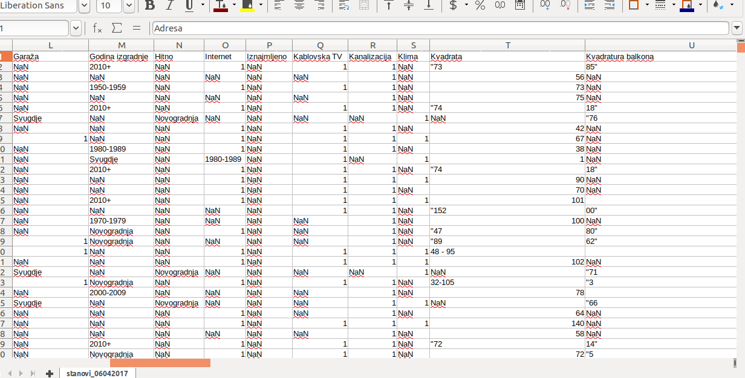

Slide 7
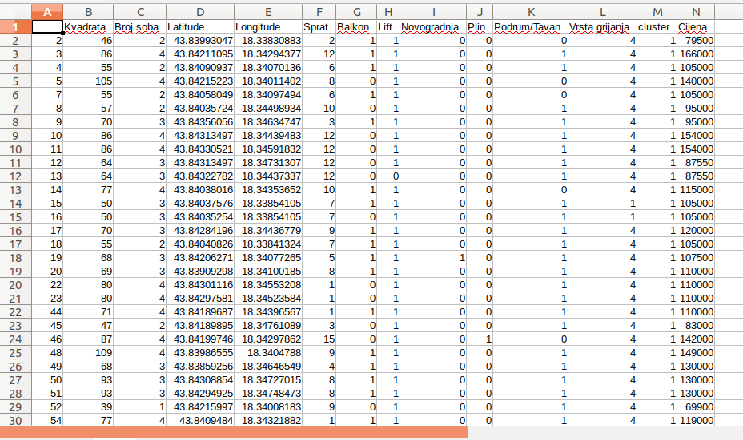

Slide 8
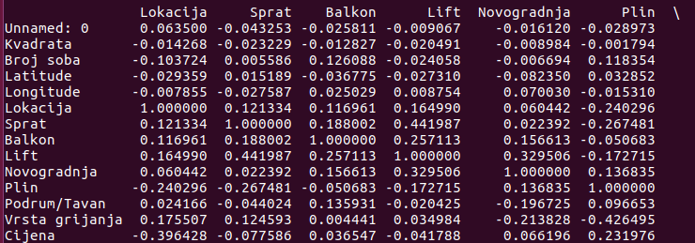
Pearson correlation

Slide 9
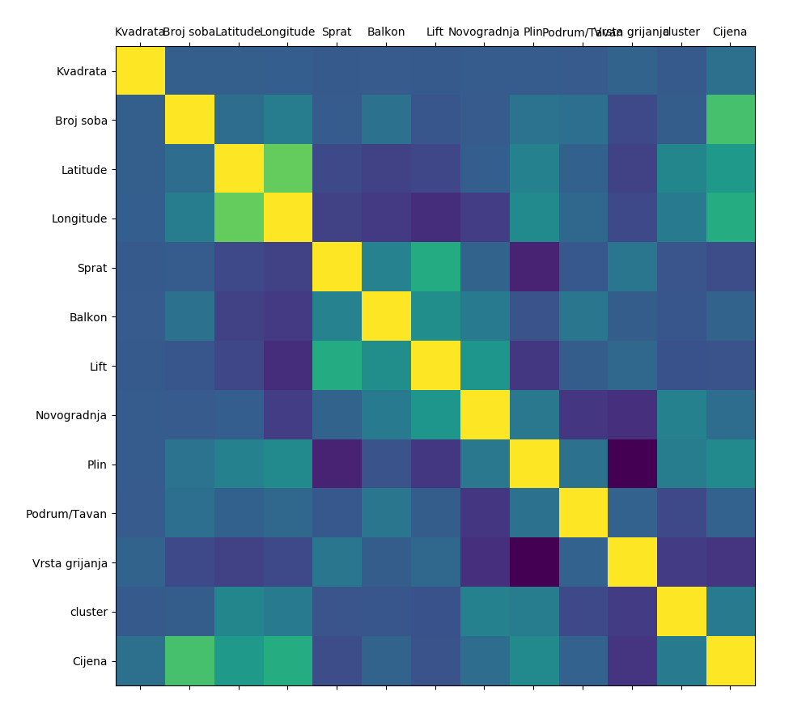

Slide 10
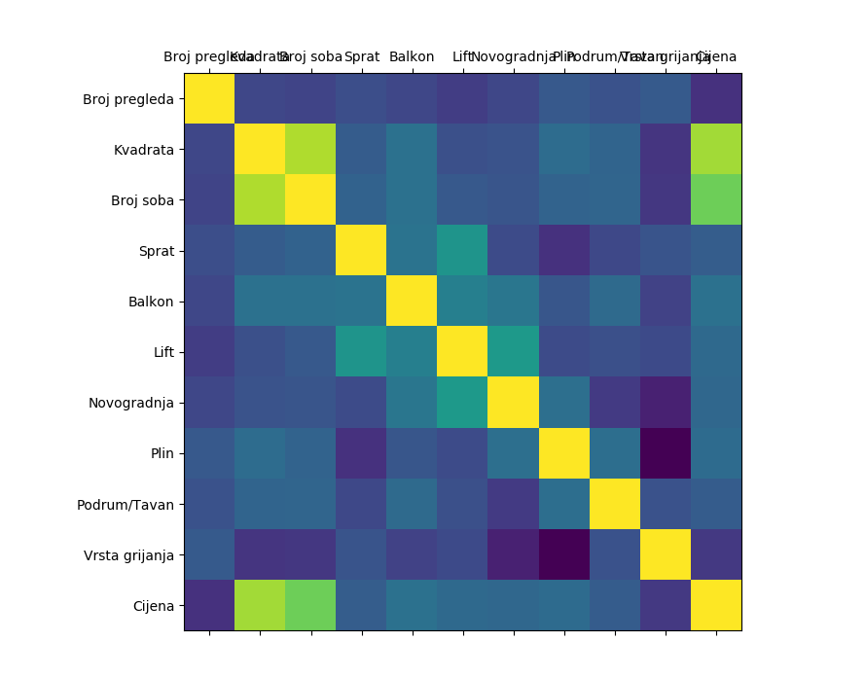
Old town

Slide 11
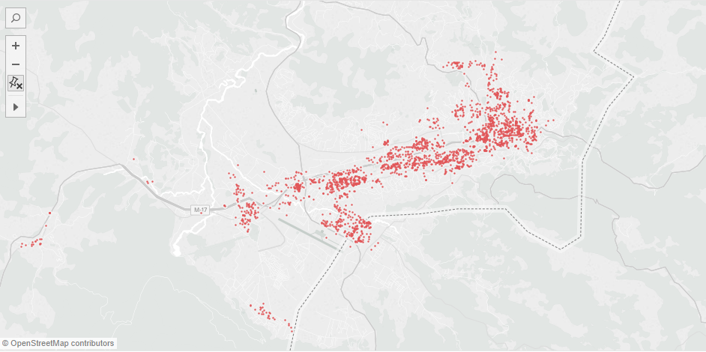
Lat/Lng

Slide 12
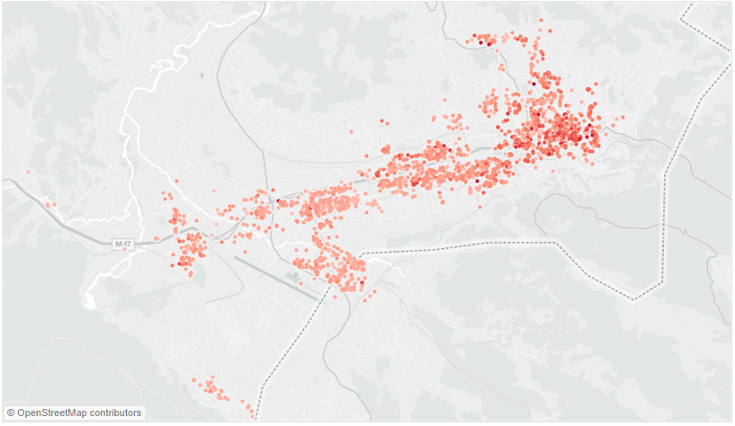
Price

Slide 13
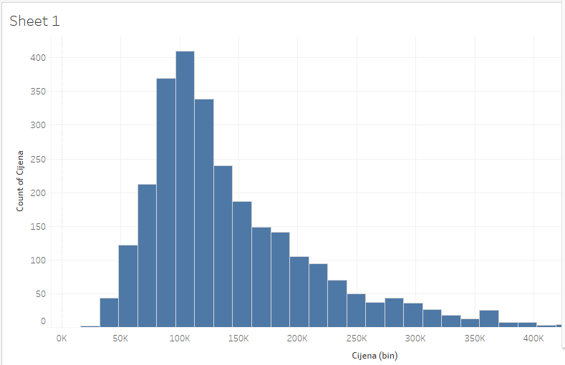
Price

Slide 14
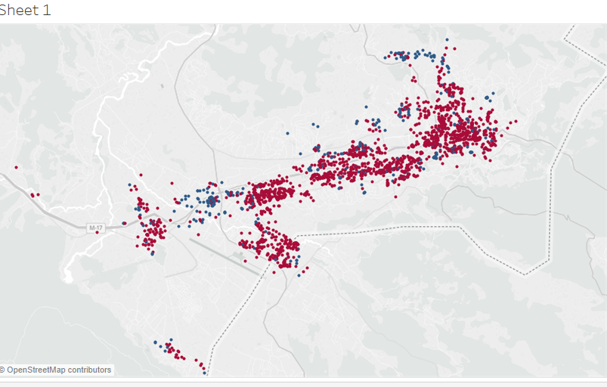
Novogradnja

Slide 15
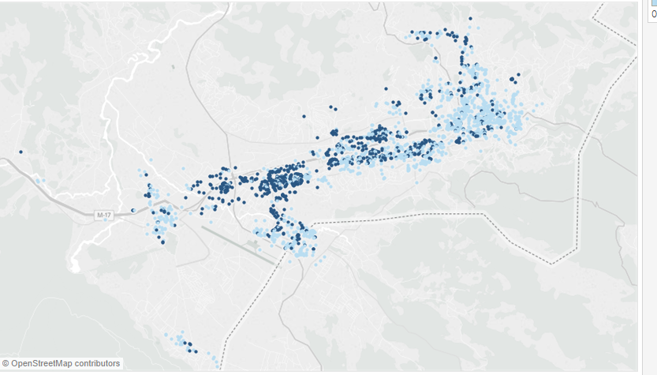
Lift

Slide 16
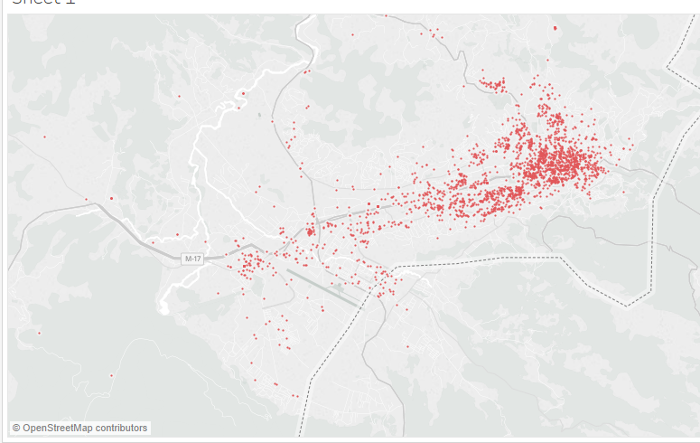
Renting

Slide 17
How?
Decision Tree Regressor training: 0.999999973227
Decision Tree Regressor testing: 0.730114739063
Linear regression training: 0.709080699608
Linear regression testing: 0.658007183086
SVR_Regressor training: 0.647519589323
SVR_Regressor testing: 0.61693135256

Slide 18
What is next?
More data
Tune current algorithms
Try another algorithms
PCA
Solve overfitting

Slide 19
Thank you!

