Slide 1
Idea → House price prediction of Sarajevo
Why?
Data
Olx.ba

Slide 2
Preprocessing data
7226 samples
50 features
2800 samples chosen
13 features chosen

Slide 3
Problems?
Squares
Missing values
Renting
Prices
Clusters / location
Data Normalization

Slide 4
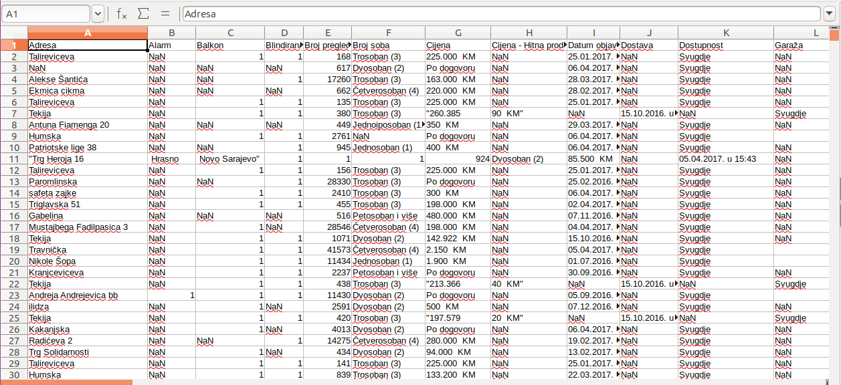

Slide 5
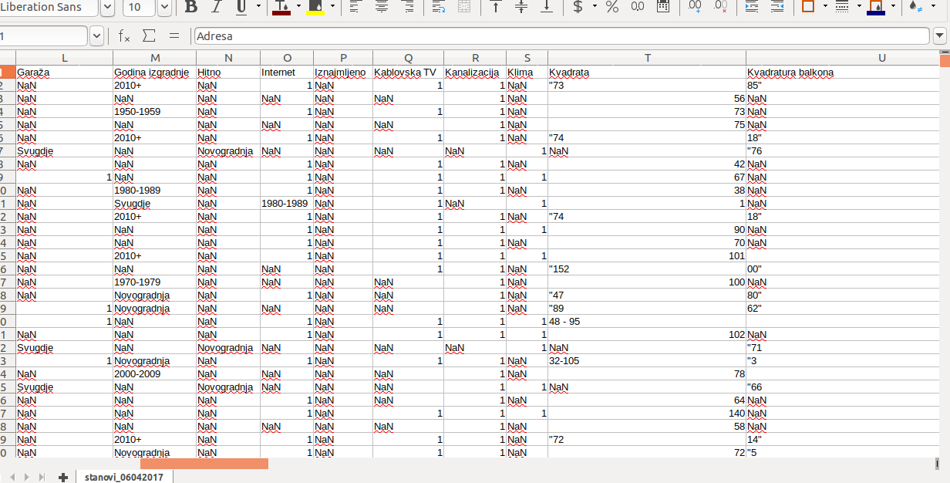

Slide 6
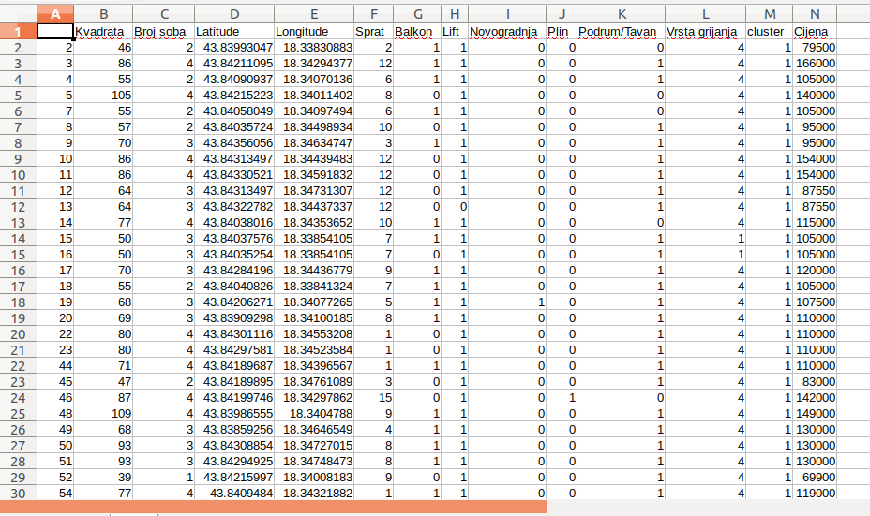

Slide 7
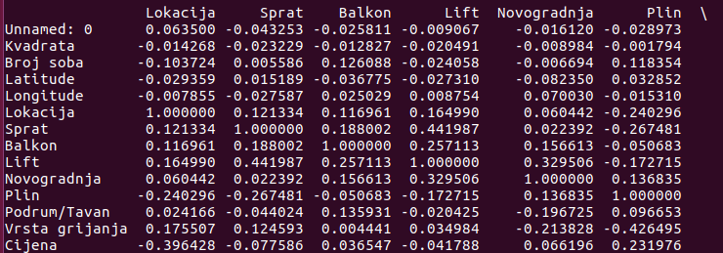
Pearson correlation

Slide 8
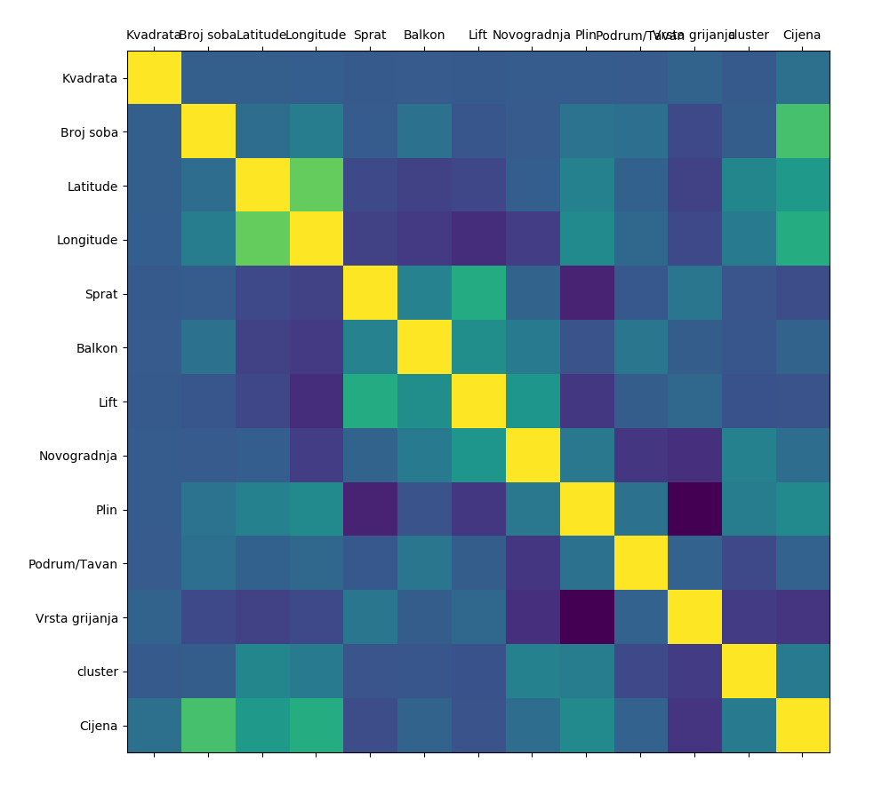

Slide 9
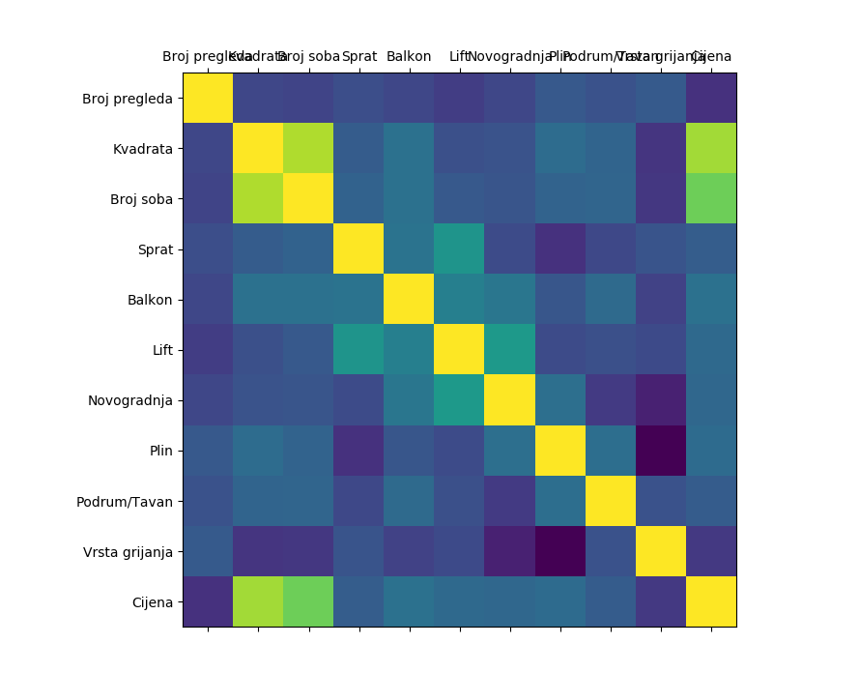
Old town

Slide 10
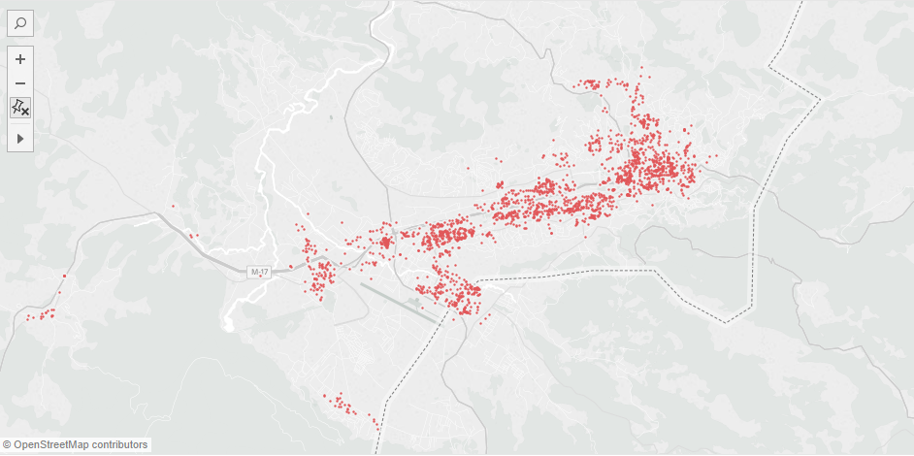
Lat/Lng

Slide 11
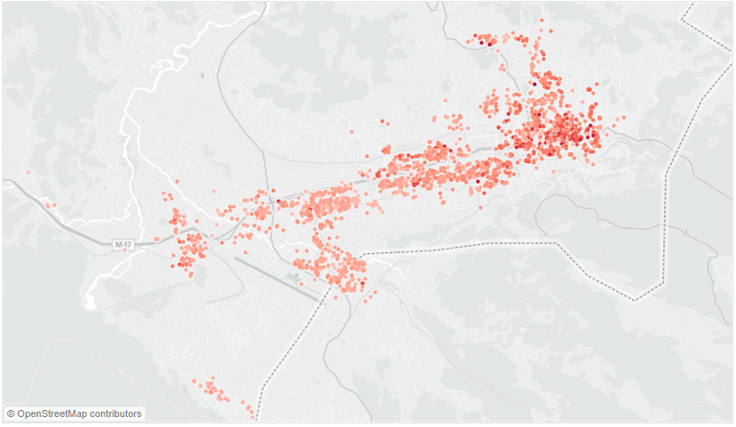
Price

Slide 12
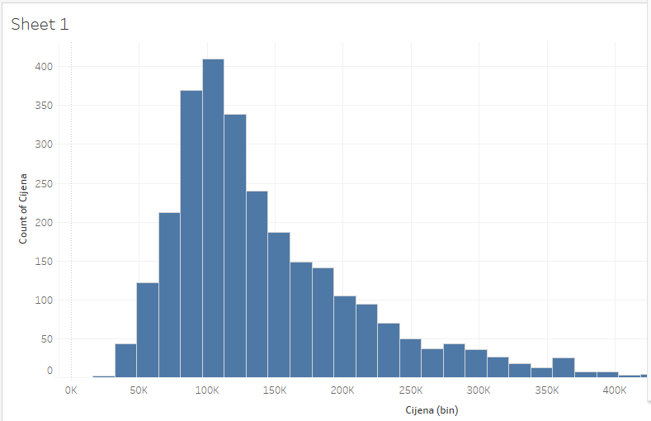
Price

Slide 13
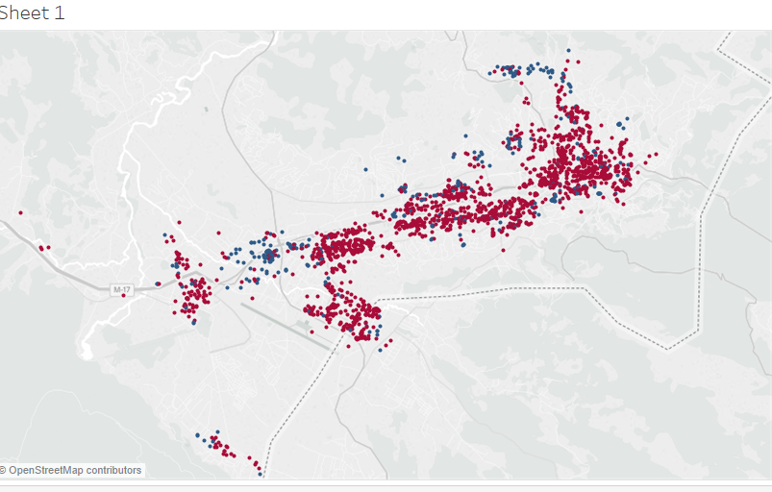
Novogradnja

Slide 14
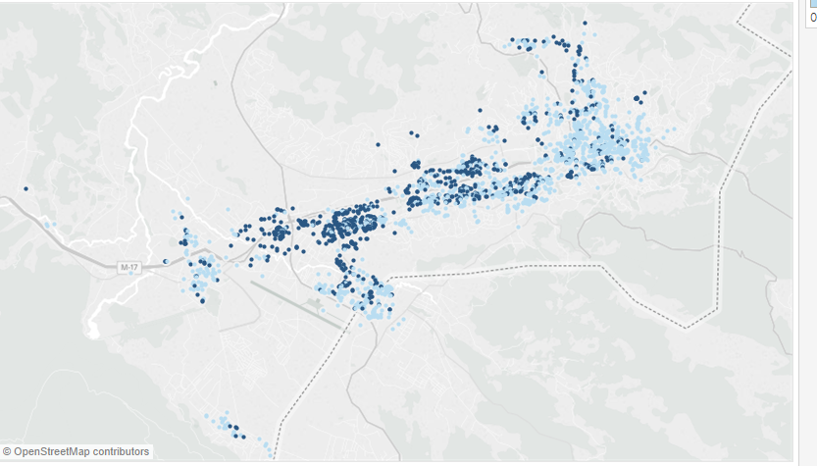
Lift

Slide 15
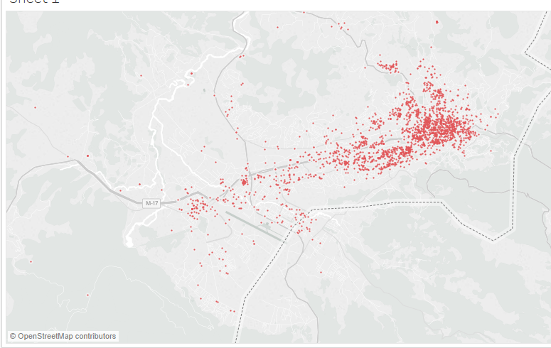
Renting

Slide 16
How?
Decision Tree Regressor training: 0.999999973227
Decision Tree Regressor testing: 0.730114739063
Linear regression training: 0.709080699608
Linear regression testing: 0.658007183086
SVR_Regressor training: 0.647519589323
SVR_Regressor testing: 0.61693135256

Slide 17
What is next?
More data
Tune current algorithms
Try another algorithms
PCA
Solve overfitting

Slide 18
Thank you!

