Slide 1
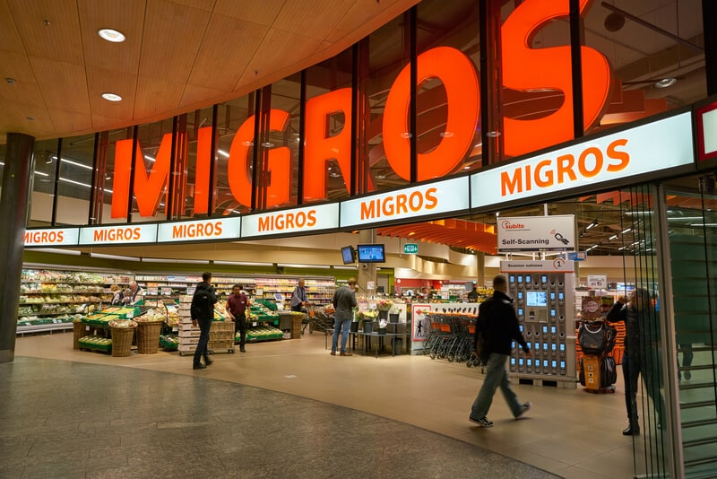
THE NEXT MIGROS STORE IN ZÜRICH
Elina, Daniel, Vahid, Justin
Photo from LeNews
Notes:
Welcome, everyone. We are the Migros team – Daniel, Elina, Justin, and Vahid.

Slide 2
Goal: What is the optimal location to open a new store?
Notes:
Our project aimed to identify the optimal location for a new Migros store in Zürich city.

Slide 3




Factors to consider
Population
Density
Income
Level
Market
Share
Competitor
Presence
Notes:
To tackle this challenge, we focused on analyzing four key factors that influence store performance.
Population Density: as dense areas offer greater market potential.
Income Level: higher purchasing power indicates a more wealthy customer base.
Market Size and Competitor Presence.
We gathered population and income level statistics from Zürich Stadt records. Additionally, we scraped store location data and mapped them to Zürich districts.
This is what we found out… Daniel

Slide 4
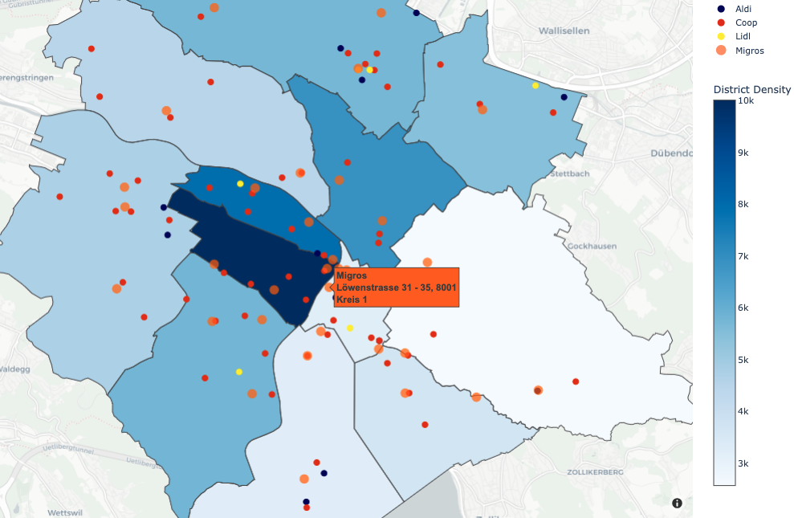
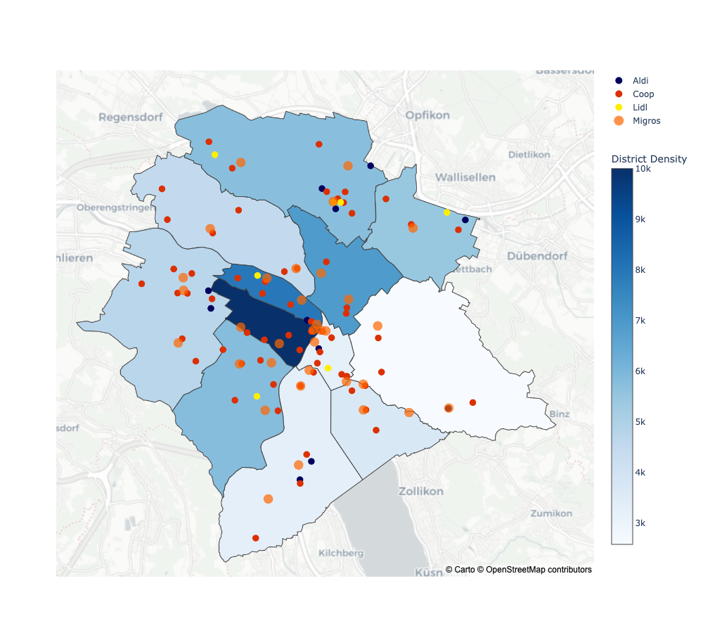
Population Density
Population density calculated for each Kreis
Location of stores shown on the map, including competitor supermarkets
Coop, Lidl, Aldi Suisse
Notes:
We made a map showing the population density of each Kreis in Zurich.
Simultaneously, we overlaid the locations of Migros stores and other major competitors, including Coop, Lidl, and Aldi, in each Kreis.

Slide 5
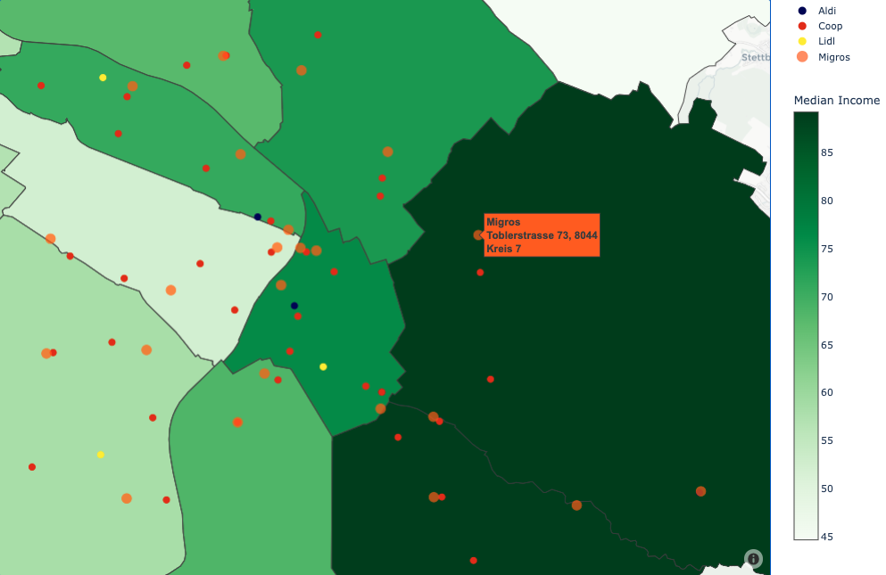
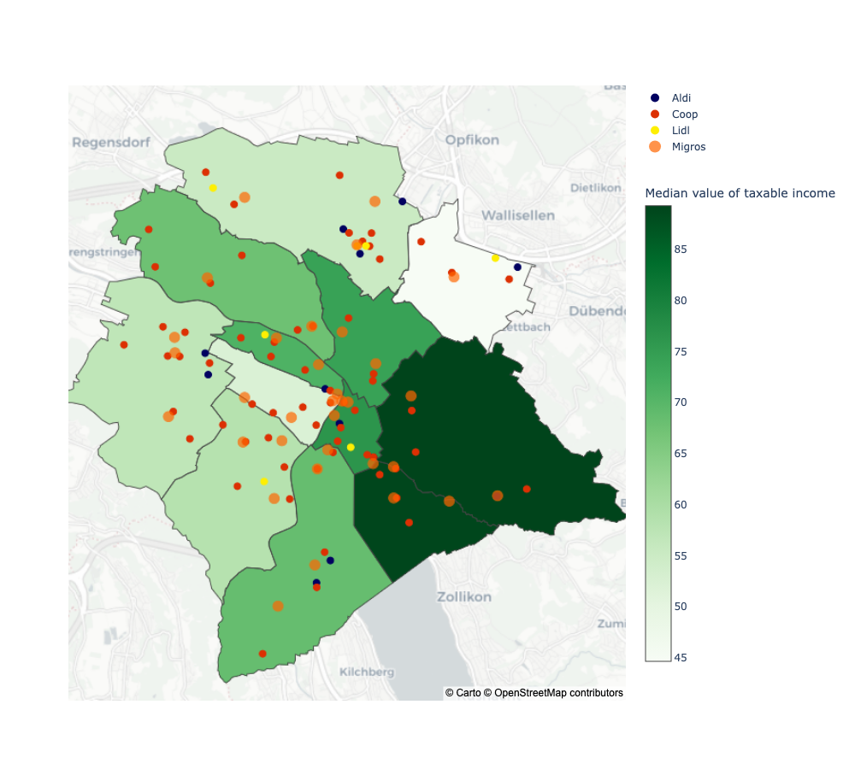
Income
Level
Average income in K-CHF calculated for each Kreis
Notes:
Following the population density analysis, our next step involved gathering data to calculate average income levels by Kreis. We then integrated this information onto the map for a comprehensive view.
The population density and average income levels were assessed, allowing us to identify patterns and trends across Kreise to help us choose the location for the new Migros store.

Slide 6
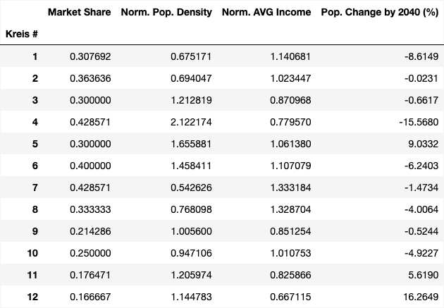
Key KPIs
Four key KPIs considered per Kreis in City of Zurich to find best Kreis for opening new store!
Migros market share
Average income of inhabitants
Kreis population density
15-year population change prediction

Slide 7
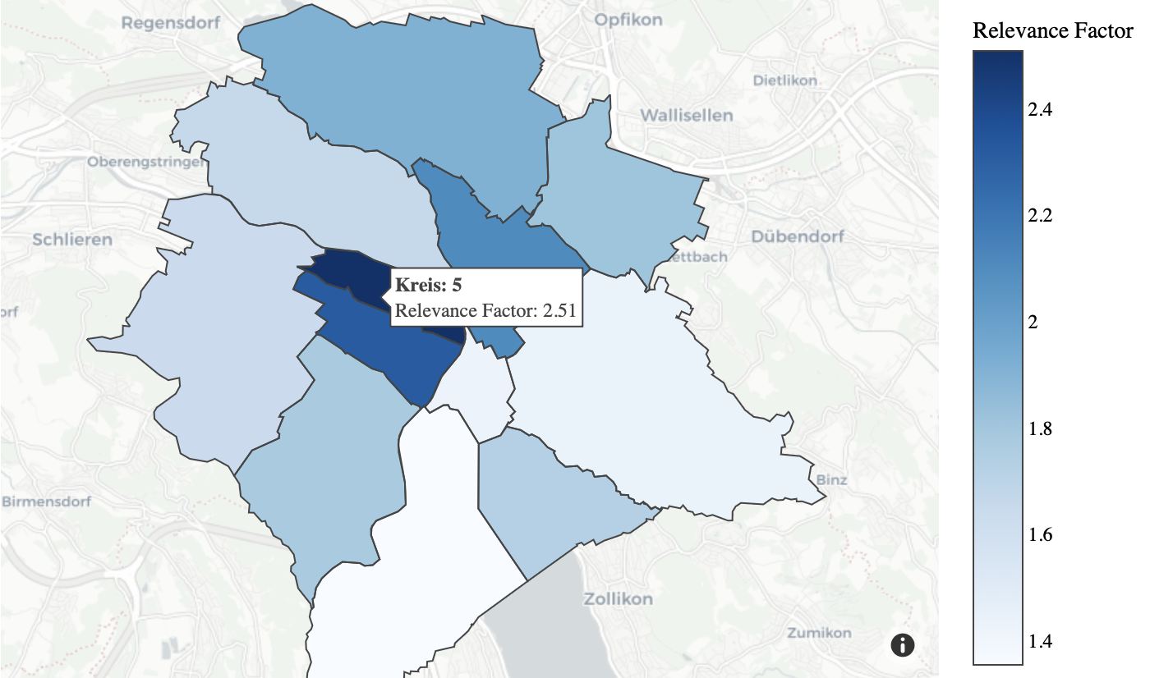
Decision Model
Relevance Factor per Kreis (RFK)
RFK = к₁ ω₁ + к₂ ω₂ + к₃ ω₃ + к₄ ω₄
к_{i} : Normalized KPI
ω_{i} : KPI weight
Interactive App developed to test for various ω_{i}

