Slide 1
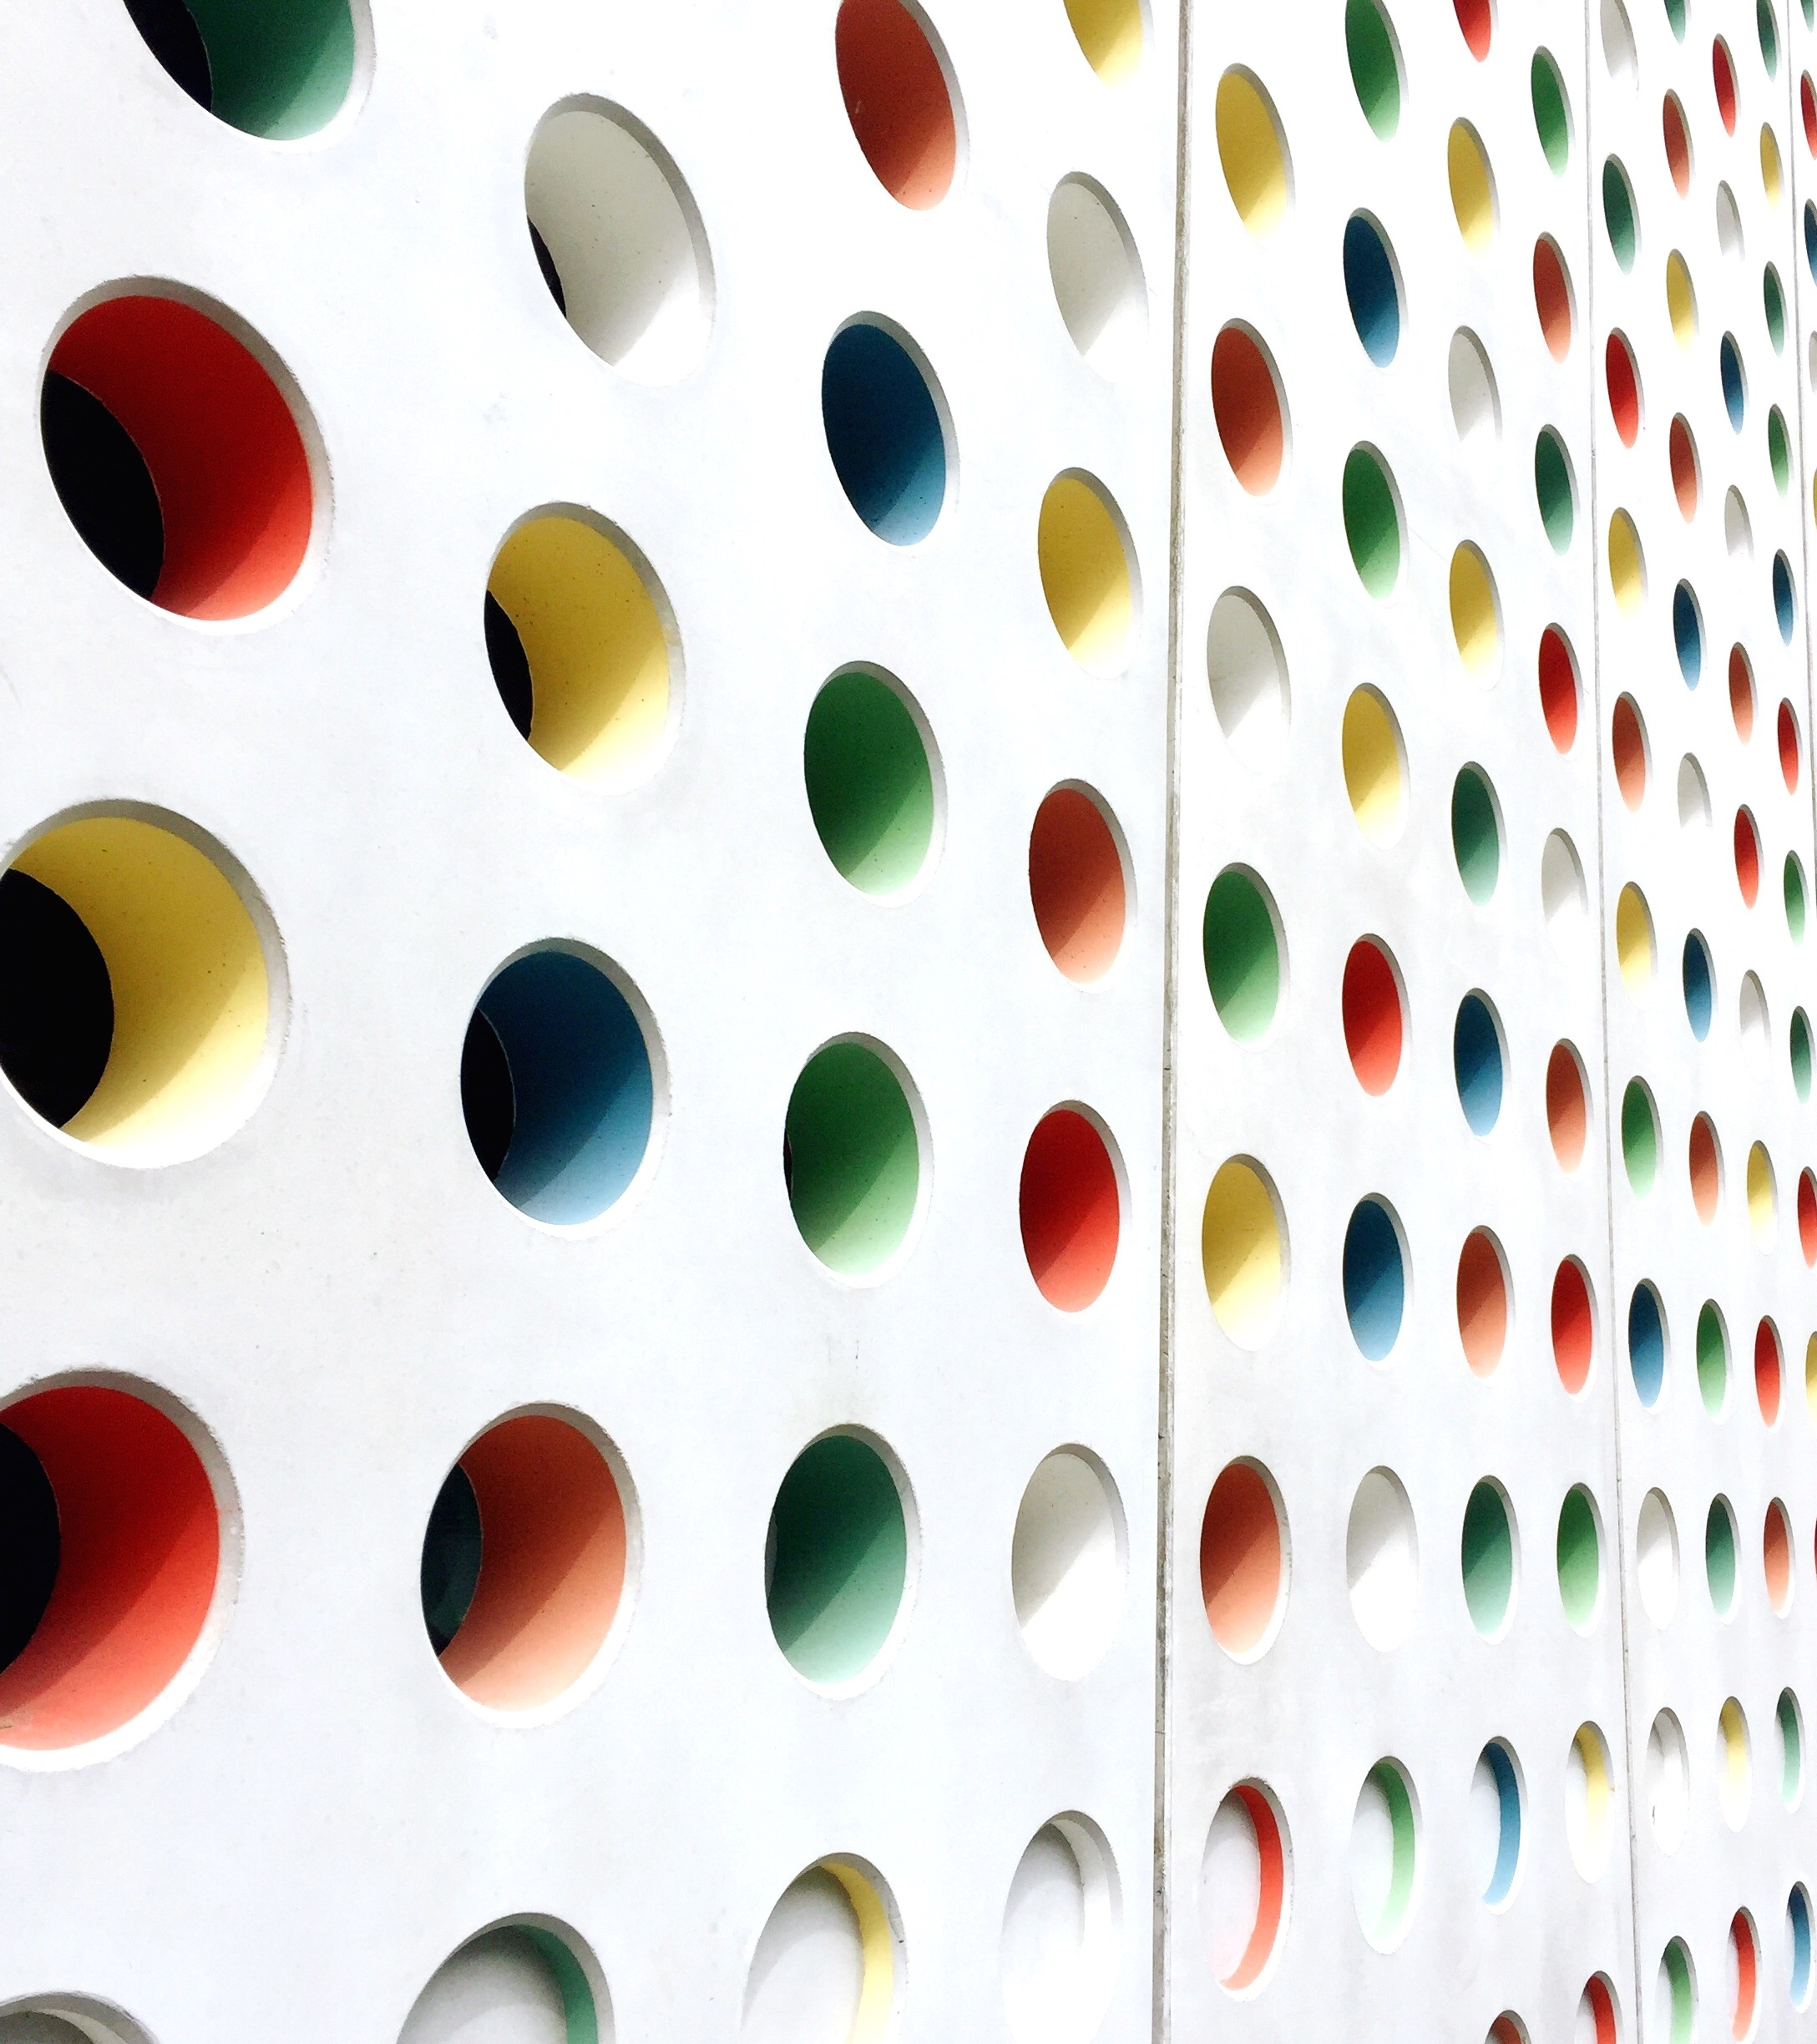
annotheta
Smart annotation system

Slide 2
What Is This About?
Why and why not
How and how come
Design and Timeline

Slide 3
Why And Why Not
Make lots of money
Help reduce people’s pain
Enable creation of better datasets
Enable creation of more datasets

Slide 4
How And How Come
Mask-RCNN: if all else fails
Curve-GCN: code unavailable
Polygon-RNN++: from the same group
Def-Grid: code available, from the same group

Slide 5
Design And Timeline
CVAT, Tensorflow or PyTorch, AWS
V1 (20-30 hours): Fri 1 Apr - Sun 17 Apr
V2 (20-30 hours): Mon 18 Apr – Sun 1 May
Final (30-50 hours): Mon 2 May - Sun 22 May

