Slide 1
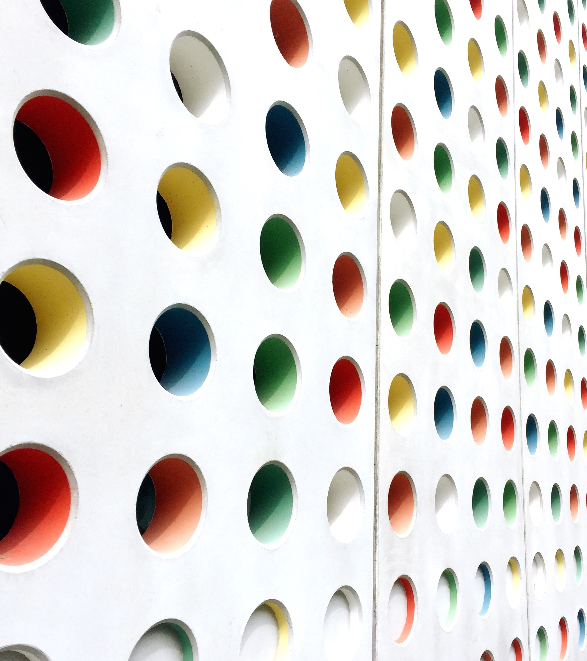
annotheta
Smart annotation system
Gonzalo tixilima, Juswaldy Jusman, zan butt

Slide 2
What Is This About?
Why?
how?
Design and Timeline

Slide 3
Why And Why Not
This is a hard problem
Not many open-sourced solutions
Help reduce time and stress
Enable creation of more, and better datasets

Slide 4
How And How Come
Curve-GCN: code unavailable
Polygon-RNN++: from the same group
Def-Grid: code available, from the same group
Mask-RCNN: if all else fails

Slide 5
Design
Simple front end for UI (CVAT)
Deployed ML Backend (our focus)
Basic REST API endpoints to send/receive data
MS COCO data format

Slide 6
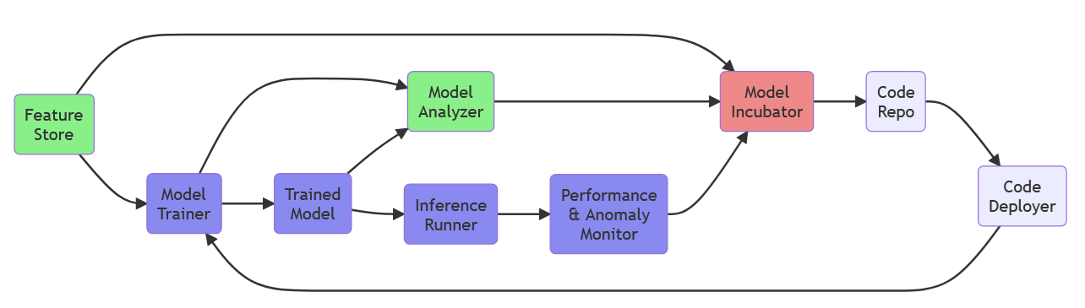
Design

Slide 7
Timeline
V1 (20-30 hours): Fri 1 Apr - Sun 17 Apr
V2 (20-30 hours): Mon 18 Apr – Sun 1 May
Final (30-50 hours): Mon 2 May - Sun 22 May

