Slide 1
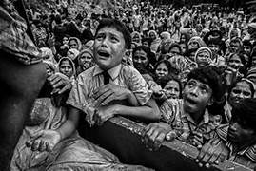
Presentation Topic Rohingya Crisis in Bangladesh

Slide 2
SHEKH JUTHI
ID: 1810132
Sec: 14

Slide 3
Objects
Present condition of Rohingya.
Historical Background of Rohingya.
Cause of their present situation.
Different strategies of Government.
How govermentis coping up with crisis.
Several problems related to the Rohingya issues.
Recommendation and remedies to the emmergency.

Slide 4
METHOLOGY
Source of data
Internet
Representation of data
By Graphs
By Map
Newspaper
By Pictures

Slide 5
INTRIDUCTION
WHO ARE ROHINGYA
HOW THEY CAME
WHEN
HISTORY

