Slide 1

NeuroSent
Project Name: NeuroSent
Tagline: Transforming Raw Feedback into Actionable Intelligence with AI
Team Name: CodeX
Event: DevCraft: Simon’s Command Line
Date: 6 April 2026
Domain: AI/ML × Web Application × Institutional Analytics

Slide 2
Problem Statement
Educational institutions receive thousands of feedback entries every semester — yet:
Manual reading of every feedback entry is humanly impossible at scale
Delayed response to critical issues (bullying, harassment, safety threats)
Zero data-driven insights — administration makes decisions based on gut feeling
Fear of retaliation — students give dishonest or no feedback at all
No dept-wise breakdown — generic reports provide zero actionable value
“A student reports harassment. Nobody reads it for 3 weeks. By then, the damage is done.”

Slide 3
Target Audience
Primary Users:
Students — Submit anonymous/named feedback, track own sentiment scores
Staff & Faculty — Submit feedback, access personal and departmental reports
HODs / Dept. Heads — Monitor department-level sentiment trends and analytics
Administrators — Global analytics, user management, risk alerts, audit logs
Institution Types:
Engineering colleges • Universities • Schools • Professional Institutes
Scale: Designed for 1,000+ concurrent users per institution

Slide 4
Existing Solutions
Generic NLP APIs (VADER, TextBlob) — No institutional context, no RBAC, no risk detection
Google Natural Language API — Expensive at scale, no role-based access, no domain tuning
Survey Tools (Google Forms, SurveyMonkey) — Data collection only, zero AI sentiment analysis
MonkeyLearn — General-purpose, no safety alerts, no educational domain focus
Microsoft Azure Text Analytics — Enterprise cost, no anonymous submission, no bulk workflow
Common Limitations Across ALL Existing Tools:
No domain-specific NLP • No real-time risk/safety alerts • No 4-tier RBAC • No hybrid AI fallback

Slide 5
Gaps & Opportunities
Gap 1 — No domain-specific NLP: 500+ college-specific keywords ignored by generic models
Gap 2 — No real-time safety detection: Bullying, harassment, self-harm go unreported for weeks
Gap 3 — No institutional RBAC: No tool maps Student → Staff → HOD → Admin hierarchy
Gap 4 — No anonymous feedback: Fear of retaliation suppresses honest responses
Gap 5 — No offline AI fallback: 100% cloud dependency means downtime during quota exhaustion
Gap 6 — No negation-aware override: “Not clean” and “not working” classified as Neutral by all existing tools
NeuroSent fills every single one of these gaps.

Slide 6
Your Solution
NeuroSent — AI-Powered Institutional Feedback Intelligence Platform
1. Classifies sentiment (Positive / Negative / Neutral) using a 3-layer hybrid AI engine
2. Detects high-risk content in 7 categories (bullying, harassment, self-harm, threats) in real-time
3. Instant email alerts dispatched to admins the moment critical content is detected
4. Department-wise dashboards with interactive charts, date filtering, and TF-IDF word clouds
5. Anonymous submissions supported — identity stripped at database level for honest feedback
6. Professional report exports in PDF (ReportLab), Excel (Pandas), and CSV formats
Built purpose-first for educational institutions — not a generic tool retrofitted to education.

Slide 7
Key Features
Hybrid NLP Engine: Gemini 2.0 Flash → RoBERTa fallback → Complaint-aware override (3 layers)
Real-time Risk Detection: 7 categories — bullying, harassment, violence, threats, self-harm, discrimination, corruption
Bulk CSV/Excel Upload: Batch AI processing (15 texts/call = 15× API efficiency), background threading
Interactive Dashboard: Sentiment trends, dept-wise bar charts, date filtering, TF-IDF keyword word cloud
4-Tier RBAC: Student → Staff → HOD → Admin with strict permission boundaries
Enterprise Security: Bcrypt, CSRF, rate limiting, account lockout, MFA (TOTP), session timeouts, audit logs
Report Generation: PDF (ReportLab) + Excel (Pandas + OpenPyXL) + CSV exports
AI Model Training: Trigger RoBERTa fine-tuning directly from admin dashboard with real-time progress

Slide 8
System Architecture
Frontend Layer:
TailwindCSS + Jinja2 Templates + Chart.js + WordCloud2.js | Login/MFA • Dashboard • Feedback Form • Admin Panel
Flask Application Layer (HTTPS):
Security: CSRF • Rate Limiting • Security Headers • 15-min idle + 12-hr absolute session timeout
9 Blueprints: Auth • Dashboard • Feedback • Upload • Reports • Admin • Profile • Training • Recovery
Data & AI Layer:
NLP Engine — Layer 1: Gemini 2.0 Flash (API) | Layer 2: RoBERTa (local) | Layer 3: Complaint override
Database — SQLAlchemy ORM | 6 models: Users, Feedback, Uploads, AuditLog, OTPs, Replies
Email Engine — SMTP/Gmail | Welcome, OTP, Risk Alerts, Password Reset

Slide 9
Tech Stack
Backend: Flask 3.0+ • SQLAlchemy ORM • SQLite (dev) / PostgreSQL (prod)
AI Primary: Google Gemini 2.0 Flash via OpenRouter API — fast inference, ~200ms
AI Fallback: HuggingFace RoBERTa (cardiffnlp/twitter-roberta) — local GPU, zero downtime
NLP: NLTK + scikit-learn TF-IDF — tokenization, stopword removal, keyword extraction
Auth & Security: Flask-Login • Flask-Bcrypt • Flask-WTF (CSRF) • Flask-Limiter • PyOTP (MFA)
Frontend: TailwindCSS • Chart.js • WordCloud2.js • Jinja2 • Vanta.js (animated bg)
Reports: ReportLab (PDF) • Pandas + OpenPyXL (Excel) • CSV export
Deployment: Docker + Gunicorn • Single-command containerized deploy • /health endpoint
Testing: Pytest — 597 lines of automated security + integration tests

Slide 10
Workflow
Step 1 — Submit: User types feedback manually or uploads bulk CSV/Excel file
Step 2 — AI Layer 1: Gemini 2.0 Flash classifies sentiment in ~200ms (handles 95% of requests)
Step 3 — AI Layer 2: If API is down/quota exceeded, RoBERTa local model kicks in (~500ms, zero downtime)
Step 4 — AI Layer 3: Complaint-aware override catches negation patterns (e.g., “not clean” → Negative)
Step 5 — Risk Scan: 7-category risk engine checks for bullying, harassment, self-harm, threats, etc.
Step 6 — Alert: If risk detected → high-priority email dispatched instantly to admin with full context
Step 7 — Dashboard: Analytics refresh in real-time; caching (TTL 60s) ensures 500+ concurrent users
Batch mode: 15 feedbacks per API call — 15× more efficient than one-by-one processing

Slide 11
Impact
Scale: Engineered for 1,000+ concurrent users — connection pooling (20 base + 40 overflow)
Speed: 15× API call reduction via batch processing; dashboard cached at TTL 60s
Reliability: Zero-downtime AI with 3-layer fallback — API → Local GPU → Override
Safety: 7 risk categories monitored in real-time; instant email alert pipeline
Security: 597 lines of automated tests — privilege escalation, XSS, CSRF, lockout, OTP expiry
Transparency: Anonymous feedback increases honest reporting; every admin action logged with IP
Insight: Dept-wise sentiment + TF-IDF keywords give administrators actionable data, not guesses
From gut feeling to data-driven institutional governance — that’s the NeuroSent impact.

Slide 12
Future Scope
1. Multilingual NLP: Hindi, Tamil, Telugu feedback analysis using multilingual transformer models
2. Trend Graphs: Weekly/monthly sentiment trends per department over time with visual timelines
3. Celery + Redis: Replace thread-based background tasks with a production-grade task queue
4. Mobile App: Flutter/React Native wrapper around the REST API for on-the-go access
5. WebSocket Alerts: Real-time push notifications for risk content in addition to email
6. AI Summaries: Auto-generate executive summaries of 100+ feedback entries using LLMs
7. Feedback Clustering: Auto-group similar complaints using sentence embeddings + HDBSCAN
8. Satisfaction Index: Student Satisfaction Index (SSI) — composite score per department per semester

Slide 13
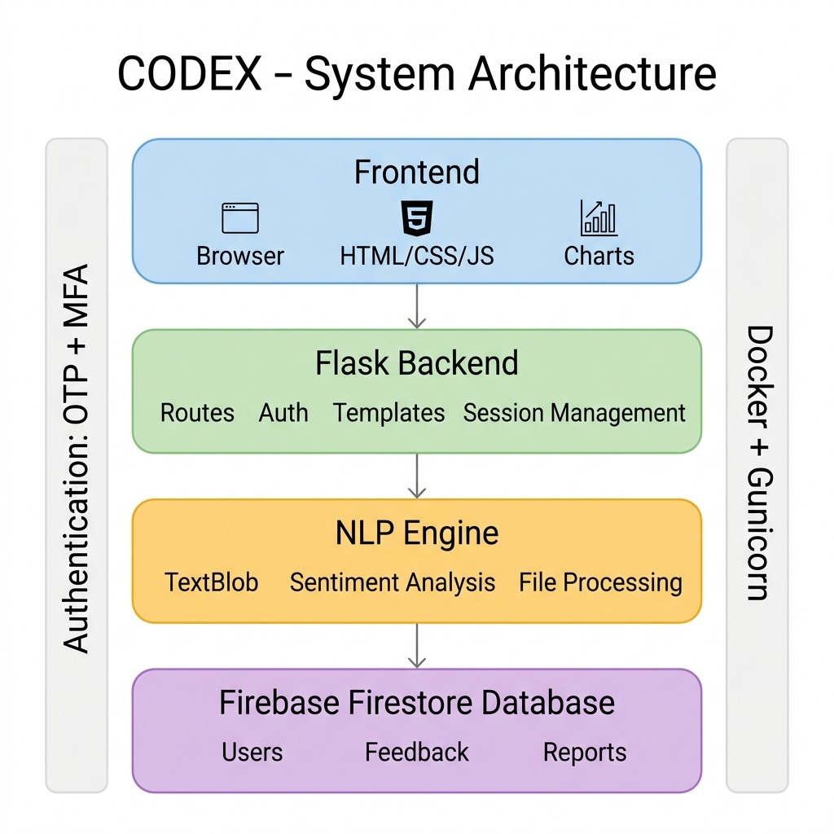
Mindmap Overview

Slide 14
Team Info
Member 1: [SABARISH B] — Full Stack Developer (Flask, SQLAlchemy, Auth)
Member 2: [THANUSH] — AI/NLP Engineer (Gemini API, RoBERTa, NLP Pipeline)
Member 3: [JS RAHUL] —Project Research and Content Curation
Member 4: [KOUSHIK S] — PPT Design And Visual Presentation
Duration: Built during the DevCraft Hackathon period
Codebase: ~5,000+ lines (backend) + templates + 597-line test suite
Deployment: Docker + Gunicorn — production-ready on Render / Heroku / Docker

