Slide 1
Semantification Infrastructure (Graph Traversal Library) Knowledge Graph Lab
Jan Heesemann, Marcel Grün,
Joep Geuskens, Nikita Averitchev

Slide 2
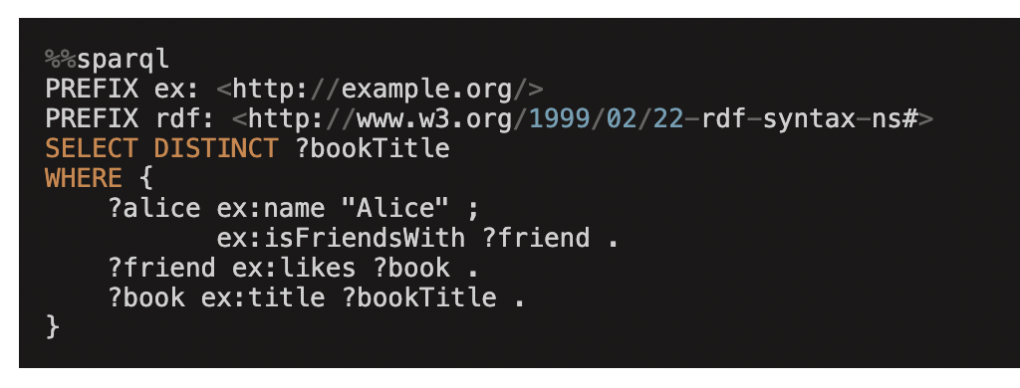
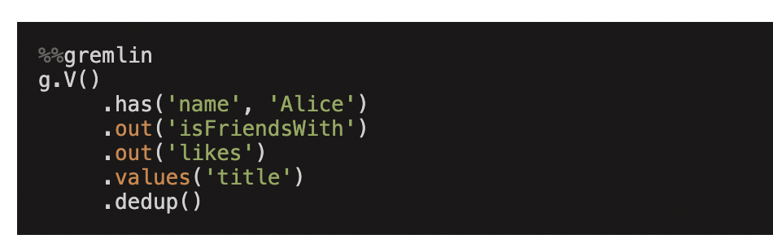

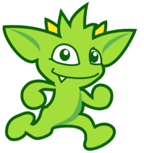
Background & Motivation
Problem: Traversing and integrating data within subsets of Knowledge Graphs (KGs) poses challenges, hindering efficient analysis and navigation
Challenges with existing approaches:
Traditional query languages like SPARQL are cumbersome on navigation tasks within KG subsets.
Real-world KG use cases involve heterogeneous data sources requiring diverse parsing and integration methods.
Connecting entities across sources often requires complex round-trip queries based on identifiers like URNs, leading to time-consuming processes.
Query: Find all distinct book titles that are liked by friends of Alice.
SPARQL
Gremlin

Slide 3
Background & Motivation
Existing Python graph libraries either rely on external services for traversal execution, limiting control and integration, or offer limited traversal APIs without a user-friendly query interface.
Libraries supporting traversal languages like Gremlin require separate infrastructure (e.g., Apache TinkerPop server), adding complexity.
Lack of a (native) Python library providing a user-friendly traversal language and seamless data integration for KG subsets.
Objective: PyMogwai
Develop a Python library addressing this gap by providing a Gremlin-like traversal language for intuitive exploration and functionalities to handle diverse data sources, streamlining the process of working with KGs in Python.

Slide 4
Milestones
Integration of Data Source Connectors
Task: Develop connectors for at least two different data source types (e.g., file system, PDF files, etc.) to integrate external data into the knowledge graph.
Milestone: Implementation and testing of data source connectors.
Development of Gremlin-like Traversal Language
Task: Implement a user-friendly traversal language similar to Gremlin, entirely in Python.
Milestone: Completion of the traversal language implementation.
Backlog
Graph Visualization
Optimization Strategies
GUI
optional

Slide 5
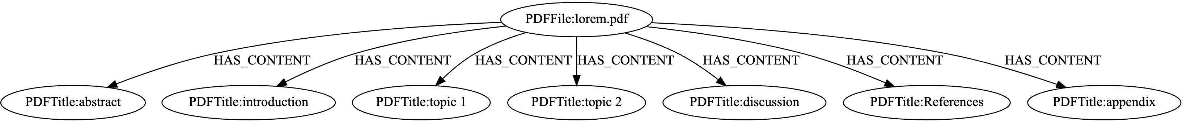
Integration of Data Source Connectors
For the implementation of the Data Source Connectors, we used certain python libraries to open and parsing the files:
We decided on using NetworkX to build our graph and build parser functions that construct a ‘MogwaiGraph’ out of the files and directories in a filesystem.
Excel (.xlsx) | PDF (.pdf) | PowerPoint (.pptx) | XML (.xml) | RDF (.rdf)
pandas + openpyxl | pypdf | PySemanticSlides | xmltodict | rdflib

Slide 6
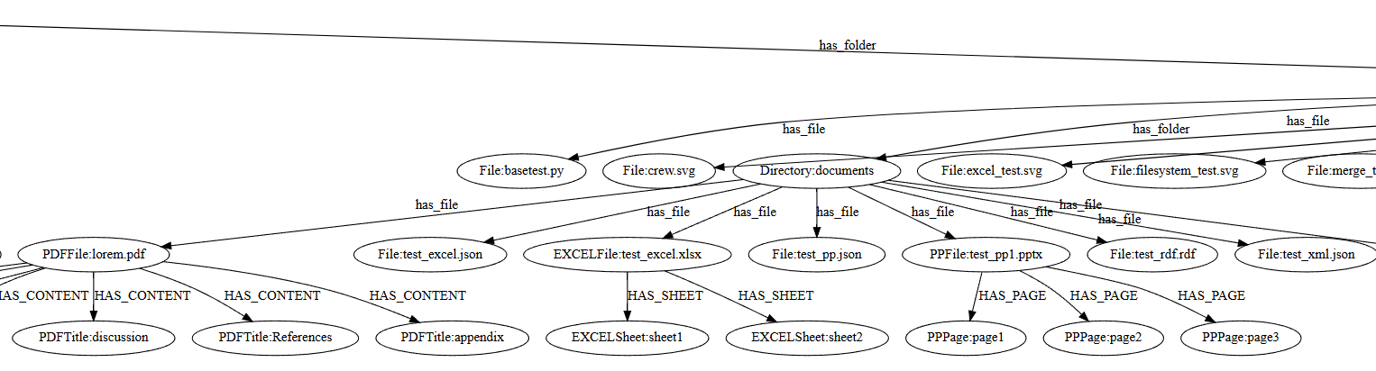
Integration of Data Source Connectors

Slide 7
Development of Gremlin-like Traversal Language
Anatomy of a basic Gremlin query
g.V().hasLabel(“Person”).has(“name”, “Joep”).out(“knows”).values(“name”).toList()
Steps
Start Step
Terminal Step
GraphTraversalSource
Start steps trigger the traversal and spawn the traversers (for example, .V(): for all vertices .E(): for all edges)
Terminal Steps execute the traversal and return a result (for example, .toList(): returns the result as a list .next(): returns the next result).

Slide 8
Development of Gremlin-like Traversal Language
Anatomy of a basic Gremlin query
g.V().hasLabel(“Person”).has(“name”, “Joep”).out(“knows”).values(“name”).toList()
Steps
Start Step
Filter step
FlatMap step
Map step
Terminal Step
GraphTraversalSource
5 general steps:
Filter: map the traverser to a boolean, where ‘False’ will not pass the traverser to the next step
Map: map the traverser to some other object
FlatMap: map the traverser to an iterator of objects that are streamed to the next step
SideEffect: perform some operation on the traverser and pass it to the next step
Branch: split the traverser

Slide 9
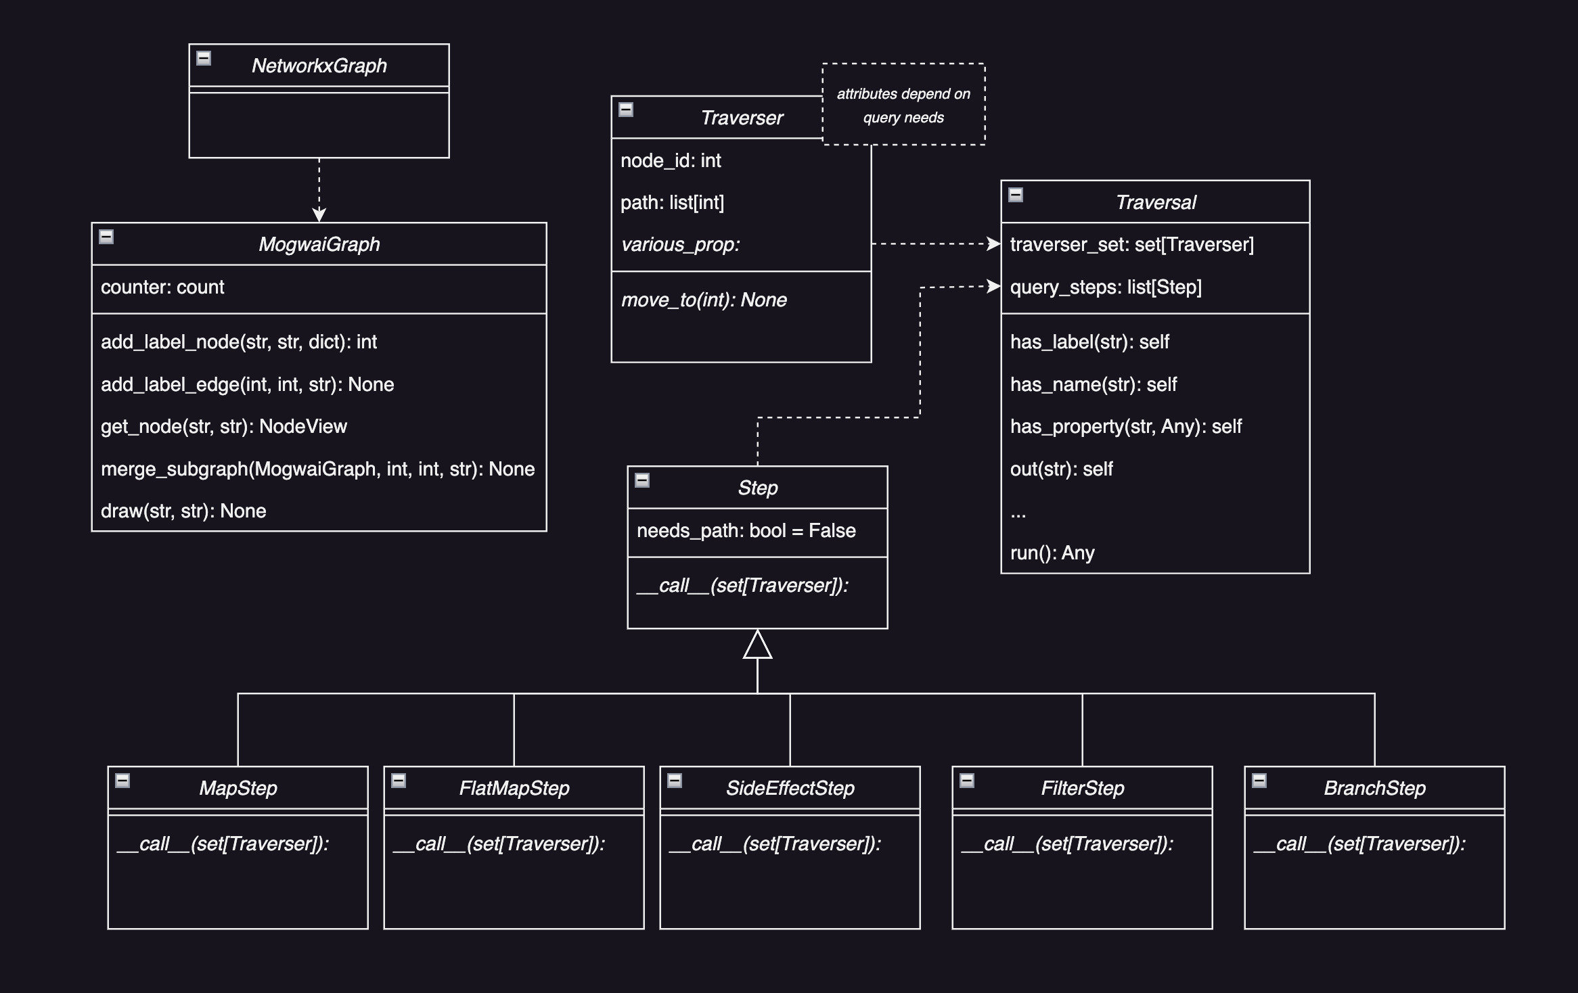
Development of Gremlin-like Traversal Language
In our Python Library:
A traverser is effectively a wrapper around a node (or edge)
A Traversal contains a set of traversers and exposes a function for each step. Each such function returns the traversal to allow daisy-chaining.
The Steps are implemented as a class with a __call__ method, so instances behave like functions.
Calling the functions on a Traversal instantiates a step and adds it to a list.
Calling .run() on a traversal, executes the steps

Slide 10

Todo
Integration of Data Source Connectors
Task: Develop connectors for at least two different data source types (e.g., file system, PDF files, etc.) to integrate external data into the knowledge graph.
Milestone: Implementation and testing of data source connectors.
Development of Gremlin-like Traversal Language
Task: Implement a user-friendly traversal language similar to Gremlin, entirely in Python.
Milestone: Completion of the traversal language implementation.
Backlog
Graph Visualization
Optimization Strategies
GUI
In Progress
optional

Slide 11
Thank you for your attention!
Questions/Suggestions?

