Slide 1
Ubay National Science High School
AERESCUE: Assistive Emergency Rescue and Support System
PROPONENT(S): Elijah Juris Evangelista
COACH: Rhys Kelsey Zabdiel Payot

Slide 2
Introduction
Drowning remains a major public-health concern.
Rescue operations can be delayed by distance and environmental conditions, making accurate target localization essential.
Previous studies show the potential of drones in rescue support.
Limited research integrates target localization, object tracking, distance estimation, and directional guidance into one shore-based rescue-support system.

Slide 3
Research Objectives
The study aims to determine whether a dual-camera computer-vision system can accurately:
Localize a selected rescue target
Track a designated moving object
Estimate the relative distance between the target and moving object
Generate directional guidance based on their calculated alignment

Slide 4
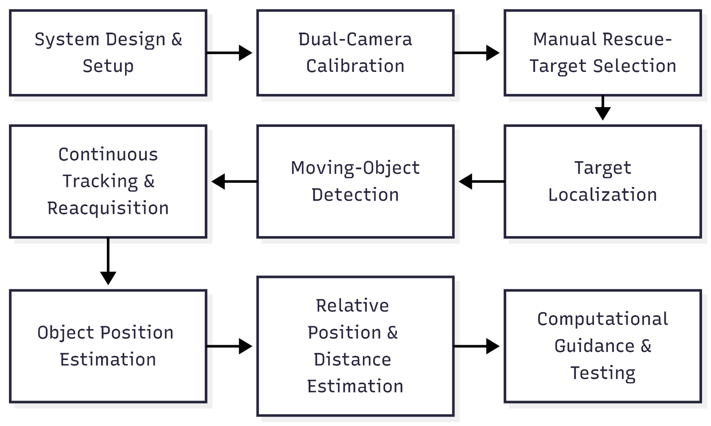
System Workflow

Slide 5
Methods: Experimental Testing
Target Localization: 10 test points, 3 trials each
Moving-Object Tracking: 5 trials along a fixed route
Reacquisition: tracking-loss events recorded
Relative Distance: 10 predetermined test points
Guidance Accuracy: LEFT, RIGHT, FORWARD, STOP/HOLD

Slide 6
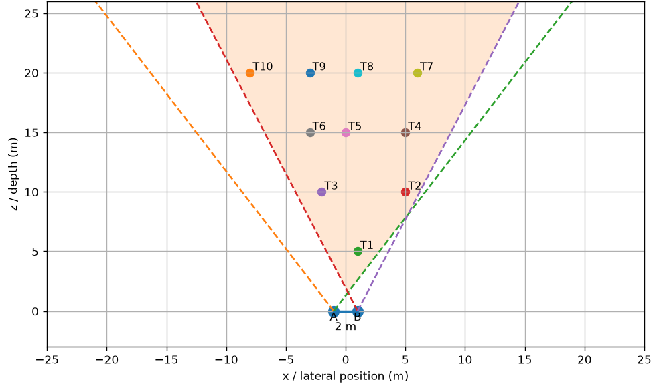
R&D: Target-Localization Accuracy of AERESCUE
Test Point | Actual Distance (m) | Mean Estimated Distance (m) | Mean Absolute Error (m) | Mean Percentage Error (%)
T1 | 5.10 | 5.67 | 0.57 | 11.18%
T2 | 11.18 | 11.47 | 0.29 | 2.59%
T3 | 10.20 | 10.85 | 0.65 | 6.37%
T4 | 15.81 | 15.65 | 0.17 | 1.08%
T5 | 15.00 | 14.66 | 0.52 | 3.47%
T6 | 15.30 | 15.47 | 0.42 | 2.75%
T7 | 20.88 | 20.70 | 0.28 | 1.34%
T8 | 20.00 | 19.26 | 0.74 | 3.70%
T9 | 20.22 | 18.44 | 1.78 | 8.80%
T10 | 21.54 | 19.25 | 2.29 | 10.63%

Slide 7
R&D: Moving-Object Tracking Performance
Trial | Camera A Success (%) | Camera B Success (%) | Both Cameras Success (%)
1 | 96.21% | 81.43% | 77.65%
2 | 96.28% | 90.50% | 87.19%
3 | 90.82% | 96.07% | 87.87%
4 | 97.04% | 89.49% | 86.52%
5 | 97.31% | 78.74% | 83.06%
Average | 95.53% | 87.25% | 84.46%
Trial | Tracking Losses | Reacquisition Opportunities | Successful Reacquisitions | Mean Reacquisition Time
1 | 7 | 7 | 7 | 5.305s
2 | 10 | 10 | 10 | 1.996s
3 | 6 | 6 | 6 | 2.451s
4 | 12 | 12 | 12 | 1.626s
5 | 14 | 14 | 14 | 1.968s

Slide 8
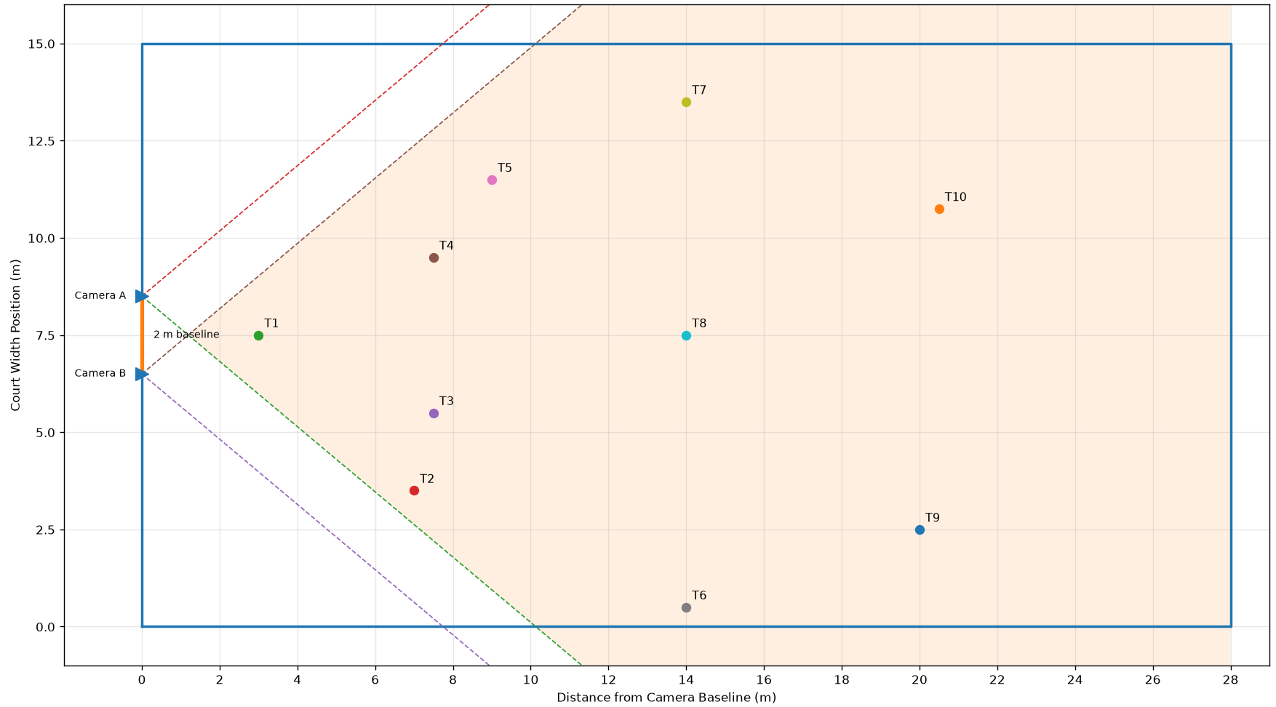
R&D: Estimated and Actual Distance of the Designated Object Relative to the Targe
Test Point | Actual Distance to Target (m) | Estimated Distance to Target (m) | Absolute Error (m) | Percentage Error
T1 | 25.00 | 24.63 | 0.37 | 1.49%
T2 | 21.37 | 21.84 | 0.47 | 2.20%
T3 | 20.59 | 21.92 | 1.33 | 6.47%
T4 | 20.59 | 21.92 | 1.33 | 6.47%
T5 | 19.41 | 20.23 | 0.82 | 4.22%
T6 | 15.65 | 16.67 | 1.02 | 6.52%
T7 | 15.23 | 16.67 | 1.44 | 9.46%
T8 | 14.00 | 16.11 | 2.11 | 15.05%
T9 | 9.43 | 11.51 | 2.08 | 22.05%
T10 | 8.17 | 9.13 | 0.96 | 11.73%

Slide 9
R&D: Computational Guidance Performance
Guidance | Tests | Correct | Accuracy (%)
FORWARD | 10 | 10 | 100%
LEFT | 10 | 10 | 100%
RIGHT | 10 | 10 | 100%
STOP | 10 | 7 | 70%

Slide 10
Conclusion
AERESCUE successfully integrated dual-camera localization, object tracking, relative-distance estimation, and computational guidance.
The system achieved 84.46% simultaneous tracking, 100% reacquisition success, and 92.5% guidance accuracy.
Localization performance was generally acceptable, but relative-distance estimation remained the main limitation.
The study shows that AERESCUE is a viable proof-of-concept rescue-support system under controlled simulated conditions.

