Slide 1
MACHINE LEARNING PROJECT | Luminar Technolab
FOCUSIQ
Student Productivity
Prediction System
Predicting productivity categories from daily study habits,
sleep, focus, stress and screen-time patterns.
Presented by
Juvans CJ

Slide 2
01 / INTRODUCTION
Project overview
FOCUSIQ is a machine-learning system that estimates a student's productivity category using a small set of daily routine indicators.
WHAT THE SYSTEM DOES
01
Collect
Five daily habit inputs
The model considers study hours, sleep hours, stress level, focus score and combined screen time. It classifies the result into Low, Medium or High productivity.
02
Analyze
Apply the trained ML model
03
Predict
Return a productivity category
04
Guide
Offer practical routine suggestions
FOCUSIQ | STUDENT PRODUCTIVITY ANALYZER
02

Slide 3
02 / PROJECT PURPOSE
Problem statement & Objective
PROBLEM STATEMENT
PROJECT AIM
Students often find it difficult to understand how everyday habits influence their productivity. Study duration, sleep, focus, stress and digital distractions can vary, making it challenging to identify patterns and improve routines.
Build a simple machine-learning system that uses selected daily-habit inputs to estimate a productivity category and provide practical feedback
FOCUSIQ | STUDENT PRODUCTIVITY ANALYZER
03

Slide 4
03 / DATA UNDERSTANDING
Dataset & selected attributes
DATASET SNAPSHOT
20,100
16
20,000
5
initial rows
initial columns
rows after duplicate removal
final model inputs
FINAL MODEL INPUT FEATURES
TARGET VARIABLE
Study hours
Daily time spent studying
Sleep hours
Daily duration of sleep
Productivity category
Stress level
Self-rating from 0 to 10
Derived from numeric productivity_score using three score bands: Low, Medium and High.
Focus score
Self-rating from 0 to 100
Total screen time
Combined phone, social media, YouTube and gaming hours
FOCUSIQ | STUDENT PRODUCTIVITY ANALYZER
04

Slide 5
04 / TOOLS USED
Dependencies & technology stack
Python
Pandas & NumPy
Core programming language
Data loading, cleaning and numerical operations
Matplotlib & Seaborn
Scikit-learn
Charts and exploratory data analysis
Preprocessing, train/test split, models and evaluation
Imbalanced-learn
Joblib
SMOTE to balance training classes
Saving the trained model and scaler
Streamlit
Interactive web application
FOCUSIQ | STUDENT PRODUCTIVITY ANALYZER
05

Slide 6
05 / EXPLORATORY ANALYSIS
Data analysis & feature relationships
CORRELATION WITH PRODUCTIVITY SCORE
Study hours
+0.733
WHAT THE ANALYSIS SUGGESTS
• Study hours show the strongest positive correlation in the selected analysis.
• Focus and sleep also have positive relationships with productivity score.
• Stress and total screen time show negative correlations.
• Correlation indicates association, not proof of cause and effect.
Focus score
+0.412
Sleep hours
+0.341
Stress level
-0.197
Total screen time
-0.228
FOCUSIQ | STUDENT PRODUCTIVITY ANALYZER
06

Slide 7
06 / END-TO-END PROCESS
Project procedure / workflow
01
Load dataset
Read CSV into Pandas
02
Inspect & clean
Check nulls, duplicates and data types
03
Engineer features
Combine digital-use columns into total screen time
04
Explore data
Review distributions and correlations
05
Prepare target
Convert productivity score into 3 categories
06
Train & evaluate
Split, scale, balance training data and compare models
07
Deploy
Use saved model and scaler in Streamlit
FOCUSIQ | STUDENT PRODUCTIVITY ANALYZER
07

Slide 8
07 / PREPARING MODEL DATA
Data preprocessing & preparation
Missing values
Duplicate records
Feature engineering
Numeric columns: median imputation
Gender: mode imputation
100 duplicate rows were identified and removed.
Phone, YouTube, gaming and social-media hours were combined into total_screen_time_hours.
Feature selection
Scaling
Class balancing
Five final predictors: study, sleep, stress, focus and total screen time.
StandardScaler was fitted on training data and applied to test data.
SMOTE was applied to the training set to balance the three target classes.
FOCUSIQ | STUDENT PRODUCTIVITY ANALYZER
08

Slide 9
08 / CLASSIFICATION SETUP
Target creation & class distribution
CLASS COUNTS BEFORE SMOTE
PRODUCTIVITY SCORE BINS
Medium
12,139
LOW
Score ≤ 40
Low
5,540
MEDIUM
40 < Score ≤ 70
High
2,321
HIGH
Score > 70
Target: productivity_category
SMOTE balanced training data to 9,719 records per class.
FOCUSIQ | STUDENT PRODUCTIVITY ANALYZER
09

Slide 10
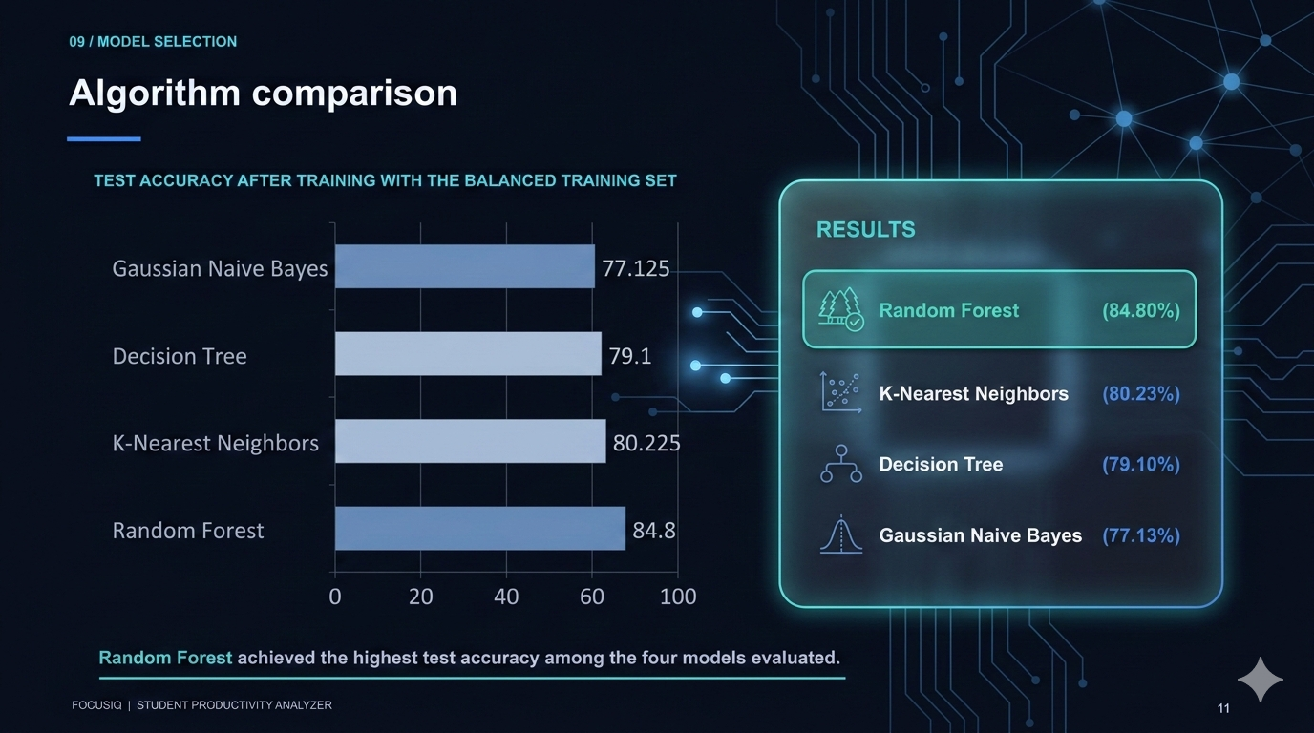
09 / MODEL SELECTION
Algorithm comparison
TEST ACCURACY AFTER TRAINING WITH THE BALANCED TRAINING SET
FOCUSIQ | STUDENT PRODUCTIVITY ANALYZER
10

Slide 11
10 / CHOSEN ALGORITHM
Why Random Forest was selected
Random Forest combines predictions from multiple decision trees to produce a final class prediction.
MODEL COMPARISON AT A GLANCE
• It achieved the highest measured test accuracy in this comparison (84.8%).
• Combining trees can provide a more stable result than relying on a single tree.
• It supports multi-class classification: Low, Medium and High.
Tree 1
Tree 2
Tree 3
Tree 4
Tree 5
Combined vote → predicted class
LOW / MEDIUM / HIGH
FOCUSIQ | STUDENT PRODUCTIVITY ANALYZER
11

Slide 12
12 / DEPLOYMENT
Prediction process & Streamlit application
Five user inputs
STREAMLIT USER INTERFACE
Students enter their usual daily values using five sliders:
Saved StandardScaler
• Study hours and sleep hours
• Stress level and focus score
• Combined daily screen time
Trained Random Forest
Predicted category
FOCUSIQ | STUDENT PRODUCTIVITY ANALYZER
12

Slide 13
13 / PROJECT OUTCOME
Key insights, applications & conclusion
KEY INSIGHTS
APPLICATIONS
CONCLUSION
• Study hours had the strongest positive correlation with productivity score.
• Focus and sleep also showed positive relationships.
• Stress and total screen time showed negative relationships.
• The model classified three productivity levels.
• Student self-assessment
• Academic mentoring support
• Awareness of screen-time habits
FOCUSIQ demonstrates how machine learning can turn everyday student routine data into an understandable productivity category.
Random Forest delivered the best result in the tested algorithm comparison, with 84.8% test accuracy.
The system is a reflection aid, not a formal academic or clinical assessment.
FOCUSIQ | STUDENT PRODUCTIVITY ANALYZER
13

