Slide 1


Click button to Start Editing

Slide 2

Click button to Save work
Click button to Stop Editing

Slide 3

CS means Content Slot
Mouse over dashed rectangle

Slide 4
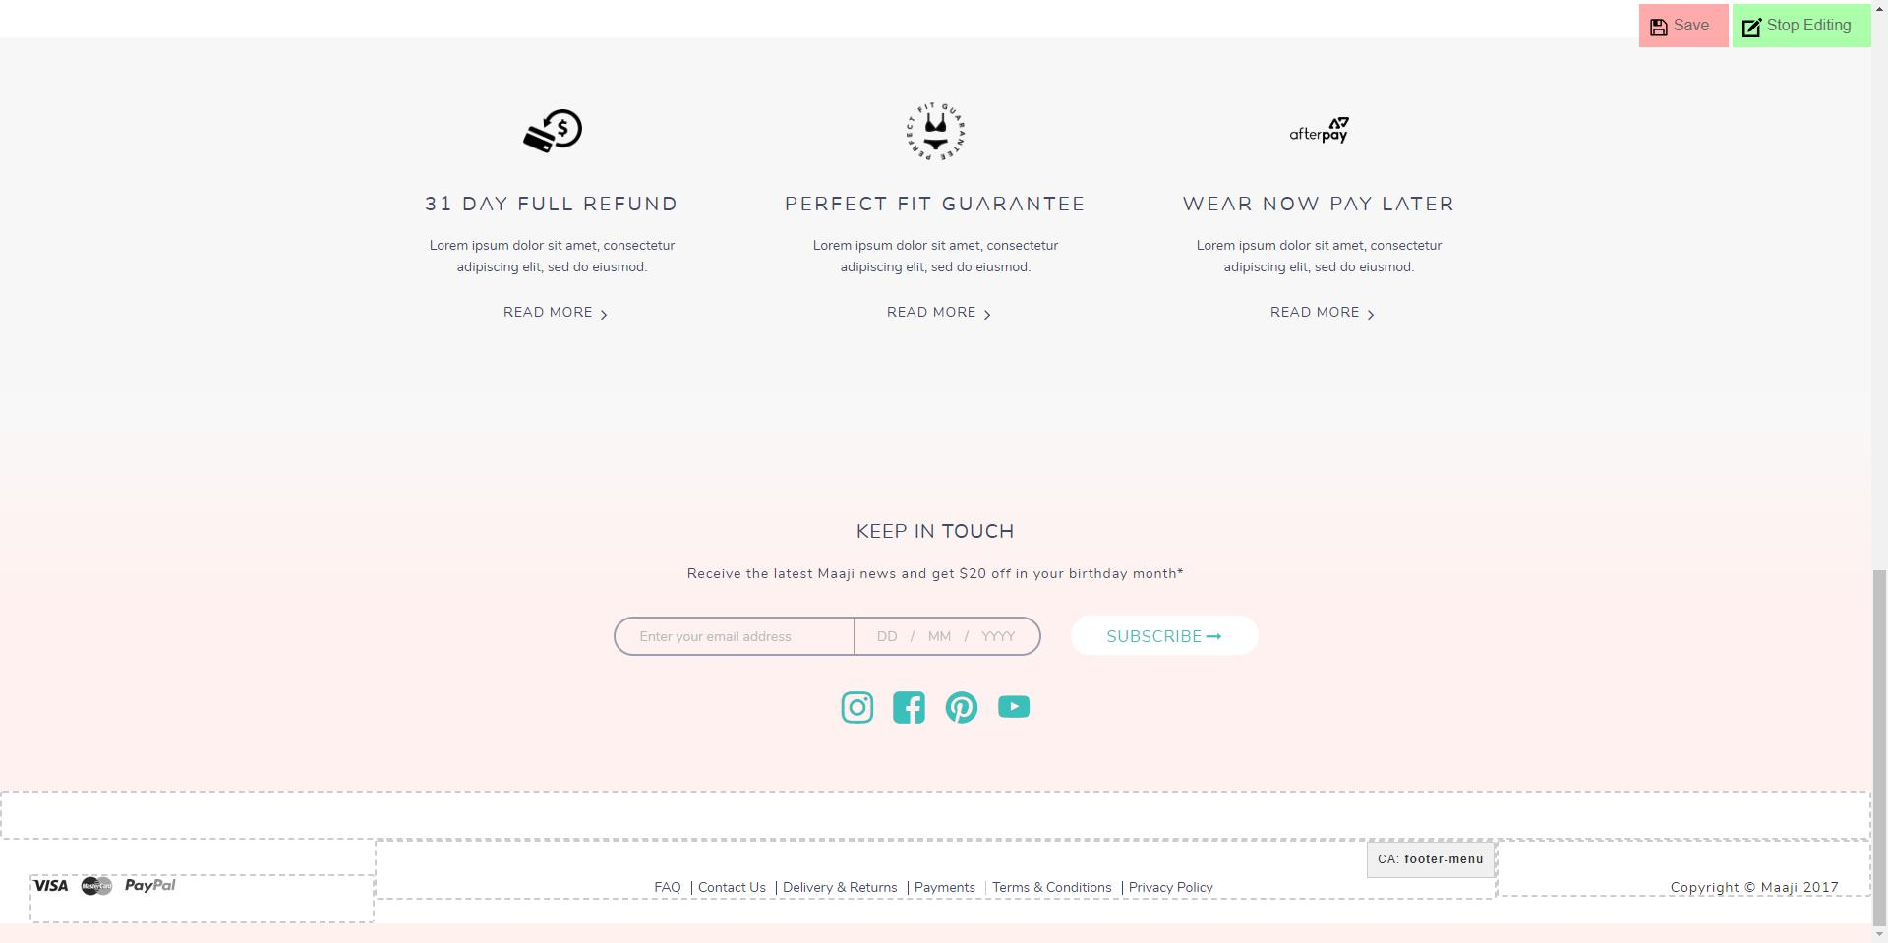
Mouse over dashed rectangle
CA means Content Asset

Slide 5
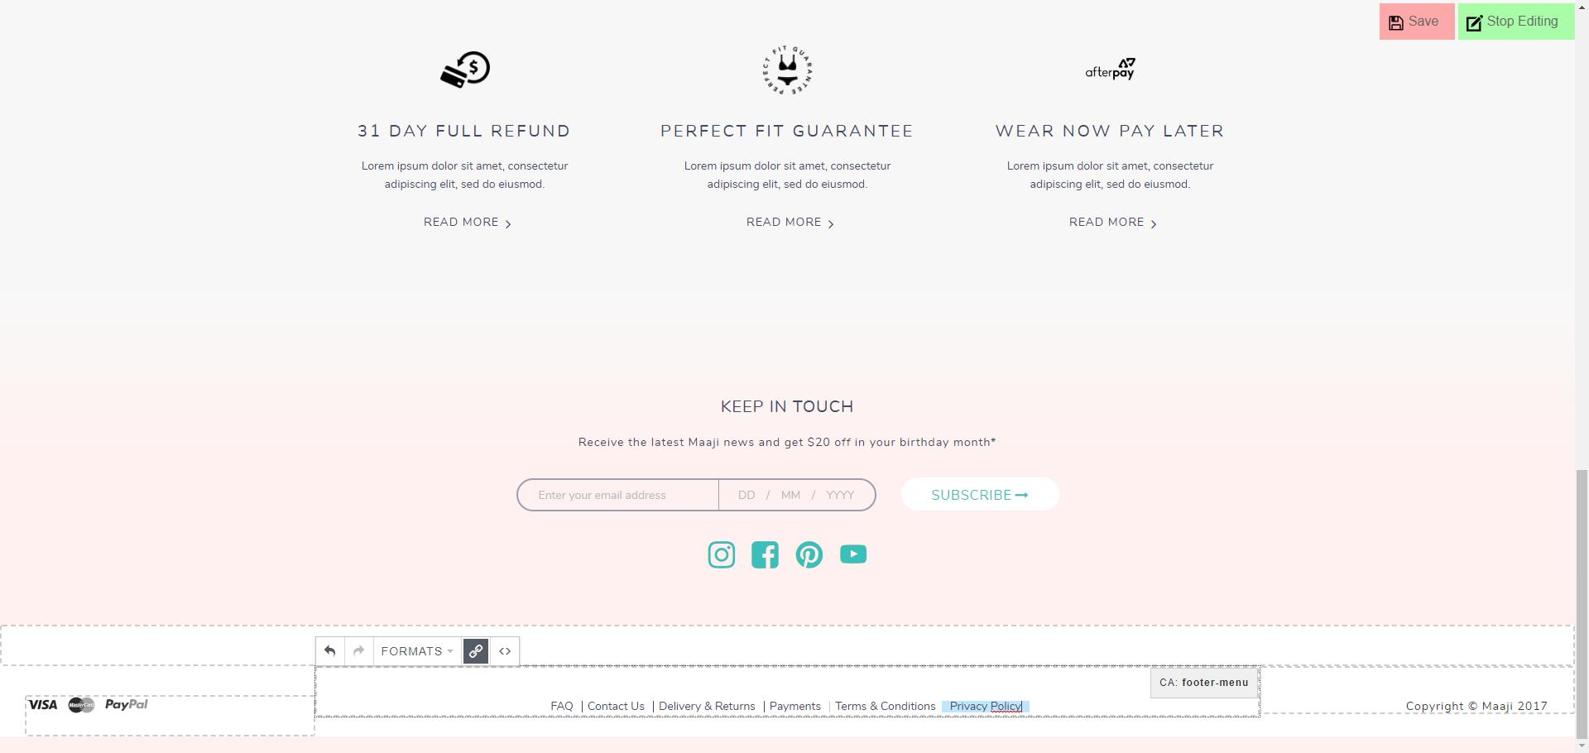
Click somewhere in the text and edit

Slide 6
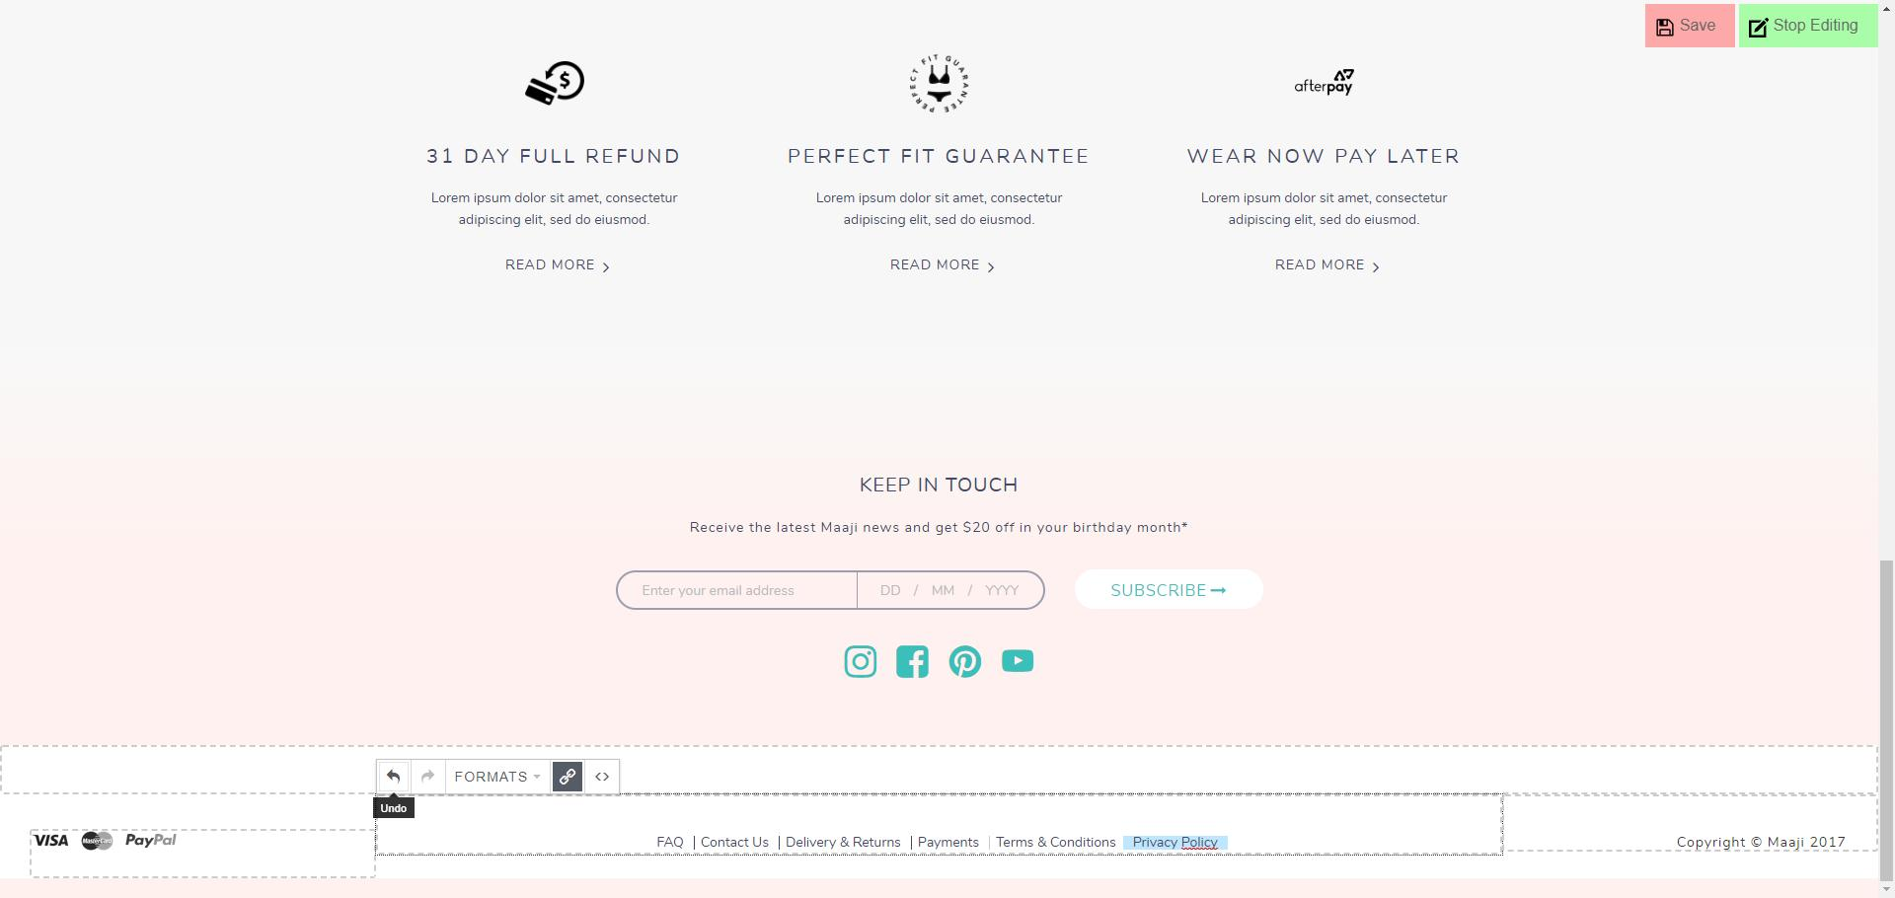
Click here to Undo previous operation(s)

Slide 7
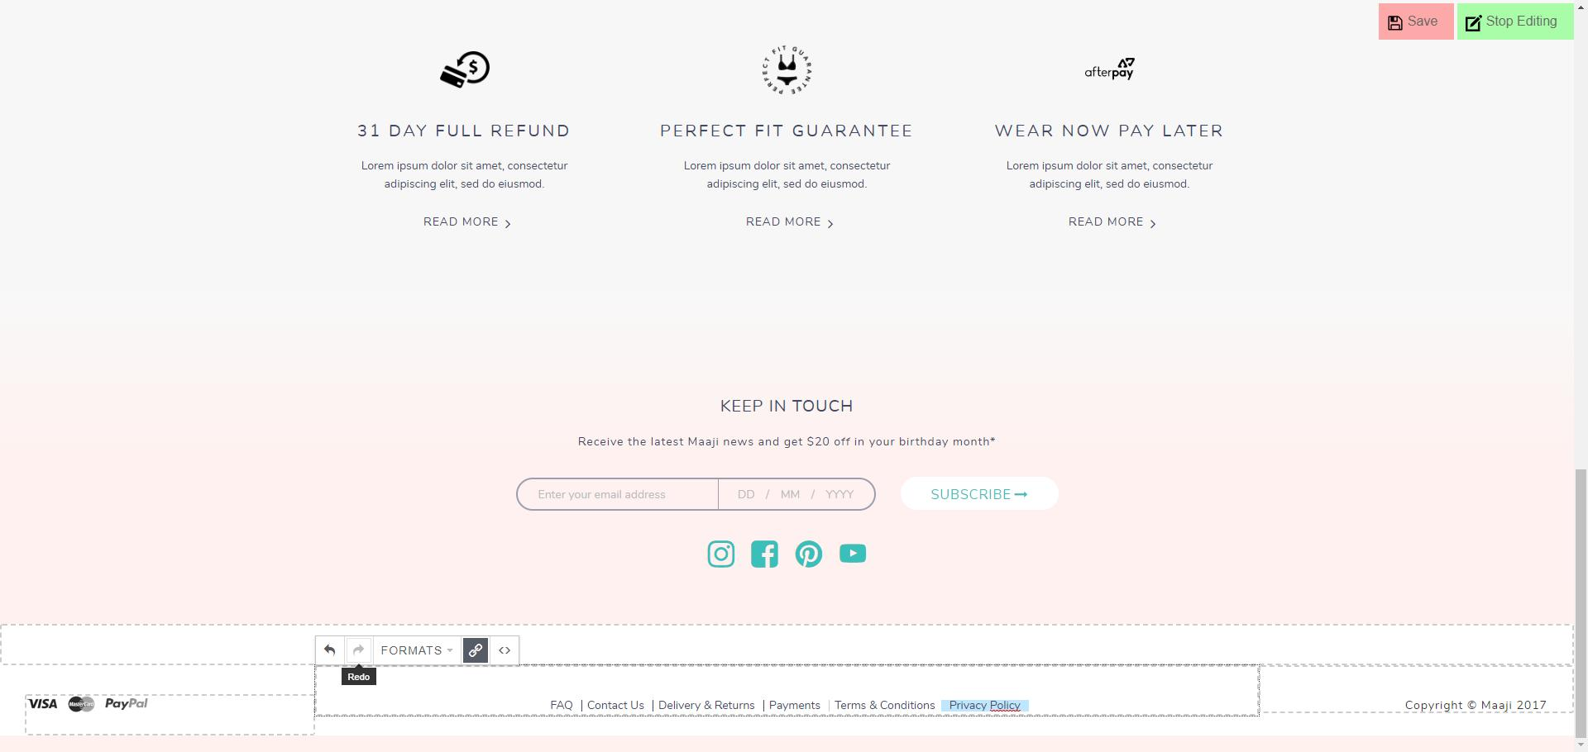
Click here to Redo previous operation(s)

Slide 8
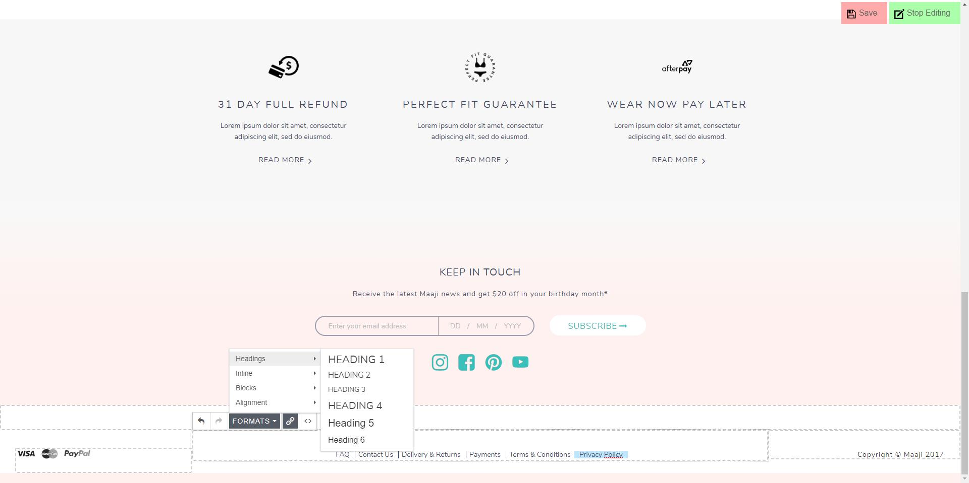
Click here to apply formatting to selected element

Slide 9
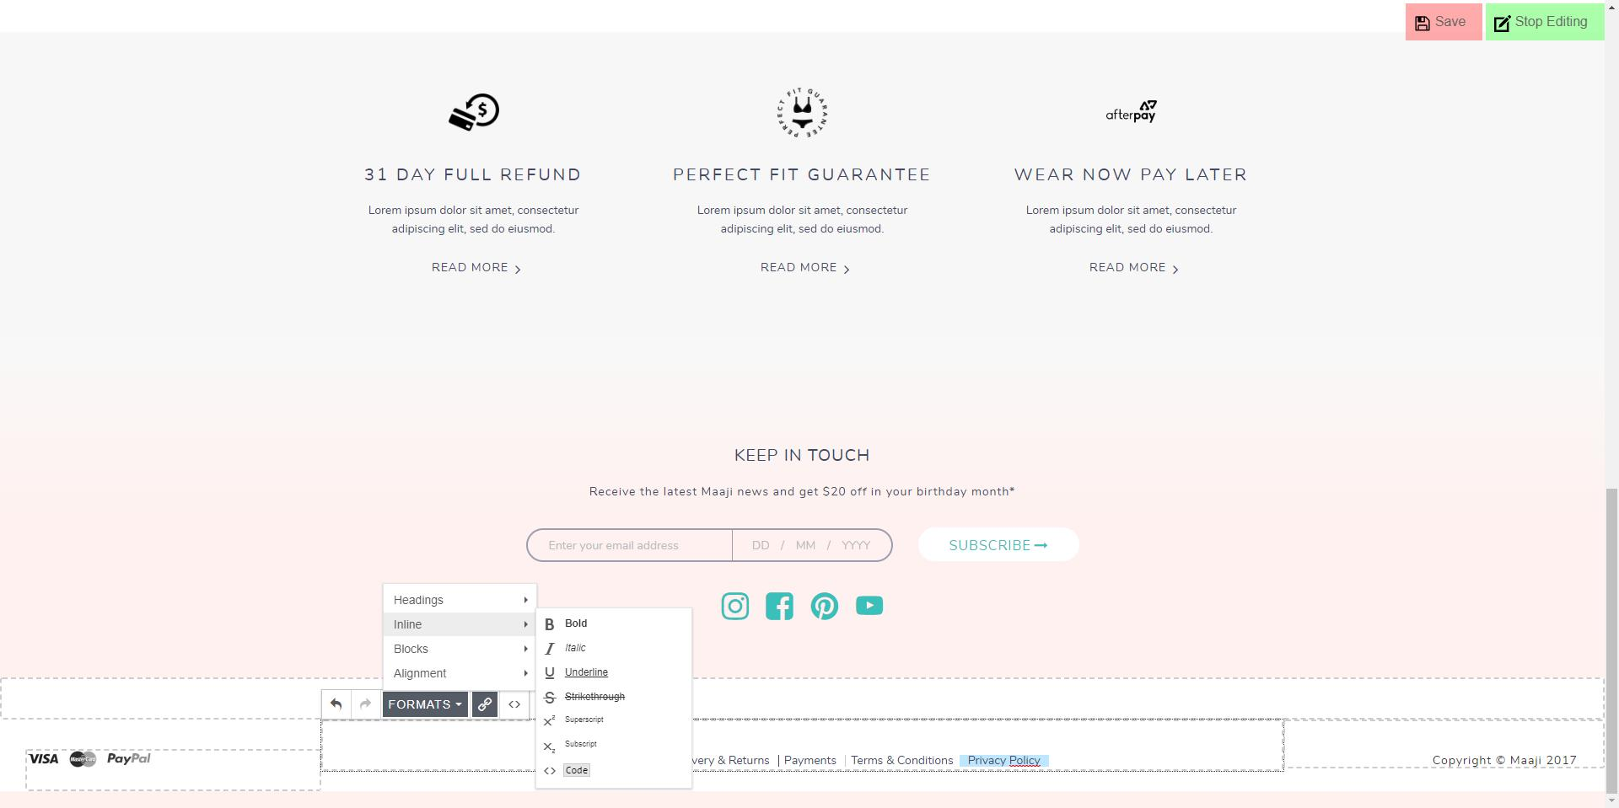
Click here to apply formatting to selected element

Slide 10
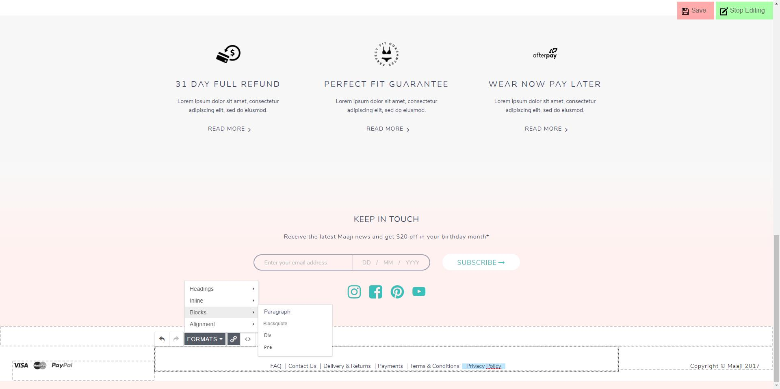
Click here to apply formatting to selected element

Slide 11

Click here to apply formatting to selected element

Slide 12
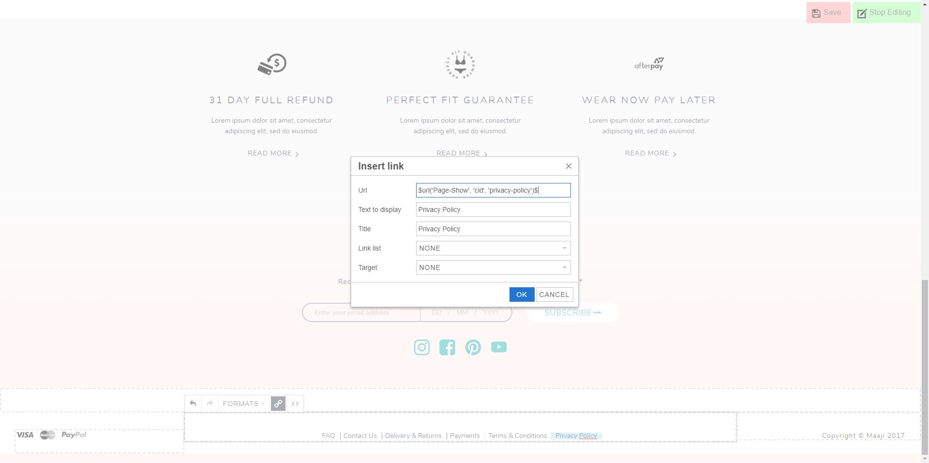
Add/Edit text of the link
Click here to add/edit a link

Slide 13
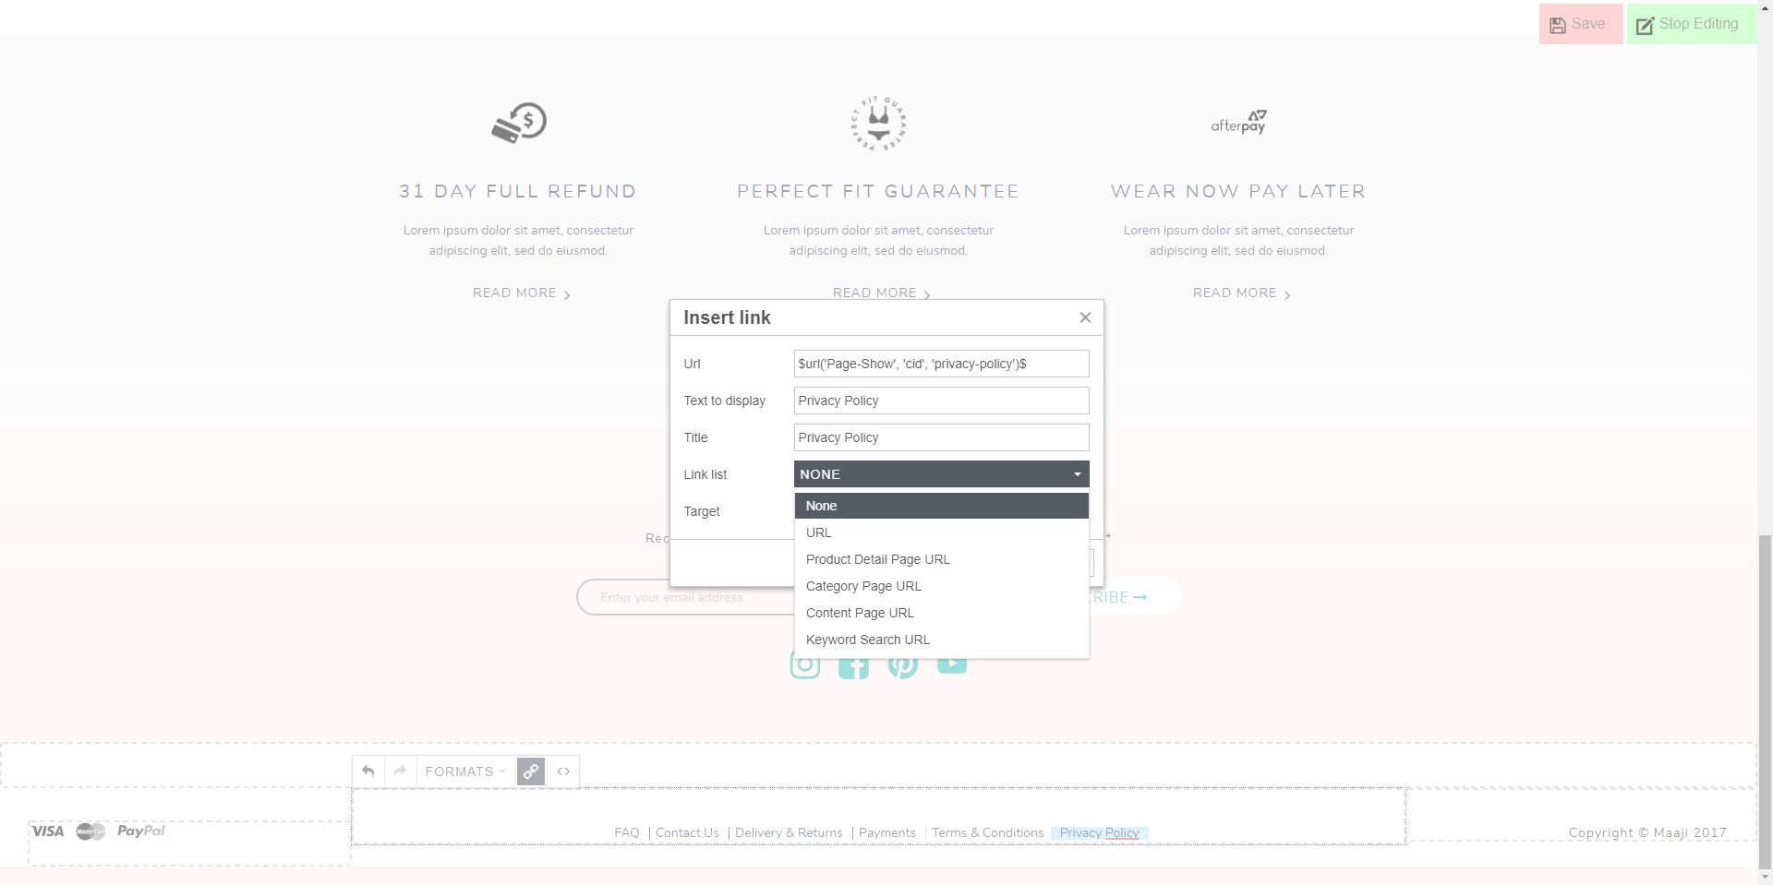
Click to choose type of the link

Slide 14
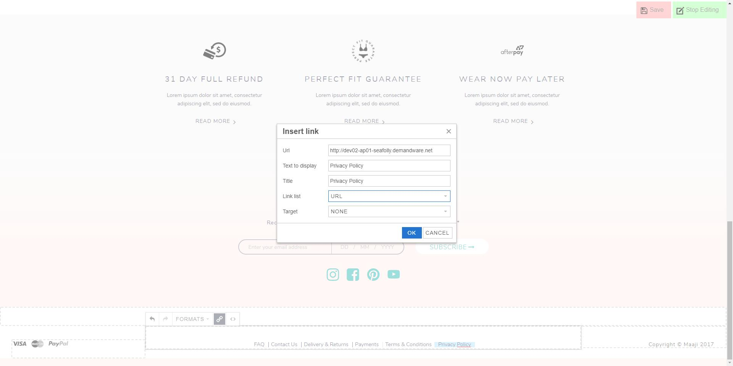
Enter URL of the external site
Choose URL and create link to external site

Slide 15
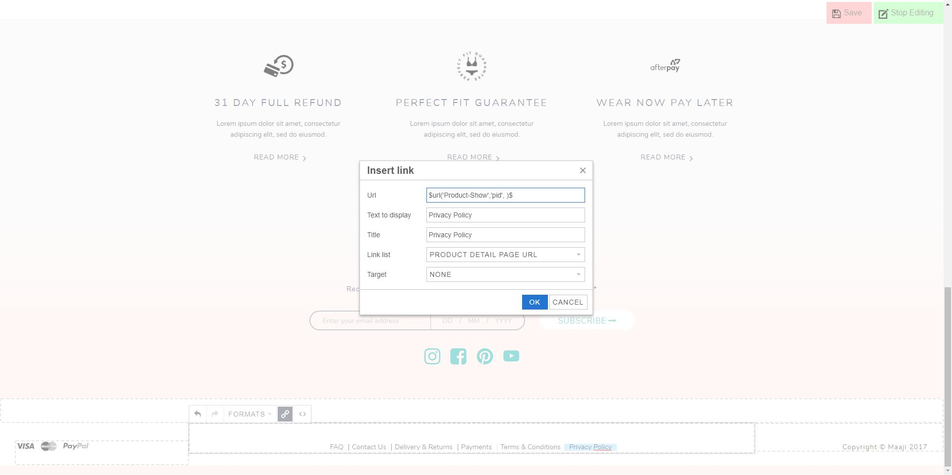
Enter PRODUCT ID after pid
Choose PRODUCT DETAIL PAGE URL
and create link to product page

Slide 16

Enter CATEGORY ID after cgid
Choose CATEGGORY PAGE URL
and create link to category page

Slide 17

Enter CONTENT ID after cid
Choose CONTENT PAGE URL
and create link to content page

Slide 18

Enter KEYWORD after q
Choose KEYWORD SEARCH URL
and create link to keyword search page

Slide 19
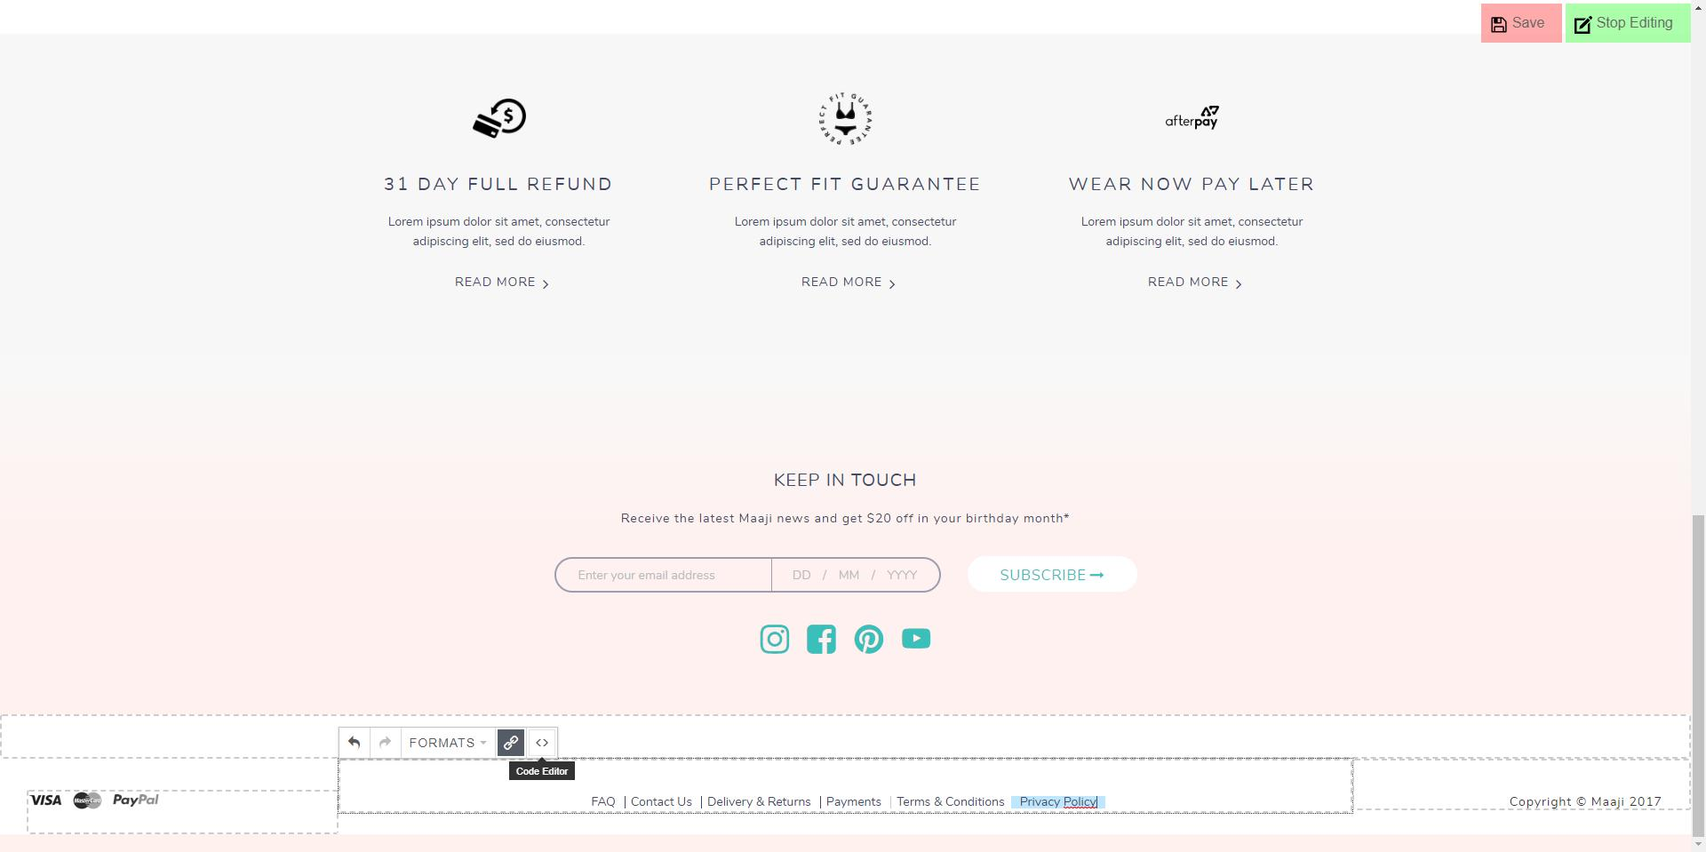
Click here to open HTML code editor

Slide 20
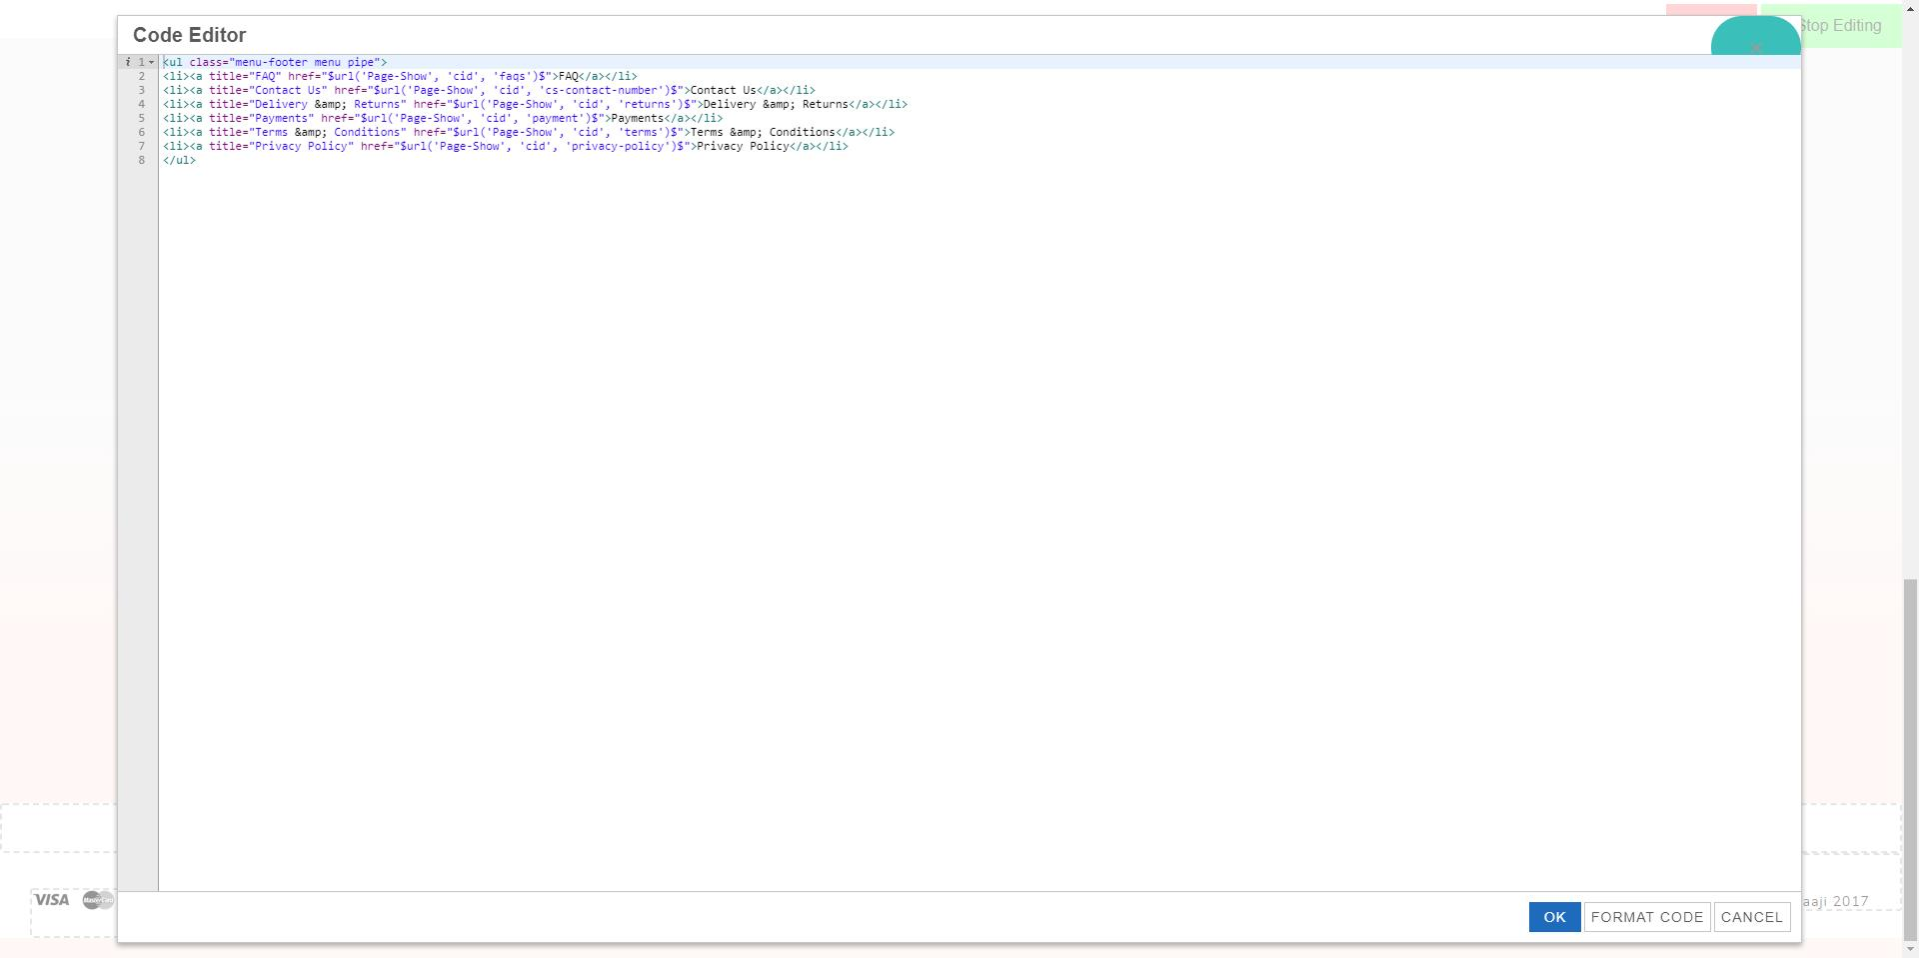
Edit HTML and confirm operation with OK at bottom right

