Slide 1
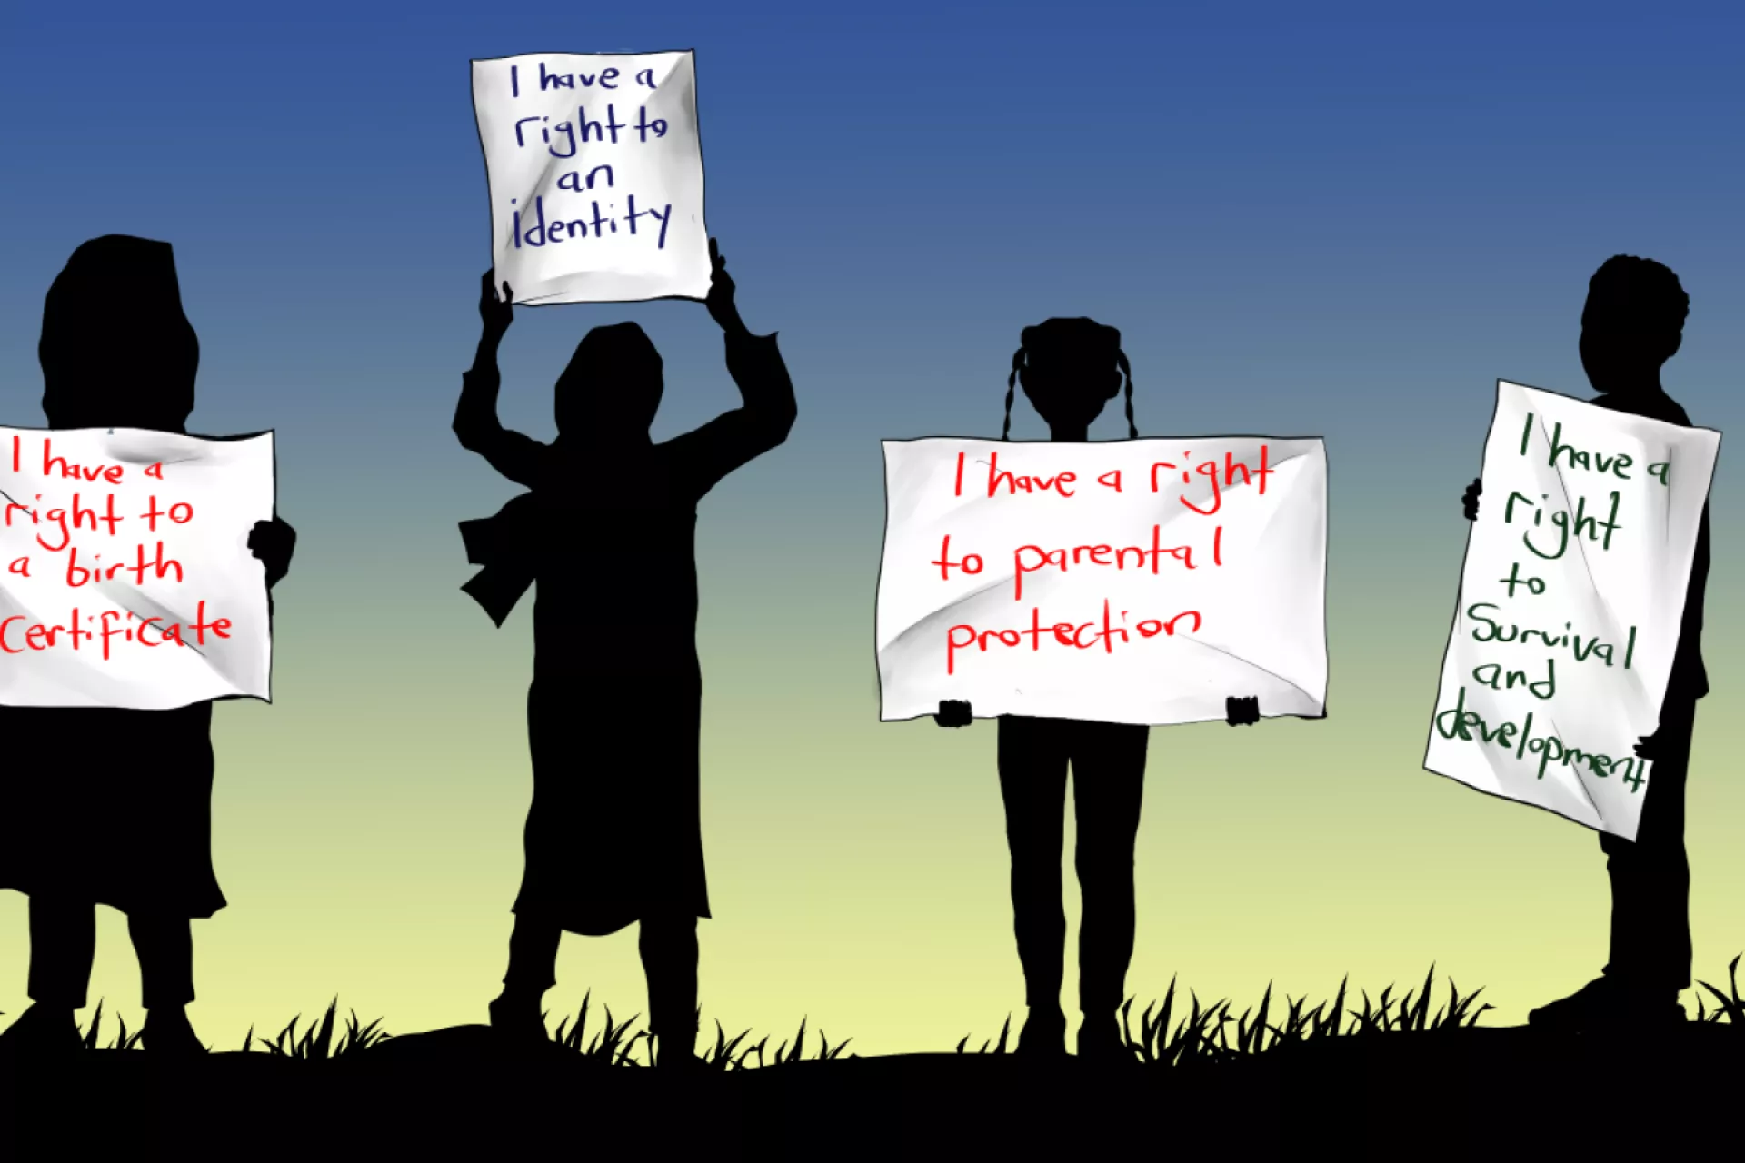
Protection of children’s right during armed conflict: The case of Ukraine. Challenges and Solutions by Hanna Kotyk

Slide 2
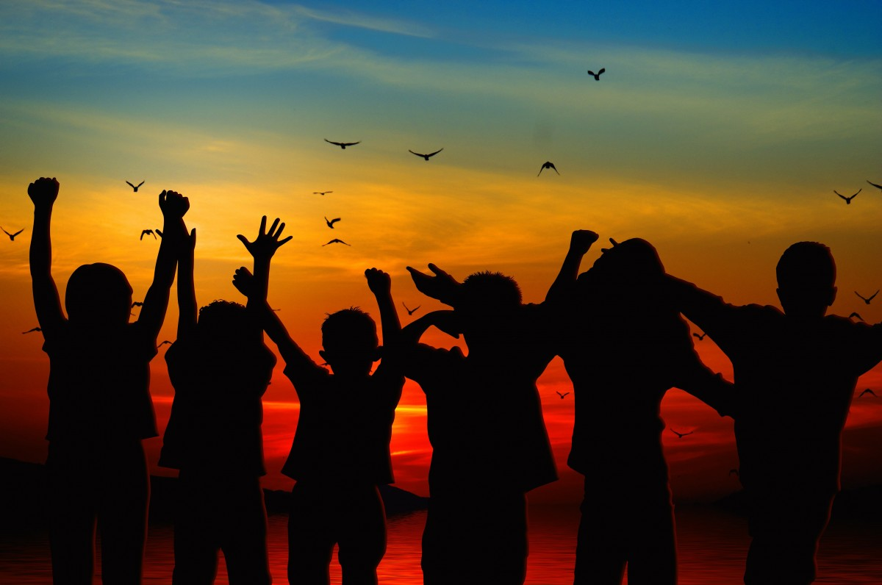
Children are the future of any nation. The children are the ones who determine the future of their country, the direction in which the country will move forward and what it will create. And so, a child’s right to life is essentially the right to life of the entire society, entire country. With this in mind, the older generation must create a world that cares for children, a world where every child feels protected, where children’s perspectives will be respected, a world without violence, a world that would make it possible to raise a healthy, happy, better generation.

Slide 3
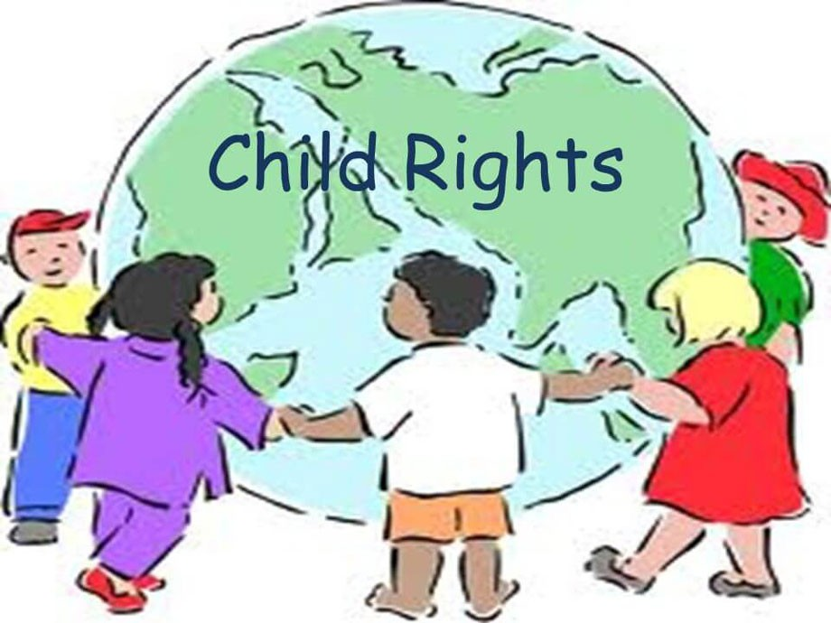
Respect for human rights begins with social attitudes towards children since children are physically and psychologically vulnerable and delicate and call for special attention.
Any developed country must have it as its strategic national goal to act in the best interests of children and to protect their rights.

Slide 4
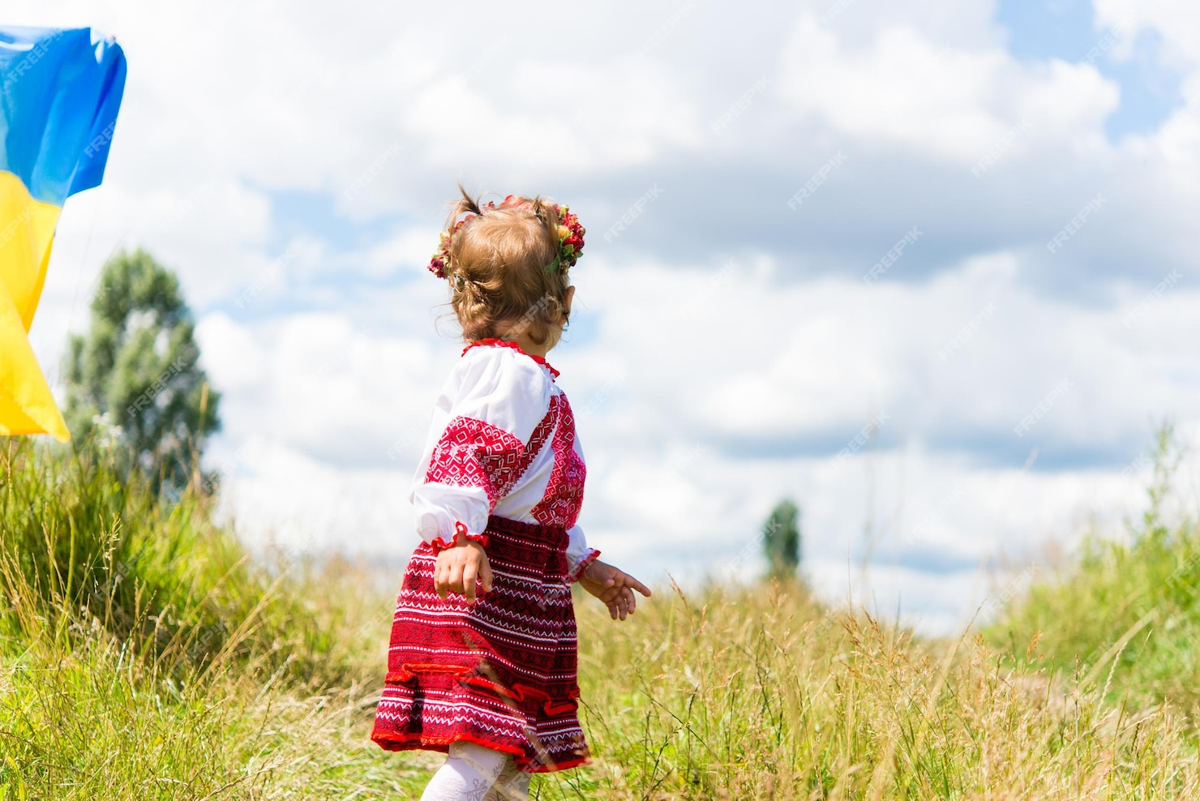
Ukraine, as a democracy that is based on the rule of law, protects the rights of all children and ensures the children’s wholesome development. It is worth noting that, prior to Russia’s war with Ukraine, all the authorized state agencies and organizations that worked on children’s human rights were fairly coordinated and effective.

Slide 5
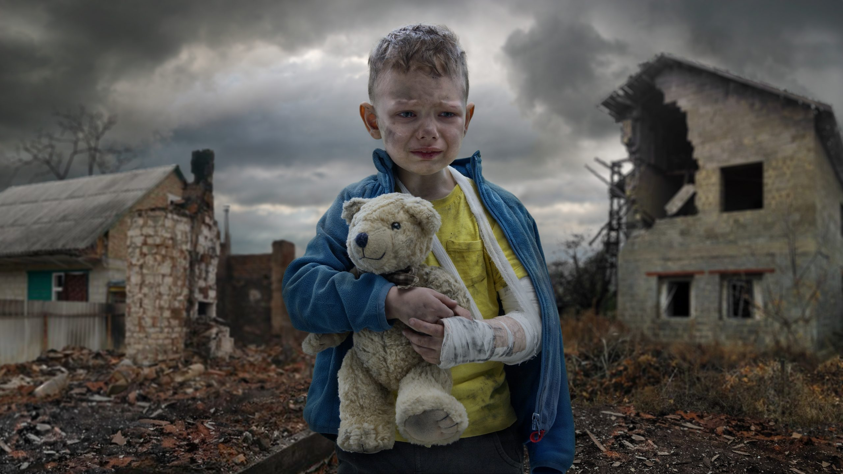
The war has ruined not only Ukraine’s infrastructure, but affected every citizen, especially its most vulnerable social group - the children. War is a complex social and political phenomenon. All population groups are negatively impacted by the war events; however, war and children are an unacceptable combination, which we cannot, unfortunately, prevent. That is why the state’s authorized bodies must make every effort to protect the children from the effects of war. In the new and changing circumstances of waging war, children are the most vulnerable group. Outside of a safe environment, where the protection of children is a priority, children face all the negative effects of war conflicts: relocation, loss of home and family members, parting with parents who can ensure the children’s survival and who have a long-term influence on the children’s growth and development that will stay with them into adulthood. Because a child’s development is a process, war poses a serious threat to the child’s physical and psychological wellbeing.

Slide 6
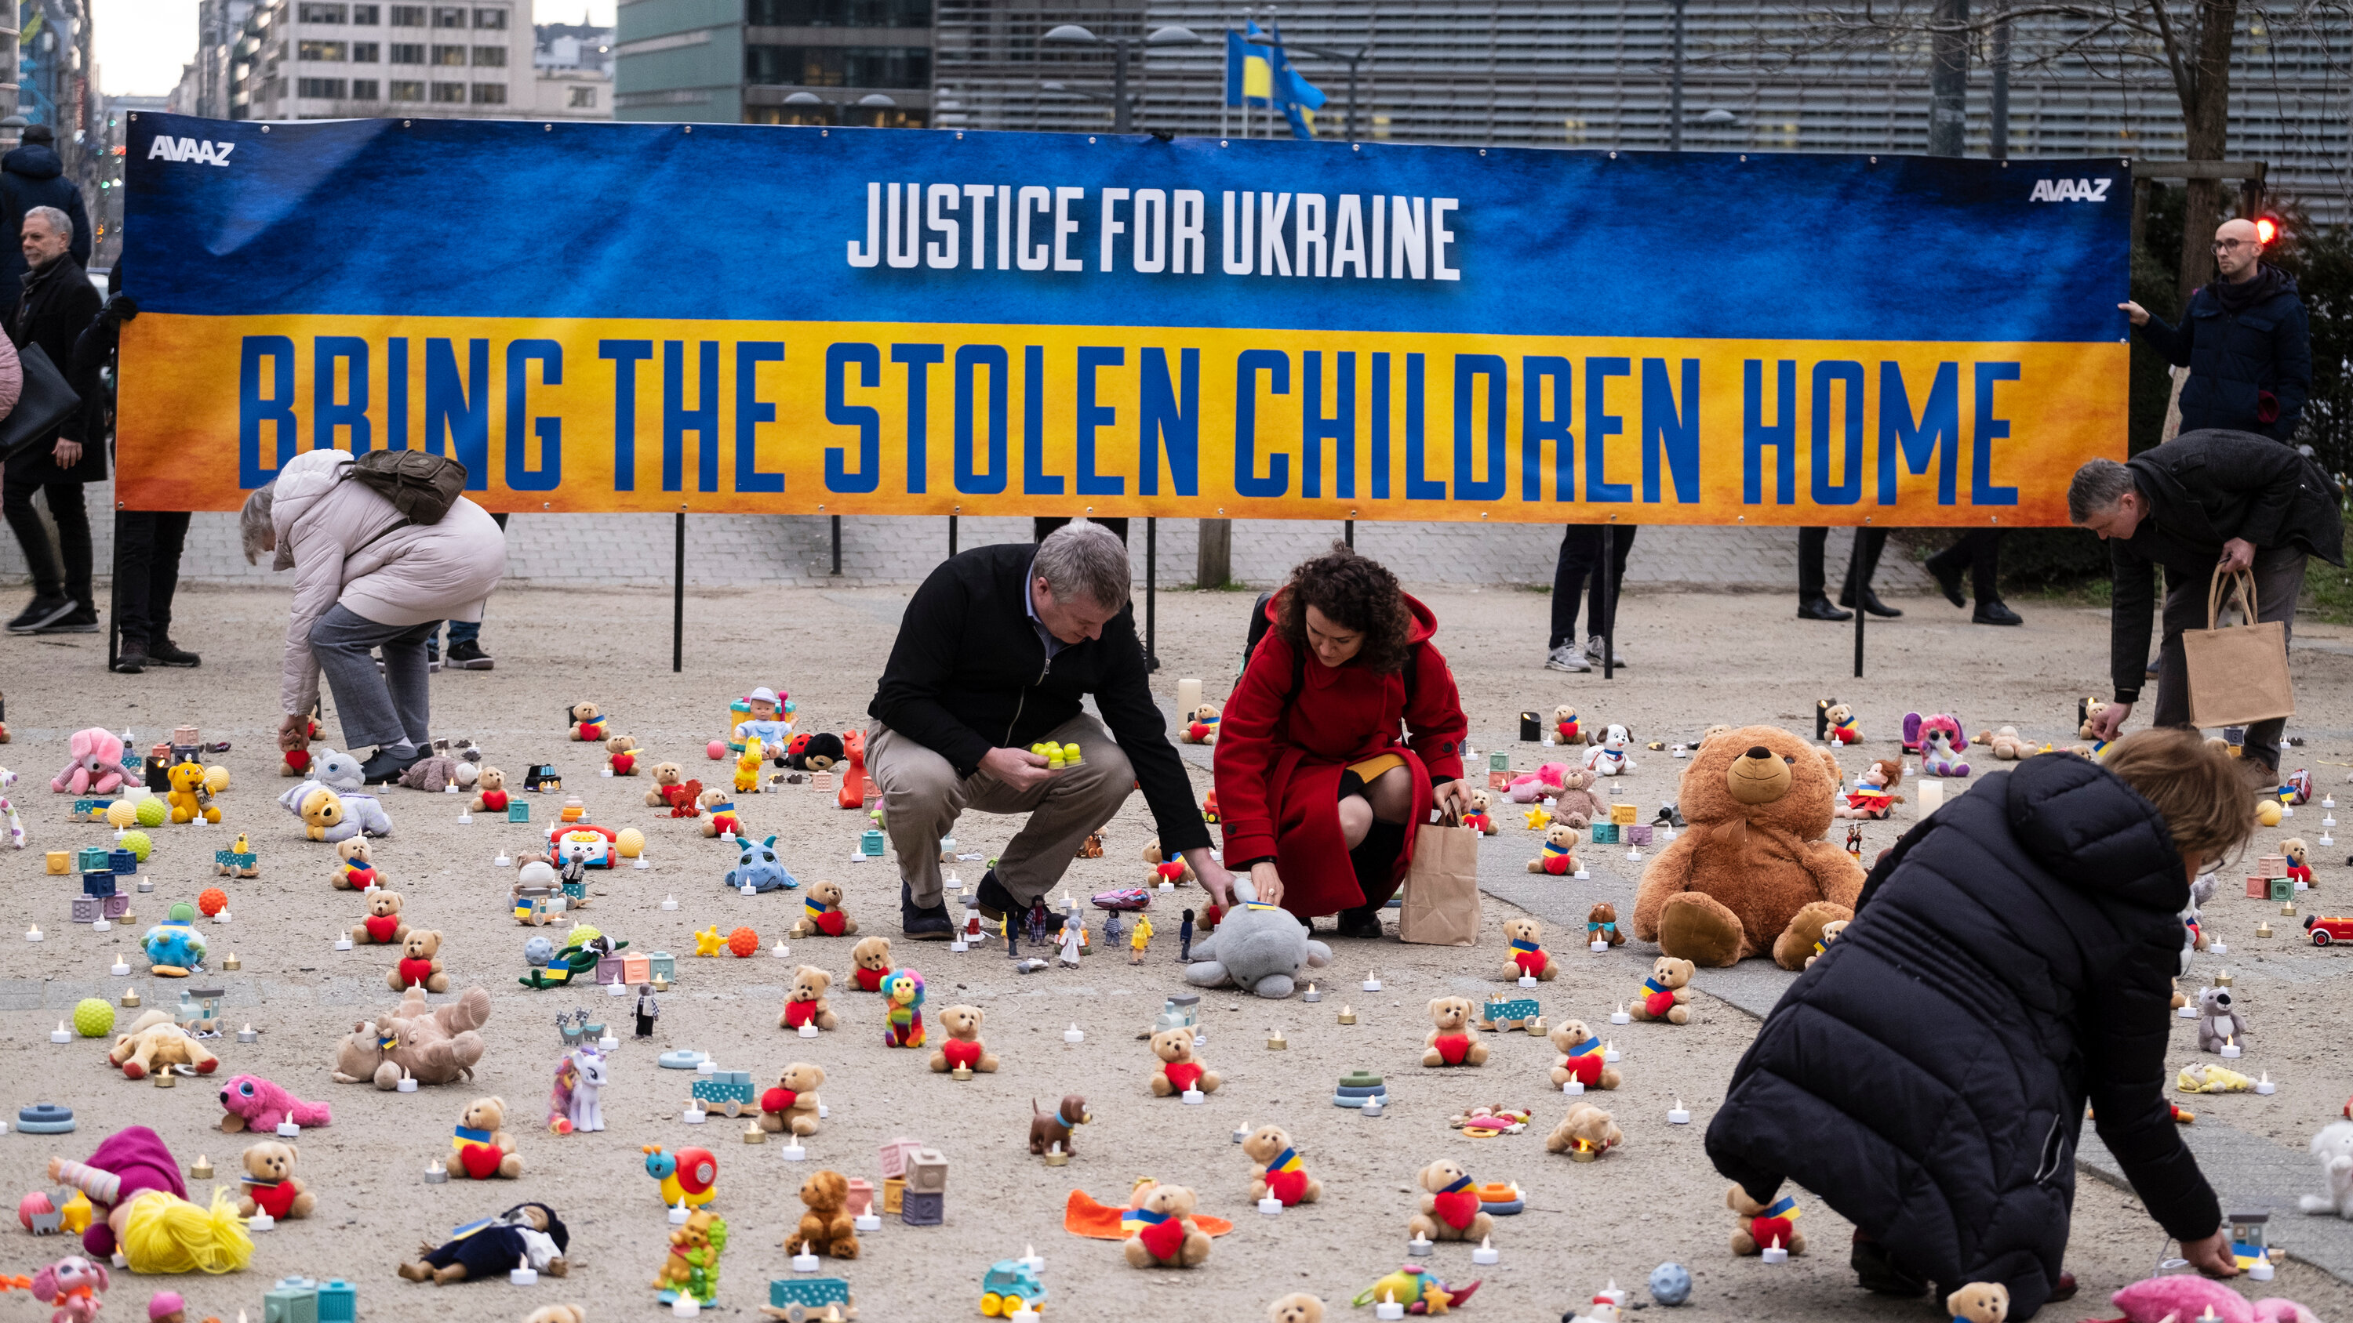
“The Russian aggression has undermined all the rights of Ukrainian children,” – points out Darya Gerasymchuk, the President’s advisor for children’s rights.
It is fairly hard to talk about children’s rights after the horrors that took place in Ukraine since the beginning of the military aggression by the neighboring state in 2014. Thousands of children lived through unprecedented horrors and violence, were kidnapped, pulled out of their homes and families and are still held captive, without any information about the fate of their relatives. Right after the occupation of the Crimea, the Russians kicked off a program “The Train of Hope” in order to transfer Ukrainian orphans and children whose parental rights were terminated for illegal adoption by Russian families.

Slide 7
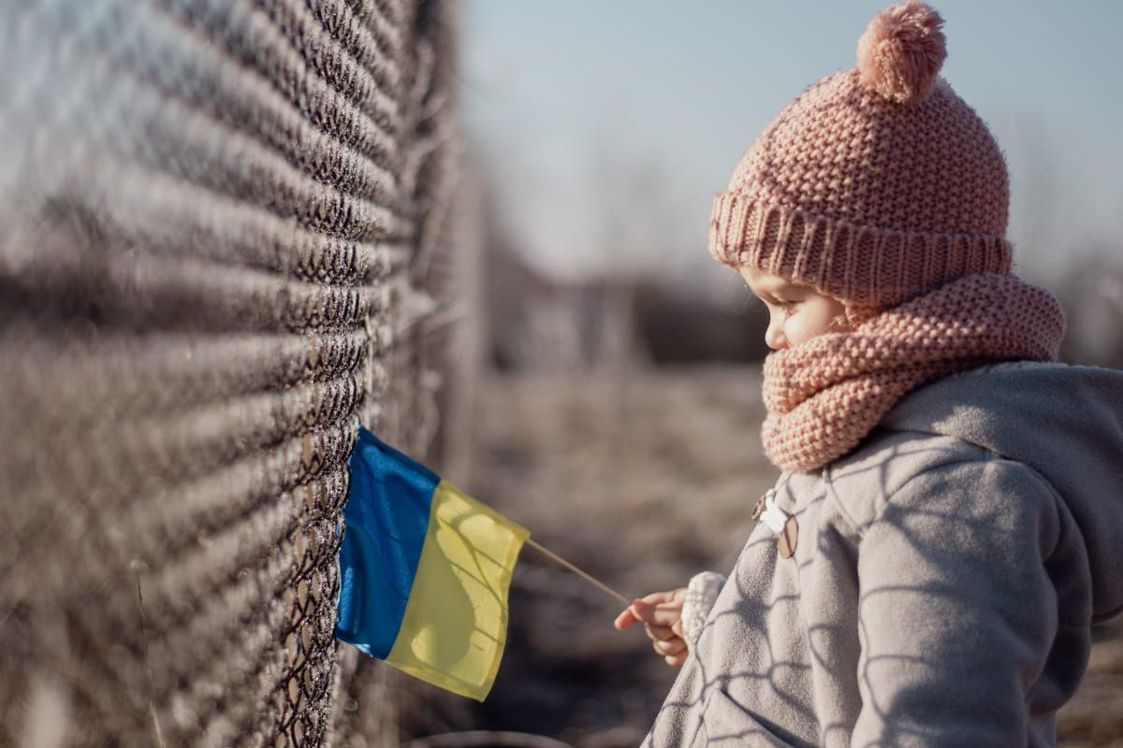
After February 24, 2022, the kidnapping of Ukrainian children has significantly increased and turned into a systemic policy. Nowadays in the Russian-occupied regions, the Russians are taking not only the children under state custody, but also taking children away from their parents and guardians. As of June 2024, the Russians have taken at least 20 000 Ukrainian children.
The Russian authorities take Ukrainian children under different pretexts. They tell the parents or guardians about “vacation” and “rehabilitation” trips as well as “educational” tours to cultural destinations or educational institutions in the Russian Federation. Within such a framework, the Russian government does not only “rescue” these children, but even allegedly invests in their physical and mental wellbeing.

Slide 8
It also needs to be noted that after three years of a full phase of the war, we see evidence of the systemic alteration of people’s identities in the occupied territories, namely, in the Lugansk and Donetsk People’s Republics (LDNR) – proclaimed by Russian to be “independent actors” — and in two other administrative regions of Ukraine.
The government in Russia and the local authorities gradually create an information bubble of the people in the occupied regions, by making it difficult or impossible to access the internet and media that are free from Russia’s censure.
The children undergo a systemic “reprogramming,” with an ultimate goal of imposing the Russian identity on them as fostering distrust (at a minimum) or hate (at a maximum) towards Ukraine and fellow citizens. The Russian government ensures the Ukrainian children are fully immersed in the Russian educational, cultural, and social space, which results in them invariably losing ties with their Ukrainian identity due to their isolation from the rest of Ukrainians.
For example, some of the deported children end up in military schools and undergo a standard military training for future entry into the Russian military.
Remarkably, teenage boys who will soon grow up to be eligible for the draft, are much more often adopted to the Russian families – the majority of children who were illegally adopted by the Russians are 14-17 years old, and there are 71% more boys than girls in this category.

Slide 9
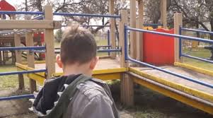
Mykyta Bilanchuk, 9, was illegally taken by the Russians from the Oleshkiv boarding school in October 2022. It took his grandmother Polina 76 days, a DNA test, and help from the volunteers to reunite with Mykyta. Now they are safe in Poland.
At the beginning of 2022, Mykyta was undergoing rehabilitation at the Oleshkiv boarding school for children with disabilities due to eating disorders and muscle weakness. After the beginning of Russia’s full-scale war against Ukraine, the facility in the Kherson region came under occupation. Initially, Russians forcibly took the children under the pretext of “evacuation” to Simferopol in the temporarily occupied Crimea and then transported them to Krasnodar in Russia. From there, Ukrainian children were later relocated to the temporarily occupied Skadovsk in the Kherson region.
Along with Mykyta, Russians illegally deported 105 Ukrainian children. Only in April 2023, journalists from Ukrainian media hromadske could find and verify the list of children taken from the boarding school. Hromadske was also able to find Mykyta’s grandmother, Polina Kindra, who lived in Poland at that time. In September 2023, the child was reunited with her with the help of journalists and the “Save Ukraine” charitable fund.

Slide 10
To bring Mykyta back, Polina Kindra decided to go to the temporarily occupied territories. Volunteers from the “Save Ukraine” assisted her in preparing all the necessary documents and planning the route.
“It’s so scary to go there because of all the checkpoints… They [Russians – ed.] check you and take fingerprints. I haven’t slept for three nights…” said Polina Kindra.
For 76 days, Polina Kindra tried to take her grandson back home.
“Then the bus arrived, and Mykyta ran up, and I shouted, ‘Mykyta!’ and he answered, ‘Grandma!’ He kissed me and asked, ‘Did you come for me?’ “ Polina recalls meeting her grandson in June 2023.
Several times, she came to the doors of the boarding school and was met with refusal. In addition, Mykyta’s grandmother had to endure several interrogations. Despite all the necessary documents confirming their family ties and Polina’s guardianship over Mykyta, Russians even compelled the woman to undergo a DNA test.
However, even with a DNA test confirmation, Polina couldn’t get her grandson back. Mykyta was illegally given Russian citizenship. The so-called director of the boarding school, Vitalii Suk, had no right to do this, as the boy had a legal guardian in Ukraine – his grandmother. Furthermore, Suk and the Russians also pressured Polina to take Russian citizenship.
“You have to take a Russian passport, and that’s it… We don’t work with DNA results,” recalled Polina about the challenging process of bringing Mykyta back home.

Slide 11
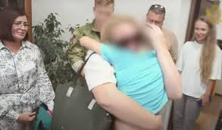
Eventually, in September 2023, the director of the boarding school agreed to return Mykyta to his grandmother. The boy was handed over personally to Polina by the Russian Presidential Commissioner for Children’s Rights, Maria Lvova-Belova, who is wanted internationally for the abduction of Ukrainian children. In front of about ten cameras, Lvova-Belova smiled and spoke about how she always encourages family reunions. However, behind the scenes, she offered Polina money to stay with her grandson in Russia. The woman firmly refused.
“It’s just a matter of how to endure, for the grandmothers, aunts, uncles whose children were taken away… Russia exerts a strong psychological pressure… If you endure, you will get them back,” told Polina later.
As of October 2023, Polina and her grandson managed to leave the temporarily occupied territories. They are currently safe in Poland. Ahead of them lies a long period of rehabilitation. In particular, Mykyta needs to undergo a preventive examination and begin further treatment after everything he’s been through.

Slide 12
All of this constitutes crimes of war and egregious violations of international law. There are key international laws that lay foundation for protecting children in the midst of military conflicts:
United Nations Convention on the right of the Child
Optinal Protocol to the Convention on the Rights of the Child on the involvement of children in armed conflict
The Geneva Convention for protecting victims of war
Convention concerning the Prohibition and Immediate Action for the Elimination of the Worst Forms of Child Labour
Additional protocols to the Geneva Convention
The Convention for Children’s Rights is the most broadly recognized tool in the world for protecting the human rights of children. The document of the Convention combines all types of children’s rights: civil, political, economic, social, and cultural.

Slide 13
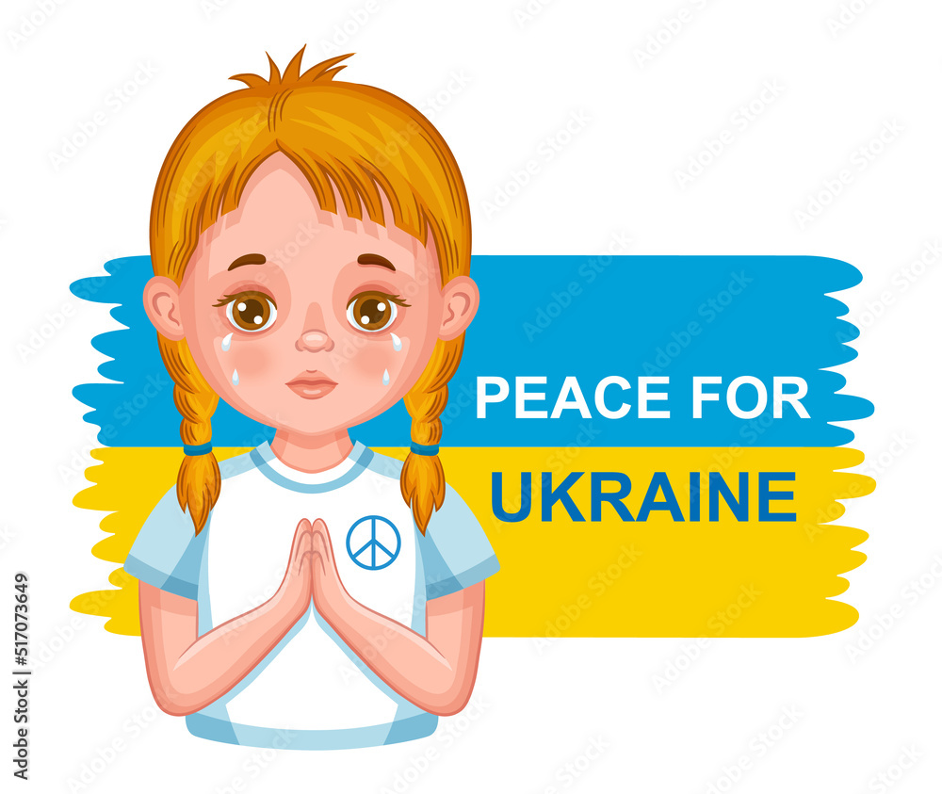
It is Ukraine’s top priority at the international arena to protect Ukrainian children who have been kidnapped or illegally deported to Russia or to the occupied regions. It is a war crime that violates numerous international treaties and principles of human rights. First, it is a violation of the rights of children to life, health, education, family nurturing, protection from any type of violence and from conscription into military action and war conflicts, a free choice of the place to live and other fundamental rights and basic freedoms; in other words, almost an entire list of rights and freedoms of children, fleshed out in international law that contains international standards of children’s rights. Second, children whose rights have been violated require special protection and care from the state as well as the international community. Third, there have emerged new types of children in Ukraine’s most recent history: children who have fallen victims of physical or psychological violence as a result of war actions; children whose parents have died or been wounded during war; and children warriors who have participated in combat.

Slide 14
Below are the main way in which legal and political protection can be provided to these children:
1.International criminal prosecution
Process:
International Criminal Court has already issued arrest warrants for Vladimir Putin and Mariya L’vova-Belova for kidnapping the Ukrainian children. The warrants were based on the investigation of the children deportation from Ukraine by the Prosecutor’s Office at the International Criminal Court. Thanks to the efforts of Ukrainian and international human rights advocates and law enforcement, we know quite a lot about how exactly the Russians kidnap the children and what these children’s lives are like, once deported.
A criminal case has been opened based on Article 8 of the Roman Statute – the military crime of deportation and relocation of civilians.
Consequences:
These warrants are effective in 124 countries, which means the suspects can be arrested upon the crossing of the border.
This is the first step towards the justice process.

Slide 15
2. Utilization of the United Nations and international mechanism for the protection of children’s rights:
The UN Convention for Children’s Rights
The Geneva Convention (IV Convention, articles 49, 50)
The Hage Convention regarding civil law aspects of international kidnapping of children (1980) – albeit the Russian Federation does not follow it.
The issue:
The Russian Federation ignores international law and does not give international agencies, such as UNICEF, access to investigate the actual situation with the children.

Slide 16
3.Political pressure and international advocacy
Actions:
Ukraine has created an International Coalition of countries for the return of the children – 30 countries have joined.
A database “Children of War” has been created and contains every case of kidnapping.
4.Collaboration with third-party countries and humanitarian organizations
Collaboration:
Some of the children have been returned with the assistance of Quatar, Turkey, Red Cross, and international human rights NGOs.
Some countries help “pick out” these children through diplomatic channels or humanitarian missions.

Slide 17
5. National litigation + criminals registry
Ukraine’s Office of the Prosecutor General has opened dozens of criminal cases for kidnapping of children.
An integrated registry of kidnapped children + criminal cases against the perpetrators, especially with the Russian “guardians” and “volunteers.”
6. The media campaign and media pressure
Wide circulation of documented instances, such as kidnapping of children from Mariupol, Kherson, etc.
Documentaries, publications, witness testimonies in the US, French, EU, Canadian Parliaments, etc.

Slide 18
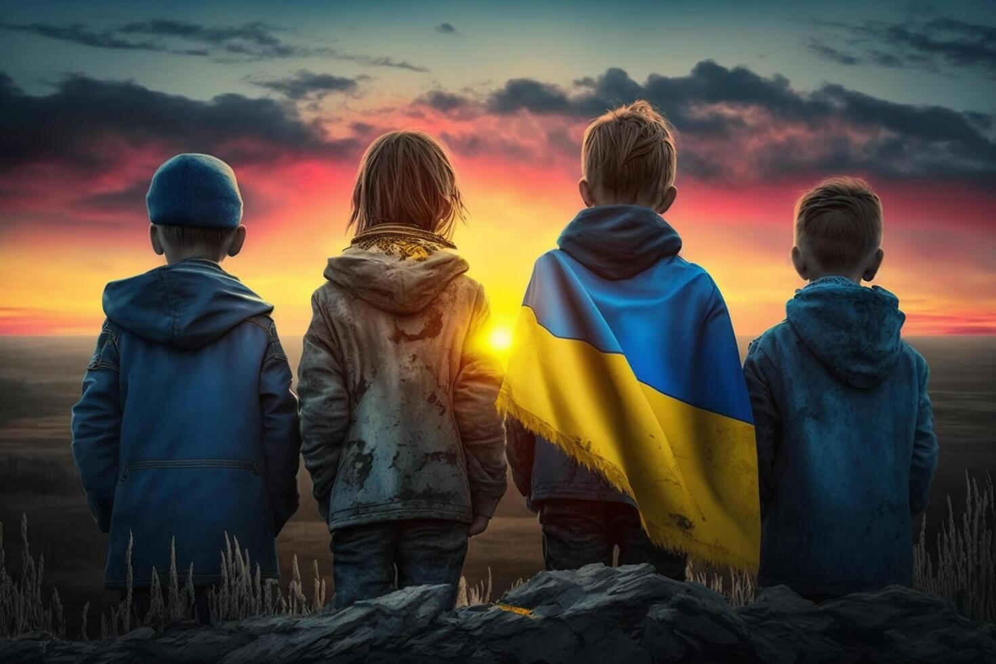
In summary, for protection of children’s rights during war to be effective, we need an integrated approach and collaboration with the international community. Only united efforts can ensure safety and wellbeing of the children who are currently living in the most vulnerable of circumstances.

