Slide 1
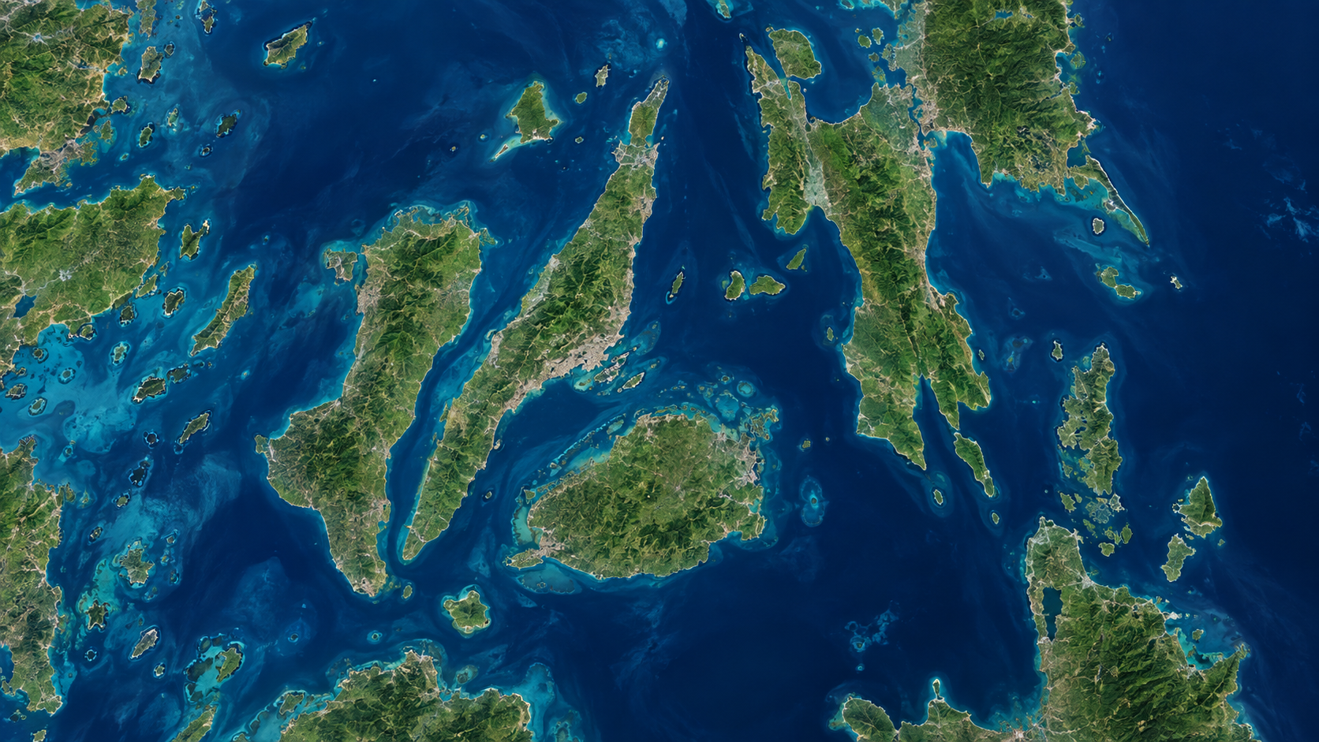

SIMPLE CEO PROPOSAL
Vessel Location
Tracking on a Map
PORT ORIGIN
CURRENT LOCATION
Use the existing Voyage and Activity process to show where each active vessel was last reported.
PORT DESTINATION
Prepared for Management Review

Slide 2
What the system does today
The existing process already records the ports, voyage and activities.
Create Voyage
Add Voyage Status
1
Enter voyage number, cargo, crew, Port Origin, Port Destination and Current Location.
2
Open the current operational phase, such as Loading, Sailing or Unloading.
Add Activity
Complete Voyage
3
Record the vessel activity and select its current port or location.
4
Close all activities and statuses, then complete the voyage.
PROPOSED CHANGE:
Add a map and coordinates to the same Create Voyage and Add Activity screens.

Slide 3
During Create Voyage: select three locations on the map
Users can search, click the map, use device location, or enter latitude and longitude.
CREATE VOYAGE
Port Origin
PORT ORIGIN
Search or select origin port
Cebu Port
Port Destination
CURRENT VESSEL LOCATION
Updated from latest activity
Search or select destination port
Current Location
Use GPS, search or drop a map pin
PORT DESTINATION
Destination Port
SAVE VOYAGE & MAP POINTS

Slide 4
How the vessel marker moves
The latest location saved from an activity becomes the vessel’s current position on the map.
1
2
3
4
Voyage starts
User adds an activity
Current location is updated
Map marker moves
Origin, destination and initial location are saved.
Example: Departed Cebu Port or Arrived at anchorage.
Use GPS, search, map pin or manual coordinates.
Managers see the latest reported vessel location.
Every update keeps the user, date, time, voyage and activity for history and accountability.

Slide 5
What the Current Voyage Map will look like
Each marker represents one vessel with an active voyage.
SELECTED VESSEL
PORT ORIGIN
MV SAMPLE 01
Cebu Port
ACTIVE VOYAGE
CURRENT VESSEL LOCATION
Voyage
VL-00048
Updated from latest activity
Status
Sailing
Origin
Cebu Port
Destination
Destination Port
PORT DESTINATION
Today, 10:42 AM
Destination Port
Last updated
VIEW VOYAGE DETAILS

Slide 6
Who can use and view it
The proposed map follows the current system permissions and vessel assignments.
1
System Administrator
View all vessels and manage the feature
2
Operations / Vessel Manager
View all active vessels and update locations
3
Technical Manager
View authorized vessels for coordination
4
Vessel Captain
View and update the assigned vessel only
5
Executive Viewer
Read-only management map

Slide 7
What “tracking” means in the first version
Management should clearly understand the difference between reported tracking and automatic tracking.
PHASE 1 — PROPOSED NOW
FUTURE OPTION
Latest Reported Location
Automatic Live Tracking
The vessel marker updates when an authorized user saves the current location during voyage creation or an activity update.
Continuous movement requires integration with an AIS provider or a dedicated GPS device installed on the vessel.
✓ Practical first release
✓ Uses the existing workflow
✓ Keeps position history
✓ Lower implementation complexity
• Automatic location feed
• Additional provider/device cost
• Connectivity and integration required
• Can be added after Phase 1

Slide 8
Management approval requested
Proceed with the simple map-enabled design before considering automatic AIS/GPS tracking.
PROPOSED PHASE 1
RECOMMENDED DECISION
Add a map to Create Voyage.
✓
APPROVE
PHASE 1
Plot Port Origin, Port Destination and Current Location.
✓
Update the vessel marker whenever a new activity location is saved.
✓
Show only vessels with an active/current voyage.
Next deliverable:
✓
Working map prototype connected to the existing Voyage and Activity screens.
Pilot the feature before investing in automatic AIS/GPS tracking.
✓
QUESTIONS & DISCUSSION

