Slide 1


Introduction to the
Tra el Itinerary Planner
An innovative travel itinerary planner designed to streamline the booking process and enhance the travel experience.

Slide 2
Transportation Booking Options
Flights
Trains
Buses
From economy to first class, choose from a wide range of flight options to suit your travel needs.
Explore flexible train schedules and routes, with options for high-speed and scenic rail journeys.
Convenient bus routes for both city-to-city travel and local exploration with on- board amenities.

Slide 3
Hotel Booking Options
1
Luxury Resorts Indulge in unmatched comfort and luxury at top-rated resorts with world-class amenities.
2
Boutique Hotels Discover charming and intimate accommodations with unique designs and personalized service.
3
Budget-Friendly Stays
Find affordable and comfortable lodging options without compromising on quality and convenience.

Slide 4
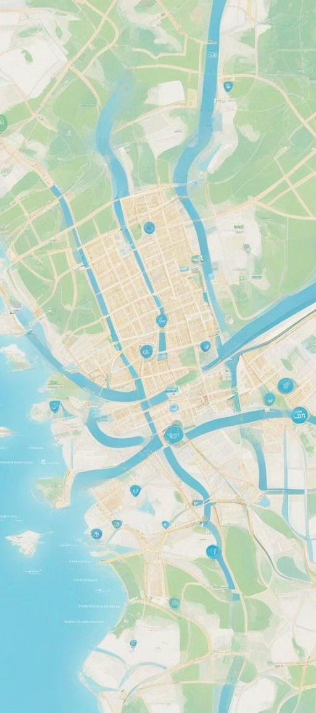

User Interface for Planning and Booking
Seamless Na igation
Easily plan and customize your itinerary with user-friendly features and interactive tools.
Real-Time A ailability Instantly view and book transportation and accommodation
options with live availability updates.
Personalized Recommendations
Receive tailored suggestions based on your preferences to create a personalized travel plan.

Slide 5
Employee Interface for Managing Bookings
Analytics
Access comprehensive data and insights to optimize booking management and enhance user experience.
Support
Effortlessly handle customer inquiries and provide seamless assistance to travelers.
Calendar View
Manage bookings efficiently with an intuitive calendar interface for clear visibility and organization.

Slide 6

Feedback and Rating System for Users
User Re iews
Engage with authentic user reviews and ratings to make informed decisions and share your experiences.
1
Interacti e Feedback
Share your travel feedback and enhance future experiences through valuable input and constructive suggestions.
2

Slide 7


Benefits of Using the Tra el Itinerary Planner
Efficiency
Streamline the planning and booking process for a stress-free and efficient travel experience.
1
2
Personalization
Receive tailored recommendations and personalized itineraries for a unique travel adventure.
3
Confidence
Gain confidence in your travel plans with real-time updates and secure booking management.

Slide 8
Conclusion and Next Steps
1
Future Explorations
Continue discovering new destinations and unlock exciting travel possibilities with the planner.
2
Ongoing Enhancements Expect continuous platform improvements to elevate your travel planning and booking journey.

