Slide 1

YouTube Songs Analysis
This internship project aims to conduct a comprehensive analysis of YouTube songs data using Power BI. The dataset contains key attributes such as video ID, channel title, title, description, tags, published date, view count, like count, favorite count, comment count, video duration, video definition, and caption details. The goal is to utilize Power BI to create insightful visualizations and reports that provide a deeper understanding of YouTube songs' performance, popularity, and user engagement. The analysis aims to uncover trends, preferences, and patterns in the data to aid content creators and stakeholders in optimizing their YouTube song content.

Slide 2
Dataset Description:
video_id: Unique identifier for each YouTube video.
2. channelTitle: Title of the YouTube channel publishing the song.
3. title: Title of the YouTube song video.
4. description: Description provided for the YouTube song video.
5. tags: Tags associated with the YouTube song video.
6. publishedAt: Date and time when the YouTube song video was published.
7. view Count: Number of views received by the YouTube song video.
8. like Count: Number of likes received by the YouTube song video.
9. favorite Count: Number of times the YouTube song video has been marked as a favorite.
10. comment Count: Number of comments posted on the YouTube song video.
11. duration: Duration of the YouTube song video.
12. definition: Video definition or quality (e.g., HD, SD). 13. caption: Availability of captions for the YouTube song video.
YouTube Songs Analysis

Slide 3
Project Objectives:
Data Cleaning and Preparation: - Clean and preprocess the dataset, handling missing values or outliers. - Convert relevant columns to appropriate data types.
2. Exploratory Data Analysis (EDA): - Explore patterns and distributions in view counts, like counts, and comments. - Identify trends in the popularity and engagement of YouTube song videos.
3. Content and Channel Analysis: - Analyze the distribution of videos across different channels. - Identify popular tags and their correlation with view counts.
4. Temporal Trends: - Explore how YouTube song video metrics vary over time. - Identify peak publishing times and their impact on engagement.
5. User Engagement Insights: - Investigate relationships between likes, comments, and views. - Identify factors influencing user engagement with YouTube song videos.
Deliverables: - Interactive Power BI dashboards showcasing visualizations of YouTube song data trends. - Reports detailing channel and content analysis, temporal trends, and user engagement insight

Slide 4
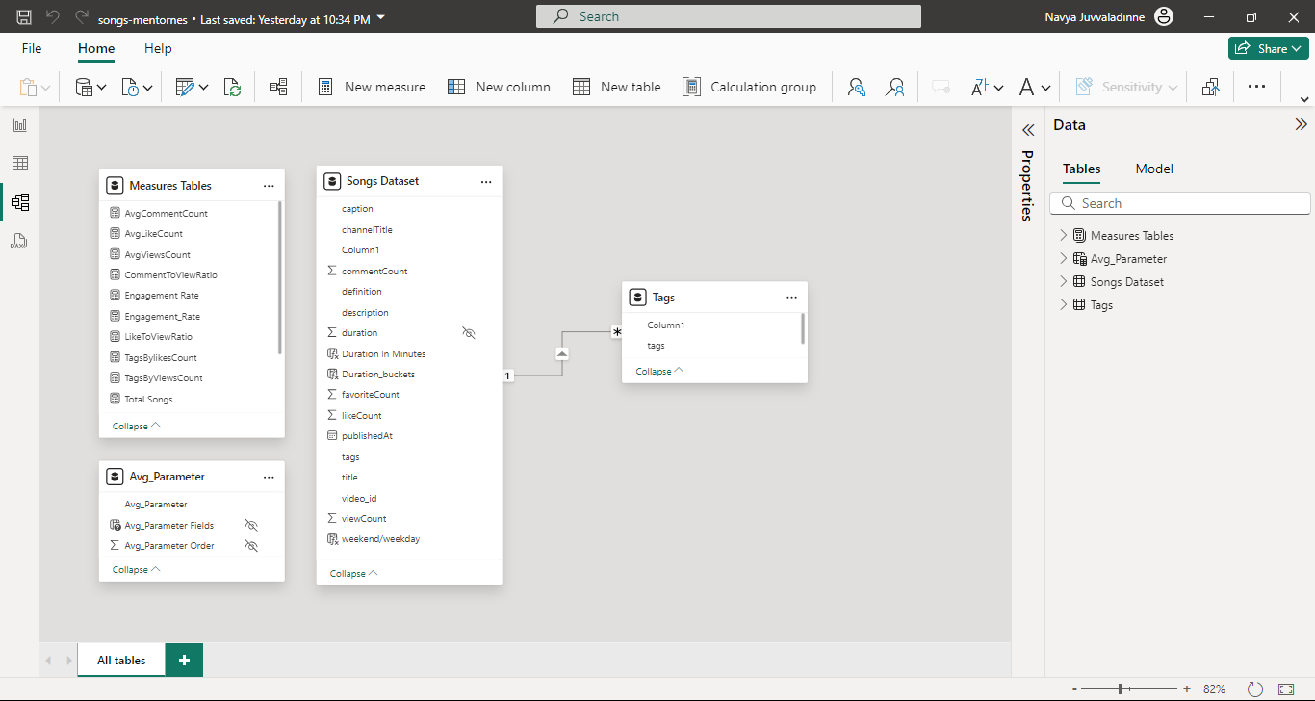
YouTube Songs Analysis

Slide 5
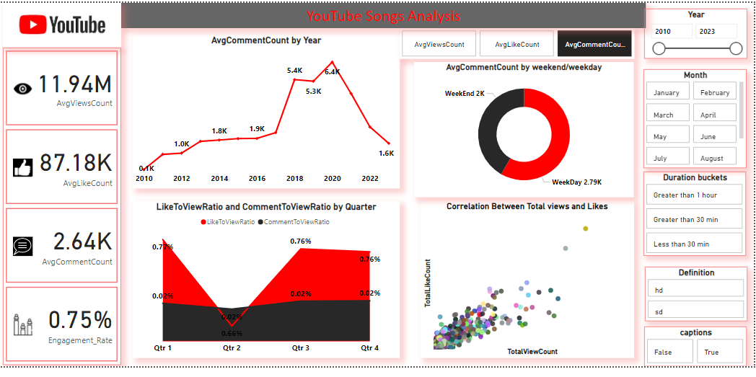
YouTube Songs Analysis

Slide 6
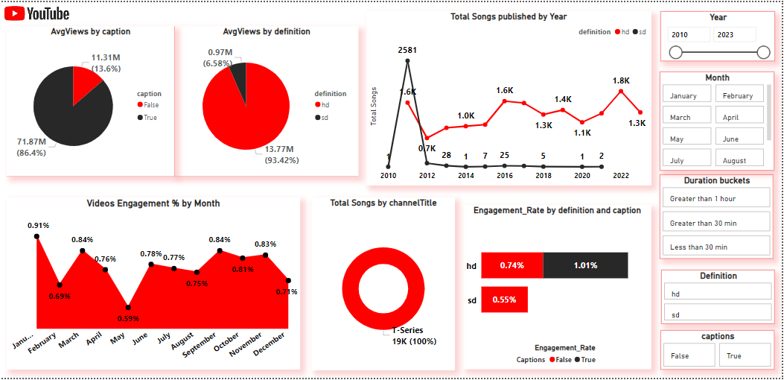
YouTube Songs Analysis

Slide 7
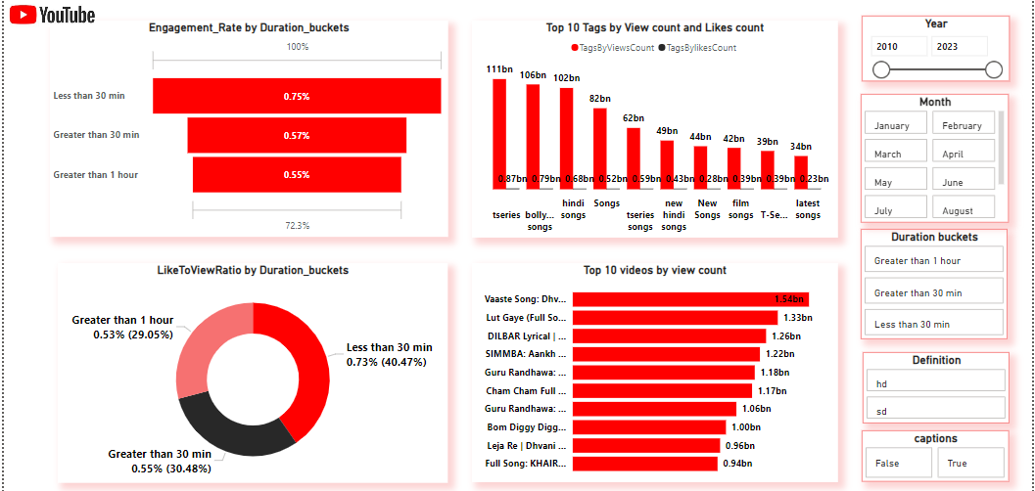
YouTube Songs Analysis

Slide 8
YouTube Songs Analysis
📊 YouTube Songs Analysis:
Key Insights: Our recent report uncovers fascinating trends in YouTube song viewership and engagement from 2010 to 2023. Here are some highlights: 📊 YouTube Songs Analysis: Key Insights Our latest report dives deep into YouTube song trends from 2010 to 2023. Here are some highlights: 📈 Viewership Trends: Average views peaked at 26M, with notable fluctuations. 👍 Engagement Metrics: Average likes and comments are 87.18K and 2.64K respectively, with a 0.75% engagement rate. 📝 Publication Trends: Annual song uploads ranged from 0.7K to 1.8K. 🎥 Video Quality: HD videos (13.77M views) outperformed SD videos (0.97M views). 📝 Captions Matter: Videos with captions received 71.87M views vs. 11.31M for those without. ⏱️ Engagement by Duration: Shorter videos (<30 min) had a higher engagement rate (0.75%). 📅 Seasonal Engagement: Monthly engagement rates peaked at 0.91%. 🔖 Top Tags and Videos: Tags like "tseries" dominated, with top videos amassing over 1B views each. 📅 Viewership Patterns: Higher average views on weekdays (12.74M) compared to weekends (8.62M). 💬 Like & Comment Ratios: Consistent like-to-view (0.76%) and comment-to-view (0.02%) ratios across quarters. These insights emphasize the importance of video quality, captions, and strategic timing in boosting engagement. 📈💡

