Slide 1
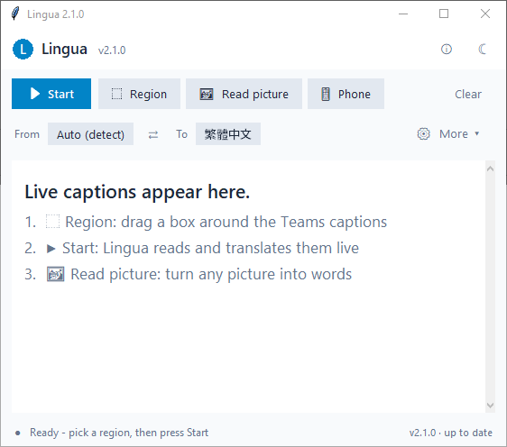
L
Lingua
Installation & Usage Guide · Windows · v2.3.1
Translate live Teams captions, typed text and pictures —
English · 繁體中文 · Bahasa Indonesia and more.
Prepared by Juwen Lie

Slide 2
What Lingua does
OVERVIEW
Live captions
Reads the Microsoft Teams live-caption strip and shows it translated, as people talk.
Text
Paste or type text → translation with tone, context, glossary, alternatives & word notes.
Read picture
Photo, screenshot or screen area → the text in it (OCR), optionally translated.
Phone
Scan a QR code to use your phone camera; the API key stays on the laptop.
• Languages: Auto-detect, English, 繁體中文, Bahasa Indonesia (16 targets for pictures).
• Engines: company AI models first → local AI on your PC (Ollama, optional) → offline packs.
• Privacy: online services (Google/MyMemory) are OFF by default; nothing typed in Text is saved.
• Updates: built-in — Lingua checks GitHub on start and every 4 h; one click to update.
Lingua 2.3.1 · Installation & Usage Guide

Slide 3
Before you start
INSTALLATION
• Windows 10 / 11 laptop. No admin rights and no Python needed.
• Office network or VPN. The company AI gateway is only reachable from inside.
• lingua.env — gateway settings file, from the first Lingua e-mail (contains NO API key).
• Your own MaaS API key. If you already use OpenCode with the company gateway, Lingua finds it automatically. Otherwise see 'Connect your API key'.
• Microsoft Teams with Live captions, for caption translation.
• Optional: Ollama (ollama.com) + 'ollama pull qwen3:8b' — local AI when company models are down.
Download
Lingua-windows.zip on GitHub:
github.com/juw12/projects/releases
→ lingua-v2.3.1
(direct link is in the e-mail)
Keep your key private
Never forward a lingua.env that has
your MAAS_API_KEY filled in —
anyone with the file can use it.
Lingua 2.3.1 · Installation & Usage Guide

Slide 4
Install in 4 steps
INSTALLATION
1
Download Lingua-windows.zip
Click the link in the e-mail (GitHub release lingua-v2.3.1).
SmartScreen warning?
The app is not code-signed, so you may
see 'Windows protected your PC'.
Click More info → Run anyway.
2
Unzip it
Right-click the zip → Extract All… You get a folder called Lingua.
3
Put lingua.env inside that folder
Save the e-mail attachment next to Lingua.exe. Keep the name exactly 'lingua.env'.
Firewall prompt?
When you use the Phone button,
Windows may ask to allow Lingua.
Allow on Private networks only.
4
Double-click 'Install Lingua.cmd'
Installs to %LOCALAPPDATA%\Programs\Lingua with Start-menu + Desktop shortcuts and an entry in Settings → Apps. Then you can delete the zip.
Lingua 2.3.1 · Installation & Usage Guide

Slide 5
What the folder should look like
INSTALLATION
• Portable option: skip the installer and just double-click Lingua.exe in this folder.
• Alternative location: lingua.env also works in %APPDATA%\lingua\lingua.env.
• Uninstall: Settings → Apps → Lingua → Uninstall.
• Updates keep your settings, history and lingua.env.
Lingua\
_internal\
Install Lingua.cmd ← double-click
Lingua.exe
lingua.env ← from the e-mail
lingua.env.example
README.txt
THIRD_PARTY_NOTICES.txt
Lingua 2.3.1 · Installation & Usage Guide

Slide 6
Connect your API key
INSTALLATION
Lingua looks for your MaaS key in this order — use whichever is easiest:
1
OpenCode already set up? Nothing to do.
Lingua reads the key from %USERPROFILE%\.config\opencode\opencode.json automatically.
2
Or set a Windows environment variable
Start → 'Edit environment variables for your account' → New → Name: MAAS_API_KEY, Value: your key. Restart Lingua.
3
Or paste it into lingua.env
Open lingua.env in Notepad, fill in the line MAAS_API_KEY=your-key and save. Keep this file private.
No key yet?
Text translation still works with local AI (Ollama) or offline language packs — slower, lower quality.
Lingua 2.3.1 · Installation & Usage Guide

Slide 7
The main window
USAGE
• Start — begin / pause live caption translation.
• Region — drag a box around the Teams caption strip (once).
• Read picture — OCR a photo, screenshot or screen area.
• Text — text translation desk (since 2.3, next to Read picture).
• Phone — QR code to use your phone camera.
• From / To — source (Auto-detect) and target language.
• More ▾ — model, opacity, font size, click-through.
• ⓘ / ☀ — settings, offline packs, updates · light/dark.
Lingua 2.3.1 · Installation & Usage Guide

Slide 8
Translate a Teams meeting live
USAGE
1
Turn on Teams live captions
In the meeting: … More → Language and speech → Turn on live captions.
Tips
• Keep the Teams captions visible —
Lingua reads the pixels on screen.
• Don't cover them with Lingua; use
More ▾ → opacity + Click-through.
• Moved / resized Teams?
Click Region again.
• Clear wipes the transcript.
• Status bar shows the speed.
2
Pick the caption region (first time only)
Click Region and drag a rectangle tightly around the caption strip. Lingua remembers it.
3
Choose languages
From: Auto (detect) is fine. To: your language (e.g. English or 繁體中文).
4
Press Start
Translated lines appear in Lingua, newest at the bottom. Scroll up to read back.
Lingua 2.3.1 · Installation & Usage Guide

Slide 9
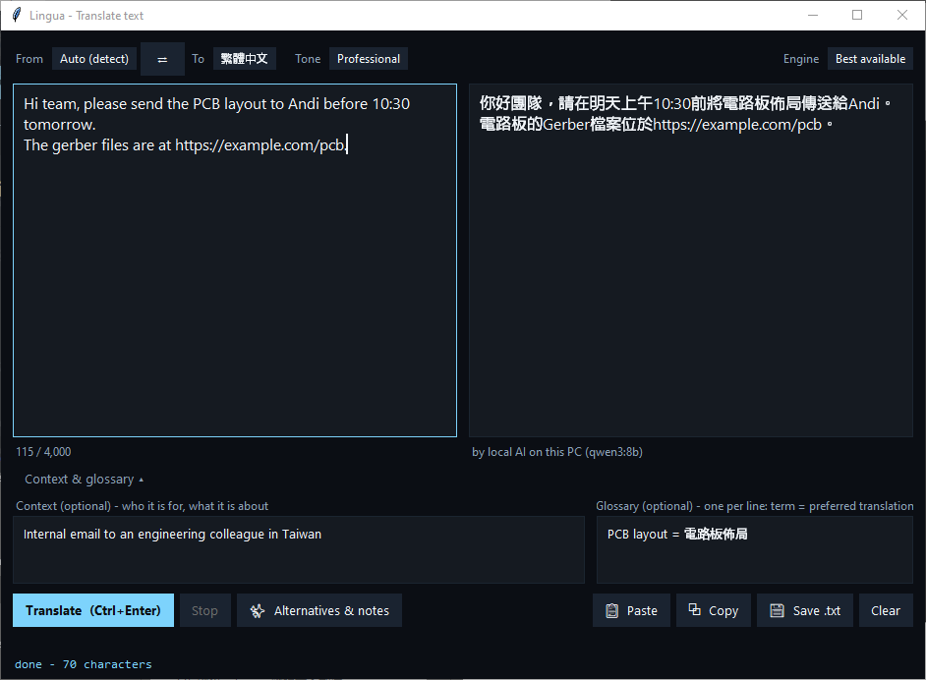
Translate text (Text button)
USAGE
• Tone: Natural, Professional, Friendly, Formal, Literal.
• Ctrl+Enter translates, Esc stops.
• Context — who it is for / what it is about.
• Glossary — one per line: PCB layout = 電路板佈局
• Engine: 'Best available' picks automatically.
• Paste · Copy · Save .txt · Clear
• Warnings if numbers, links or glossary terms changed.
Lingua 2.3.1 · Installation & Usage Guide

Slide 10
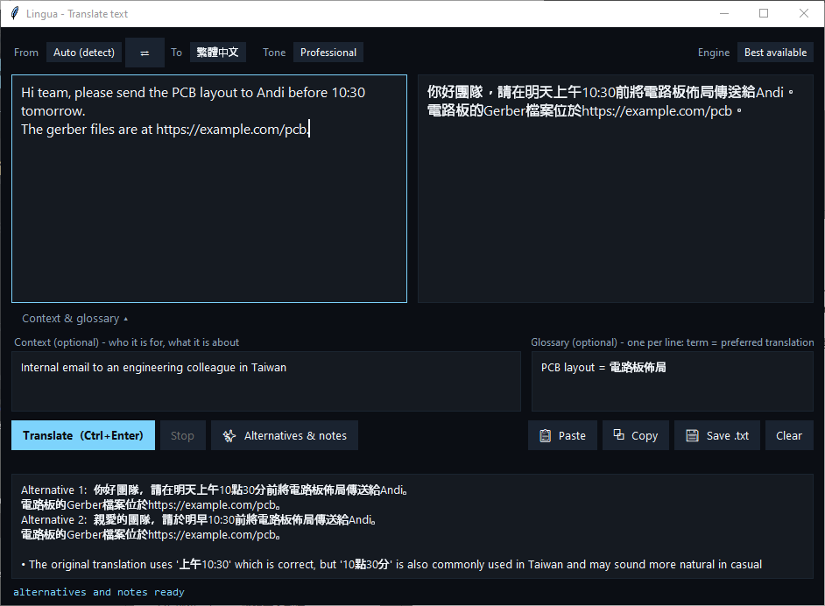
Alternatives & word-choice notes
USAGE
• Click 'Alternatives & notes' after translating.
• Two other phrasings plus English notes on word choice (e.g. what sounds more natural in Taiwan).
• Takes up to ~1 min on local AI; faster on company models.
• Nothing typed here is saved.
Lingua 2.3.1 · Installation & Usage Guide

Slide 11
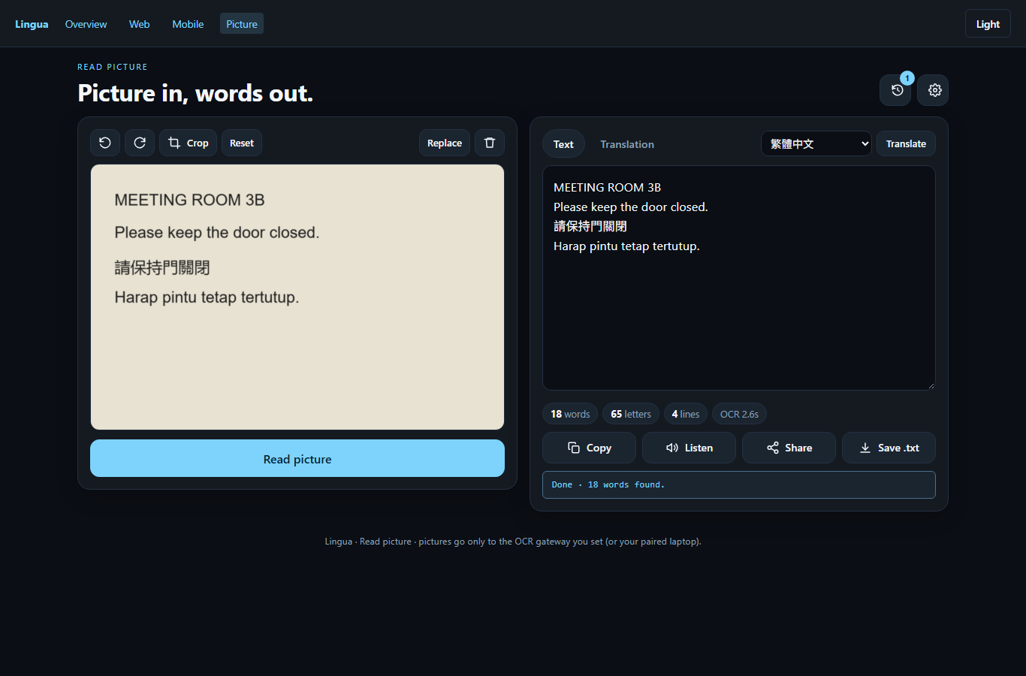
Read a picture (OCR)
USAGE
• Open a photo / screenshot (multi-select = batch), Paste (Ctrl+V) or Grab screen area.
• Rotate / crop if needed, then Read.
• Text tab — words, letters, line count.
• Translation tab — pick a language or tick Translate automatically.
• Listen · Copy · Save .txt · History
Screenshot: phone / web version. The desktop window has the same Text / Translation tabs.
Lingua 2.3.1 · Installation & Usage Guide

Slide 12
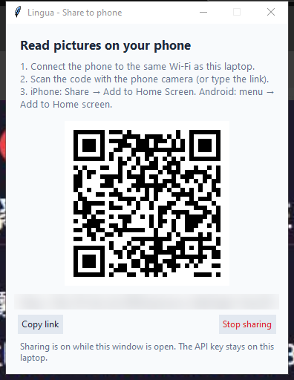
Use your phone camera (Phone button)
USAGE
1
Click Phone on the laptop
A QR code appears. Phone and laptop must be on the same Wi-Fi.
2
Scan the QR code with the phone camera
The Lingua picture page opens in the browser.
3
Add to Home Screen
iPhone: Share → Add to Home Screen. Android: ⋮ menu → Add to Home screen.
4
Take a photo → Read → Translate
Works while the Phone window is open; Stop sharing ends it.
Lingua 2.3.1 · Installation & Usage Guide

Slide 13
Updates & when the company AI is down
USAGE
Updating
• Lingua checks on start and every 4 hours.
• Click ⟳ Updates (top right) to check now.
• A blue ⬆ Update button + banner appears
when a new version is out.
• Click Update now: it downloads, verifies,
restarts and keeps your settings,
history and lingua.env.
Fallback order (automatic)
1. Company AI models (best).
2. Local AI on your PC — install Ollama,
then run: ollama pull qwen3:8b
3. Offline language packs (~70 MB / pair):
ⓘ → Translation → Download packs
for my languages.
4. Online services — OFF unless you allow
them (they send text outside the company).
Lingua 2.3.1 · Installation & Usage Guide

Slide 14
Troubleshooting
HELP
Problem | Fix
'Windows protected your PC' | More info → Run anyway (the app is not code-signed).
Translation unavailable / errors | Office network or VPN on? lingua.env next to Lingua.exe? API key set?
Nothing appears in a Teams call | Live captions on? Region still over the caption strip? Pressed Start?
First translation is slow | Local AI / offline packs load once (20–35 s); then 2–3 s each.
Phone can't open the link | Same Wi-Fi as the laptop; allow Lingua in the firewall (private); keep the Phone window open.
Odd translation | Set From to the real language, add Context / Glossary, or try Alternatives.
Update button does nothing | Check office network / VPN, then ⓘ → Check for updates; or re-download the zip and run Install Lingua.cmd again.
Lingua 2.3.1 · Installation & Usage Guide

Slide 15
Questions or feedback?
Juwen Lie · github.com/juw12
Release notes: github.com/juw12/projects/releases (lingua-v2.3.1)

