Slide 1
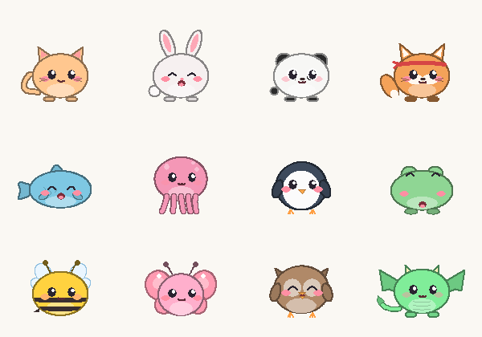
USER GUIDE
Pips
A cute social desktop pet for Windows - friends, chat & a shop
Version 2.6.0 · 2026-10-28 · Owner: Juwen Lie
English · Bahasa Indonesia · 繁體中文 · 简体中文
Pick from 23 animals - land, water and sky
https://juw12.github.io/projects/pips/

Slide 2
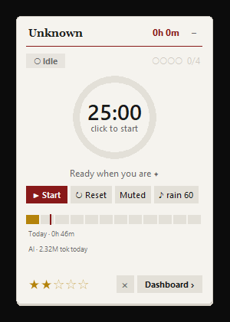
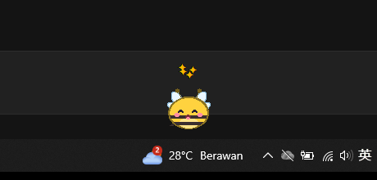
OVERVIEW
What is Pips?
• A desk buddy. A little animal lives on your taskbar - it walks, naps, chats and reacts when you play with it.
• A social pet. Click the pet to open the Pips hub: friends, chat, groups, and a shop with props and moves for your pet.
• A focus timer. Right-click → Focus timer: a 25-minute Pomodoro with soundscapes.
• Gentle reminders. Breaks, drinking water, 20-20-20 eye rest and your daily goal pop up as friendly chat bubbles.
• Insights. A daily 1-5 star focus score, app-usage tracking and charts in the dashboard.
• Private. Everything stays in the Pips folder on your PC. Nothing is uploaded.
• 4 languages. English, Bahasa Indonesia, 繁體中文, 简体中文.
Your pet on the taskbar
The Pips card
Pips · 2

Slide 3
GETTING STARTED
Install in 3 steps
1
Download
2
Unzip
3
Start
Get Pips-Windows.zip from
https://juw12.github.io/projects/pips/download/Pips-Windows.zip
Right-click the zip → Extract All…
Put the folder somewhere permanent, e.g. Documents\Pips (not inside the zip!).
Double-click “Start Pips.bat”.
The first start installs two small helpers (pywin32, Pillow) - takes ~30 s.
• Needs Python 3.10+ (free from python.org - tick “Add python.exe to PATH” when installing). Windows 10 or 11.
• Start with Windows: right-click the Pips card → Autostart, or run install_autostart.ps1 (right-click → Run with PowerShell).
Pips · 3

Slide 4
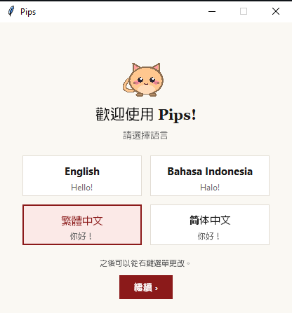
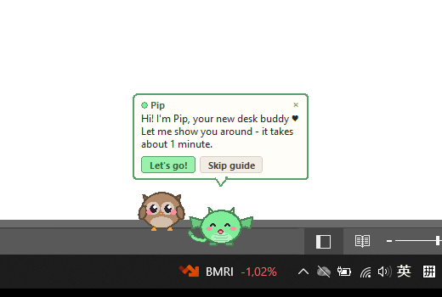
GETTING STARTED
First start: language + interactive guide
• A language window appears once. You can change it later (right-click the pet → Language).
• Then your pet walks you through the basics - just follow the bubble.
• Press “Skip guide” anytime.
• Replay: right-click the pet → Help → Interactive guide.
② Your pet says hi and offers a 1-minute guide
① Pick your language
Pips · 4

Slide 5
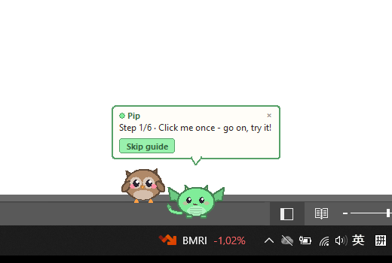
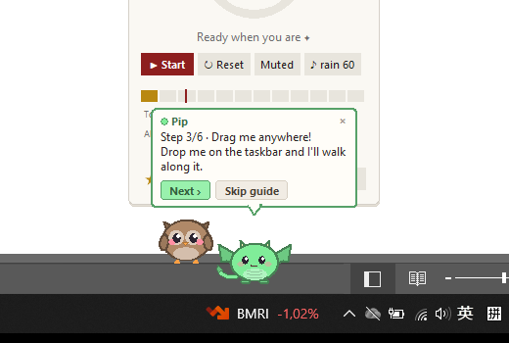
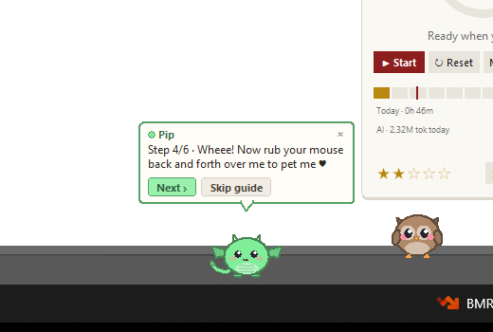
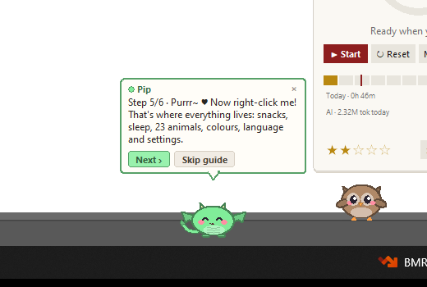
GETTING STARTED
The interactive guide, step by step
Step | What the pet asks | What it teaches
1 | Click me once | Clicking the pet opens the Pips hub (friends, chat, shop)
2 | Click the ring | Start / pause a 25-minute focus session; – or ✕ hides the card
3 | Drag me anywhere | Move the pet; drop it on the taskbar to walk there
4 | Rub your mouse over me | Petting makes it happy (hearts!)
5 | Right-click me | The menu: snacks, sleep, animals, colours, language, settings
6 | I have moods! | Keep it happy: pet, feed and finish pomodoros
Step 1
Step 3
Step 4
Step 5
Pips · 5

Slide 6
YOUR PET
Playing with your pet
Do this | What happens
Click | Giggles and opens the Pips hub (friends, chat, groups, shop)
Drag & drop | Carry it anywhere. Drop on the taskbar → it walks along it
Rub the mouse back and forth | Petting ♥ - happiness and bond go up
Shake while dragging | Dizzy! (don't overdo it)
Right-click | Menu: snack, sleep / wake, Animal, colours, size, Language, Help…
Give a snack ♨ | Fills its tummy (right-click → Give a snack)
Leave the PC | It naps after a few minutes and wakes up when you're back
Listen ♪ | Meows, barks, ribbits, hoots… its voice changes with its mood
Right-click = everything
Just want to tickle? Right-click → When I click → Only tickle (never open Pips).
Pips · 6

Slide 7
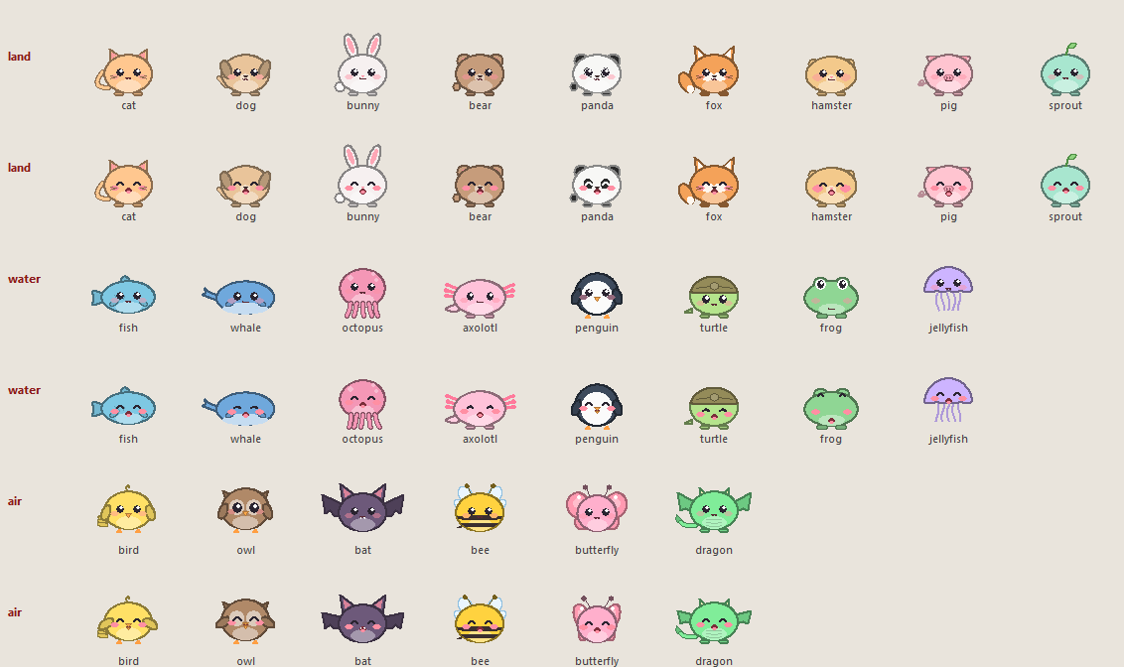
YOUR PET
23 animals in 3 groups
• Land (9): cat, dog, bunny, bear, panda, fox, hamster, pig, sprout - they walk & hop.
• Water (8): fish, whale, octopus, axolotl, penguin, turtle, frog, jellyfish - they swim with bubbles.
• Sky (6): bird, owl, bat, bee, butterfly, dragon - they hover and flap.
• Change: right-click → Animal, or the tabs in Pet status & settings.
• Make it yours: name, body colour, cheek colour and size S / M / L.
• Own voice ♪: every animal sounds different - happy, sleepy, hungry or grumpy.
Pips · 7

Slide 8
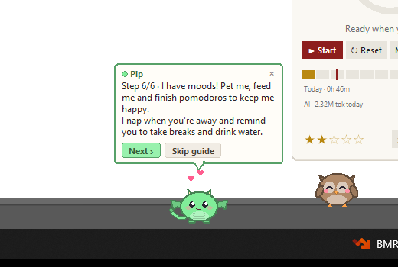
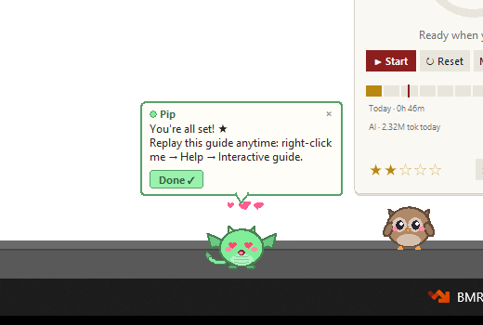
YOUR PET
Moods & needs
Stat | Goes up when… | Goes down when…
Happiness | You pet it, finish pomodoros, hit your goal | Ignored for long
Energy | It naps (when you're away or via Sleep) | Time awake, lots of play
Food | You give a snack | Slowly over the day
Bond | Every interaction, every day together | (never really drops)
Moods you'll see: very happy · happy · okay · sad · very sad · tired · hungry · grumpy · sleeping.
Check them anytime: right-click → Pet status & settings.
Pips · 8

Slide 9
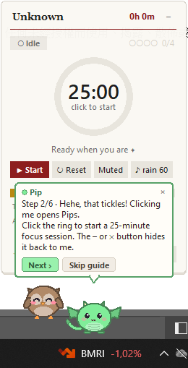
FOCUS
Focus timer (right-click → Focus timer)
• Start: click the ring or ► Start. 25 min focus → 5 min break; every 4th break is longer.
• Pause / reset: click the ring again, or ↻ Reset.
• Sound: rain, thunder, brown noise, café, ocean, forest, fireplace, crickets, wind - pick one and set its volume (♪ button).
• Status pill: shows what you're doing now (Focus / Idle / Break) and the app in front.
• Score: ★ 1-5 focus score for today, updated live.
• Hide: – or ✕ tucks the card back into your pet. Click the pet to bring it back.
• While you focus, your pet wears a little headband and nudges you if you drift to distracting apps.
Pips · 9

Slide 10
FOCUS
Reminders, goals & dashboard
• Reminders as bubbles: stand-up breaks, drink water, 20-20-20 eye rest, pomodoro done, daily goal reached.
• Daily goal & streaks: set a pomodoro goal; streaks and XP keep you going.
• Coach tips: short, friendly suggestions based on your day.
• Turn bubbles off: Pet status & settings → uncheck “Show reminders & notifications as chat bubbles” (you'll get normal notifications).
Dashboard (right-click the card → Dashboard)
• Focus timeline of today
• Hour-of-day heatmap
• 7-day focus score trend
• Pomodoros per day
• Top apps & time per app
• History, weekly and monthly reports
Pips · 10

Slide 11
TOGETHER
Friends, profiles, ranks & badges
• Levels & XP: every finished pomodoro gives XP - level up as you focus.
• 22 achievements: first tomato, 4 / 8 in a day, 3 / 7 / 14-day streaks, early bird, night owl, pet lover... Your pet celebrates each one.
• Open: click the pet (or right-click → Pips hub…).
• Works offline: levels and achievements are calculated on your PC.
Friends (optional, off by default)
• Turn on Friends, swap 6-letter friend codes
• Chat with friends and in your own groups
• Wave, pet, send a snack, high five - or send your pet to visit their desktop!
• Affinity: friendship grows from Acquaintance to Soulmates
• Create a private group and invite friends
• Ranks: everyone on Pips by XP, badges or streak
• Profile: photo, bio, info, status (online / busy / away) - public or private
• Label friends: Bro, Bestie, Partner, Soulmate...
• Never shared: apps, window titles, scores, files
• One click turns it off and deletes your online data
Pips · 11

Slide 12
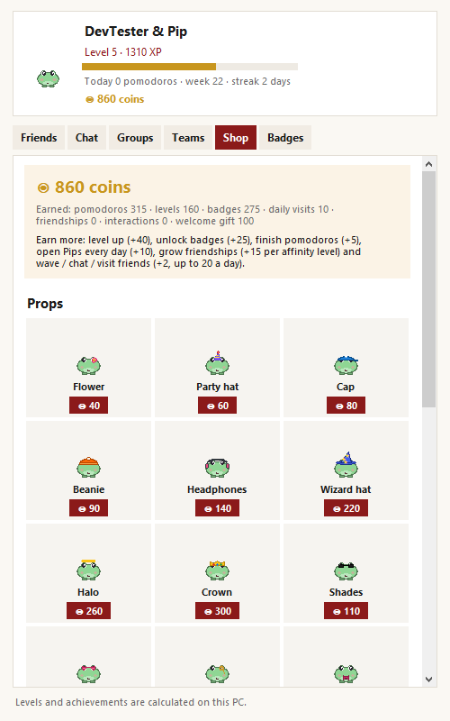
TOGETHER
Shop: props & moves for your pet
• Open: click the pet → Shop tab (or right-click → Shop…).
• Coins: level up +40, badges +25, open Pips each day +10, friendship +15 per affinity level, wave / chat / visit a friend +2, pomodoro +5. Start gift: 100.
• Props: 17 to collect - crown, wizard hat, headphones, shades, scarf, cape, wings... Wear one per slot: head, face, neck, back.
• Moves: spin, dance, moonwalk, backflip, kung fu, spider swing. Right-click → Do a trick - your happy pet also shows off on its own.
• Friends see it: your props appear on your avatar, and your pet does a move when it visits a friend's desktop.
The Shop tab
Pips · 12

Slide 13
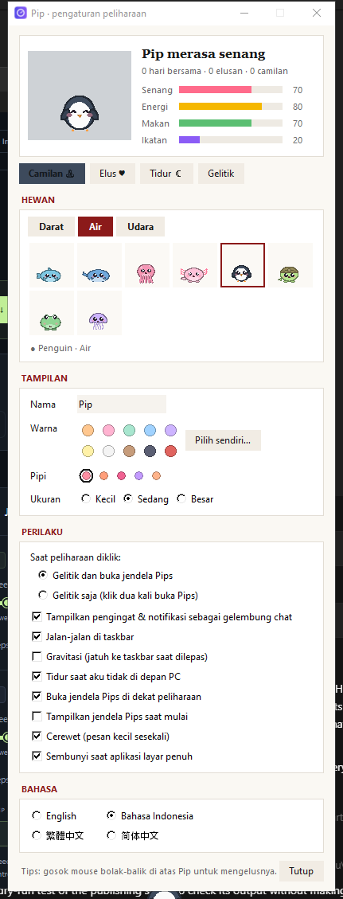
CUSTOMIZE
Make it yours: Pet status & settings
Right-click the pet → Pet status & settings…
• Status: mood + happiness, energy, food, bond bars.
• Animal: Land / Water / Sky tabs - click a tile.
• Look: name, colour, cheeks, size S / M / L.
• Language: switch instantly.
• Click action: open hub · open focus timer · tickle (double-click opens) · only tickle
• Show reminders as chat bubbles
• Walk around on the taskbar
• Gravity (falls when dropped)
• Nap when I'm away
• Open the card next to the pet
• Chatty (little messages)
• Hide during full-screen apps
• Check for updates automatically
• Animal sounds + volume (quiet while focusing)
• Dark mode (also: right-click the pet → Dark mode)
(shown in Bahasa Indonesia)
Pips · 13

Slide 14
CUSTOMIZE
Languages
English
Bahasa Indonesia
繁體中文
简体中文
Hello!
Halo!
你好！
你好！
• Change anytime: right-click the pet (or the card) → Language. Everything switches instantly - menus, bubbles, reminders, the card.
• First start: Pips guesses from your Windows language and asks once.
• Update notes are shown in your language too.
Pips · 14

Slide 15
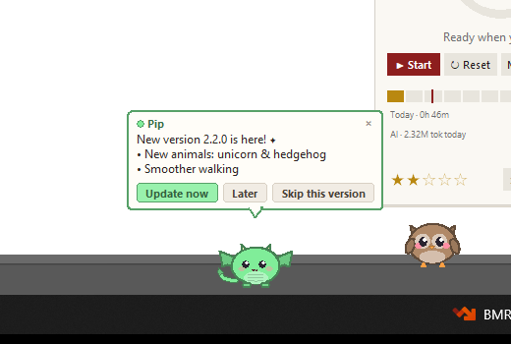
NEW IN 2.1
Updates - right inside Pips
• Automatic check: shortly after start and every 6 hours (needs internet).
• Your pet tells you what's new and offers: Update now · Later · Skip this version.
• Update now: downloads, verifies (SHA-256), installs and restarts Pips by itself - about 10 seconds.
• Your stuff is safe: settings, pet, history and reports are never touched. The old version is backed up in the backup\ folder.
• Manual check: right-click the pet → Help → Check for updates.
• Don't want it? Pet status & settings → uncheck “Check for updates automatically”.
Example of an update notice (sample version text)
Pips · 15

Slide 16
HELP
Troubleshooting & FAQ
Problem | Try this
Nothing happens when I start | Install Python 3 from python.org (tick “Add to PATH”), then run Start Pips.bat again.
“Windows protected your PC” | Click More info → Run anyway (the .bat just starts Python).
Where is my pet? | Look on the taskbar. Right-click the card → Pet → Show. It hides during full-screen apps.
The focus card is gone | Right-click the pet → Focus timer → Open. Or restart Pips.
Update failed | Check internet / proxy, try Help → Check for updates later, or download the zip again and unzip over the old folder.
Move Pips to another PC | Copy the whole folder - config.json and data\ keep your settings and history.
Uninstall | Quit (right-click → Quit), disable Autostart, delete the folder.
Pips · 16

Slide 17
RELEASE NOTES
What's new in 2.6.0
Profiles, ranks, online status & dark mode · 2026-10-28
• Profile tab: profile picture (or your pet), about me, job, location, hobbies, birthday and a status message
• Public or private: public profiles can be added directly and viewed in full; private profiles need a friend request that they accept, and strangers only see name, photo, pet, level and status
• Click anyone to open their profile - badges, info, their friends - and add them, chat or wave from there
• Ranks tab replaces Teams: everyone using Pips, sorted by XP, badges or streak
• Online status: auto (online / away when idle / offline) or set Online, Busy, Away or Appear offline yourself
• Relationship labels for friends: Buddy, Bro, Sis, Bestie, Partner, Soulmate, Family, Work buddy
• Dark mode: Profile tab or right-click the pet → Dark mode (hub, settings and the focus card)
Bahasa Indonesia
• Tab Profil: foto profil (atau peliharaanmu), tentang aku, pekerjaan, lokasi, hobi, ulang tahun dan pesan status
• Publik atau pribadi: profil publik bisa langsung ditambahkan dan dilihat lengkap; profil pribadi perlu permintaan pertemanan yang diterima, dan orang asing hanya melihat nama, foto, peliharaan, level dan status
• Klik siapa saja untuk membuka profilnya - lencana, info, teman-temannya - lalu tambahkan, chat atau lambaikan dari sana
• Tab Peringkat menggantikan Tim: semua pengguna Pips, diurutkan menurut XP, lencana atau beruntun
• Status online: otomatis (online / pergi saat tidak aktif / offline) atau atur sendiri Online, Sibuk, Pergi atau tampak offline
• Label hubungan untuk teman: Sobat, Bro, Sis, Sahabat, Pasangan, Belahan jiwa, Keluarga, Rekan kerja
• Mode gelap: tab Profil atau klik kanan peliharaan → Mode gelap (hub, pengaturan dan kartu fokus)
Pips · 17

Slide 18
RELEASE NOTES
Version history
Version | Date | Highlights
2.6.0 | 2026-10-28 | Profiles, ranks, online status & dark mode Profile tab: profile picture (or your pet), about me, job, location, hobbies, birthday and a status message; Public or private: public profiles can be added directly and viewed in full; private profiles need a friend request that they accept, and strangers only see name, photo, pet, level and status; Click anyone to open their profile - badges, info, their friends - and add them, chat or wave from there; Ranks tab replaces Teams: everyone using Pips, sorted by XP, badges or streak
2.5.1 | 2026-10-28 | New cute Pips logo New Pips logo: Pip the cat on a Pips-red tile, matching the app colours (desktop shortcut, windows and website)
2.5.0 | 2026-10-28 | Shop, coins, props & moves Shop: earn coins and spend them on your pet - 17 props (crown, wizard hat, headphones, shades, scarf, cape, angel wings...) and 6 moves: spin, dance, moonwalk, backflip, kung fu and spider swing!; Coins come from leveling up (+40), badges (+25), opening Pips each day (+10), friendships (+15 per affinity level), waving / chatting / visiting friends (+2) and pomodoros (+5). Everyone starts with a 100-coin gift; Your friends see your props: on avatars in the hub and when your pet visits their desktop - it shows off one of your moves; Pips is now a social pet: clicking the pet opens the Pips hub (friends, chat, groups, shop, badges)
2.4.0 | 2026-10-28 | Chat, groups, affinity & pet visits Chat: message your friends, and chat inside groups. Your pet pops up new messages as a bubble - click it to reply; Pet interactions: wave, pet their pet, send a snack, high five - or send your pet to visit: it walks onto your friend's desktop for a little while!; Affinity: every chat and interaction grows your friendship - Acquaintance → Buddy → Good friends → Close friends → Best friends → Soulmates; Your own groups: create a private group, invite your friends, they accept or decline. Group board + group chat; the owner can remove members
2.3.0 | 2026-10-28 | Friends, levels & achievements Levels & XP: every finished pomodoro earns XP and your level grows - plus 20 achievements to unlock (first tomato, 8 in a day, 7-day streak, early bird, night owl, pet lover...). Your pet celebrates each one; Friends (optional, off by default): get a 6-letter friend code, add colleagues, see today's board and join a team board like PTB. Your pet tells you when a friend finishes a pomodoro; Privacy: only your name, pet, level, streak and pomodoro counts are shared - never apps, window titles or scores. One click turns it off and deletes your online data. Right-click the pet → Friends & achievements…
2.2.0 | 2026-10-28 | Pet sounds Your pet has a voice! Each of the 23 animals has its own sound (meow, woof, ribbit, hoot, buzz, oink, whale song...) and it changes with its mood: happy chirps, sad whimpers, sleepy yawns, hungry calls, grumpy huffs and soft snores; It also reacts with sound when you tickle, pet, feed, shake or wake it; Settings: right-click the pet → Sounds to switch on/off; Pet status & settings has a volume slider, a ▶ Hear me button and "Stay quiet while I'm focusing" (on by default)
2.1.2 | 2026-10-28 | Tickle-only mode New click option "Only tickle (never open Pips)": click and tickle your pet as much as you like - the Pomodoro window stays closed (open it from the right-click menu). Right-click the pet → When I click
2.1.1 | 2026-10-28 | Owner info About Pips now shows the owner: Juwen Lie (right-click the pet → Help → About)
2.1.0 | 2026-10-28 | Interactive guide & in-app updates Interactive first-run guide: your pet walks you through clicking, dragging, petting and the right-click menu; In-app updates: Pips tells you when a new version is out - update with one click (your settings and data are kept); New Help menu: replay the guide, check for updates, see the version; Option to turn automatic update checks off
2.0.0 | 2026-10-28 | Desktop pet, 23 animals & 4 languages Desktop pet that lives on your desktop and taskbar - drag it, tickle it, pet it; 23 animals in 3 groups: Land walks, Water swims with bubbles, Sky hovers and flaps; Moods (happy, sad, tired, hungry, grumpy...), naps when you're away, wakes up when you're back; Cute chat-bubble reminders: breaks, water, 20-20-20 eye rest, pomodoro done, daily goal
1.5.0 | 2026-10-24 | Renamed to Pips + insights Renamed from Productivity Widget to Pips; Dashboard charts: focus timeline, hour heatmap, 7-day score trend, pomodoros per day; AI token usage on the card and dashboard; Daily diary export and weekly / monthly reports
1.0.0 | 2026-10-21 | First release Always-on-top Pomodoro card with progress ring; Rain / thunder / brown-noise / cafe soundscapes; Live app-usage tracking and a daily 1-5 star focus score; Goals, streaks, XP, coach tips and break reminders
Pips · 18

Slide 19
Have fun & stay focused ♥
Pips is made and owned by Juwen Lie
Download & updates: https://juw12.github.io/projects/pips/
Questions or ideas? Just reply to the Pips email.

