Slide 1
MECH639
ADVANCED ROBOTICS
Term Project

Slide 2
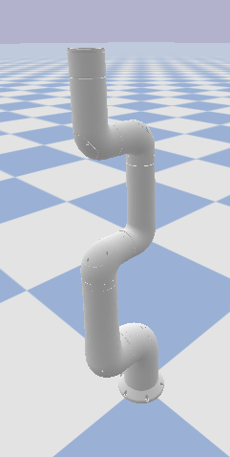
Configuration of IndyRP2
Link 0 Info:
-- Position: [0.0, 0.0, 0.08]
-- Orientation(Q): [0.0, 0.0, -0.0, 1.0]
-- Orientation(E): [0.0, 0.0, -0.0]
-- Orientation(A): [1.0, 0.0, 0.0] 0.0
-- Orientation(M): [1.0, 0.0, 0.0, -0.0, 1.0, -0.0, -0.0, 0.0, 1.0]
Link 1 Info:
-- Position: [-0.0, -0.11, 0.3]
-- Orientation(Q): [0.5, 0.5, -0.5, 0.5]
-- Orientation(E): [0.0, 90.0, -90.0]
-- Orientation(A): [0.57735, 0.57735, -0.57735] 120.0
-- Orientation(M): [0.0, 1.0, 0.0, 0.0, 0.0, -1.0, -1.0, 0.0, 0.0]
Link 2 Info:
-- Position: [-0.0, -0.19, 0.68]
-- Orientation(Q): [0.0, 0.0, 0.0, 1.0]
-- Orientation(E): [0.0, -0.0, 0.0]
-- Orientation(A): [1.0, 0.0, 0.0] 0.0
-- Orientation(M): [1.0, -0.0, 0.0, 0.0, 1.0, -0.0, 0.0, 0.0, 1.0]
Link 3 Info:
-- Position: [-0.0, -0.08, 0.75]
-- Orientation(Q): [0.5, 0.5, -0.5, 0.5]
-- Orientation(E): [0.0, 90.0, -90.0]
-- Orientation(A): [0.57735, 0.57735, -0.57735] 120.0
-- Orientation(M): [0.0, 1.0, 0.0, 0.0, 0.0, -1.0, -1.0, 0.0, -0.0]
Link 4 Info:
-- Position: [-0.0, -0.0, 1.02]
-- Orientation(Q): [0.0, -0.0, 0.0, 1.0]
-- Orientation(E): [0.0, -0.0, 0.0]
-- Orientation(A): [1.0, 0.0, 0.0] 0.0
-- Orientation(M): [1.0, -0.0, -0.0, 0.0, 1.0, -0.0, 0.0, 0.0, 1.0]
Link 5 Info:
-- Position: [-0.0, -0.12, 1.1]
-- Orientation(Q): [0.5, 0.5, -0.5, 0.5]
-- Orientation(E): [0.0, 90.0, -90.0]
-- Orientation(A): [0.57735, 0.57735, -0.57735] 120.0
-- Orientation(M): [0.0, 1.0, 0.0, 0.0, 0.0, -1.0, -1.0, 0.0, -0.0]
Link 6 Info:
-- Position: [-0.0, -0.19, 1.27]
-- Orientation(Q): [0.0, -0.0, 0.0, 1.0]
-- Orientation(E): [0.0, -0.0, 0.0]
-- Orientation(A): [1.0, 0.0, 0.0] 0.0
-- Orientation(M): [1.0, -0.0, -0.0, 0.0, 1.0, -0.0, 0.0, 0.0, 1.0]
Q: Quaternion
E: Euler
A: Axis-Angle
M: Matrix

Slide 3
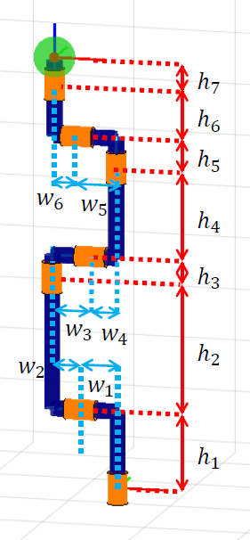
Configuration of IndyRP2
[0, -0.1864, 1.367]
H7=0.100(미정)
[0, -0.1864, 1.267]
H6=0.168
[0, -0.1174, 1.099]
H5=0.083
[0, -0.0034, 1.016]
H4=0.267
[0, -0.0784, 0.749]
H3=0.0655
[0, -0.1937, 0.6835]
H2=0.384
[0, -0.109, 0.2995]
H1=0.222
[0, 0, 0.0775]

Slide 4
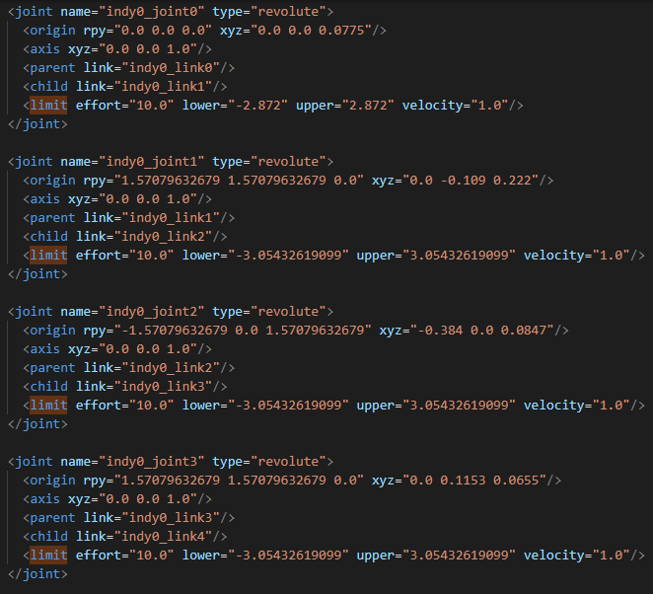
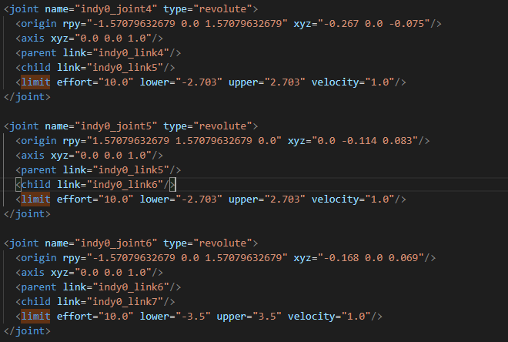
Constrains of Joint Angle

