Slide 1
MECH639
ADVANCED ROBOTICS
Term Project

Slide 2
TO DO
Basic Kinematics
Modern Robotics 코드 Notaion [w,v] > [v,w] 변경하고, 코드 검증하기
Advanced Robotics에서 배운 exponential map of twist 공식이 modern robotics에서 배운 식하고 동일하지 않음. 확인 필요
IndyRP2 Configuration 알아내기 → FK를 통해 확인함
FK/IK 정상 작동하는지 확인하기 → IK/FK 교차검증으로 확인함
End effector 추가해서 FK/IK하기 → 눈으로 확인함
Trajectory Planning 코딩하기 → 임의 원 생성까지 완료함
Generate circular trajectory
Arbitrary center/radius/position/orientation circular trajectory 생성하고, 3D로 plot하기
Circular trajectory tracking 하기: 코드 정리4 (time 측정)
Null Motion
Joint Limit avoidance 판정하기
Manipulability Maximization 최적화하기
Potential function minimization 최적화하기
Plotting
Joint angle, joint velocity 가시화하기
End-Effector의 Euler angle 가시화하기
Manipulability 가시화하기
Potential function 가시화하기
Tracking Error 가시화하기

Slide 3
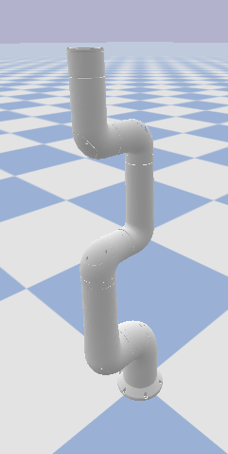
Configuration of IndyRP2
Link 0 Info:
-- Position: [0.0, 0.0, 0.08]
-- Orientation(Q): [0.0, 0.0, -0.0, 1.0]
-- Orientation(E): [0.0, 0.0, -0.0]
-- Orientation(A): [1.0, 0.0, 0.0] 0.0
-- Orientation(M): [1.0, 0.0, 0.0, -0.0, 1.0, -0.0, -0.0, 0.0, 1.0]
Link 1 Info:
-- Position: [-0.0, -0.11, 0.3]
-- Orientation(Q): [0.5, 0.5, -0.5, 0.5]
-- Orientation(E): [0.0, 90.0, -90.0]
-- Orientation(A): [0.57735, 0.57735, -0.57735] 120.0
-- Orientation(M): [0.0, 1.0, 0.0, 0.0, 0.0, -1.0, -1.0, 0.0, 0.0]
Link 2 Info:
-- Position: [-0.0, -0.19, 0.68]
-- Orientation(Q): [0.0, 0.0, 0.0, 1.0]
-- Orientation(E): [0.0, -0.0, 0.0]
-- Orientation(A): [1.0, 0.0, 0.0] 0.0
-- Orientation(M): [1.0, -0.0, 0.0, 0.0, 1.0, -0.0, 0.0, 0.0, 1.0]
Link 3 Info:
-- Position: [-0.0, -0.08, 0.75]
-- Orientation(Q): [0.5, 0.5, -0.5, 0.5]
-- Orientation(E): [0.0, 90.0, -90.0]
-- Orientation(A): [0.57735, 0.57735, -0.57735] 120.0
-- Orientation(M): [0.0, 1.0, 0.0, 0.0, 0.0, -1.0, -1.0, 0.0, -0.0]
Link 4 Info:
-- Position: [-0.0, -0.0, 1.02]
-- Orientation(Q): [0.0, -0.0, 0.0, 1.0]
-- Orientation(E): [0.0, -0.0, 0.0]
-- Orientation(A): [1.0, 0.0, 0.0] 0.0
-- Orientation(M): [1.0, -0.0, -0.0, 0.0, 1.0, -0.0, 0.0, 0.0, 1.0]
Link 5 Info:
-- Position: [-0.0, -0.12, 1.1]
-- Orientation(Q): [0.5, 0.5, -0.5, 0.5]
-- Orientation(E): [0.0, 90.0, -90.0]
-- Orientation(A): [0.57735, 0.57735, -0.57735] 120.0
-- Orientation(M): [0.0, 1.0, 0.0, 0.0, 0.0, -1.0, -1.0, 0.0, -0.0]
Link 6 Info:
-- Position: [-0.0, -0.19, 1.27]
-- Orientation(Q): [0.0, -0.0, 0.0, 1.0]
-- Orientation(E): [0.0, -0.0, 0.0]
-- Orientation(A): [1.0, 0.0, 0.0] 0.0
-- Orientation(M): [1.0, -0.0, -0.0, 0.0, 1.0, -0.0, 0.0, 0.0, 1.0]
Q: Quaternion
E: Euler
A: Axis-Angle
M: Matrix

Slide 4
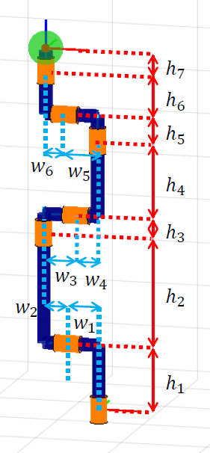
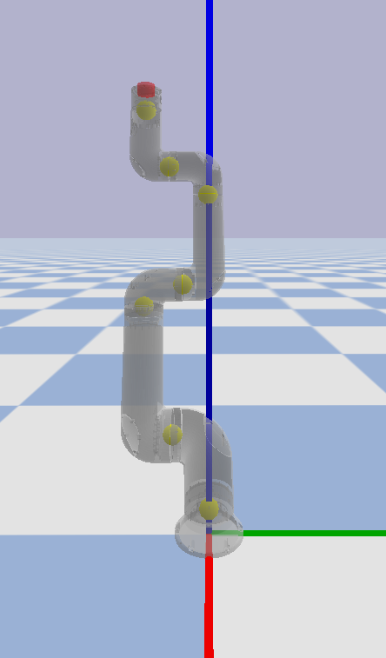
Configuration of IndyRP2
[0, -0.1864, 1.327]
H7=0.06
[0, -0.1864, 1.267]
H6=0.168
[0, -0.1174, 1.099]
H5=0.083
[0, -0.0034, 1.016]
H4=0.267
[0, -0.0784, 0.749]
H3=0.0655
[0, -0.1937, 0.6835]
H2=0.384
[0, -0.109, 0.2995]
H1=0.222
[0, 0, 0.0775]
h0
H0=0.0775

Slide 5
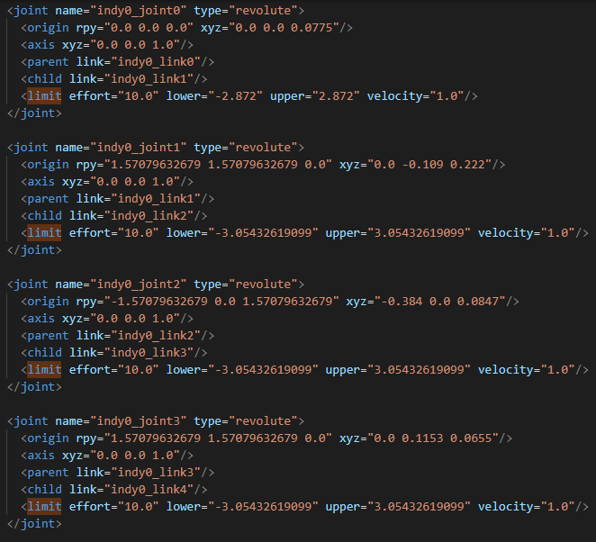
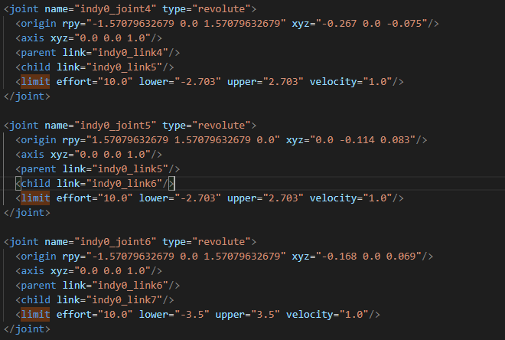
Constrains of Joint Angle

