Slide 1
Paper figure

Slide 2








5 2 3
1 3
2 3 2
5 4

Slide 3








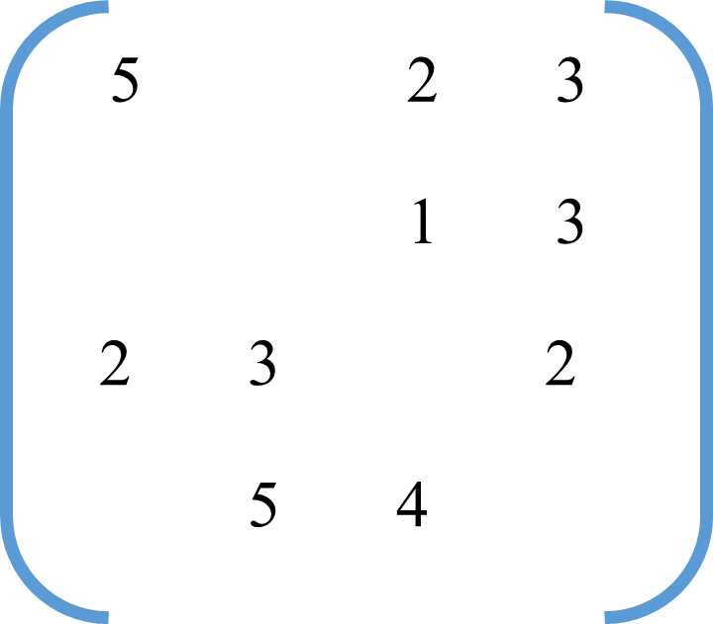






$f_{1}$
$f_{2}$
$f_{3}$
0.5
-1.0
2.0
$f_{1}$
0.5
-1.0
-0.5
3.2
≈
•
0.2
-1.0
1.0
$f_{2}$
1.2
-4.0
0.5
-2.5
-5.1
2.0
-3.5
$f_{3}$
-2.5
1.0
-0.2
-1.5
0.5
2.1
0.7

Slide 4




















U
U
$u_{1}$
$u_{2}$
$u_{3}$
…
$u_{i}$
…
$u_{m}$
R
R
V
V
$r_{1,1}$
. . .
$r_{1,n}$
.
.
.
.
.
.
…
…
$r_{i,j}$
$v_{1}$
$v_{2}$
$v_{3}$
$v_{j}$
$v_{n}$
$r_{m,1}$
. . .
$r_{m,,n}$
U
U
$u_{1}$
$u_{2}$
$u_{3}$
…
$u_{i}$
…
$u_{m}$
ALS
Gradient Descent

Slide 5
item 2
item 1
rating 1
rating 2
item
dependency
user
dependency
rating
dependency
user 1
user 1
user
item 5
item 3
rating 1
item 2
rating 2
user 1
user 2
user 2
user dependency : 1
user dependency : 2
rating 5
item dependency : 1, 2
item dependency : 2, 3, 5
user 2
rating dependency : 1, 2
rating dependency : 2, 3, 5

Slide 6
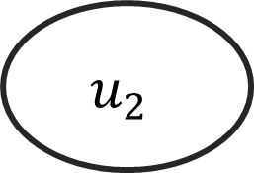













$$v_{2}$$
item
dependency
$v_{1}$
$r_{1,1}$
user
dependency
rating
dependency
$r_{1,2}$
$$u_{1}$$
$$u_{1}$$
user
$$v_{5}$$
$$v_{3}$$
$r_{2,2}$
$$v_{2}$$
user 1
user 2
$r_{2,3}$
user dependency : 1
user dependency : 2
item dependency : 1, 2
item dependency : 2, 3, 5
$$u_{2}$$
$r_{2,5}$
rating dependency : 1, 2
rating dependency : 2, 3, 5
$$u_{2}$$

Slide 7

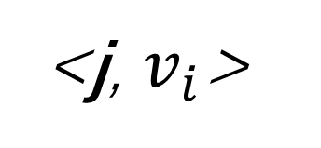


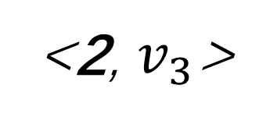







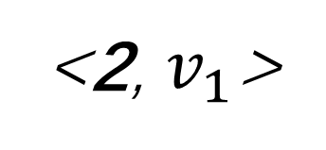
item
dependency
item
…
…
$v_{1}$
$v_{2}$
$v_{3}$
$v_{i}$
$v_{m}$
<2, $v_{1}$>
<2, $v_{3}$>
<j, $v_{i}$>
user
user
…
…
$u_{1}$
$u_{2}$
$u_{3}$
$u_{j}$
$u_{n}$

Slide 8
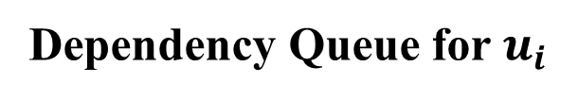
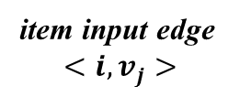
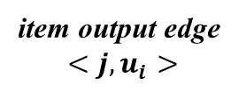


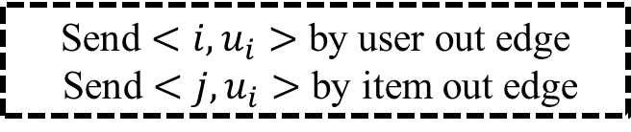
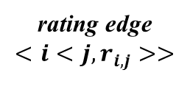
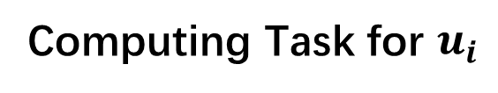

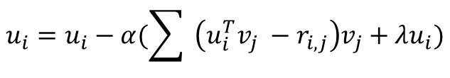
item input edge
$$<i, v_{j}>$$
Dependency
Checking
user
item
rating
Dependency Queue for $u_{i}$
$U_{i}$
user input edge
$$<i, u_{i}>$$
rating edge
$$<i<j, r_{i,j}>>$$
Computing Task for $u_{i}$
Task
Execution
$$u_{i}=u_{i}−α(\sum{ \left(u_{i}^{T}v_{j} −r_{i,j}\right)v_{j}+λu_{i})}$$
user output edge
$$<i, u_{i}>$$
item output edge
$$<j, u_{i}>$$
Send $<i, u_{i}>$ by user out edge
Send $<j, u_{i}>$ by item out edge
Data
Sending

Slide 9













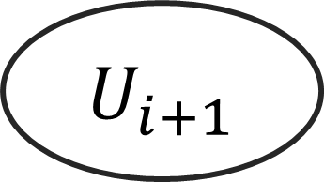
$U_{i}$
$U_{i}$
…
…
$u_{1}$
$u_{2}$
$u_{3}$
$u_{i}$
$u_{n}$
Local
Access
$U_{i+1}$
$$U_{i+1}$$
…
…
$u_{1}$
$u_{2}$
$u_{3}$
$u_{i}$
$u_{n}$

Slide 10




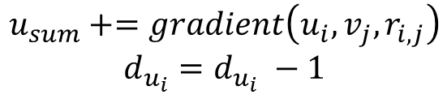
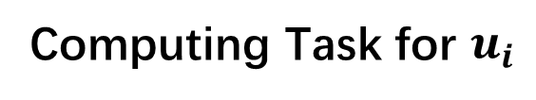

Local Storage
$$<i, { v}_{j}>$$
item input edge
$$<i, v_{j}>$$
Data
Querying
Query
user
rating
$$u_{i}, { r}_{i.j}$$
Return
$U_{i}$
user input edge
$$<i, u_{i}>$$
rating edge
$$<i<j, r_{i,j}>>$$
Computing Task for $u_{i}$
Task
Execution
$$u_{sum}+=gradient\left(u_{i}, v_{j}, r_{i,j}\right)$$
$$d_{u_{i}}=d_{u_{i}} −1$$
$$d_{u_{i}}=0$$
user output edge
$$<i, u_{i}>$$
item output edge
$$<j, u_{i}>$$
$$u_{i}=u_{i} −α{ (u}_{sum}+λu_{i})$$
Data
Sending
Send $<j, u_{i}>$ by item out edge

Slide 11














V
V
Global Sending
$v_{i}$
$v_{i}$
Local Sending
U
U
Node 1
Node 2
Node 3
Node 1
Node 2
Node 3
$$u_{1}$$
$$u_{2}$$
$$u_{3}$$
$$u_{4}$$
$$u_{5}$$
$$u_{6}$$
$$u_{1}$$
$$u_{2}$$
$$u_{3}$$
$$u_{4}$$
$$u_{5}$$
$$u_{6}$$
Typical Sending Strategy of Dataflow Model
Multicasting

Slide 12





Dataflow Graph
Dataflow Execution Model
<1, 5>
<1, 2>
<2, 3>
<2, 4>
Busy
Free
Busy
Free
+
$$√$$
+
-
PE
PE
PE
PE
<1, 2>
Fetch
Fetch
×
×
$÷$ task
$√$ task
$−$ task
<0, 3>
<0, 5>
$$÷$$
Task Queue

