Slide 1
Project on E-commerce website
github link
https://github.com/juyal7/CJ_Projects/blob/master/Course-end%20Project%201%20Creating%20a%20Shopping%20App%20Using%20Python/E-commerce_app.py

Slide 2
Functionality
Admin
User
Add items to cart
Remove items from cart
Checkout and Payment
Add category and items in website
Remove Category
Create and Login
Create Credentials and Login

Slide 3
Code –Snippet

Slide 4
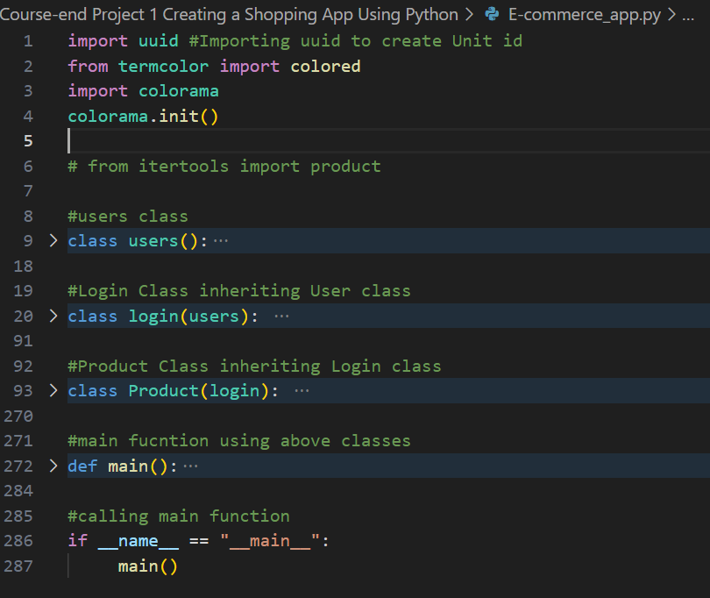
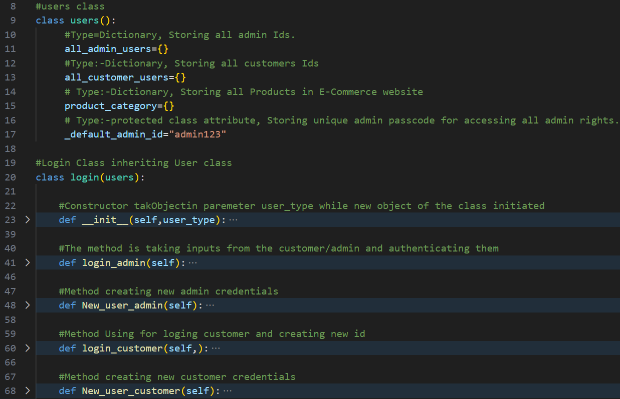

Slide 5
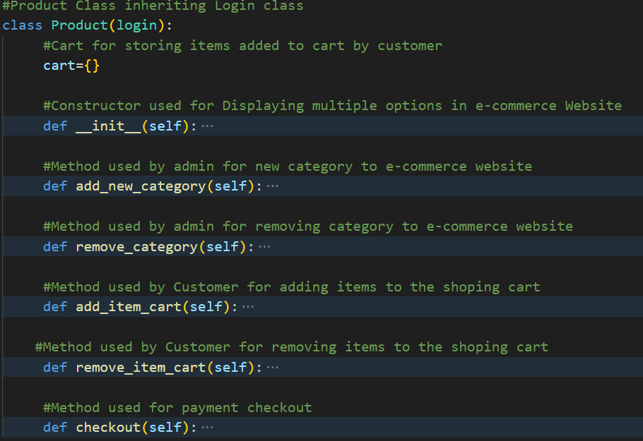
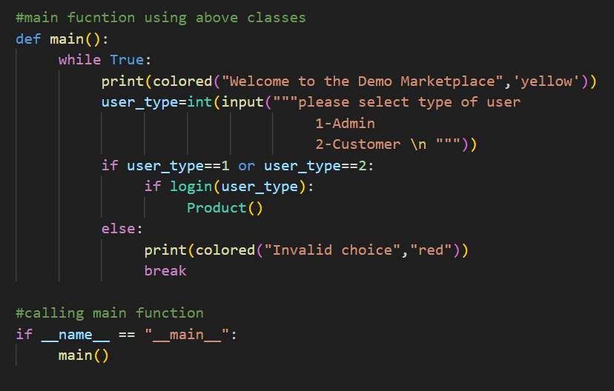

Slide 6
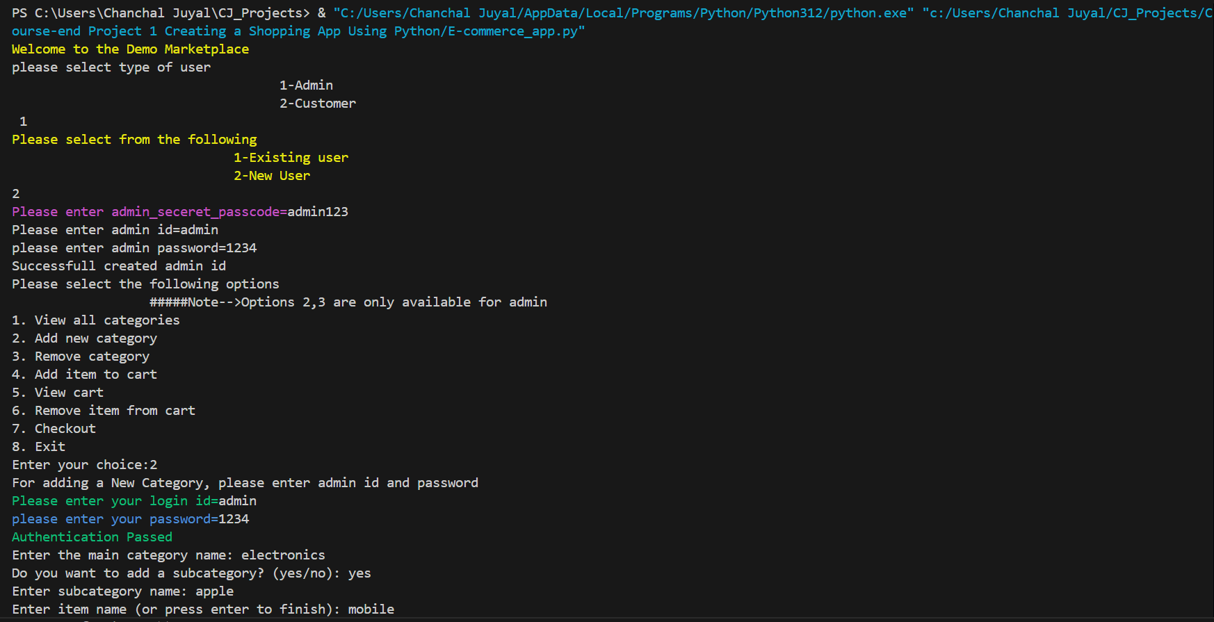
Selecting options
Adding admin credentials
Selecting options (Choice 2 for adding new category)
Adding Electronics category and 2 subcategory)

Slide 7
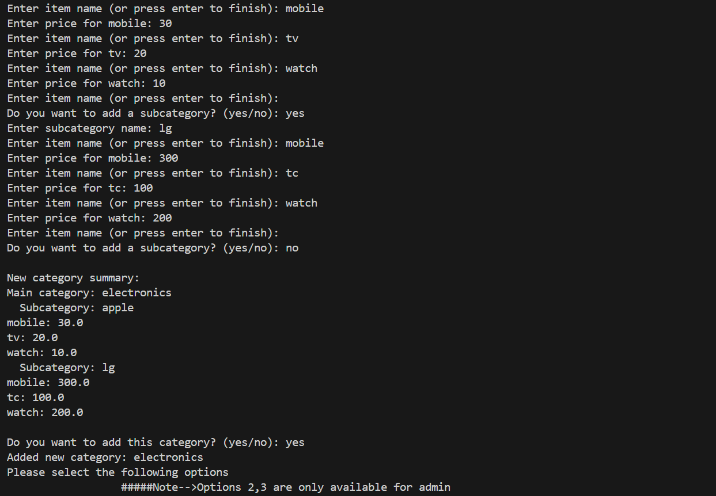
Add Electronics category and 2 subcategory)

Slide 8
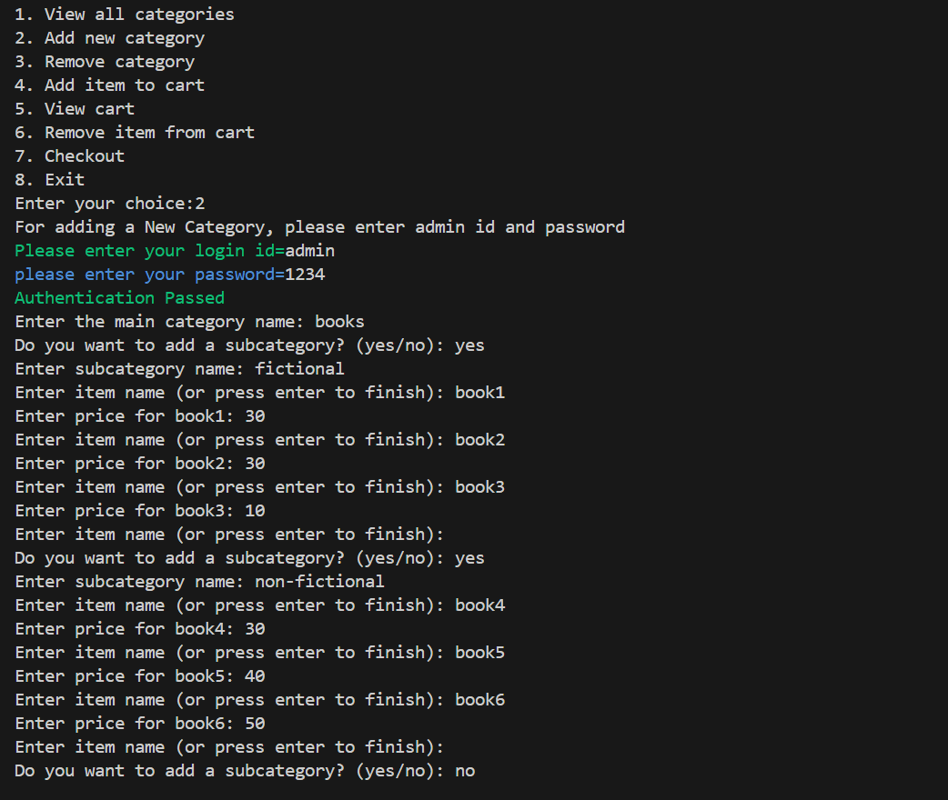

Slide 9
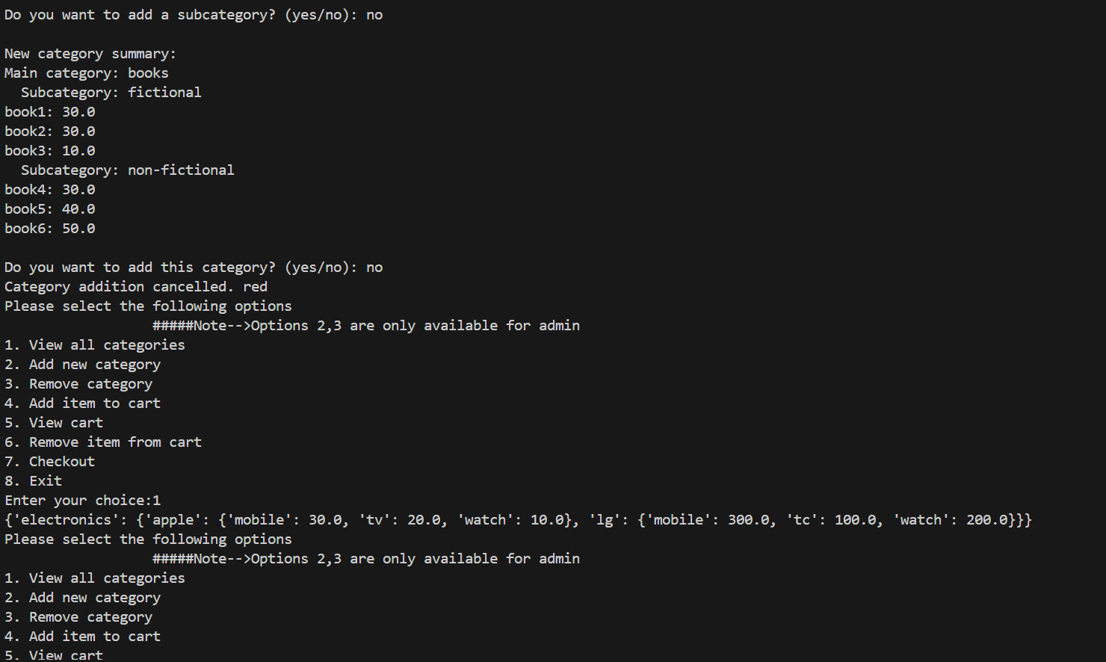
Add book category and 2 subcategory)
View all categories in website

Slide 10
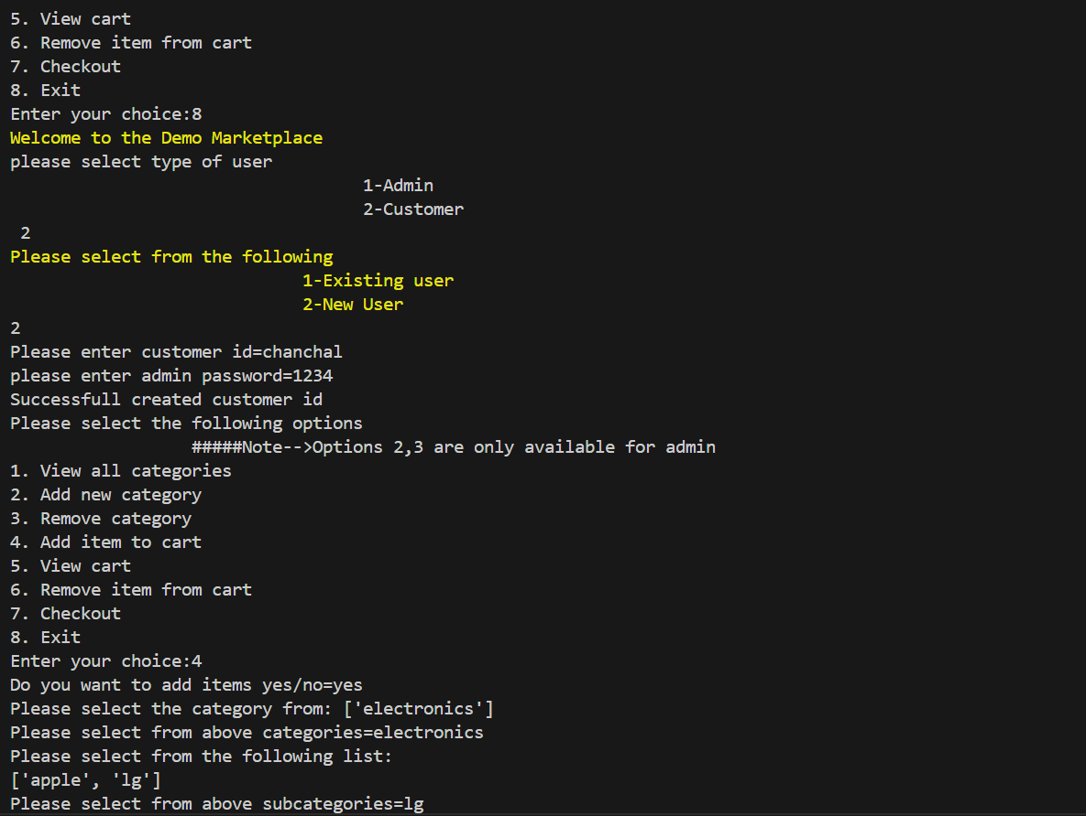
Login as a customer
Adding Items into the customer’s cart

Slide 11
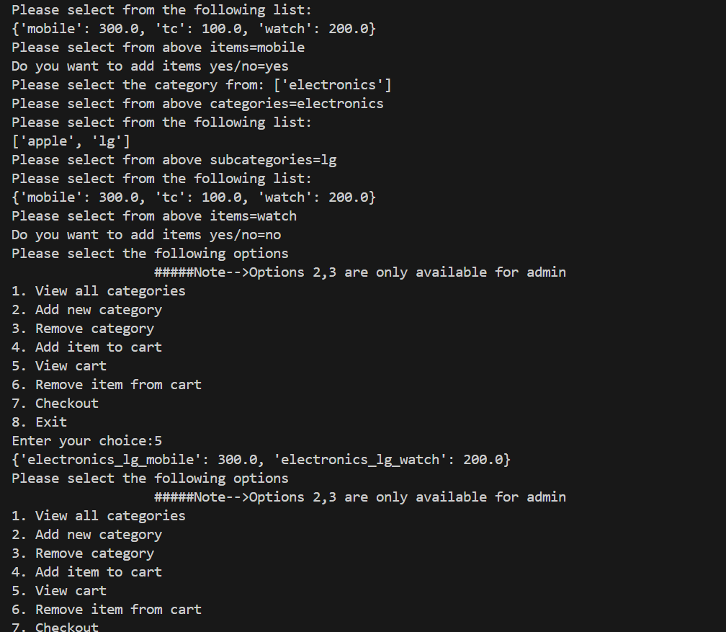
Added items and viewing

Slide 12
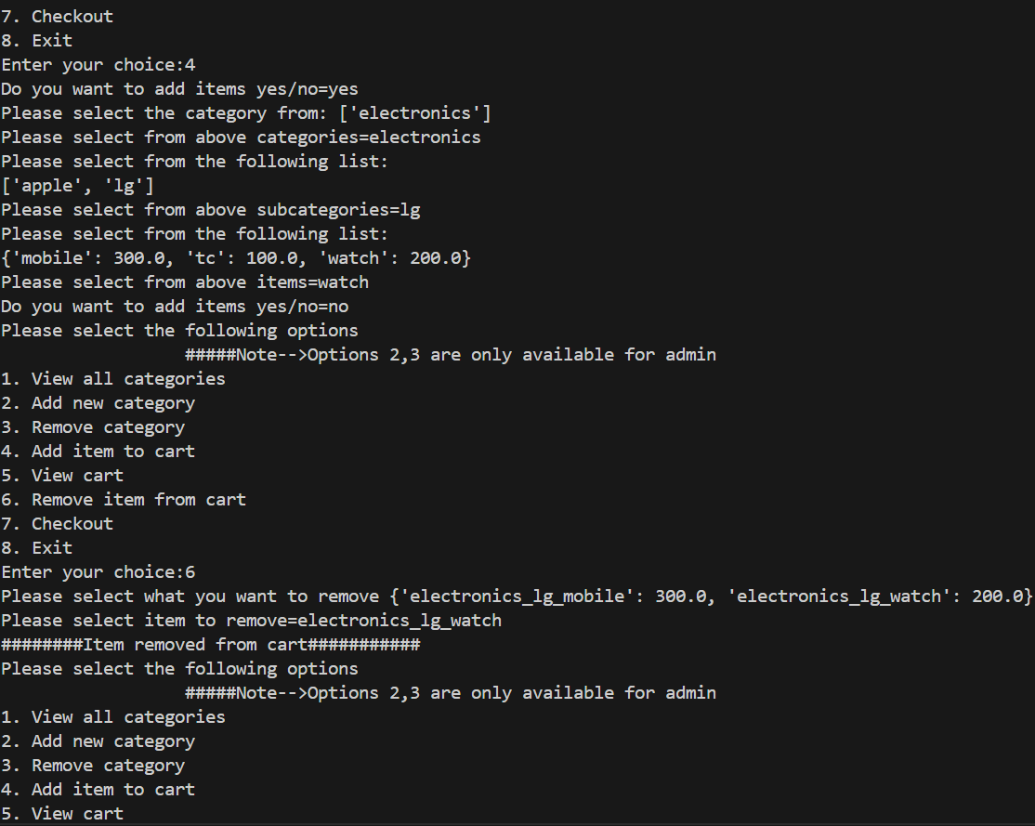
Added items and viewing
Removing items for customer’s cart

Slide 13
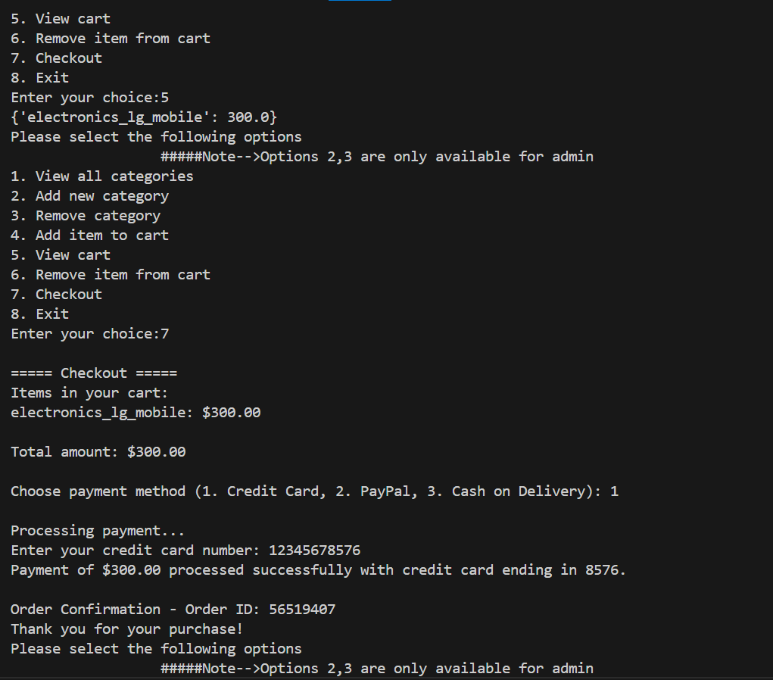
Checkout option

