Slide 1
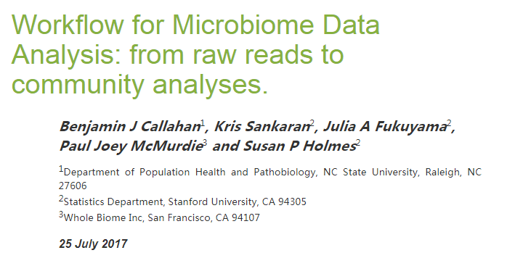
Notes:
http://web.stanford.edu/class/bios221/MicrobiomeWorkflowII.html#different_ordination_projections

Slide 2
Introduction
Data：16s rRNA
Traditional OTUs analysis methods：
1) cluster reads -> 97% -> taxonomy(RDP, Greengene)
2) Do not incorporate all the data, such as sequence quality
New workflow:
1) From raw reads to tables : filter, trim, sequence variants, amplicon sequence variants (ASVs)
2) Creation of a phylogenetic tree
Notes:
传统的OUT方法得到的结果依赖于数据集相对丰度，所以不同数据集直接的不可比较。
针对第（1）点
扩增子序列变异amplicon sequence variants (ASVs)—不同数据集之间可比（基于数据集之外的物种鉴定结果）。
去重复化
去嵌合体chimera component

Slide 3
Phyloseq
Operational Taxonomic Units (OTUs)
1）filter
taxonomic filtering : 去掉注释为NA的以及uncharacterized的
prevalence filtering : 使用出现率筛选 一般5%阈值（结合实际情况）
2）agglomerate taxa
species or sub-species functional redundancy in microbial community
实际上，找功能冗余比较困难。但根据进化关系，可以按照分类去group。
如果分类不确定，基于进化树找最相近的分类。指定树的高度。
3) abundacne value transformation
transform microbiome count data to account for differences in library size, variance, scale.
4) subset by taxonomy
相对丰度出现双峰，看下一级物种丰度。
Notes:
3) 求相对丰度
function(x){x / sum(x)})
取log
log(1 + x) transformation ----normalizing the abundance data

Slide 4
Different ordination projections
PCA on ranks
using a rank-transformed version of the data to perform PCA
represent the abundances by their ranks
CCA(Canonical Correspondence Analysis)
environmental variables
Notes:
原始的abundance 重尾
As before, the purpose of creating biplots is to determine which types of bacterial communities are most prominent in different mouse sample types. It can be easier to interpret these biplots when the ordering between samples reflects sample characteristics – variations in age or litter status in the mouse data, for example – and this central to the design of CCpnA.

Slide 5
Supervised learning
Partial Least Squares (PLS)
Random forest
Notes:
预测年龄

Slide 6
Multitable techniques
sparse Canonical Correlation Analys is (sparse CCA)
Filter data→transform them → log metabolites
use sparse CCA as a screening procedure, rather than as an ordination method.
Notes:
sCCA用来筛选，而不是排序
library(PMA)
换成其他协变量

Slide 7
Graph-based analyses 未看
对精分项目来说，尝试使用的为sparse CCA。

