Slide 1
小檗碱联合益生菌治疗新发糖尿病 宏基因组研究项目进展
08/02/2018

Slide 2
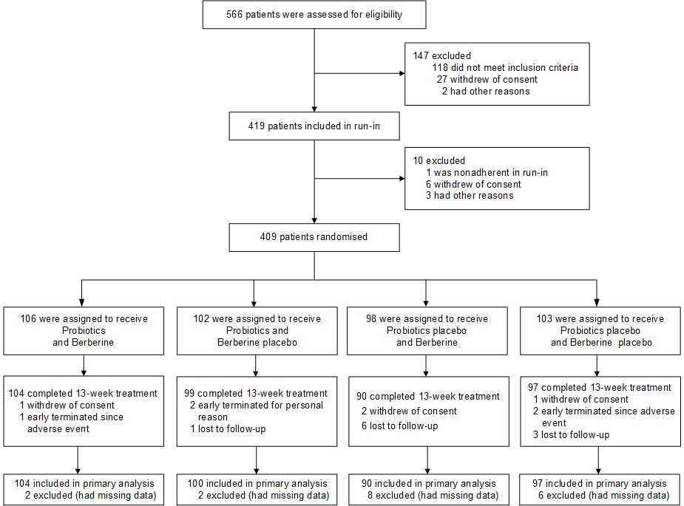
Figure 1. Flow Diagram of Participants in the PREMOTE Trial

Slide 3
Table 1—Baseline Characteristics of Participants
Abbreviations: BBR, berberine; HbA1c, glycated haemoglobin; HOMA-IR, homeostasis model assessment index for assessing insulin resistance;
HOMA- ß, HOMA for assessing ß cell function; P values refer to comparisons among groups in baseline characteristics in ANOVA analyses,
Mean (SD) or Median (IQR)

Slide 4
Table 2— Primary Outcomes in All Participants and the elderly participants
Abbreviations: BBR, berberine, HbA1c, glycated haemoglobin; HOMA-IR, homeostasis model assessment index for assessing insulin resistance.
Model 1: ªP values refer to comparison between probiotics plus berberine group and the other groups after intervention using GEE model on the basis of intention-to-treat (ITT) analysis. All analyses only adjusted for baseline HbA1c;
Model 2: ^{b}P values refer to comparison between probiotics plus berberine group and the other groups after intervention using GEE model on the basis of ITT analysis. All analyses adjusted for age, baseline HbA1c, HOMA-IR, LDL-cholesterol, AST, aspartate transaminase, TP, total protein.
Among participants aged ≥ 50 years, ANOVA showed that change in HbA1c in the probiotics-plus-BBR group (-0·99[0·74]%) was significantly greater than that in the placebo group (-0·59[0·92]%, p=0·0024) and the probiotics-alone group (-0·52[0·61]%, p=0·0005), but not significantly different from the BBR-alone group (-0·90[0·72]%, p=0·48)

Slide 5
Table 3—Comparison in Clinical Parameters after Treatment in All Participants
Abbreviations: BBR, berberine, HOMA-IR, homeostasis model assessment index for assessing insulin resistance; HOMA- ß, HOMA for assessing ß cell function; Mean (SD) or Median (IQR)
P values refer to comparison between probiotics plus berberine group and the other groups after treatment using GEE model on the basis of ITT analysis. All analyses adjusted for age and baseline values.

Slide 6
Table 4—Comparison in Clinical Parameters after Treatment in Participants Aged ≥ 50 years
Abbreviations: BBR, berberine, HOMA-IR, homeostasis model assessment index for assessing insulin resistance; HOMA- ß, HOMA for assessing ß cell function; Mean (SD) or Median (IQR);
P values refer to comparison between probiotics plus berberine group and the other groups after treatment using GEE model on the basis of ITT analysis. All analyses adjusted for age and baseline values.

Slide 7
Relative abundancies of all 9 probiotics in the faecal samples from all the participants in four groups, A; the participants older than 50 years (≥50),
B; the participants older than 50 years (≥50),
C. Color key represent the relative abundancies of each taxa. *, q<0.01 baseline versus 13 weeks treatment; #, q <0.05, lower RA in age<50 than age ≥50, KW analysis.
In Age all, n=85 in placebo, n=89 in Probiotics, n=77 in BBR and n=94 in Probiotics+BBR;
in Age≥50, n=55 in placebo, n=52 in probiotics, n=45 in BBR and n=31 in Probiotics+BBR;
in Age<50, n=30 in placebo, n=37 in probiotics, n=32 in BBR and n=63 in Probiotics+BBR

Slide 8
Method for metagenomic profiling
测试以下3种方法对9种口服益生菌物种的定量敏感度：
IGC based profile
mOTU
MetaPhlAn2
采用IGC-based profile 对本项目数据进行分析
Species | Occurrence-IGC | Occurrence-mOTU | Occurrence-MetaPhlAn2
Bifidobacterium_breve | 0.988351 | 0.054622 | 0.082353
Bifidobacterium_longum | 0.999104 | 0.348739 | 0.378151
Lactobacillus_casei | 0.771505 | 0.004202 | 0.002521
Lactobacillus_crispatus | 0.485663 | 0.016807 | 0.015126
Lactobacillus_fermentum | 0.822581 | 0.042017 | 0.048739
Lactobacillus_plantarum | 0.301971 | 0.031092 | 0.034454
Lactobacillus_rhamnosus | 0.228495 | 0.036134 | 0.045378
Lactobacillus_salivarius | 0.913082 | 0.045378 | 0.047059
Lactobacillus_gasseri | 0.889785 | 0.026891 | 0.019328

Slide 9
Method for metagenomic profiling
IGC based profile 对种口服益生菌物种的定量
鼠李糖杆菌定殖如否？Pass by ？
Species | Total gene number (IGC) | Annotated gene Number In this study | Baseline relative abundance (Median, n=386)
Bifidobacterium breve | 2618 | 2480 | 2.043989e-06
Bifidobacterium longum | 8552 | 7626 | 6.215054e-05
Lactobacillus casei | 2762 | 2417 | 3.244182e-08
Lactobacillus crispatus | 3001 | 2769 | 0.000000e+00
Lactobacillus fermentum | 2320 | 2215 | 5.920996e-08
Lactobacillus gasseri | 3655 | 3242 | 8.530827e-08
Lactobacillus plantarum | 150 | 148 | 0.000000e+00
Lactobacillus rhamnosus | 31 | 18 | 0.000000e+00
Lactobacillus salivarius | 2668 | 2516 | 7.788613e-08

Slide 10
Q1： BBR + Pro 联用较单用BBR 对初发T2D病人肠道微生态是否有影响？
Permanova based on species profile
——基线期4组人群的肠道菌群无显著差异 （P=0.621）
性别、年龄与初发T2D病人的肠道菌群显著相关 (P＜0.05)
Phenotype | SampleNum | Df | R2 | Pr(>F)
Group | 385 | 3 | 0.006319 | 0.621
Sex | 385 | 1 | 0.01487 | 0.001
Age | 385 | 1 | 0.013092 | 0.002
RBC | 380 | 1 | 0.00922 | 0.008
AST | 381 | 1 | 0.008244 | 0.015
——治疗后4组人群的肠道菌群存在显著差异 （P=0.001）
Probiotics+BBR 与 BBR 无差异； Probiotics与Placebo无差异
其余任意两组间存在显著差异 (P ＜0.05)
 | Df | R2 | P.value
Group | 3 | 0.012756 | 0.001
Pro vs BBR+P | 1 | 0.054547 | 0.001
Placebo vs BBR+P | 1 | 0.047609 | 0.001
Pro vs BBR | 1 | 0.044411 | 0.001
Placebo vs BBR | 1 | 0.038794 | 0.001
BBR vs BBR+P | 1 | 0.004433 | 0.579
Pro vs Placebo | 1 | 0.003546 | 0.704
Q2：BBR + Pro 联用较单用BBR 对初发T2D病人肠道微生态有哪些不同的影响？
Notes:
不同的年龄段是否， 还是这样子 ？

Slide 11
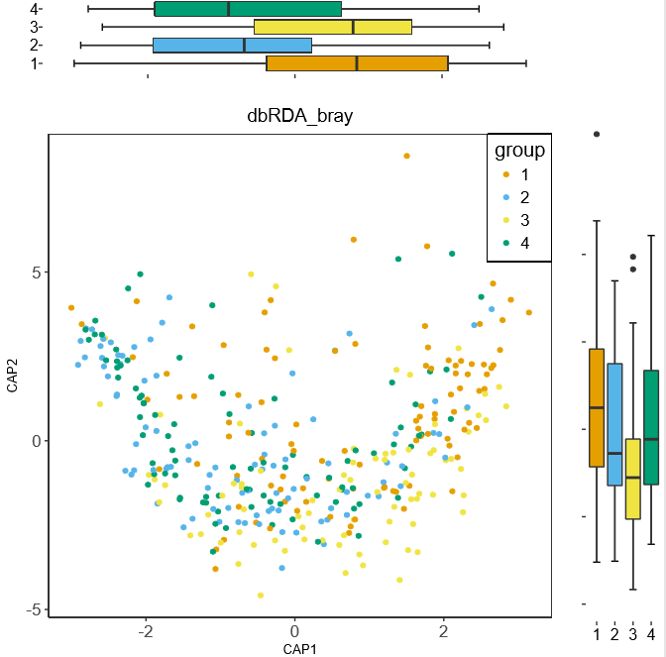
Q2：BBR + Pro 联用较单用BBR 对初发T2D病人肠道微生态有哪些不同的影响？
RDA based on the species profile:
整体结果上，CAP1 联用组和单用组肠道微生态更接近，CAP2两者表现出差异

Slide 12
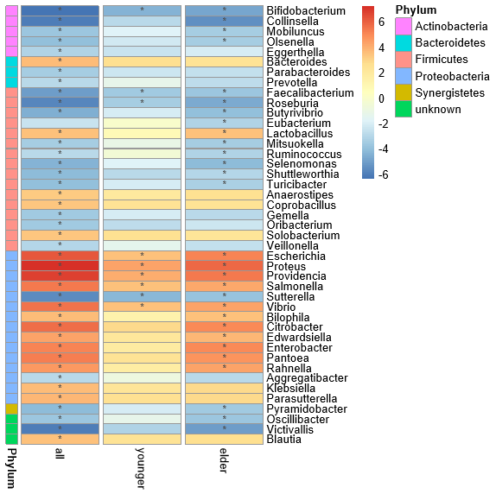
Q3. 联用和单用对肠道微生态的影响与否在50+/50-组显著不同？
Genus cutoff:
Genus gene number > 100
Genus occrrance > 20%
Paired-wilcox based on genus profile
——Actinobacteria 和 Fimicutes 的多数genus在联用组下降， 在50+相较50-下降更显著（z-score, p.adjust <=0.01(*)）
其中Lactobacillus显著上升
——Proteobacteria的genus在联用组上升， 在50+相较50-上升更显著（z-score, p.adjust <=0.01(*)）
联用组
Notes:
Figure文件路径： Ruijin_berberMeta - 文档\Analysis\Result\03.profile\Genus

Slide 13
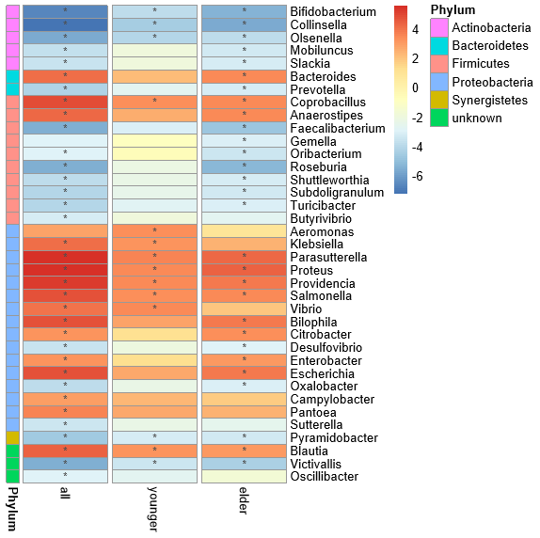
Q3. 联用和单用对肠道微生态的影响与否在50+/50-组显著不同？
Genus cutoff:
Genus gene number > 100
Genus occrrance > 20%
Genus cutoff:
Genus gene number > 100
Genus occrrance > 20%
Paired-wilcox based on genus profile
——单用和联用表现出相同的pattern
——Lactobacillus没有显著变化
单用组
Notes:
Figure文件路径： Ruijin_berberMeta - 文档\Analysis\Result\03.profile\Genus

Slide 14
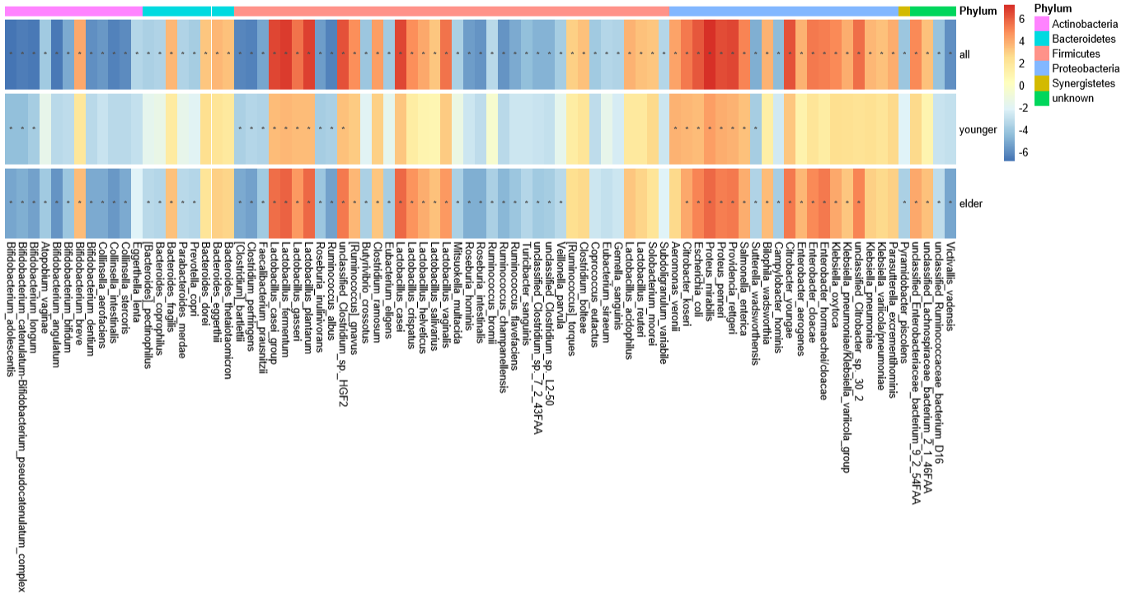
Q3. 联用和单用对肠道微生态的影响与否在50+/50-组显著不同？
Species cutoff:
species gene number > 100
联用组
Notes:
Figure文件路径： Ruijin_berberMeta - 文档\Analysis\Result\03.profile\Species

Slide 15
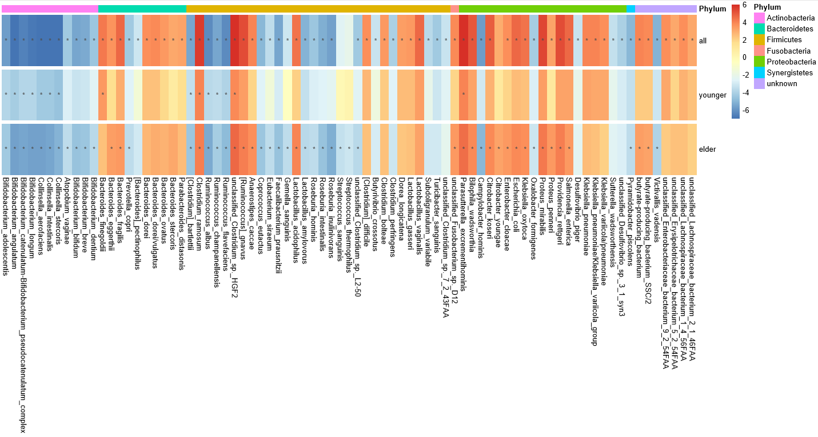
Q3. 联用和单用对肠道微生态的影响与否在50+/50-组显著不同？
Species cutoff:
Species gene number > 100
Notes:
Figure文件路径： Ruijin_berberMeta - 文档\Analysis\Result\03.profile\Species

Slide 16
Q4. 联用组相较单用组对微生态的影响有什么不同？
Elder 组间比较的差异物种
gene number >= 100
paired-wilcox p.value <=0.01
——四组只在联用组显著物种
——四组只在单用组显著物种

Slide 17
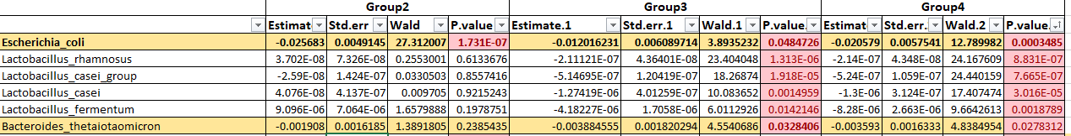
Q4. 联用组相较单用组对微生态的影响有什么不同？
comparison between probiotics plus berberine group and the other groups after intervention using GEE model
Model : Species = Group + baseline(Species)
All:

Slide 18
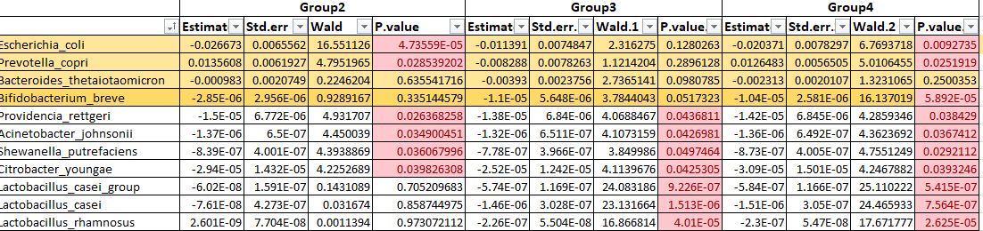
Q4. 联用组相较单用组对微生态的影响有什么不同？
comparison between probiotics plus berberine group and the other groups after intervention using GEE model
Model : Species = Group + baseline(Species)
Age>=50:

Slide 19
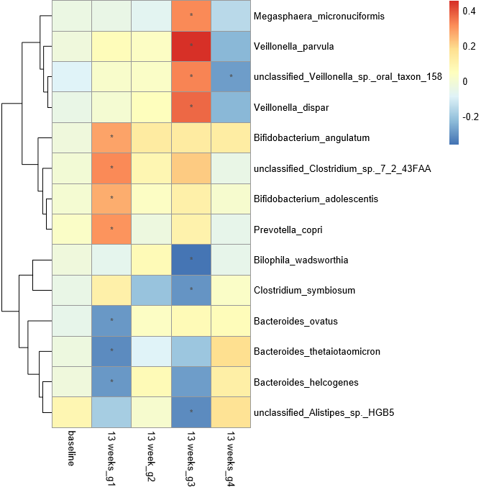
Q5.联用组和单用组的肠道微生态变化 （仅种水平）是否与疗效获益显著有关
Spearman correlation
HbA1c在treatment 4组和baseline的物种spearman correlation
(在单用组和联用组至少一个满足p.Value <= 0.01）
Notes:
C:\Users\renhuahui\BGI Tech Solutions (Hongkong) Co., Ltd\Ruijin_berberMeta - 文档\Analysis\Result\08.spearman
这里强调 菌和血糖相关指标correlation的转化
50+ / 50-

Slide 20
Q6.只存在于联用组的特定显著肠道微生态变化是否与该组患者的疗效获益显著有关
Spearman correlation

Slide 21
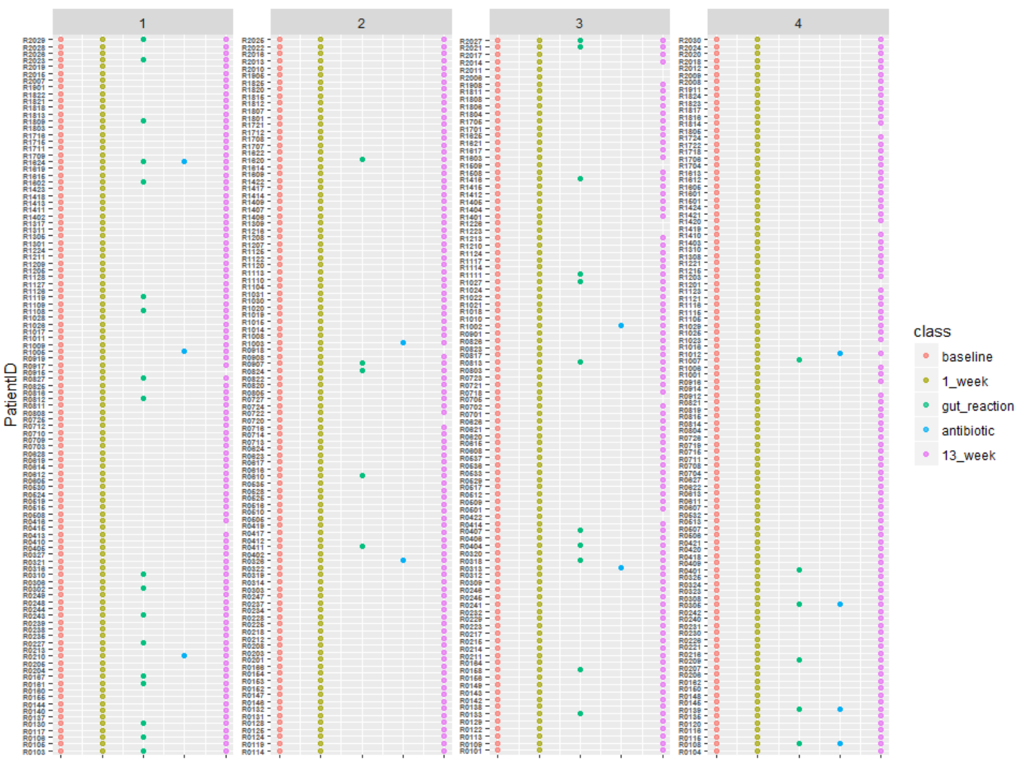
Preview of sample
 | Group_1 106 | Group_2 102 | Group_3 98 | Group_4 103
Gut_react | 18 | 5 | 11 | 6
Antibiotic | 3 | 2 | 2 | 4
Drop_num | 2 | 2 | 7 | 6
> Result：
Group1和Group3有更多的肠道反应病人
Group3和Group4有较多的掉组
服用抗生素且有肠道反应的病人
R0108、R0139、R0305、R1624

Slide 22
 | Group_1 (n=88) | Group_2 (n=97) | Group_3 (n=87) | Group_4 (n=97) | Pvalue
X2hPPG | 11.22 ± 2.62 | 13.79 ± 3.2 | 11.37 ± 2.95 | 14.13 ± 3.54 | 3.60E-15
HbA1C | 6.62 ± 0.66 | 7.27 ± 0.9 | 6.71 ± 0.77 | 7.23 ± 0.97 | 9.16E-12
FPG | 6.74 ± 1.21 | 7.85 ± 1.46 | 6.9 ± 1.29 | 7.62 ± 1.95 | 3.30E-09
TC | 4.51 ± 0.92 | 5.16 ± 1.12 | 4.44 ± 1.01 | 4.97 ± 0.96 | 1.50E-07
LDL_C | 2.84 ± 0.77 | 3.2 ± 0.87 | 2.78 ± 0.82 | 3.2 ± 0.87 | 6.36E-05
TG | 1.52 ± 0.77 | 2.26 ± 2.31 | 1.45 ± 0.73 | 1.59 ± 0.8 | 0.017285999
PLT | 237.29 ± 56.3 | 215.39 ± 56.15 | 229.28 ± 66.32 | 223.61 ± 59.72 | 0.048292931
AST | 19.74 ± 7.11 | 21.64 ± 8.6 | 21.37 ± 7.16 | 21.51 ± 6.99 | 0.074323399
cp120 | 8.07 ± 2.76 | 7.4 ± 2.65 | 8.01 ± 2.78 | 8.24 ± 2.78 | 0.080773795
BUN | 5.26 ± 1.28 | 6.5 ± 6.87 | 6.08 ± 6.88 | 5.2 ± 1.26 | 0.103758371
ALT | 22.35 ± 11.46 | 26.05 ± 16.86 | 24.21 ± 14.21 | 26.16 ± 14.38 | 0.14657081
ins0 | 10.49 ± 6.26 | 11.75 ± 6.2 | 12.11 ± 7.61 | 12.48 ± 7.95 | 0.154384279
ins120 | 56.59 ± 31.8 | 53.5 ± 31.96 | 58.98 ± 36.14 | 67.35 ± 44.5 | 0.163438422
waist | 89.05 ± 11.11 | 91.5 ± 14.22 | 88.09 ± 9.31 | 89.75 ± 8.38 | 0.177307816
WBC | 6.37 ± 1.44 | 6.31 ± 1.61 | 6.19 ± 1.44 | 6.68 ± 1.81 | 0.198293142
HDL_C | 1.16 ± 0.23 | 1.18 ± 0.27 | 1.19 ± 0.26 | 1.24 ± 0.3 | 0.239143464
SBP | 124.43 ± 11.21 | 124.46 ± 11.6 | 127.05 ± 13.2 | 125.86 ± 12.17 | 0.278630616
Hb | 145.65 ± 13.03 | 146.82 ± 14.09 | 142.81 ± 15.76 | 145.02 ± 16.37 | 0.432978281
cp0 | 2.5 ± 0.9 | 2.56 ± 0.77 | 2.62 ± 1.04 | 2.67 ± 0.97 | 0.470916495
TBIL | 88.47 ± 74.83 | 81.65 ± 70.6 | 98.46 ± 74.91 | 87.24 ± 68.6 | 0.506602802
ALB | 45.55 ± 2.83 | 45.07 ± 3.13 | 45.35 ± 3.04 | 45.25 ± 3.36 | 0.532420195
hip | 96.47 ± 5.33 | 96.86 ± 6.88 | 95.85 ± 7.33 | 96.8 ± 5.75 | 0.62584952
DBP | 76.58 ± 8.78 | 76.28 ± 8.15 | 77.74 ± 9.78 | 76.51 ± 9.08 | 0.639371313
RBC | 4.93 ± 0.49 | 4.9 ± 0.43 | 4.86 ± 0.47 | 4.95 ± 0.59 | 0.728280403
TP | 72.24 ± 7.6 | 73.29 ± 4.05 | 72.88 ± 4.7 | 73.48 ± 4.79 | 0.754072657
Cr | 64.09 ± 14.19 | 65.46 ± 16.7 | 64.15 ± 14.1 | 65.98 ± 13.71 | 0.805143712
weight | 68.9 ± 11.11 | 70.28 ± 11.39 | 69.42 ± 13.35 | 70.38 ± 12.29 | 0.809655014
UA | 332.78 ± 77.05 | 331.34 ± 87.94 | 329.09 ± 82.82 | 336.84 ± 86.73 | 0.978251499
Phenotype on 13 week between 4 group
Result:
1. 2hPPG、HbA1C、FPG、TC、LDL_C、TG组间差异显著

