Slide 1
Brief introduction of multi-omics
汇报人：邹曼利
日期：2017/10/29

Slide 2
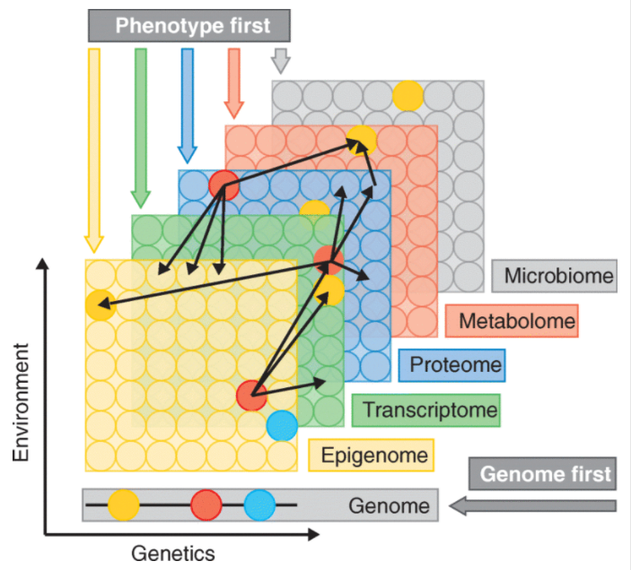
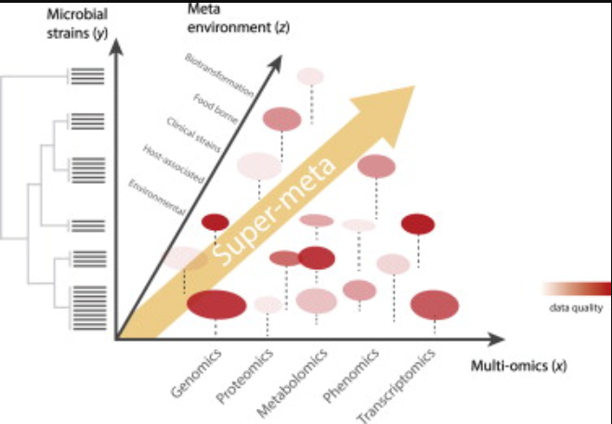
overview

Slide 3
Basis of multi-omics
Database available
Substantial base of knowledge covering
Collecting and integrating multi-omics data

Slide 4
Importance
Single “omics” analysis are often limited to correlations and may generally end up identifying the consequential changes rather than causative ones.
Multi-omics approach allows better understanding of complex diseases like cancer and further impact in designing better diagnostic tools and therapies for the treatment of a disease

Slide 5
Common types of multi-omics
simple integration (two different –omics datasets)
more comprehensive and computationally demanding ones
(multiple –omics data)

Slide 6
Multi-omics data analysis approach
Unsupervised data integration：
matrix factorization methods
correlation-based analysis
bayesian methods …
Supervised data integration ：
network-based methods
multiple kernel learning
multiple-step analysis
Semi-supervised data integration ：
GeneticInterPred

Slide 7
Biological insights from data integration methods
Unsupervised :
assign objects into different subgroups
1
Supervised :
derive patterns for different phenotypes and assign labels to unlabeled data
2
Semi-supervised methods : build object-wise similarity networks through compiling omics data and assign labels to unknown objects
3

Slide 8
difficulties
Proper data transformation & normalization
Better statistical tools to deal with experimental measurement errors and missing proteomic data
Handling the nonlinearity property of correlation between transcriptomic and proteomic data
interactions among different layer are major concerns for data integration strategies
There are limited systematic methods for connecting these two bodies of knowledge

Slide 9
Progress
2006 zero-inflated Poisson regression model to address issues with missing proteomics data
2007 co-inertia analysis(CIA) method to visualize gene and proteomic expression data stemming
2009 stochastic Gradient Boosted trees approach to uncover possible nonlinear relationships between two levels of omics
2014 A multivariate approach to the integration of multi -omics datasets has been recently proposed (named MCIA, Multiple Co-Inertia Analysis)

