Slide 1
Data: 171 observations * 360 bacteria types(feature)
171 observations * 2 health states
Training set: 93 observations * 361
Testing set: 78 observations * 361
Method: Random Forest
Purpose: Given a observation, we can use our model to classify
him to different health state.

Slide 2
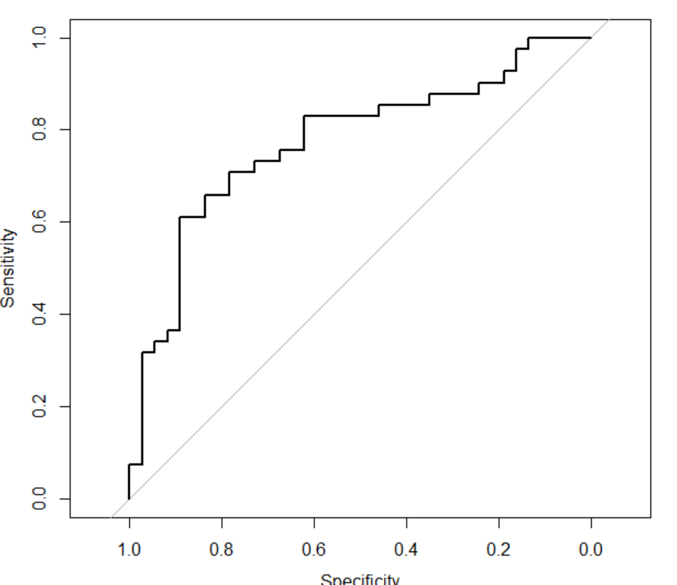
Area under the curve(AUC): 0.7739
ROC:

