Slide 1
Glomeruli Detection using Transfer Learning
Center for Network Science (Indiana University, Bloomington)
Yash Kumar
Jashjeet Singh Madan
INDIANA UNIVERSITY BLOOMINGTON

Slide 2
Object Detection using MaskRCNN (Keras)
SECTION 1

Slide 3
Methodology
Manually annotate train images in XML format that provide bounding boxes for glomeruli in cell images
Create masks for glomeruli in cells and label them as 1 while the rest of the background as 0
Create unique identifier of multiple masks in a single cell image
Run MaskRCNN on the train images and load weights of pre trained mask_rcnn_coco model
Evaluate the model on test images using Mean Precision value

Slide 4
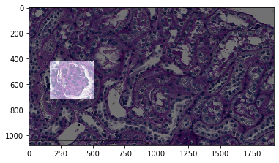
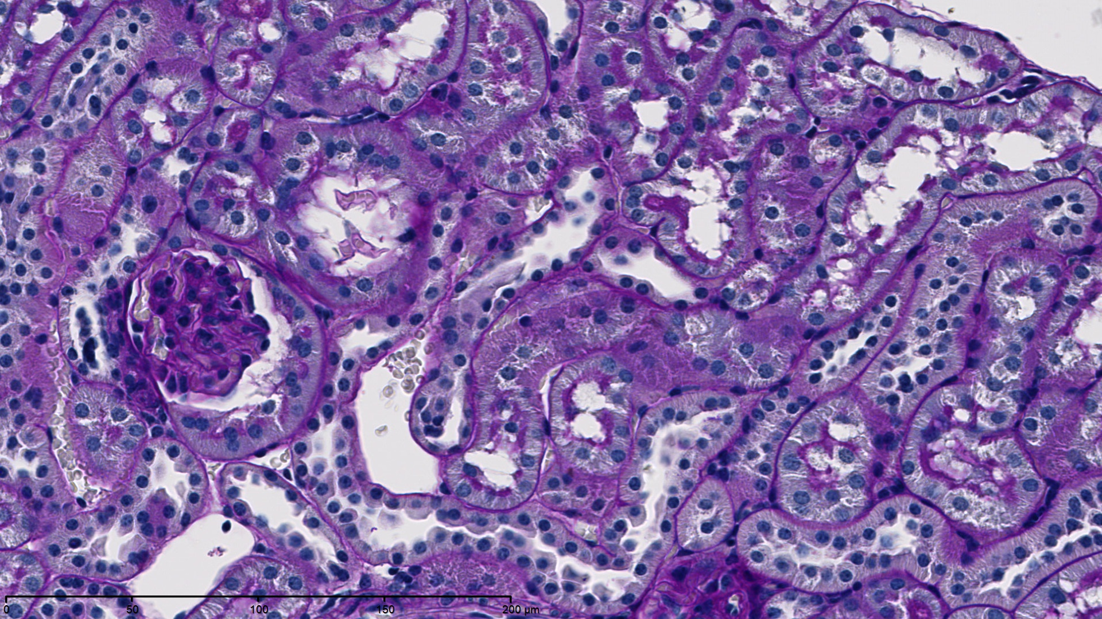
Creating masks for input cell image
Input cell image
Masked glomeruli

Slide 5
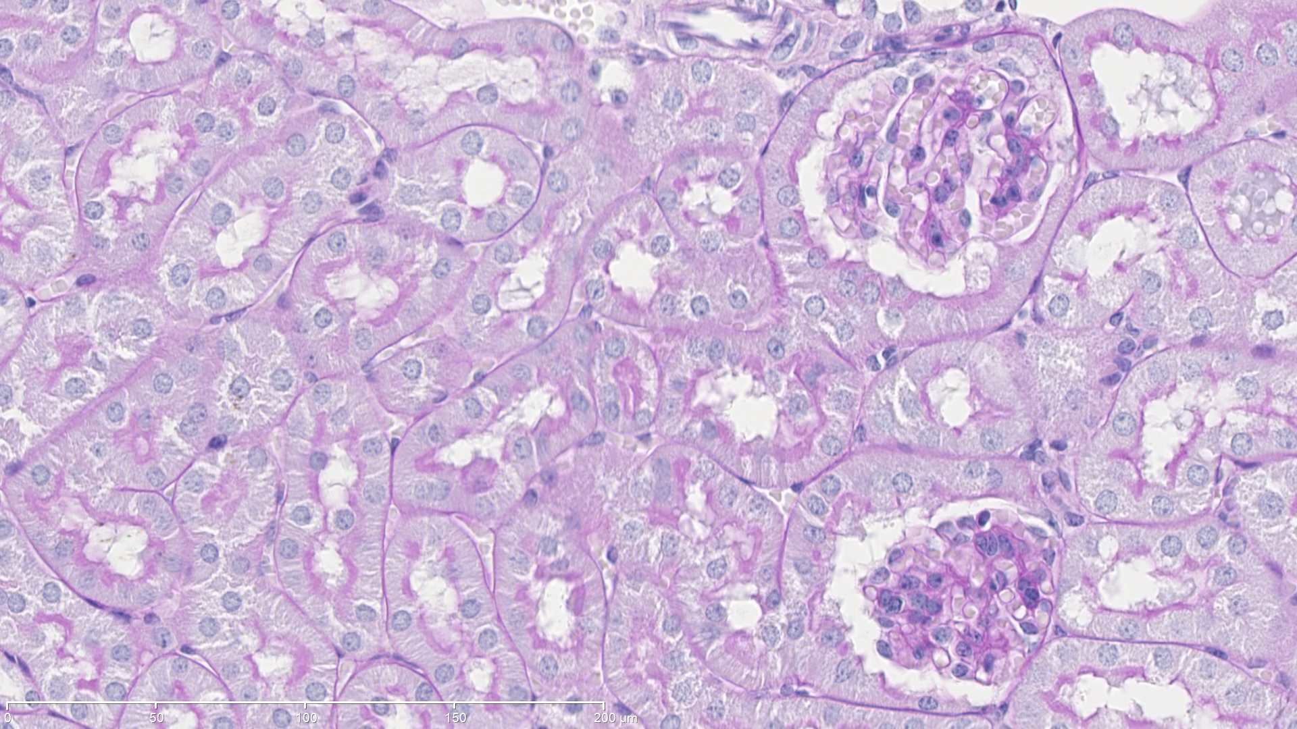
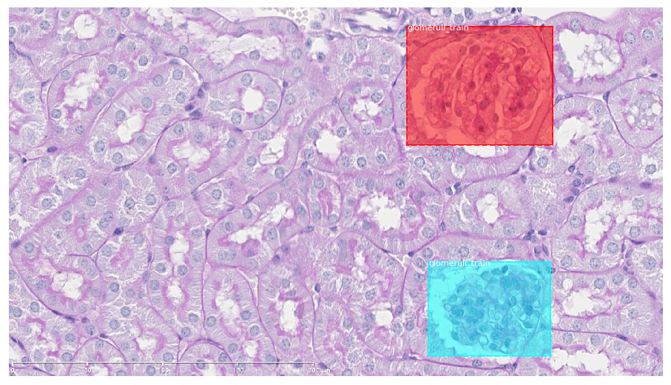
Unique identifier for multiple masks
Input cell image
Unique Mask glomeruli

Slide 6
Model Parameters and Running Time
Parameters | Values
Train images | 75
Test images | 25
Epochs | 5
Average running time is 65 sec per train image per epoch
Average running time for 5 epoch is 7 hours approx.

Slide 7
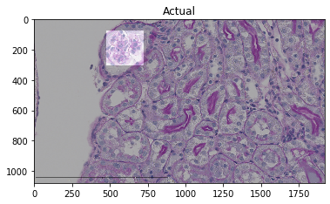
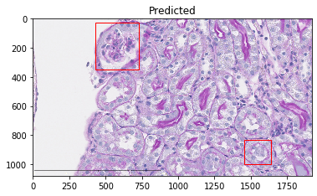
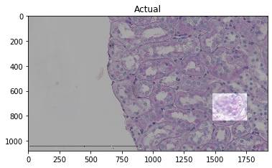
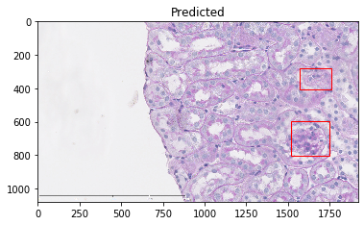
Model Results on Test Images

Slide 8
Drawbacks
Running time is exponential with increase in number of train images
Currently, number of training images taken is very small. It works well for other object detection datasets where training images are greater than 150
Mean precision value for test images is 70%

